Slide 1
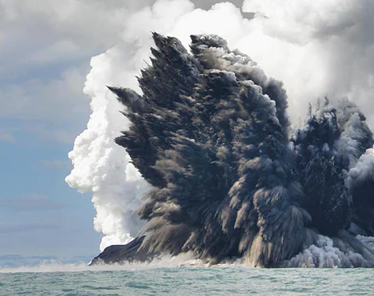
The Volcano-Stratigraphic Setting of the Pallas Green Zinc - Lead Deposit
IAEG - September 2023
Dave Blaney & Ted Coffey
Notes:
Acknowledgements – The authors would like to thank Glencore for permission to give this presentation, and thanks to the people who have worked on the project, their hard work and endeavours have brought us to the current level of understanding, in particular David Stewart, Graham Reid, Allan Huard,

Slide 3
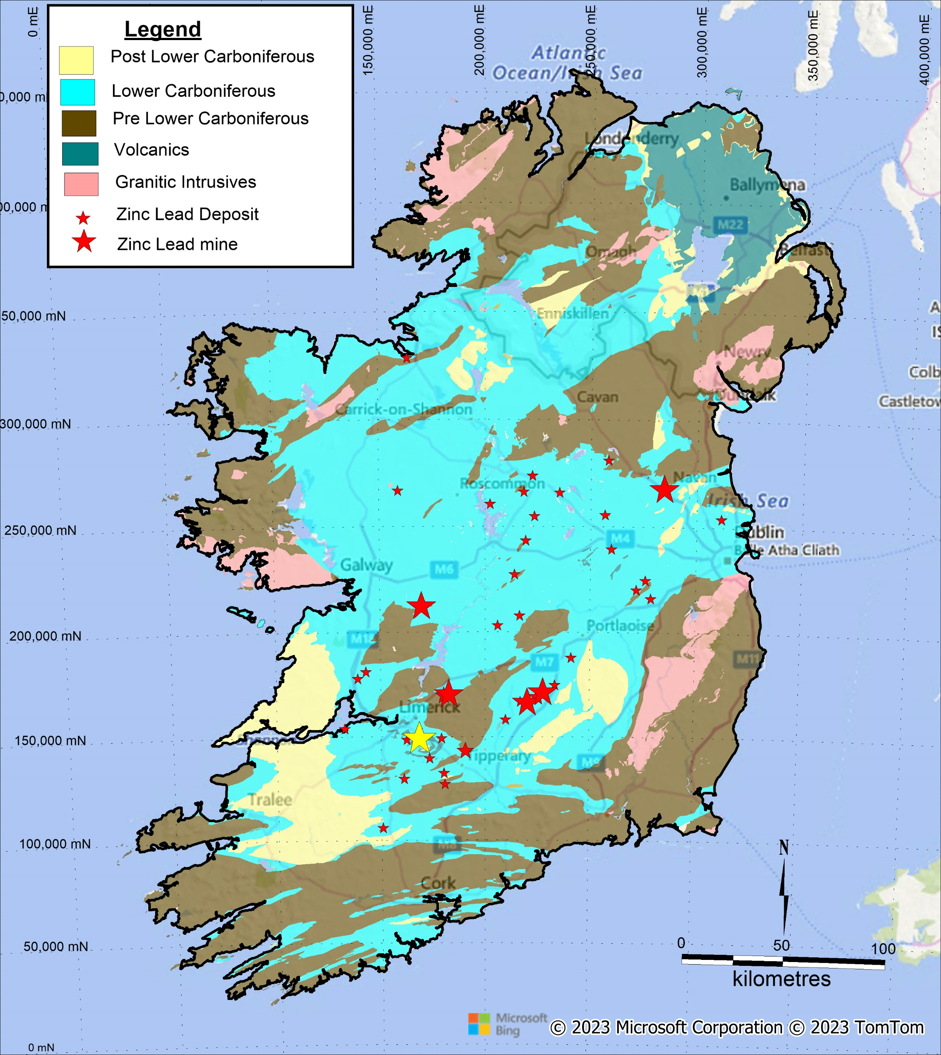
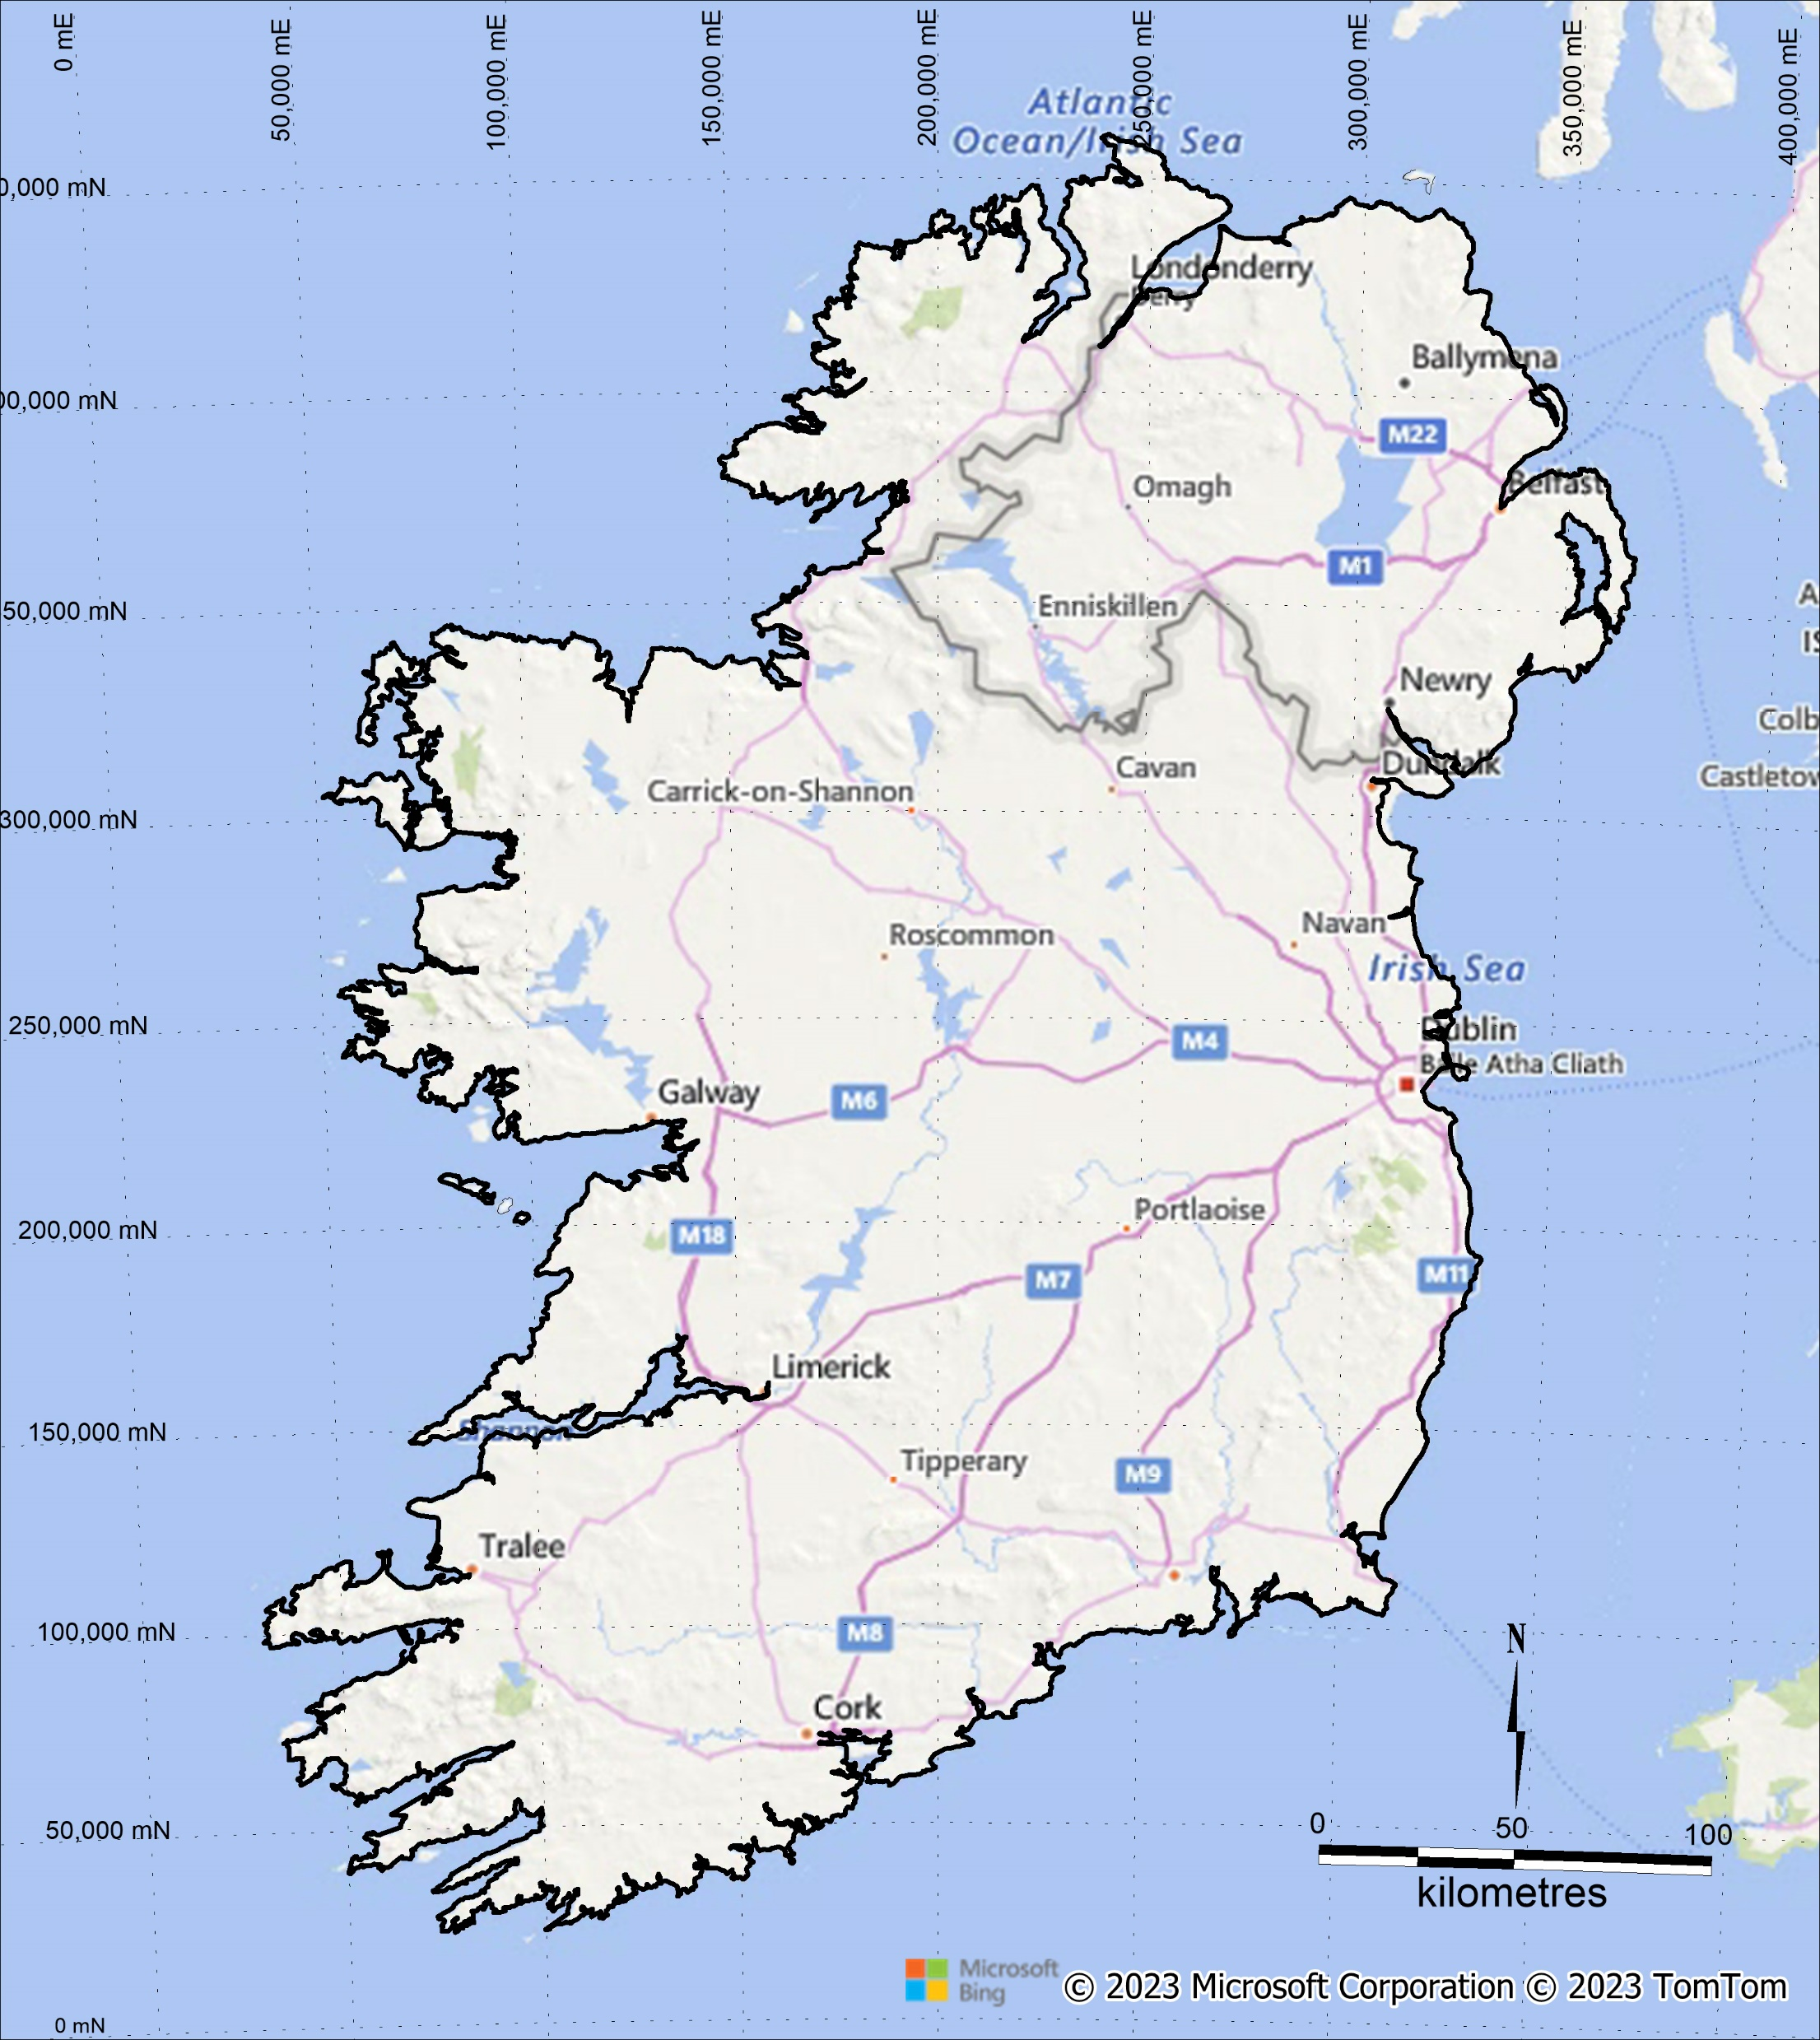
Pallas Green - Location
The Pallas Green deposit is located to the southeast of Limerick City in Northern County Limerick.
There is now an excellent road, rail and power infrastructure in the area
The deposit lies within the southwestern quadrant of the Irish Lower Carboniferous basin.
Complex interdigitating Limestones with fault controlled Lower Palaeozoic inliers
Mineral Deposits are developed along trends controlled by Caledonian basement features
Pallas Green is located in the Limerick Basin, a focus for recent exploration activity
Pallas Green

Slide 4
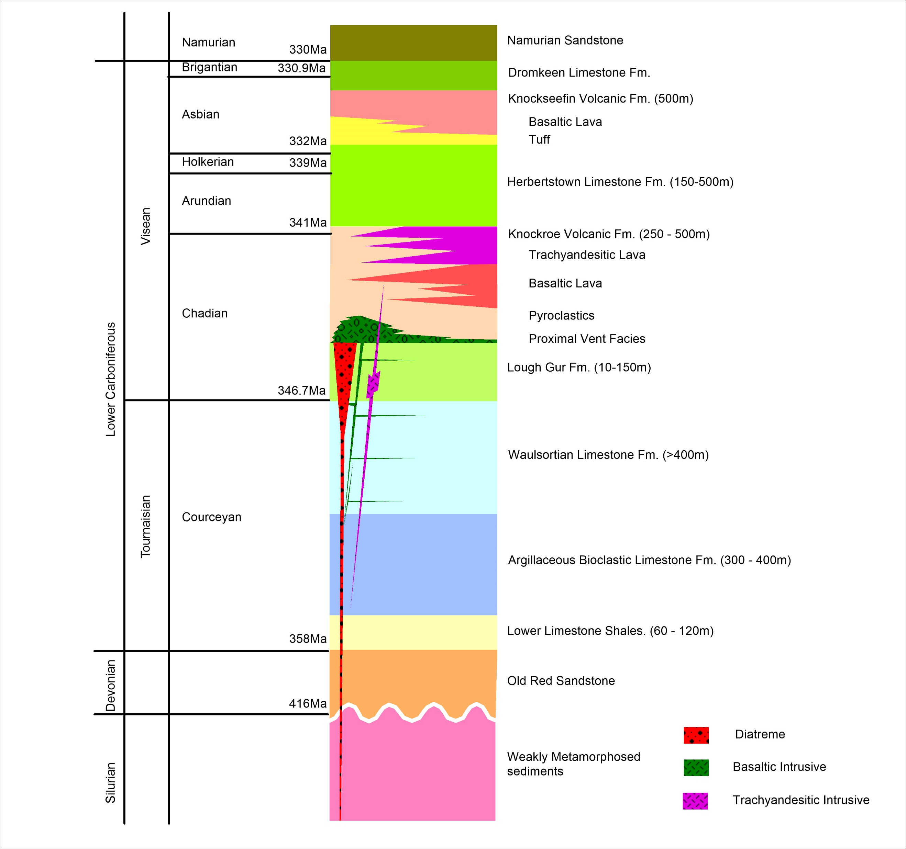
Pallas Green - Stratigraphy
Normal marine transgressive succession from Lower
Limestone Shales through to the Lough Gur Fm.
Knockroe Volcanics from mid Chadian to Lower
Arundian
Extrusives consist of basic, alkali-basalts maturing to
intermediate trachyandesites. Occurring as tuffs,
pyroclastics, agglomeratic breccias and lava flows
Intrusives consist of complex diatremes, altered
basaltic dykes and sills and porphyritic trachyte dykes
and laccoliths.
Knockroe Volcanics are overlain by the Herbertstown
Limestones Fm. With a variable lithofacies caused by
burial of relic volcanic topography.
Knocksheefin Limestone fm. Basaltic Flows and
lithic tuffs.

Slide 5
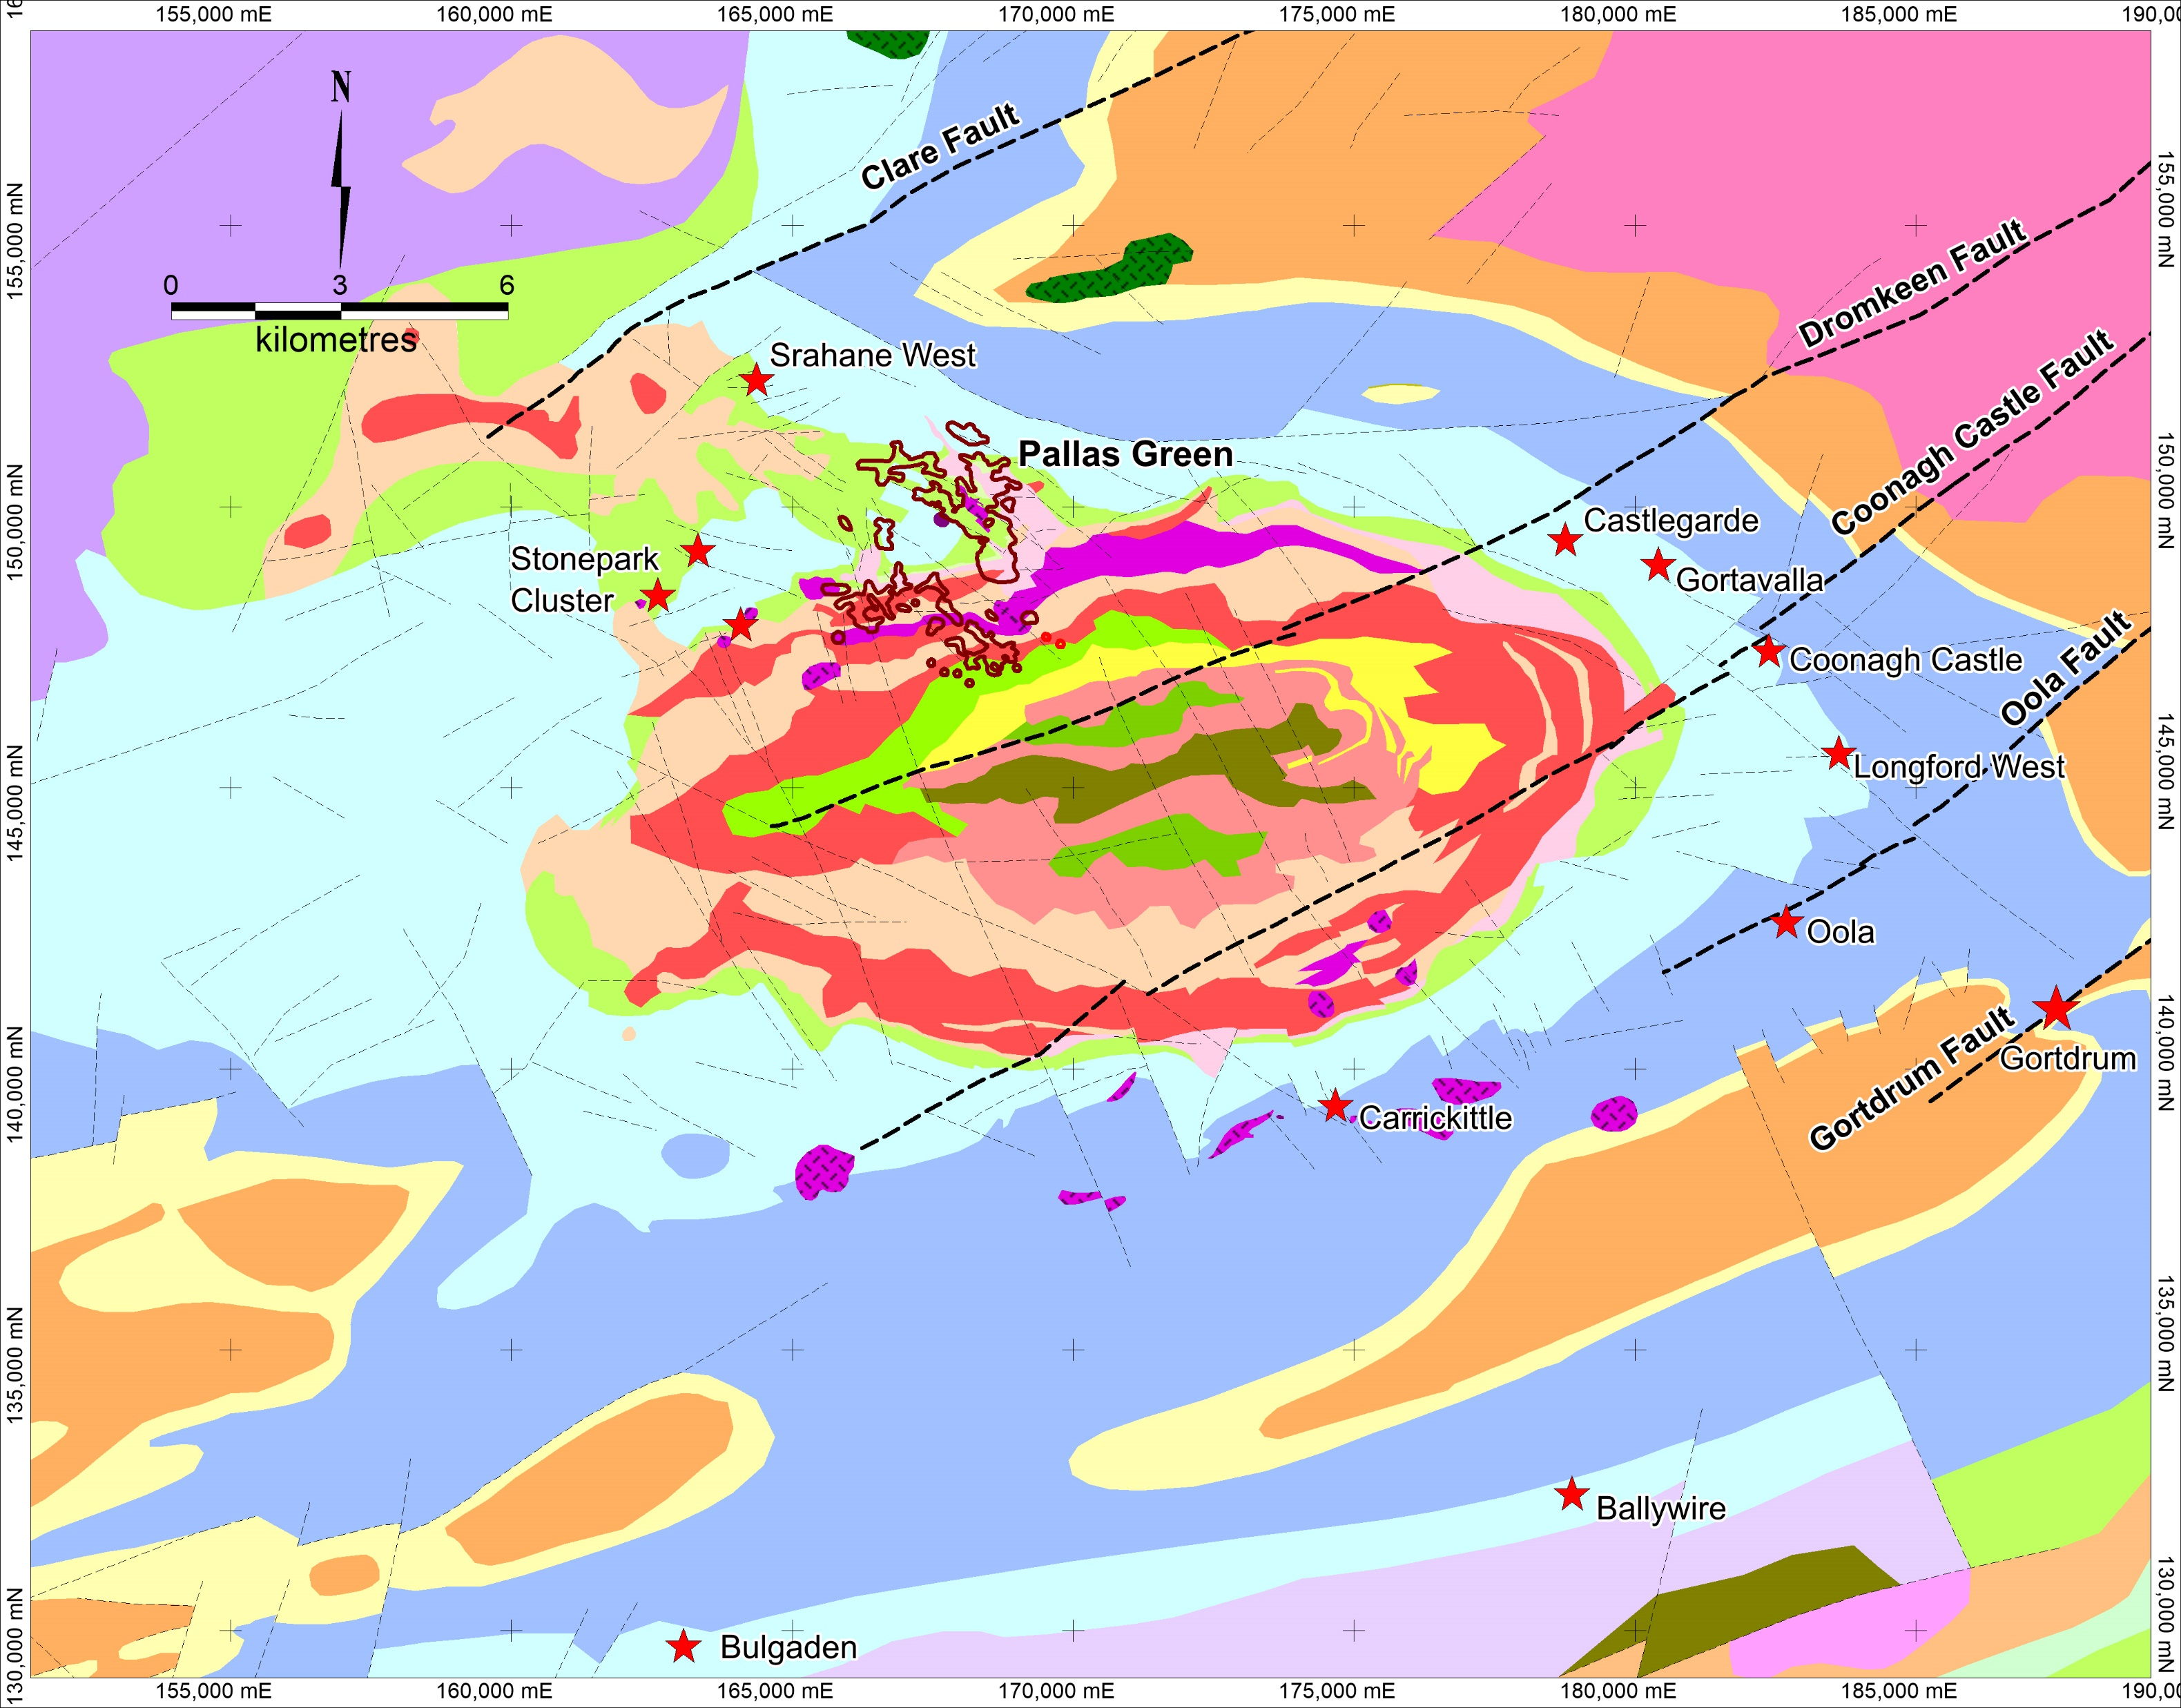
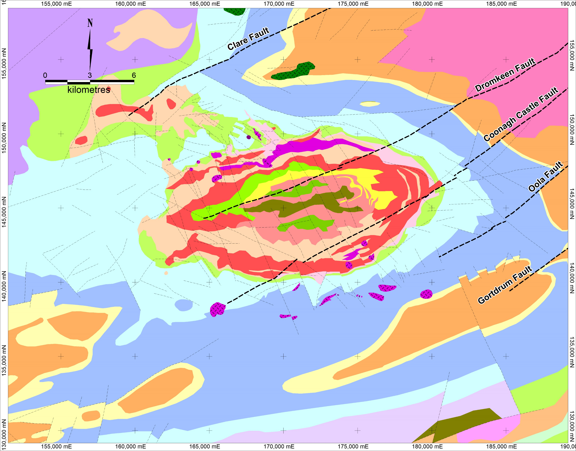
Limerick Geology
Extensive well developed Waulsortian Limestone
Major Caledonian basement faults
Major volcanic centre with 2 x episodes of volcanism.
Limerick basin is an ovoid, synformal structure – difficult to explain – Caldera Collapse?
Significant mineral occurrences
Cu Mineralisation hosted by Lower Limestone Shales
Zn / Pb hosted by Waulsortian
Focus of current presentation

Slide 6
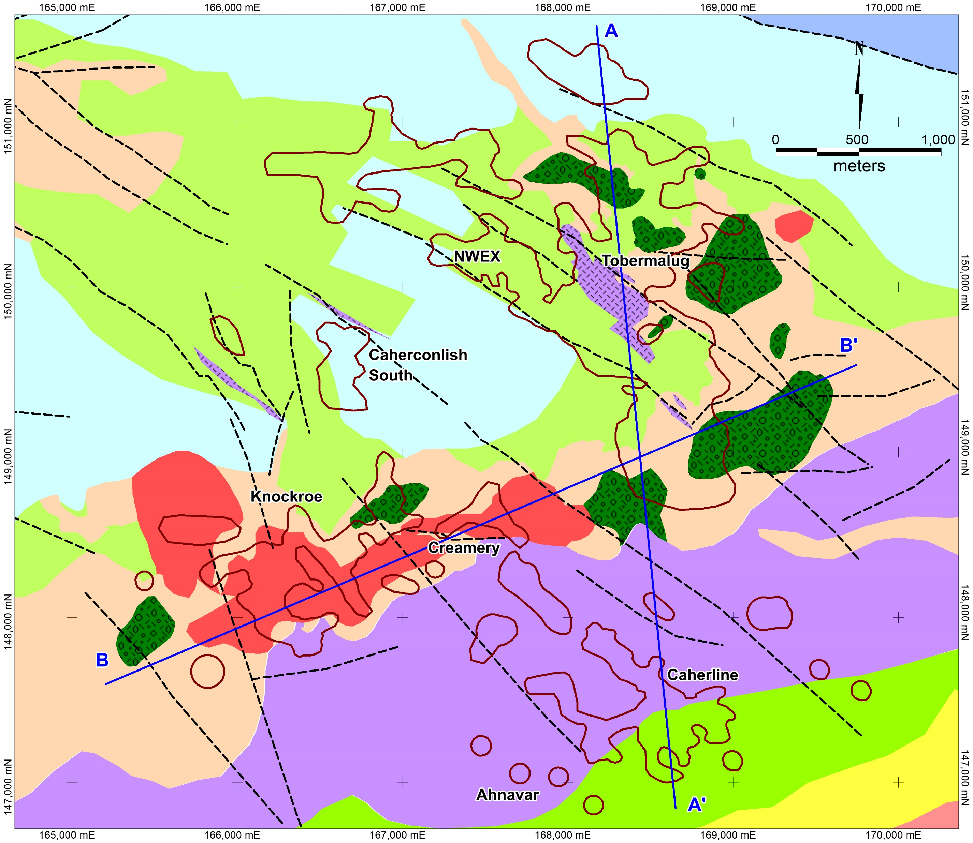
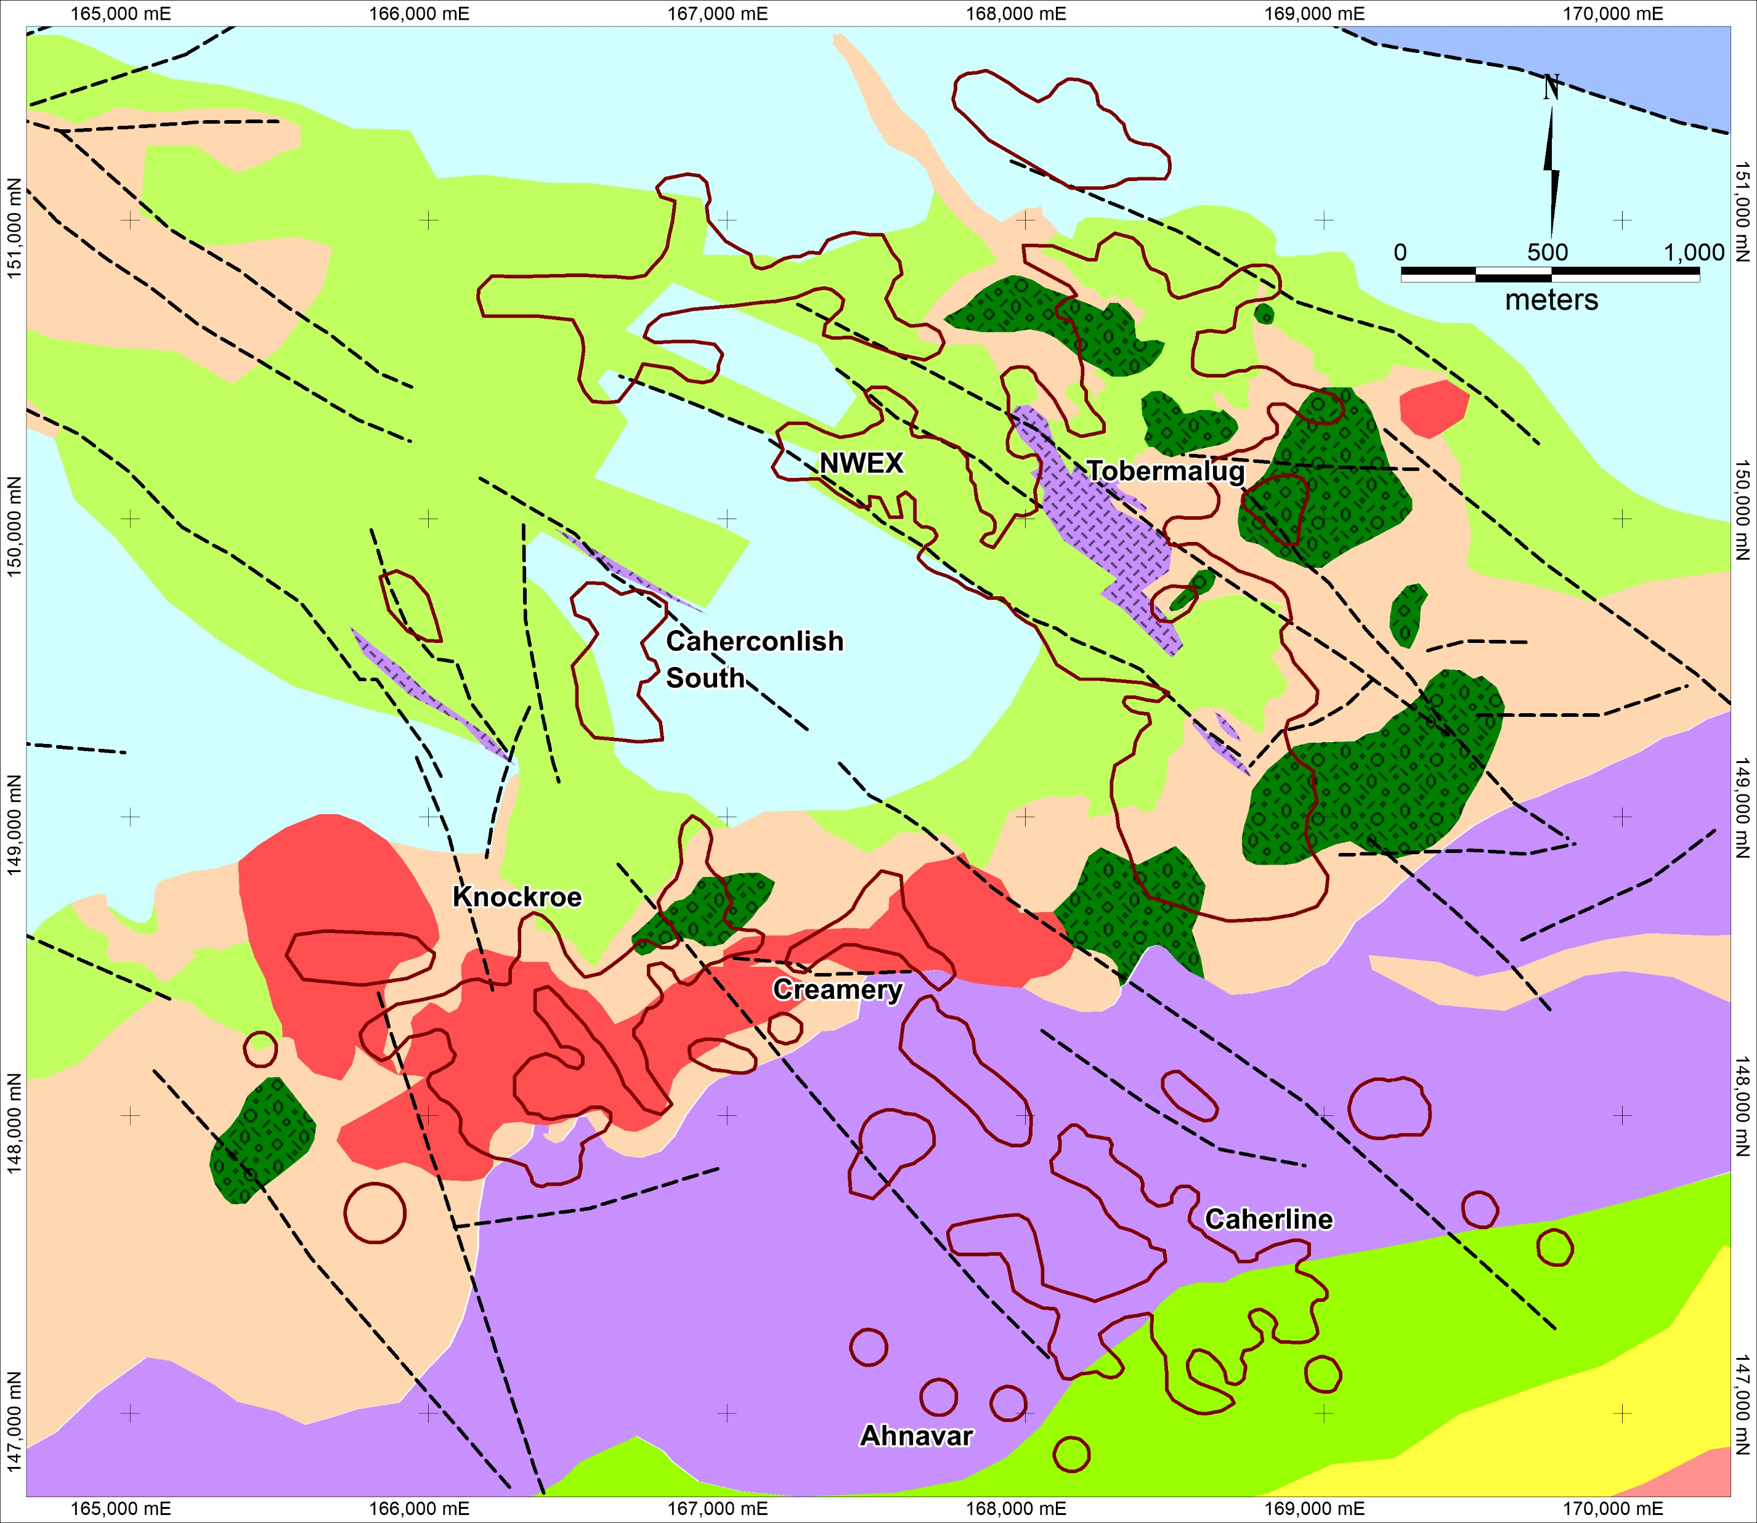
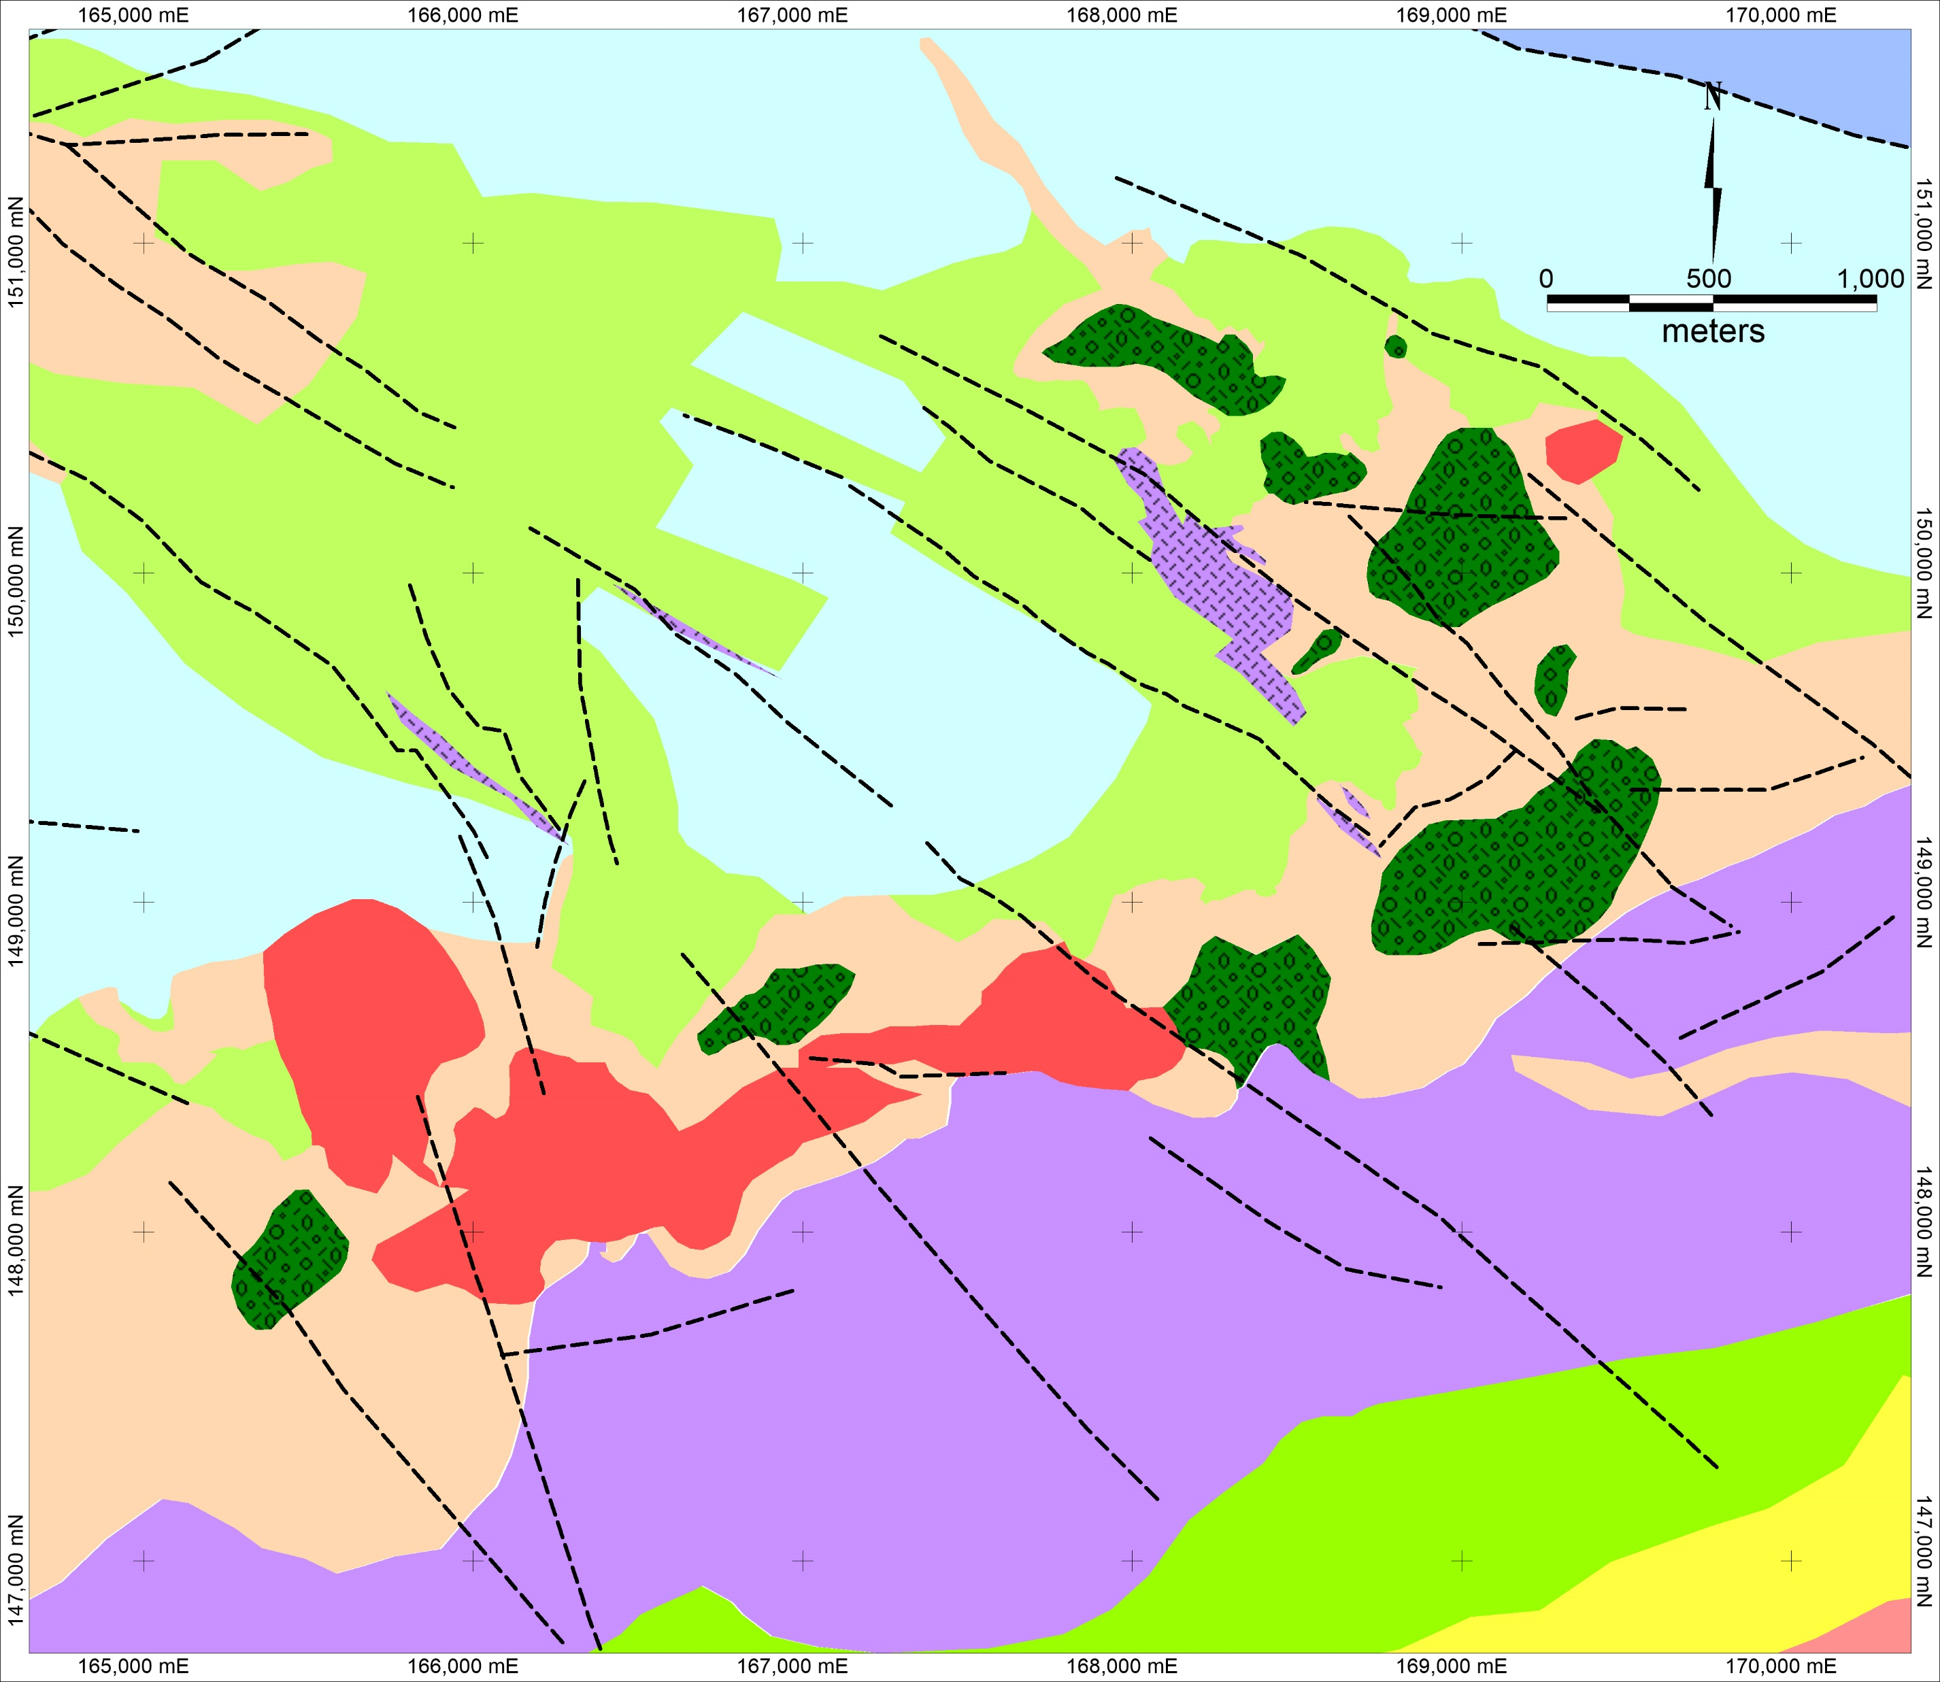
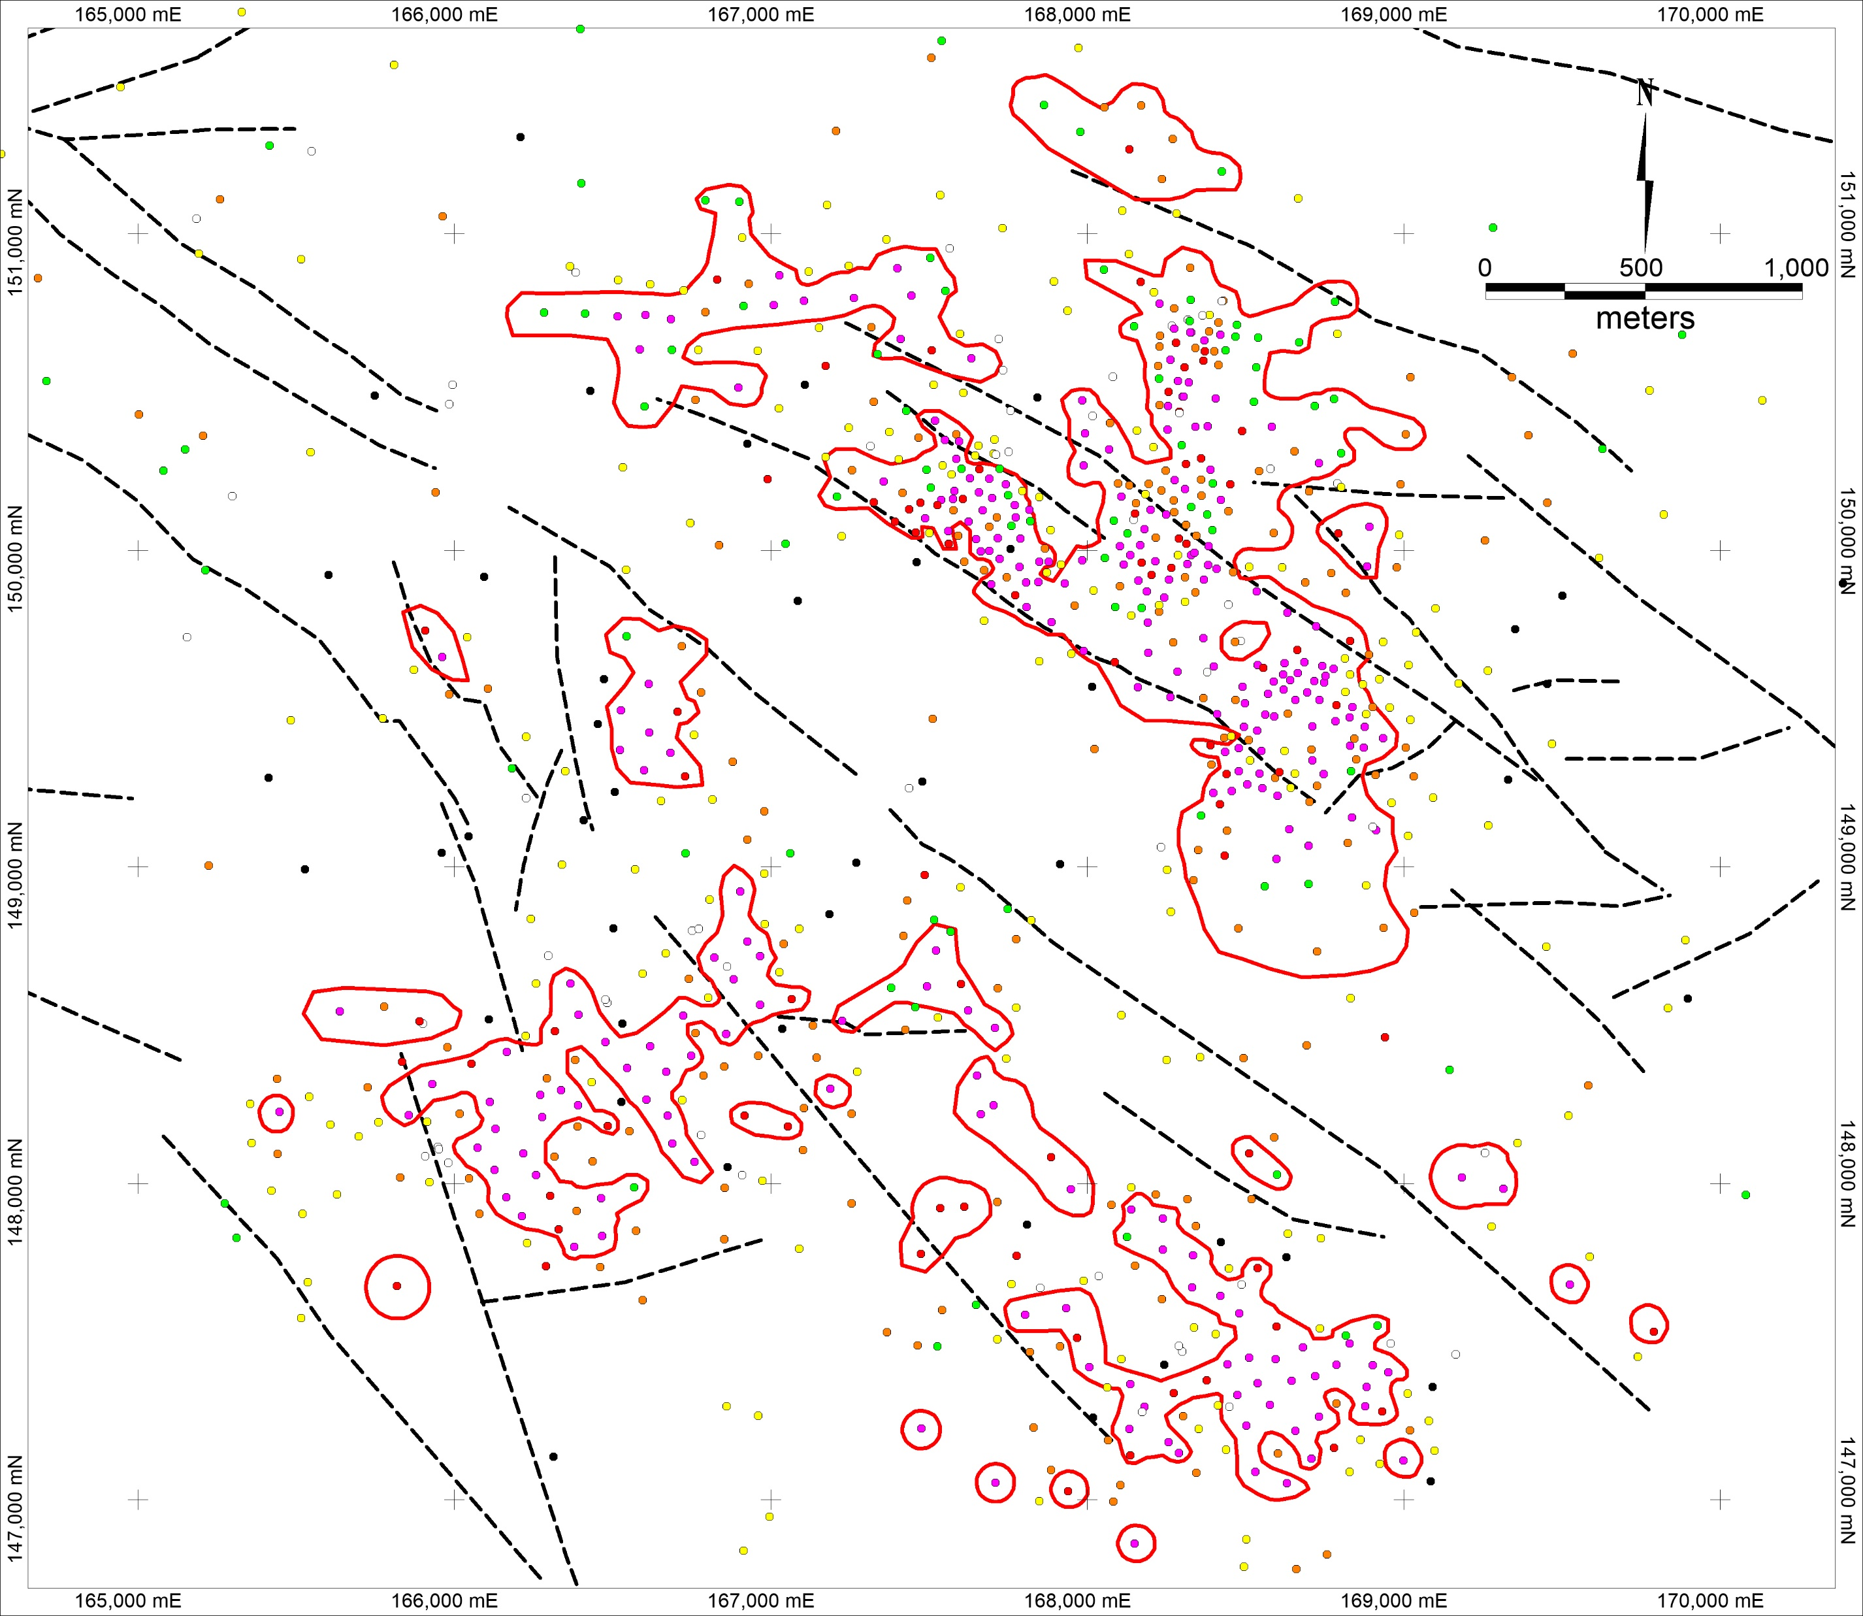
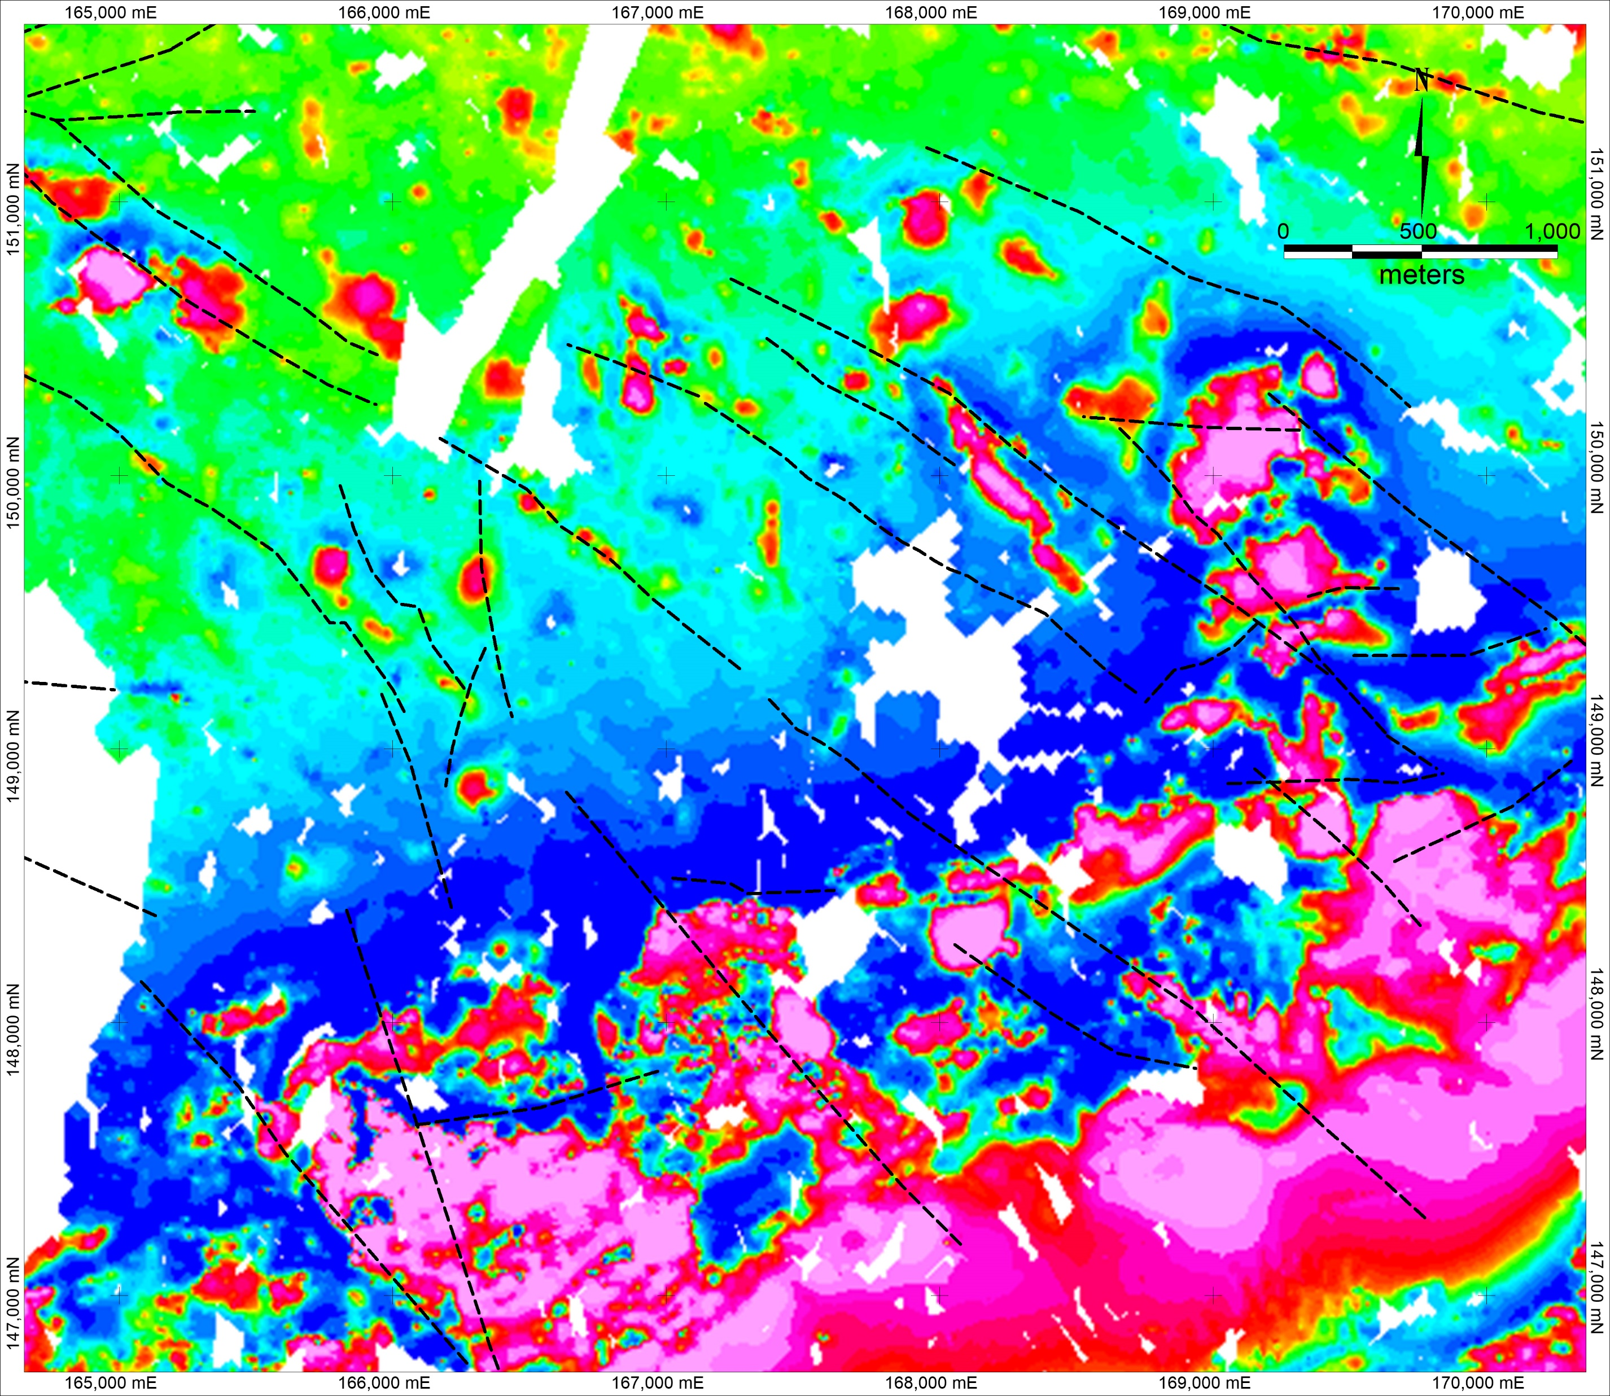
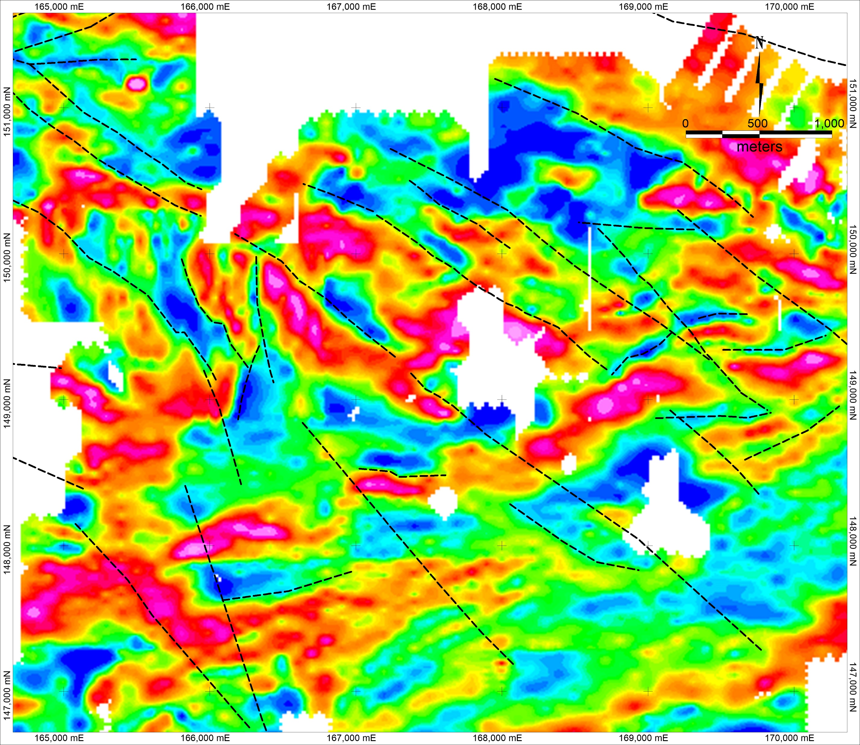
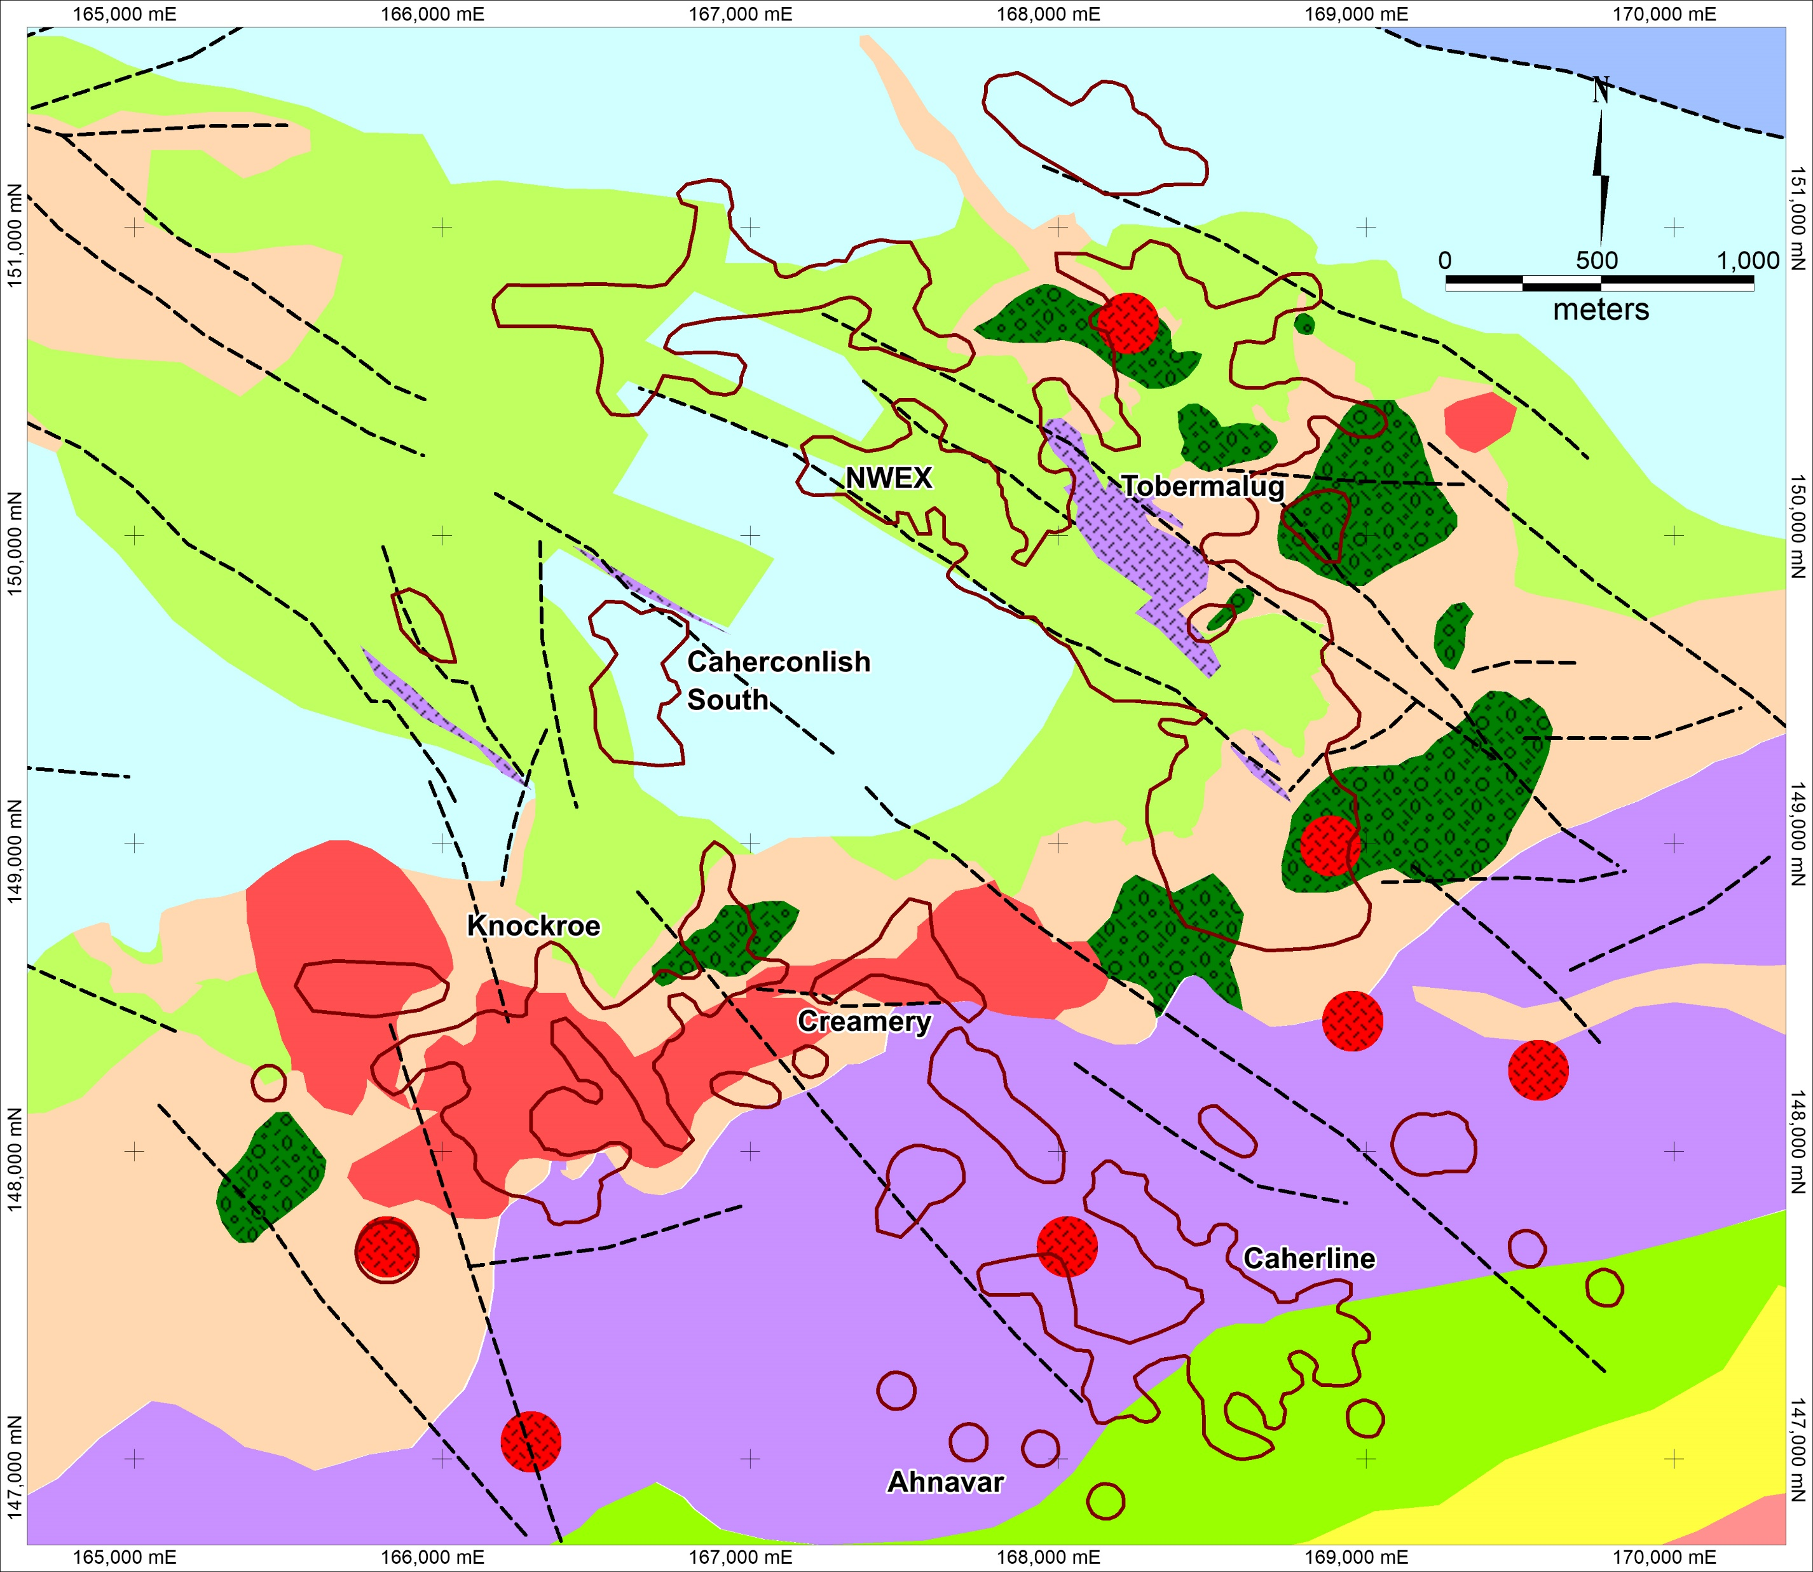
Pallas Green Geology
Waulsortian Limestone dipping to the south beneath the Lough Gur Fm. and Knockroe volcanics
Footprint of the basal Waulsortian hosted mineralised zones
Location of the main diatreme bodies
Ground magnetic map – note the Knockroe Volcanics and the linear anomalies associated with porphyries
IP Resistivity map – Very useful for identifying contacts / structures
Diamond Drilling – Pierce point locations and code for intersections
Section A – A’ and B – B’ location

Slide 7
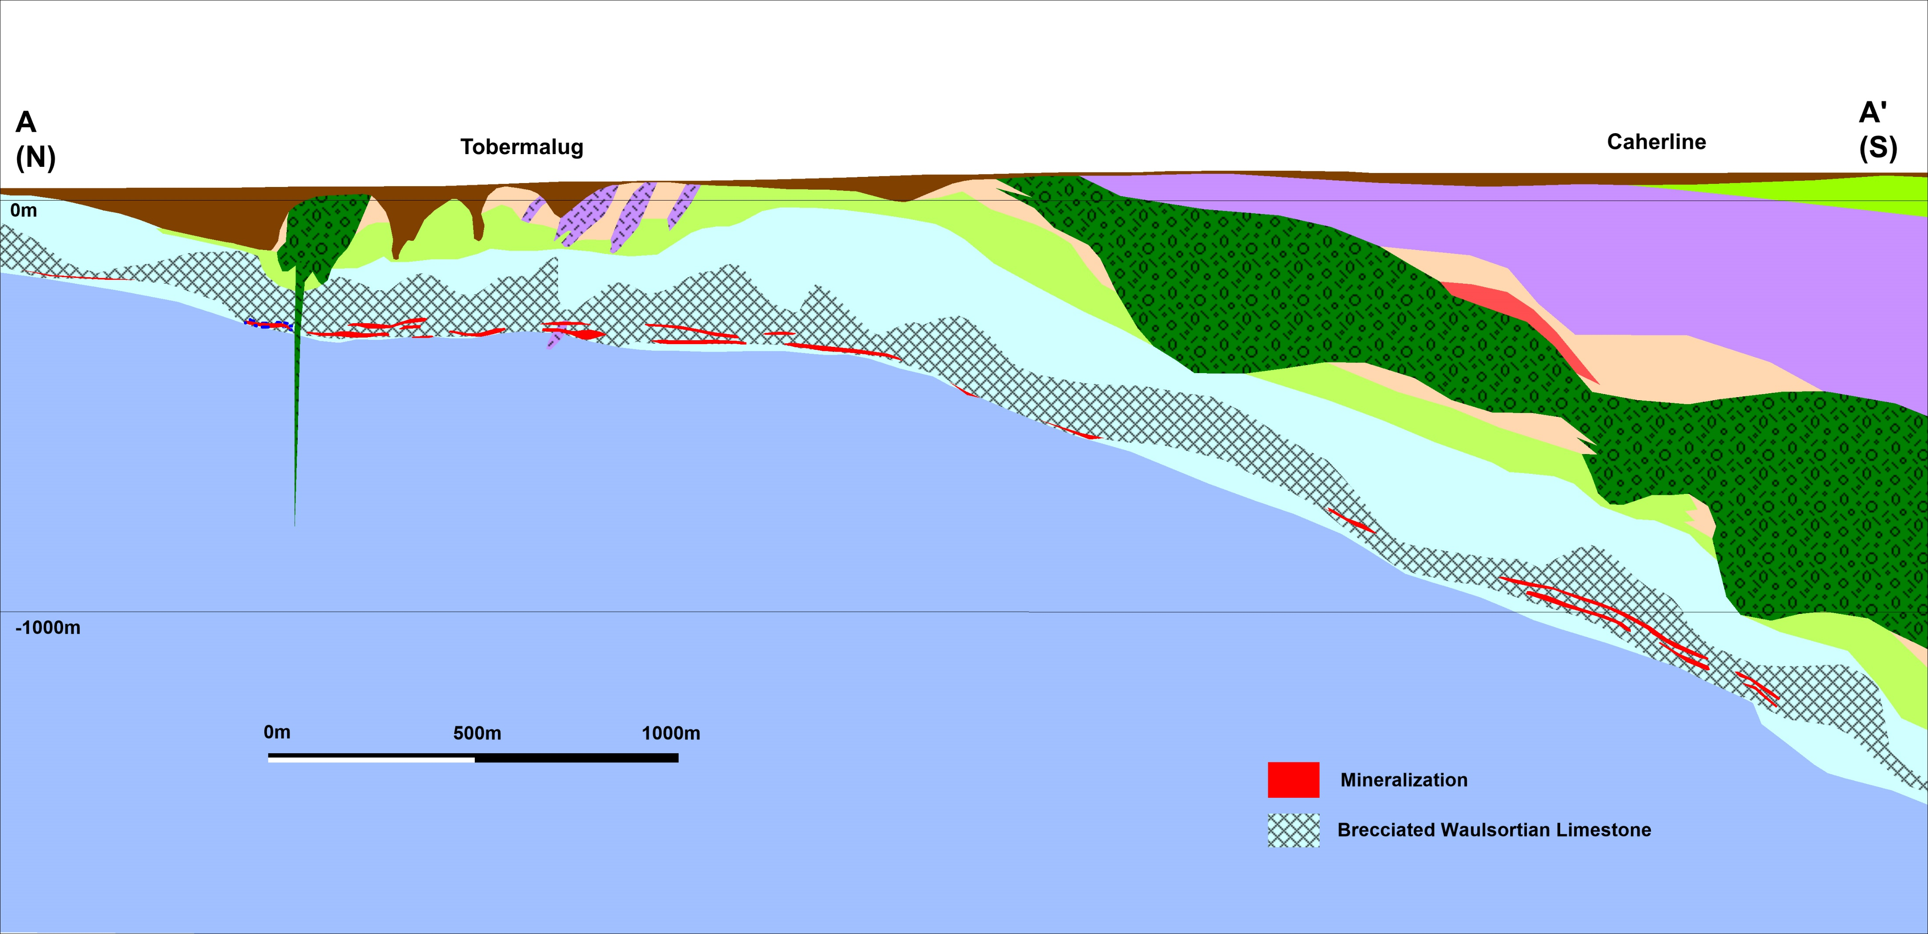
Section A – A’

Slide 8
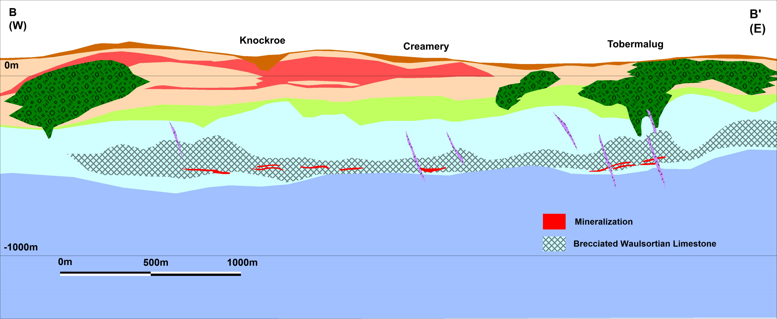
Section B – B’

Slide 9
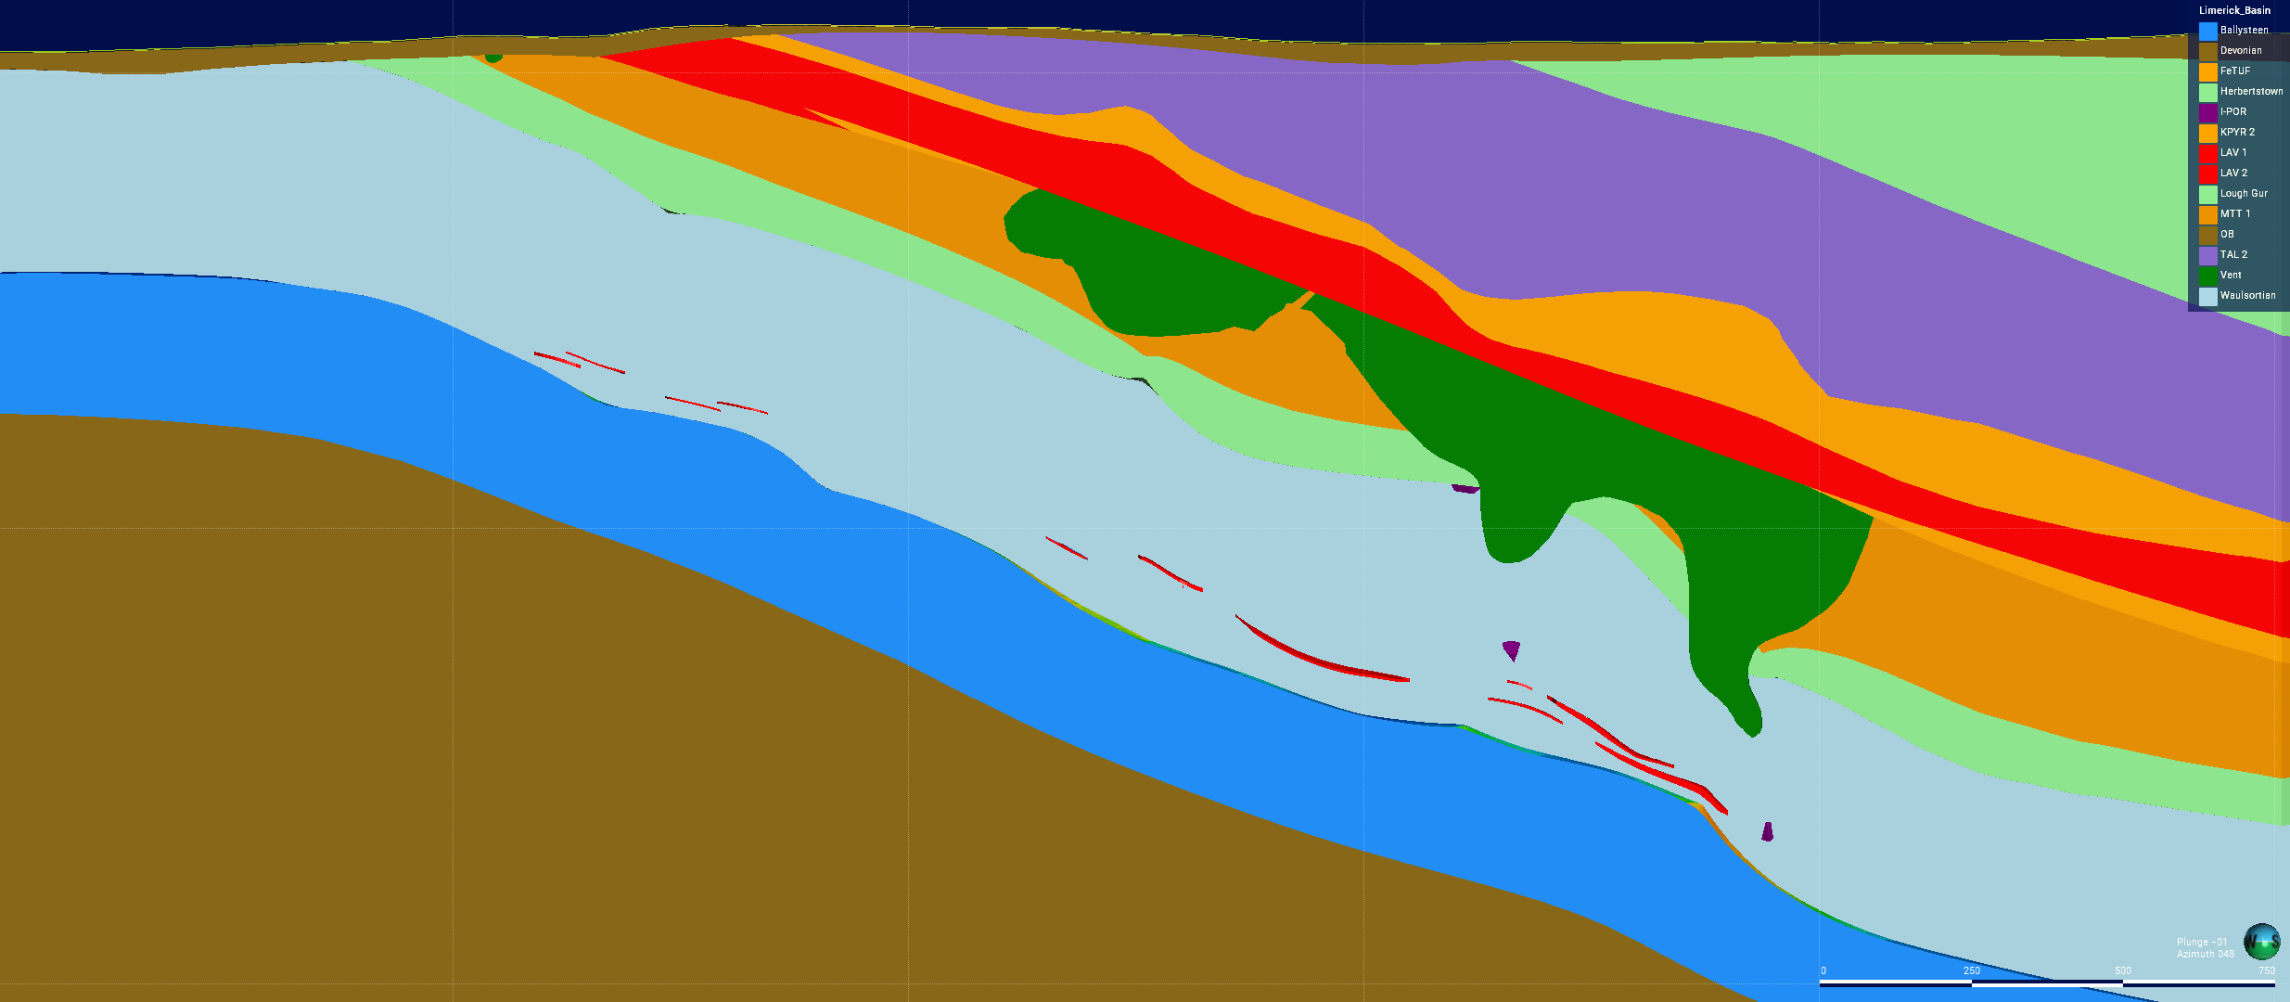
Knockroe Volcanics Caherline NW - SE
NW
SE

Slide 10
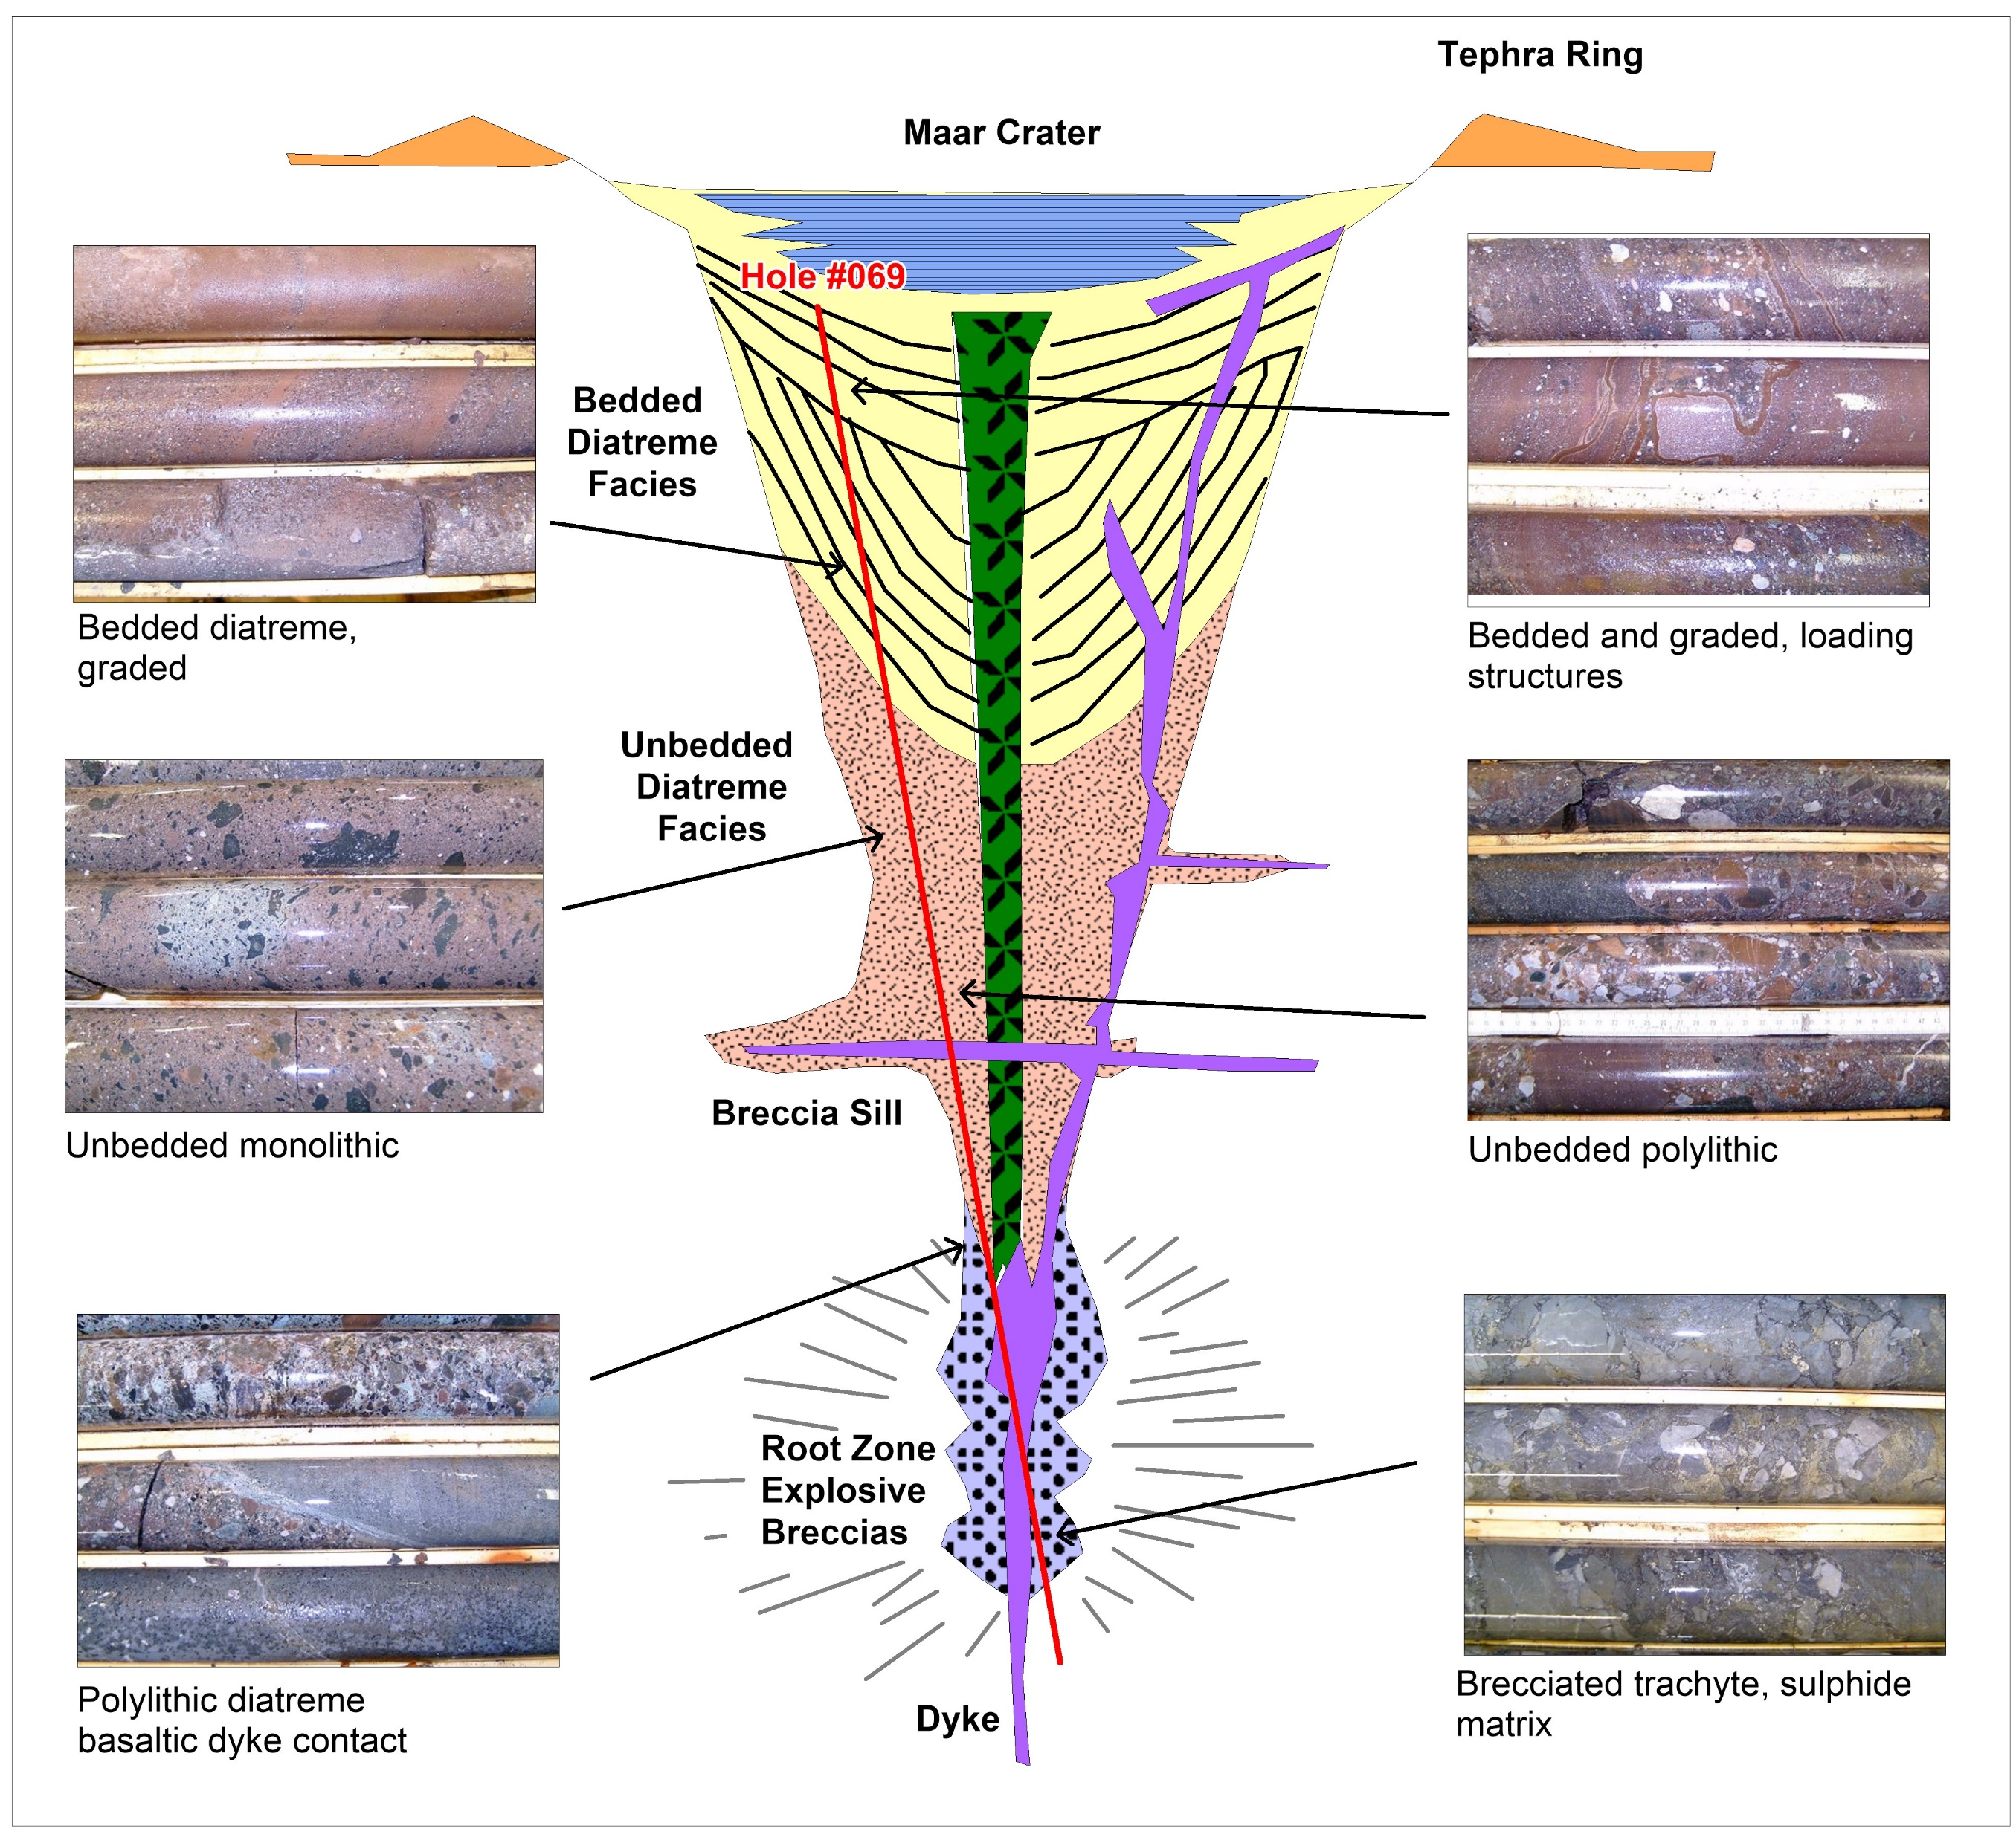
Diatreme Morphology
Seven diatremes have been intersected by diamond drilling, given their size and morphology relative to drilling there are likely to be more.
One hole (MN-2529-069) collared in the upper part of diatreme and drilled through to the Root system before exiting into the ABL.
Examples of the facies intersected are related to the Lorenz schematic.
Upper part is oxidised, bedded, and graded with loading structures.
Unbedded section is chaotic with monolithic and polylithic breccias
Root system brecciated and mineralised

Slide 11
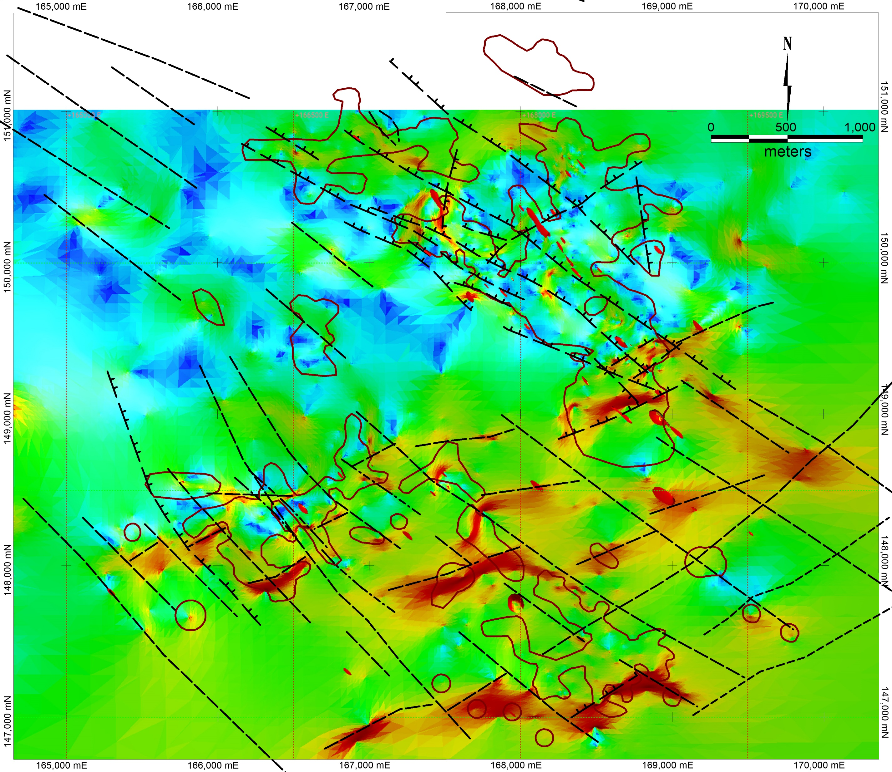
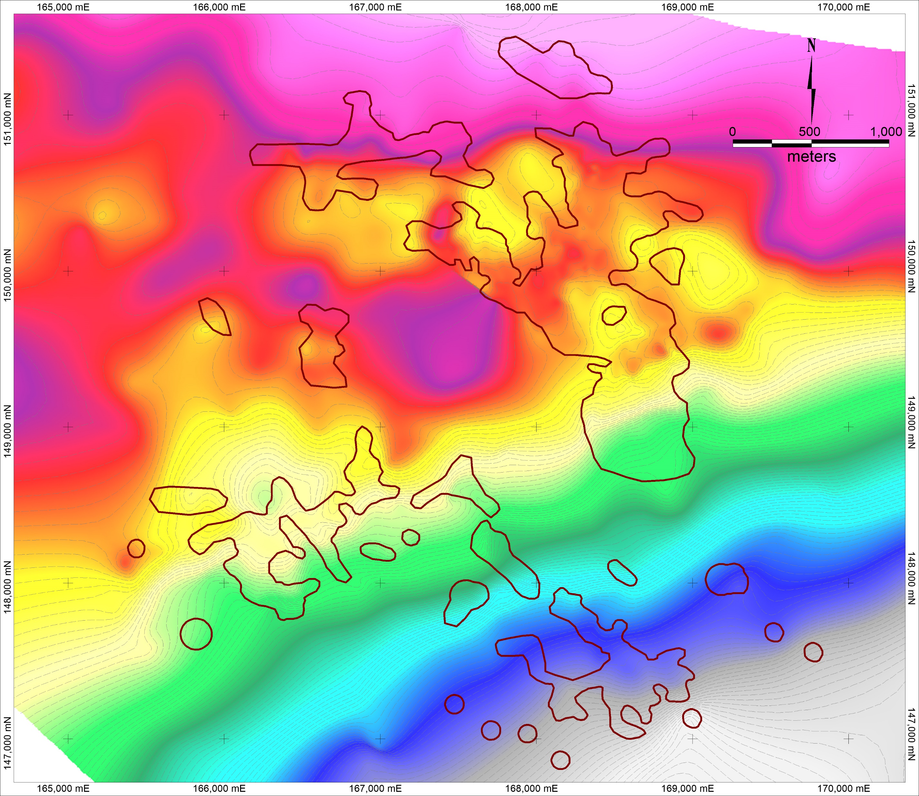
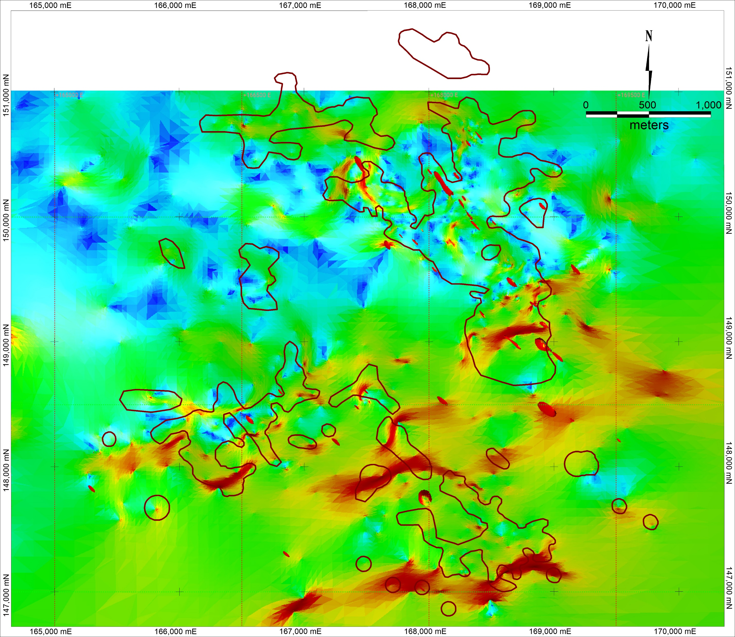
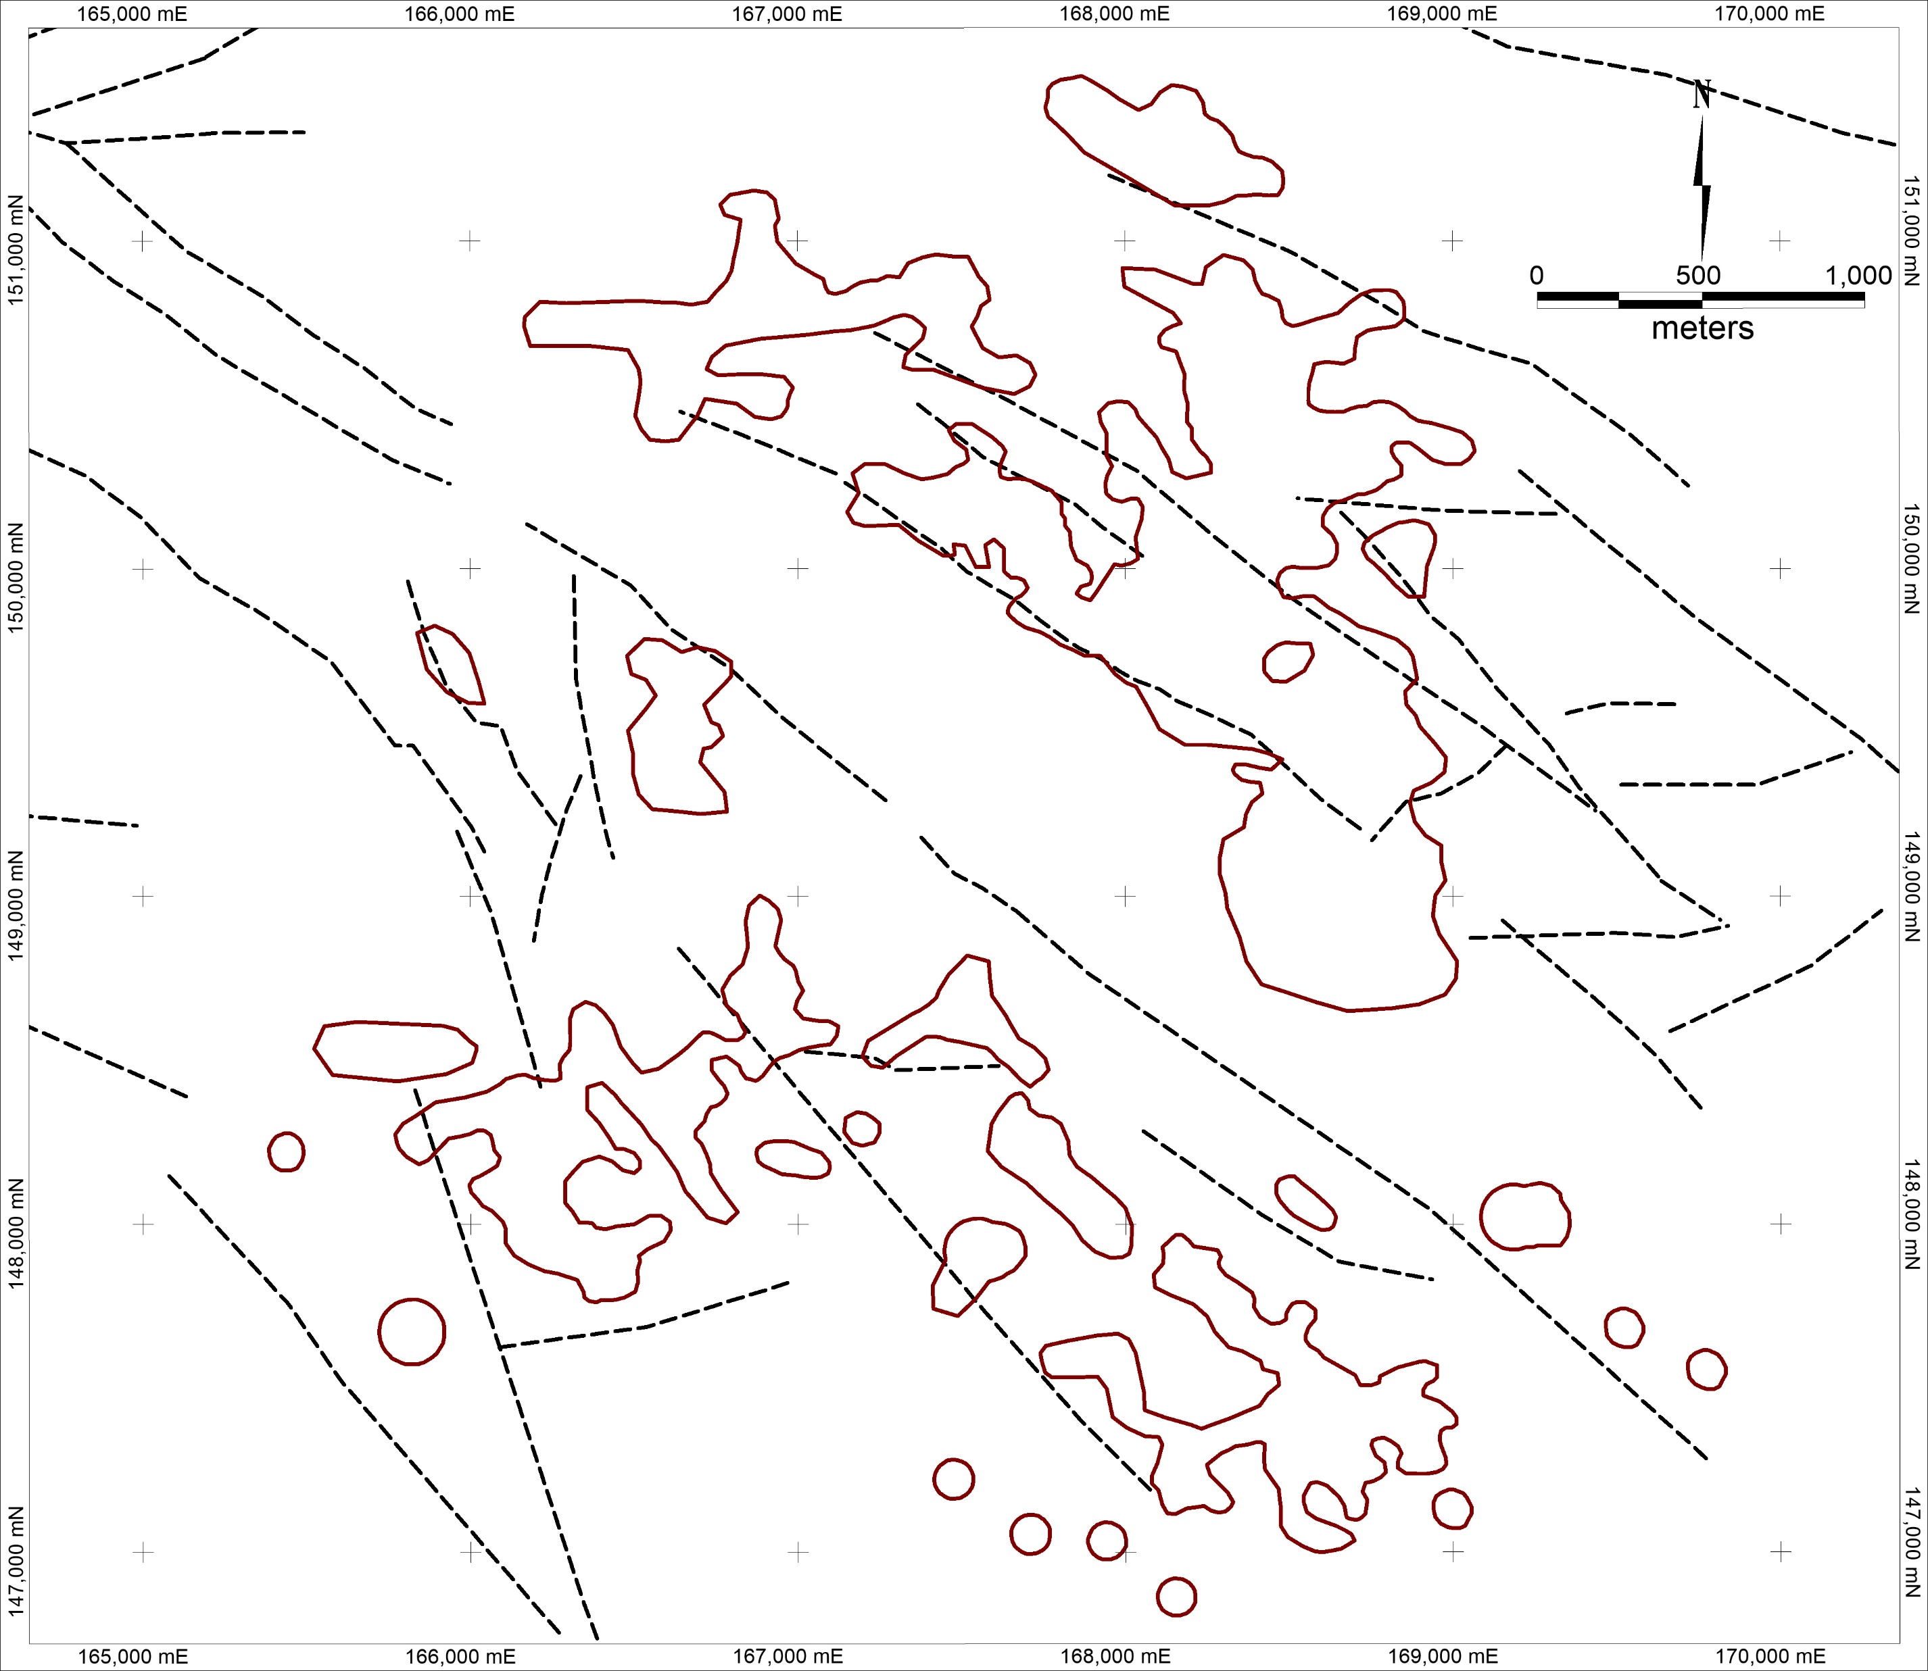
Structure
Preliminary structural modelling based upon mapping and surface geophysical surveying
As the programme developed the data derived from drilling was incorporated and a Base of Waulsortian Isobath model constructed.
NW-SE faulting predominates as it is perpendicular to the regional strike and relatively easy to discern. Particularly to the south where the regional dip increases
To the south a Face Dip model of the base of Waulsortian / ABL contact was particularly useful
Based upon the Face Dip model and drilling a more complex model was created. There is a clear NW-SE / NE-SW conjugate structural pattern.

Slide 12
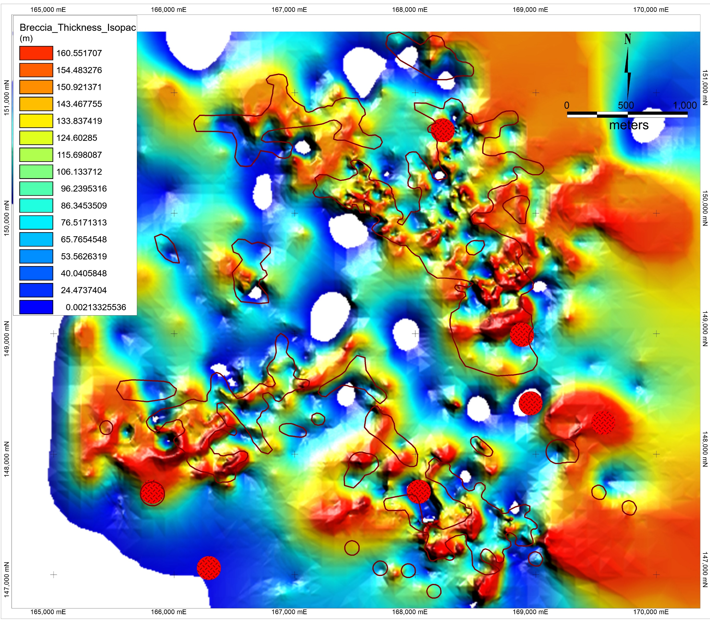
Breccia Isopach Map
Brecciation is developed within the Waulsortian Limestone, often within the basal 50m.
The thickness of the breccia bodies is variable and often controlled by faulting, e.g NWEX.
A clear NW-SE / NE-SW trend is obvious
Brecciation is a critical component of the mineralisation and acts as ground preparation.
Mineralisation is hosted by BMB / PMB and Intrusive breccias.
Intensity of brecciation is quite variable.

Slide 13
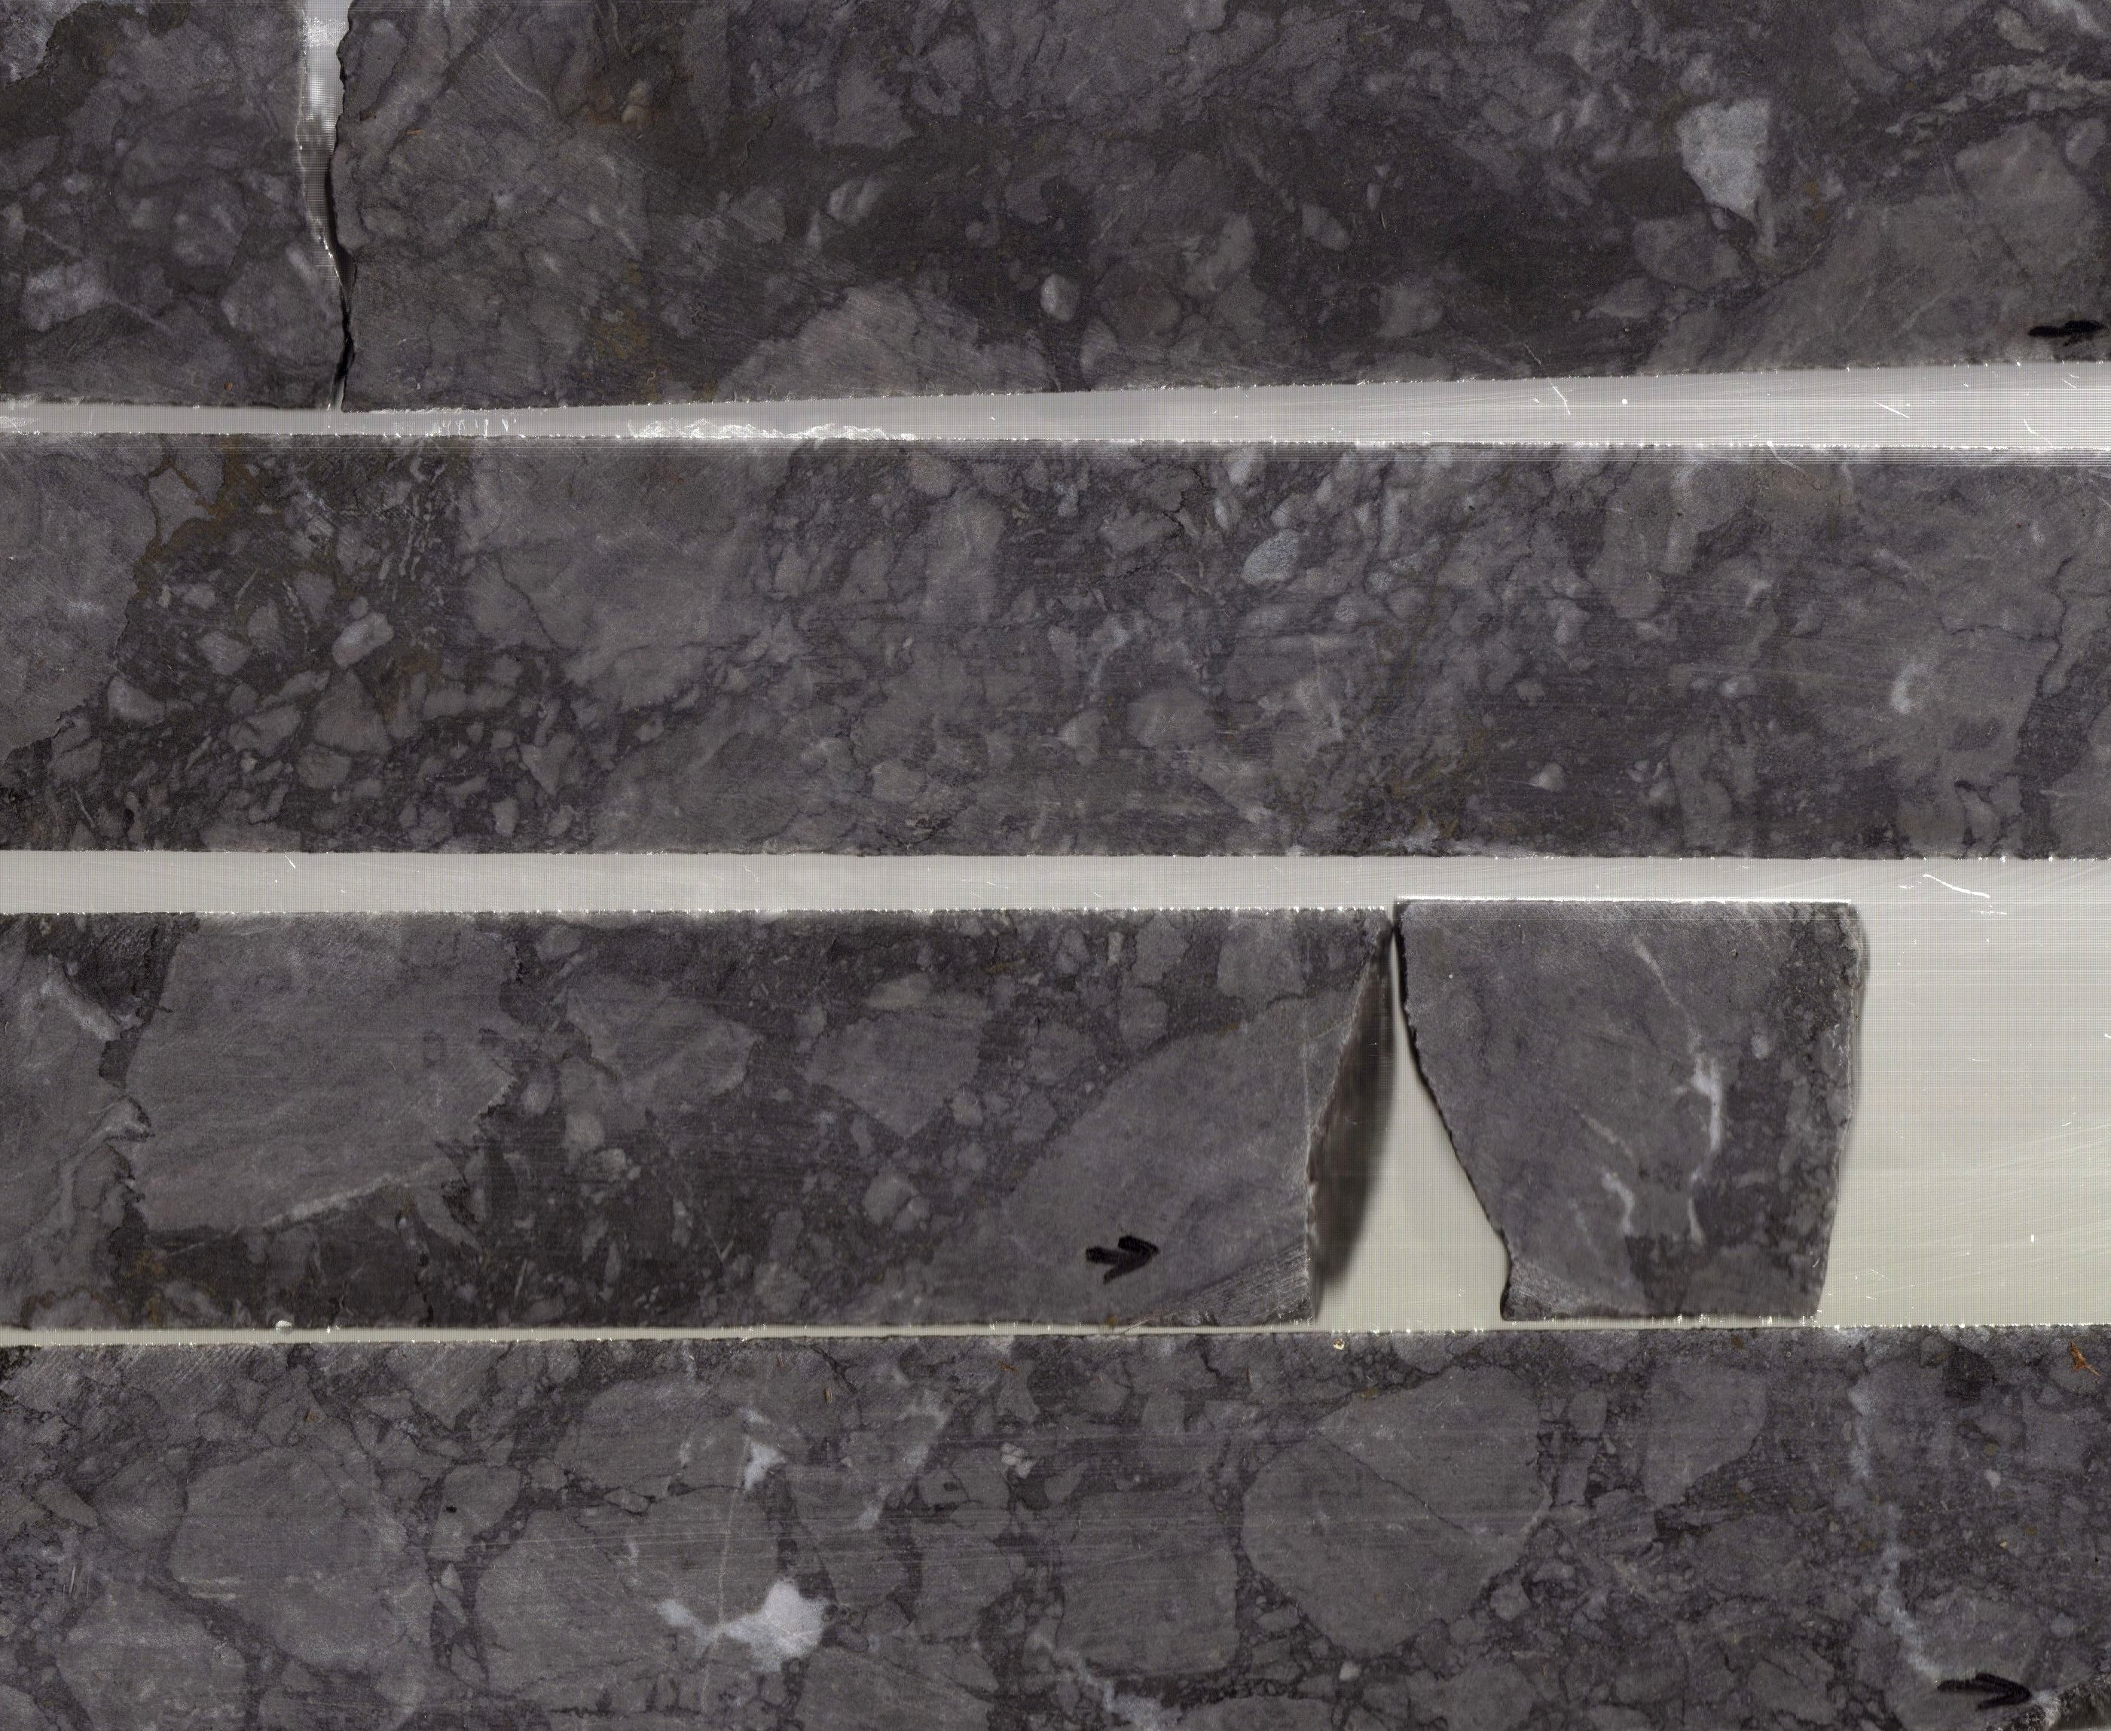
Breccia Styles BMB
BMB (Black Matrix Breccia) is the most abundant breccia style.
Dominated by angular to sub-rounded, highly irregular shaped Waulsortian Limestone clasts of variable size (2->100mm)
Typically, the matrix is fine-grained, dark grey to black in colour, comprised of black dolomite and / or argillite.
Textures range from clast to matrix supported
Clast-matrix contacts range from diffuse or gradational to extremely sharp.

Slide 14
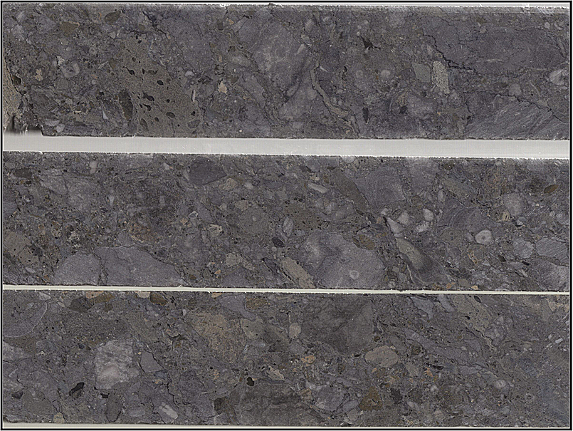
Breccia Styles PMB
PMB (Poly-Mictic Breccia) is a very important and widespread breccia style.
It comprises a spectrum of breccia types, consisting of variable percentages of intrusive and Waulsortian clasts in an igneous (intrusive) and / or carbonate matrix.
The typical PMB is a complex zone of interdigitating Waulsortian Limestone and minor basaltic sills, which have undergone multiple phases of brecciation.
Some of the igneous clasts in PMB’s display plastic deformation related to mechanical compaction suggesting PMB’s were developing during the Knockroe Volcanics intrusive phase

Slide 15
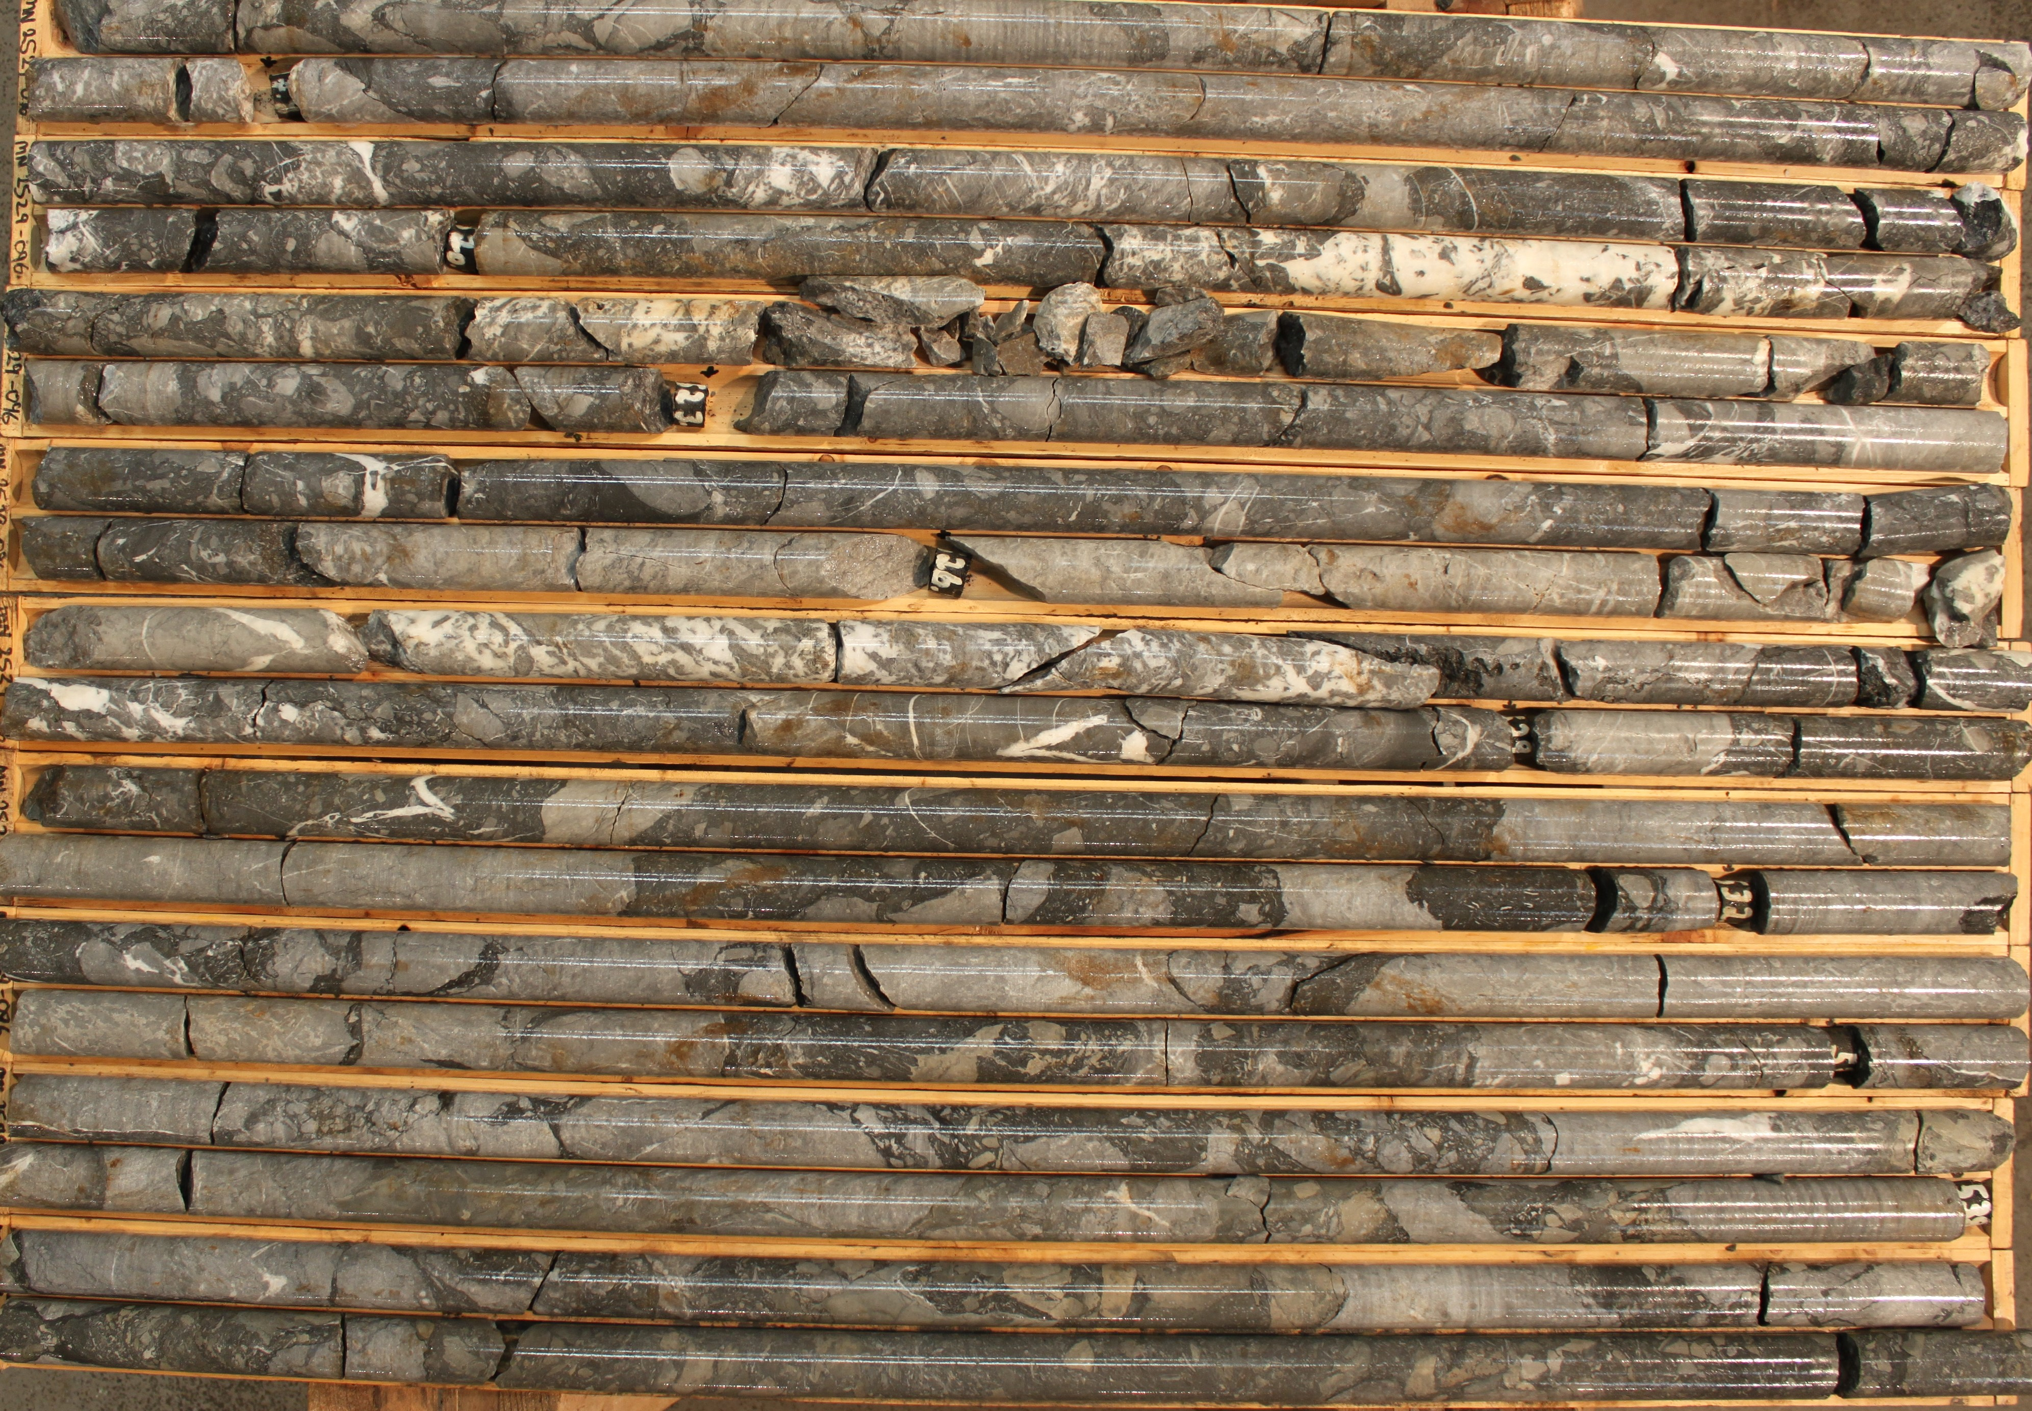
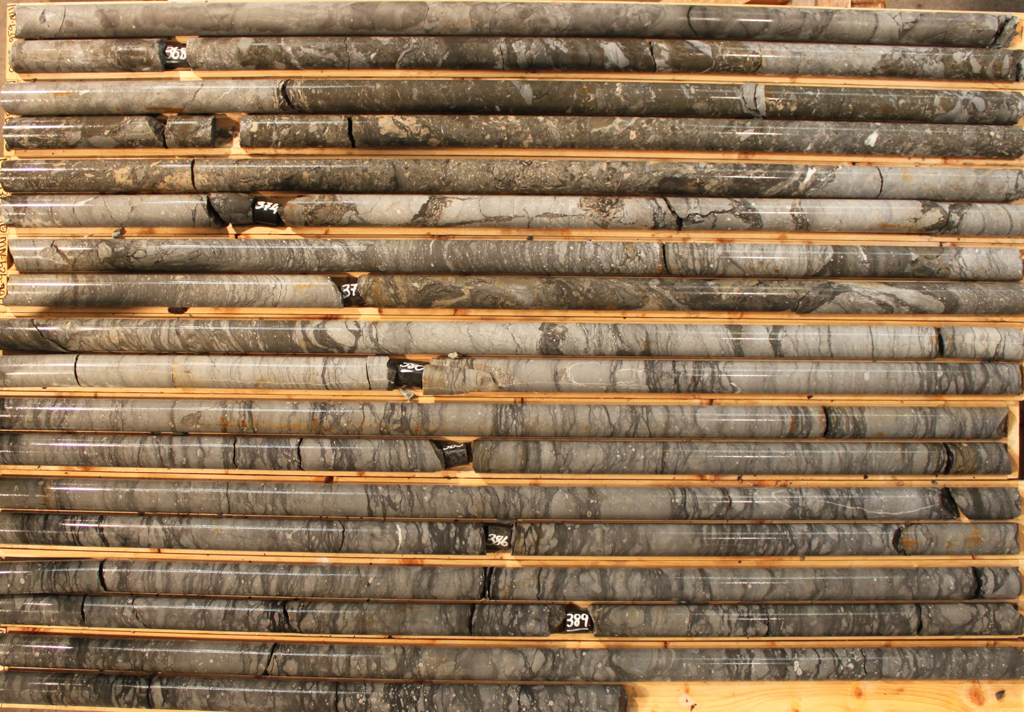
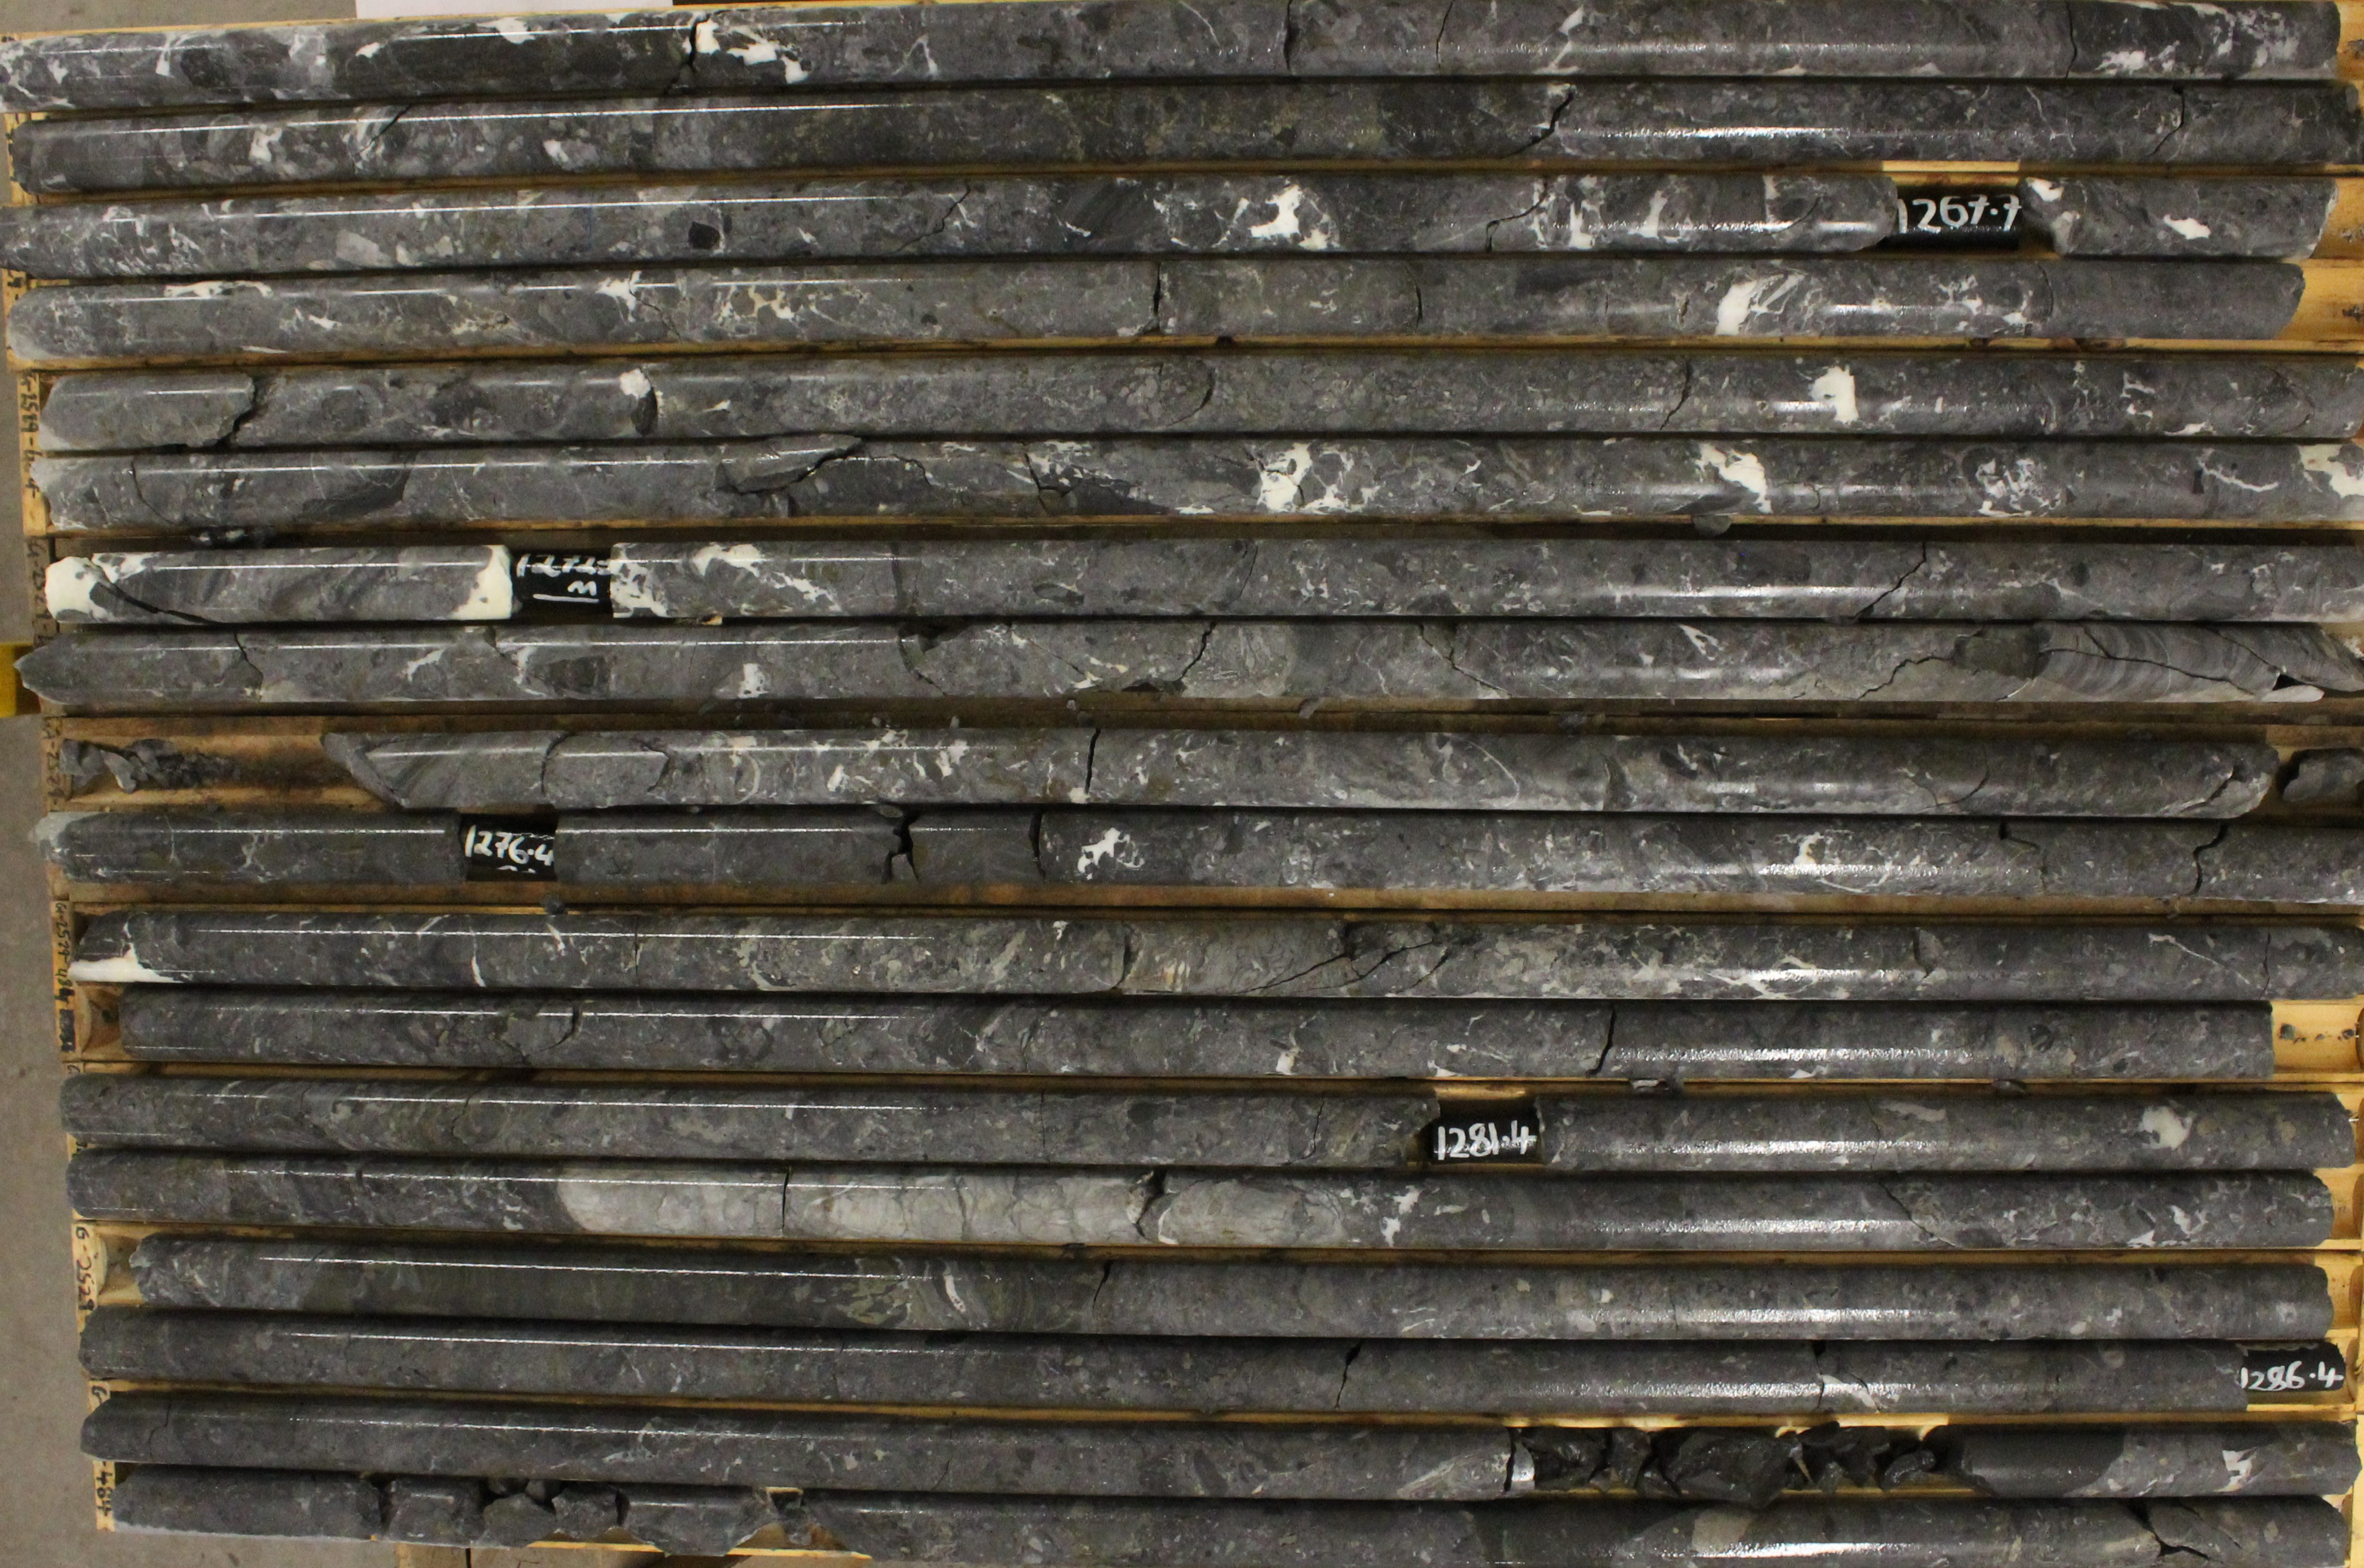
Breccia – Rockmass
Thick zones of breccia can have variable breccia styles that interdigitate (BMB, PMB, WMB)
Occasionally thick zones of breccia can be dominated by a single style of breccia, usually BMB.
Mineralisation tends to focused towards the basal parts of the breccia systems.
Subordinate breccia styles are observed at Pallas Green, including vermicular, and sandstone matrix.

Slide 16
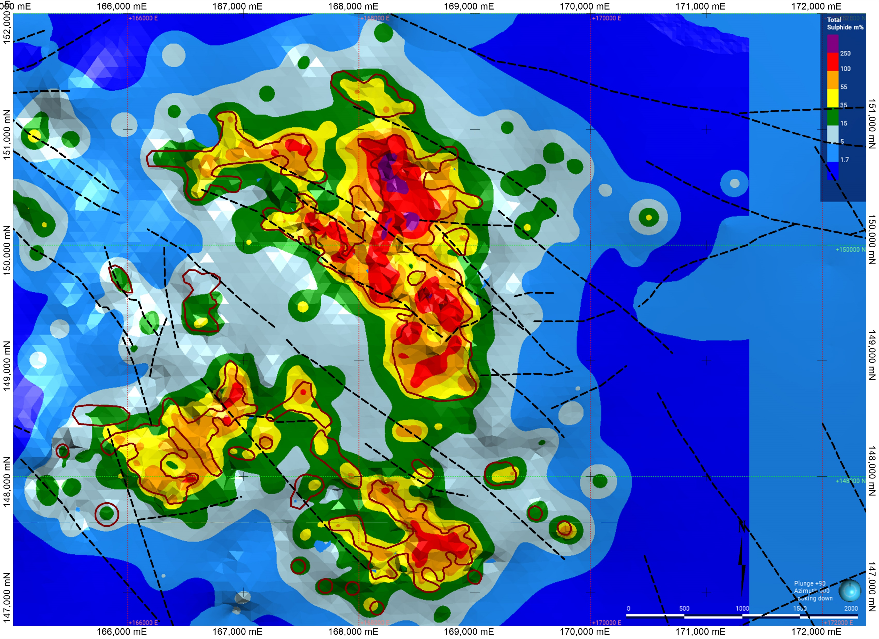
Mineralisation
A “Total Sulphide Model”(TSM) has been generated from the split core assay results.
It is based upon the sulphide grade and the thickness of the mineralised interval to create an intensity model
The TSM is used to define and delineate the zones of most intense mineralisation
The assay data is used to delineate metal endowment and enrichment.

Slide 17
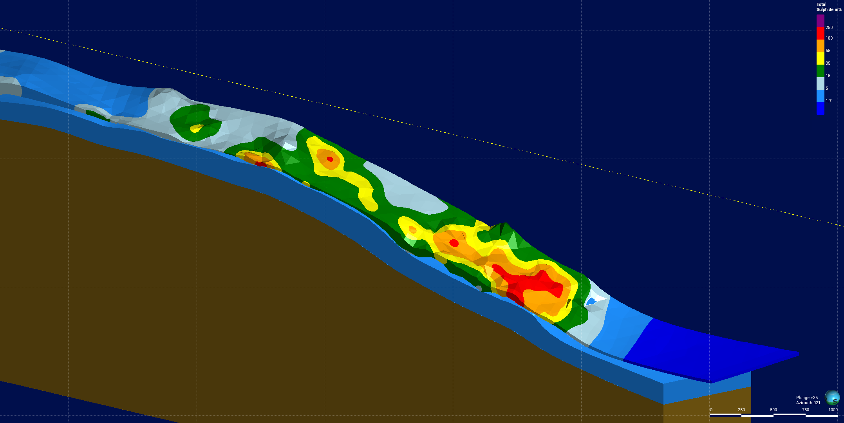
Total Sulphides Caherline Zone
Presented is the “Total Sulphide Model”(TSM) from the dip section at Caherline .
The TSM is constrained by the mineralised composites and sits either on or just above the base of Waulsortian / ABL contact.
The drilling traces show the drilling control on the TSM.
The TSM is based upon intercepts on a nominal 100 – 150m centre spacing

Slide 18
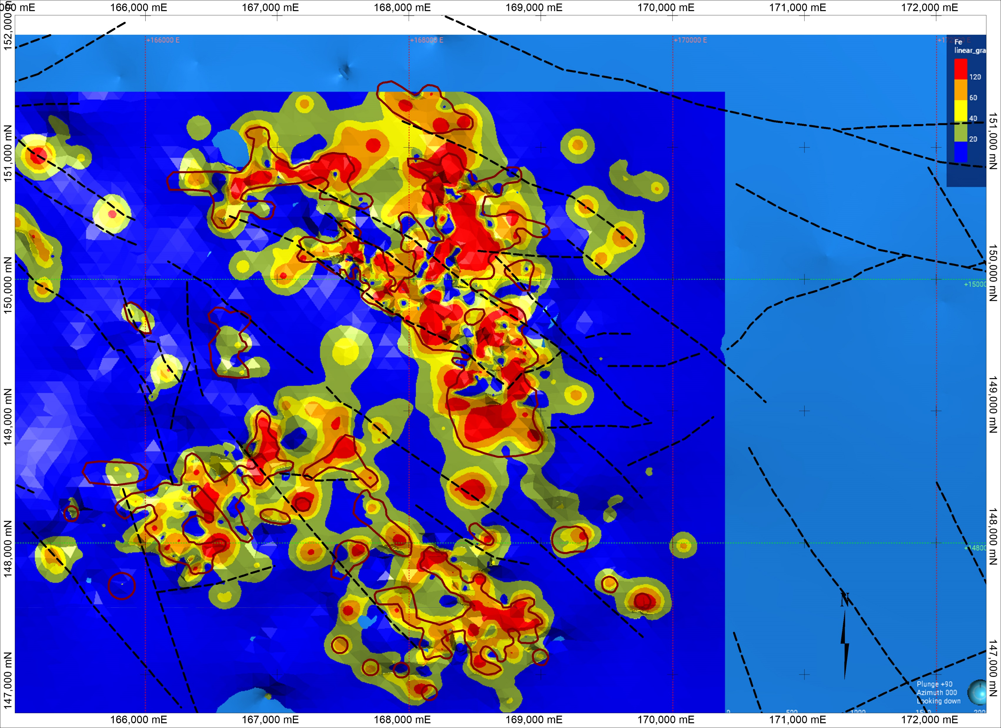
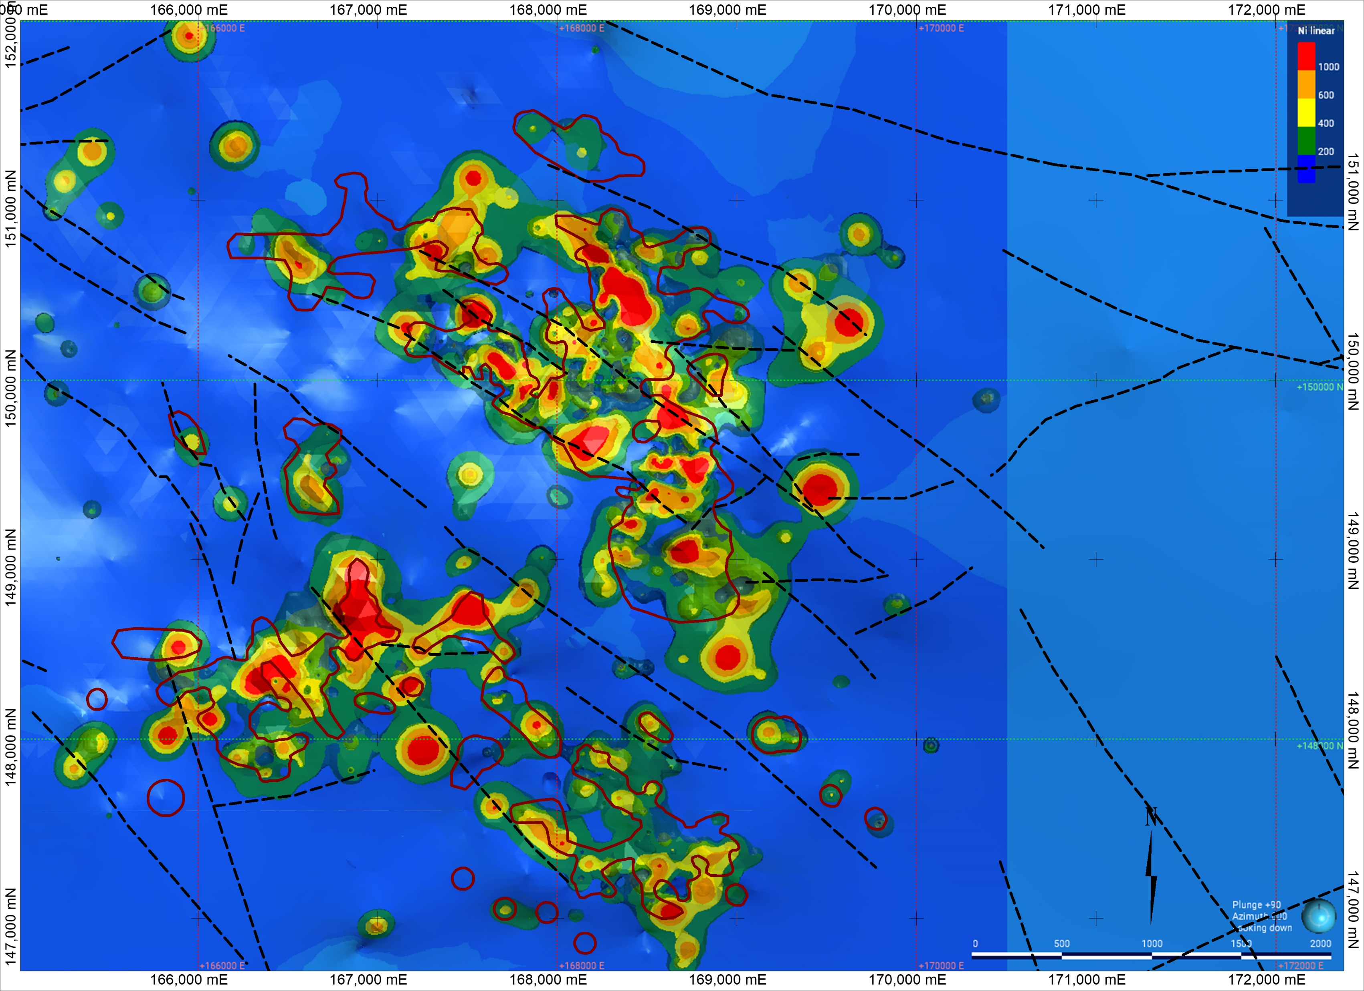
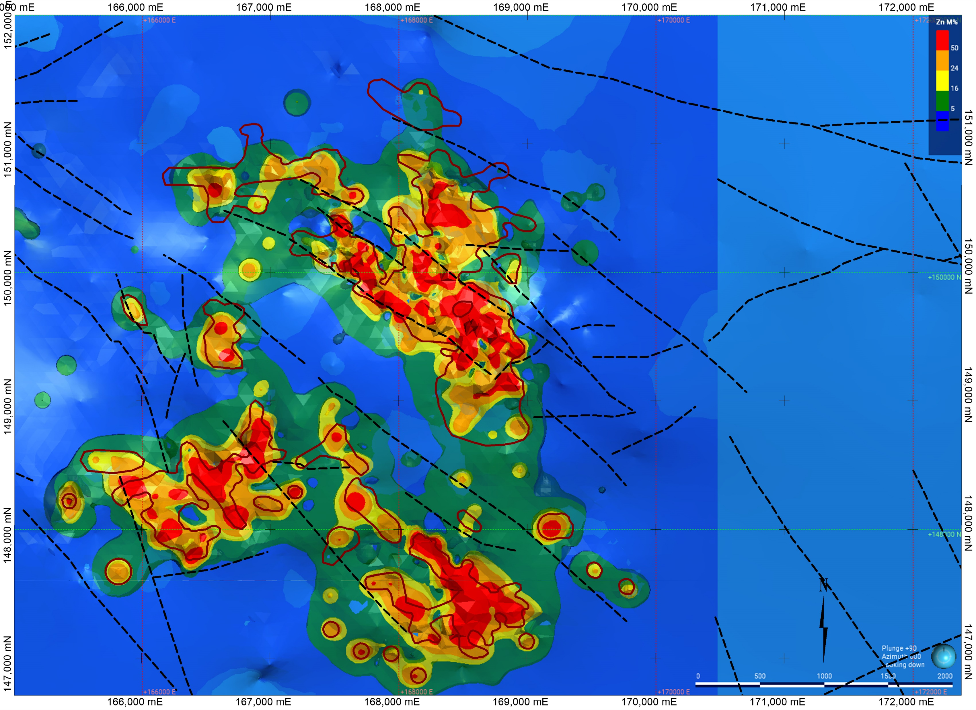
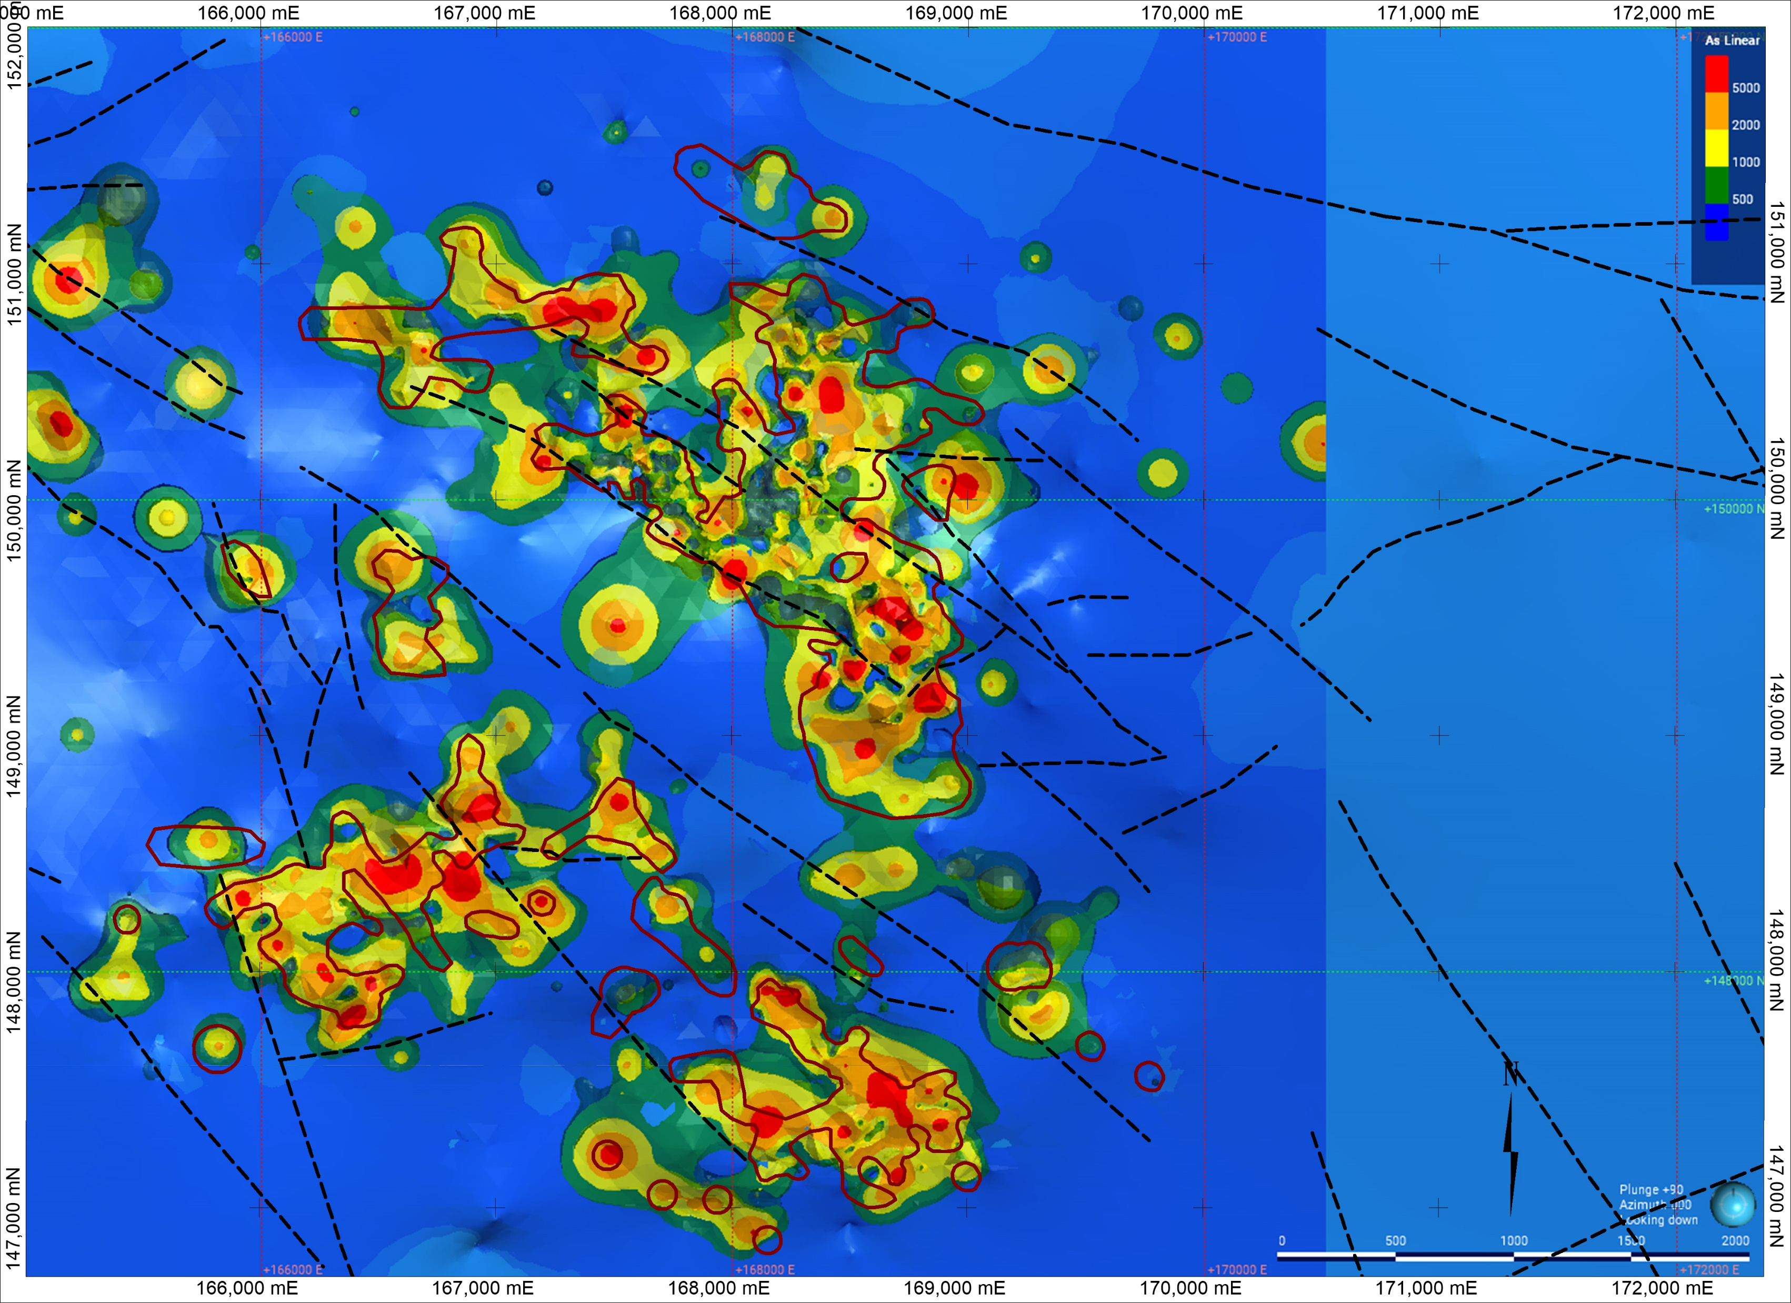
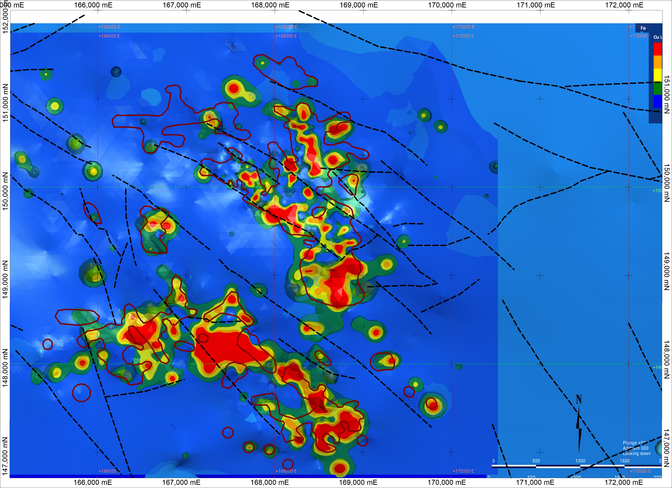
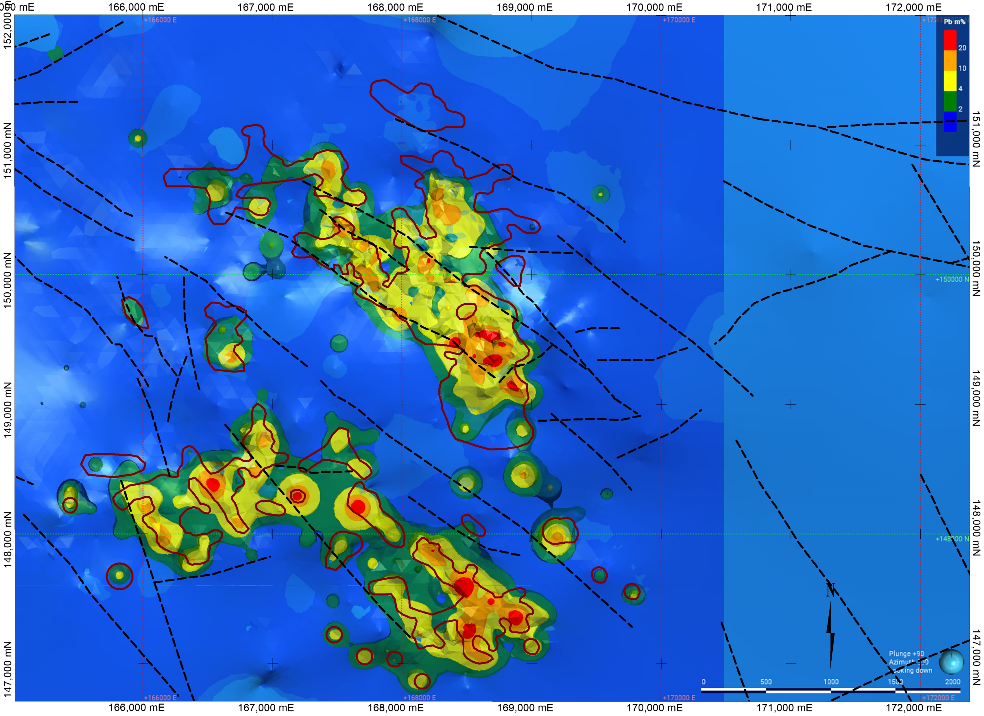
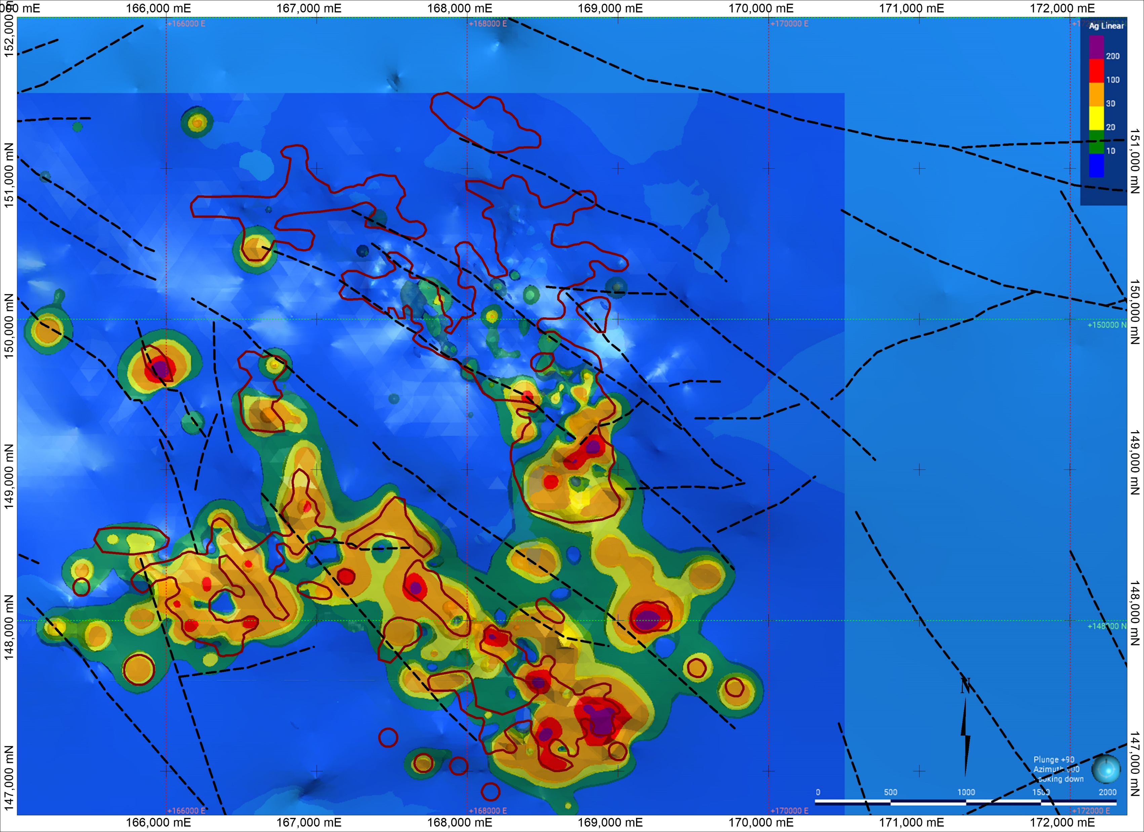
Metal Zonation
Zinc – maximum 54.33% Composite int. mean 8.26%
Lead - maximum 49.66% Composite int. mean 1.55%
Silver - maximum 130g/t
Composite int. mean 3.04g/t
Arsenic - maximum 3503ppm
Composite int. mean 236ppm
Copper - maximum 6,400ppm
Composite int. mean 34.1ppm
Nickel - maximum 4,738ppm
Composite int. mean 117ppm
Iron - maximum 56.3%
Composite int. mean 6.52%

Slide 19
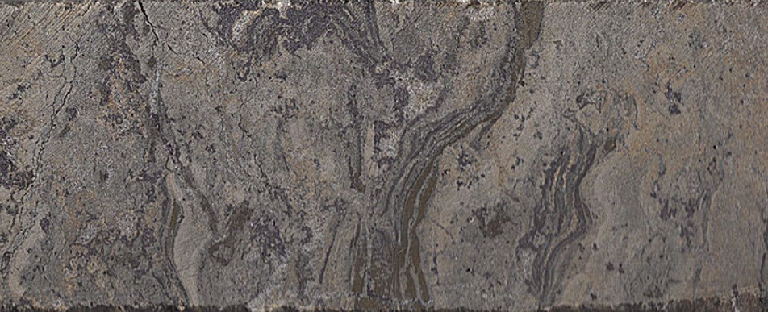
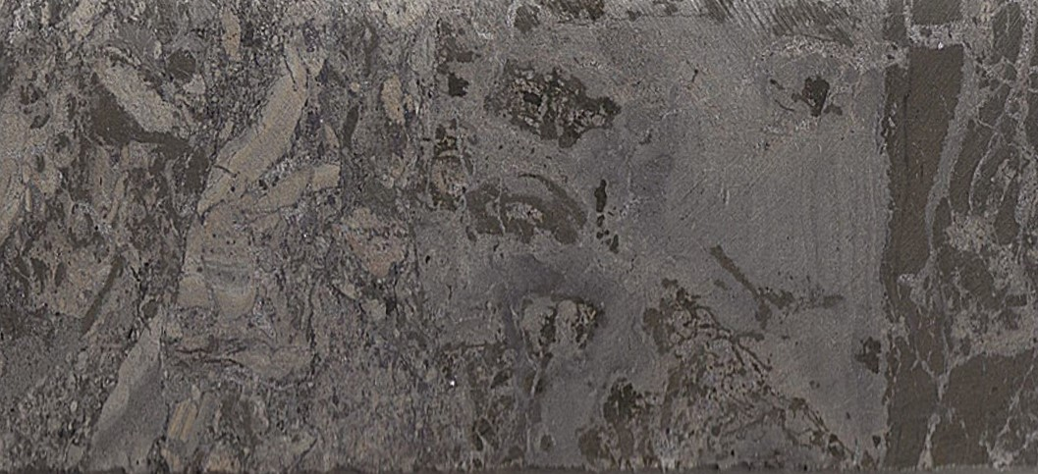
Mineralisation
Fine grained, pale brown / pink / grey, sphalerite. Brecciated
Laminae of finely crystalline galena and pyrite
Late stage dolomite
Brecciated multiphase, fine grained, pale brown / pink, sphalerite, with later replacement by fine grained grey sphalerite
Finely disseminated fine grained galena
Lath like clast of fine grained pyrite, partially replaced by sphalerite

Slide 20
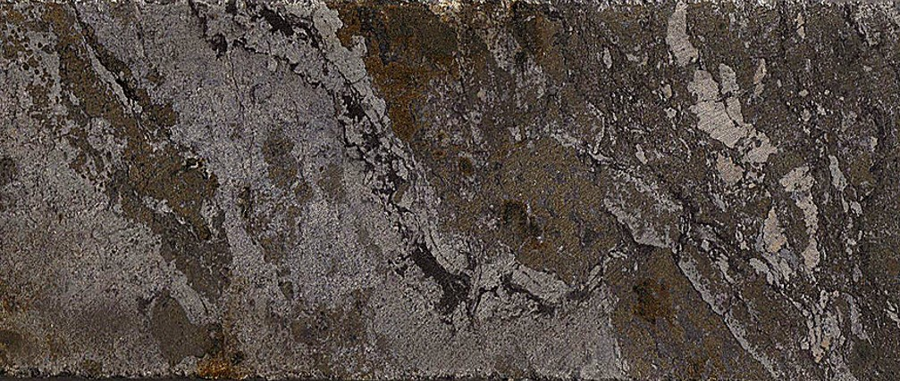
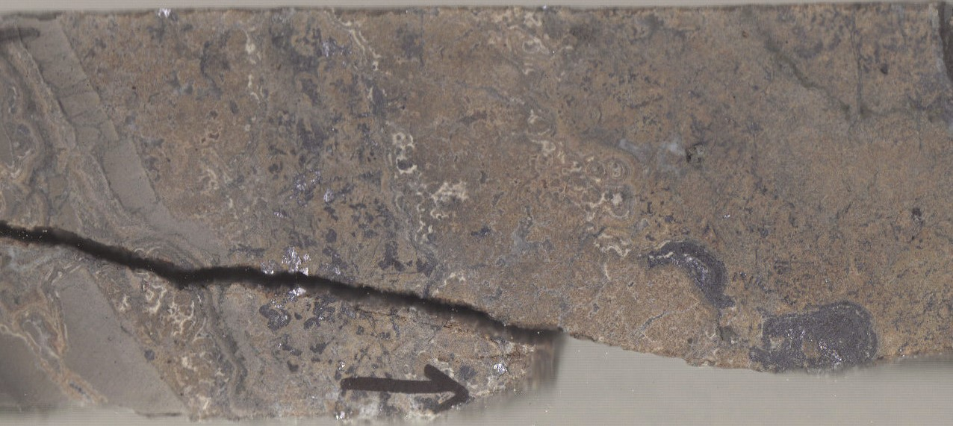
Mineralisation
Banded, fine to medium crystalline pyrite, with clasts of fine grained pink sphalerite
Partially replaced by pale grey sphalerite
Minor late stage black dolomite
Finely collomorphic teak brown, fine grained sphalerite
Coarsely crystalline euhedral galena
Late stage creamy dolomite

Slide 21
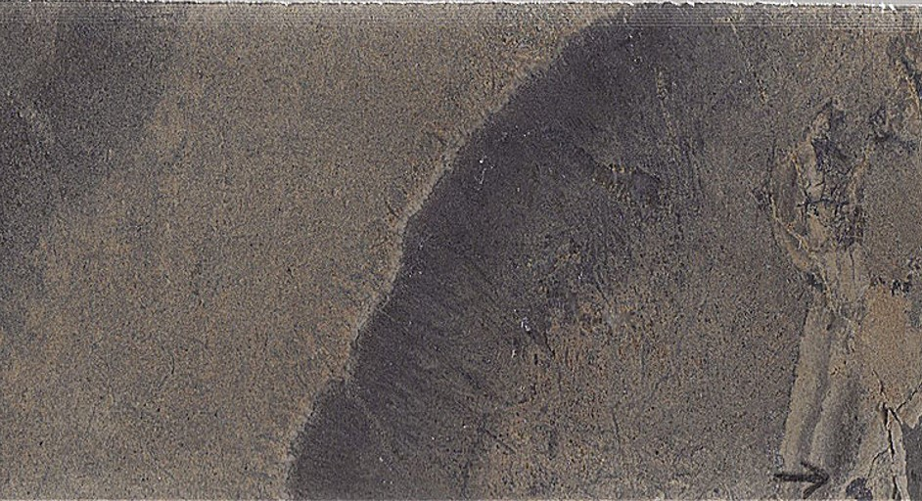
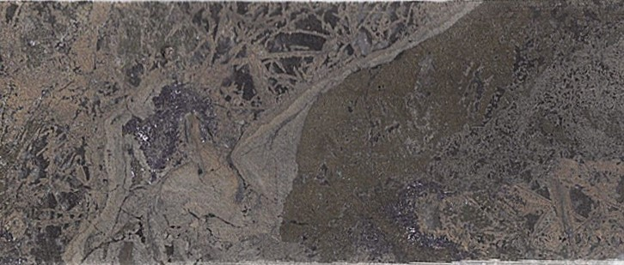
Mineralisation
Banded, pale brown, fine grained sphalerite.
Discrete bands with finely disseminated, fine grained galena
Pyrite partially replaced by grey fine grained sphalerite.
Multiphase sphalerite.
Disseminated euhedral galena.
Elongate clasts of pale pink/brown sphalerite overgrowing delicate needles of dendritic galena.

Slide 22
Mineralisation Multiphase massive sulphides, brecciating and replacing porphyritic trachyte
Multiphase, fine grained, pale brown / grey
Sphalerite partially replacing pyrite
Porphyritic Trachyte clasts
Multiphase, fine grained pale brown / grey
sphalerite rimming and partially replacing trachyte clasts
White, fine-grained sphalerite
Deposited within fractures and
replacing immediate wall rock of
trachyte clasts

Slide 23
Pallas Green Zn / Pb Deposit Summary
The deposit has an Inferred Resource of 45 Million Tonnes, grading 7.21% Zn / 1.22% Pb using a 4% Zn + Pb cut off.
The deposit has a simple mineralogy (sphalerite, galena and pyrite).
It is hosted within the basal part of the Waulsortian Limestone
Ground preparation is in the form of laterally and vertically extensive breccia systems
There is a strong structural control with conjugate NW-SE and NE-SW faults. However, no major domain boundary fault, with a throw in excess of 200m, has been discovered. It is possible that the mineralisation to date is controlled by 2nd and 3rd order faults and the main controlling is yet to be found.
The Knockroe Fm. extrusive and intrusive rocks add a layer of complication to the system. But may have contributed to the development of an atypical amount of brecciation
Trace element characteristics show low concentrations of smelter credit metals like silver, copper or nickel. However, the concentrations of smelter penalty elements like arsenic, selenium or mercury are also low. The recent GSI sponsored ECE assessment found that there is endowment of germanium, which could be of interest.
Is it an Irish Type Deposit? – It has many of the characteristics of other Irish Type deposits, with some strong similarities and differences to both Silvermines and Lisheen.

Slide 24
Thank You

