Slide 1
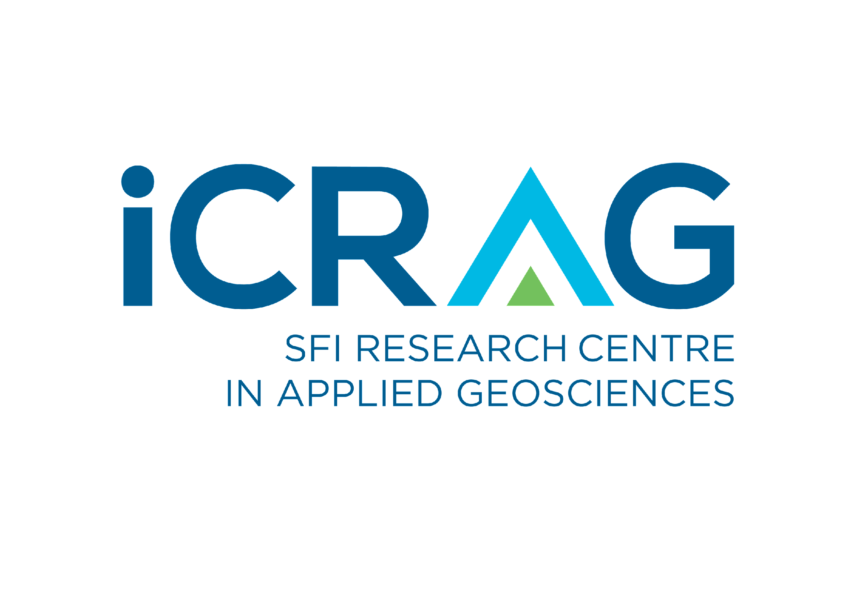




A New Look at the Gortdrum Copper Deposit, Co. Tipperary (+ bonus Limerick content!)
Eoin Dunlevy^{1,2}, Koen Torremans¹, Mark Holdstock³, and Murray Hitzman¹
¹iCRAG / UCD, ²Terranta GmbH, ³Group Eleven Resources

Slide 2
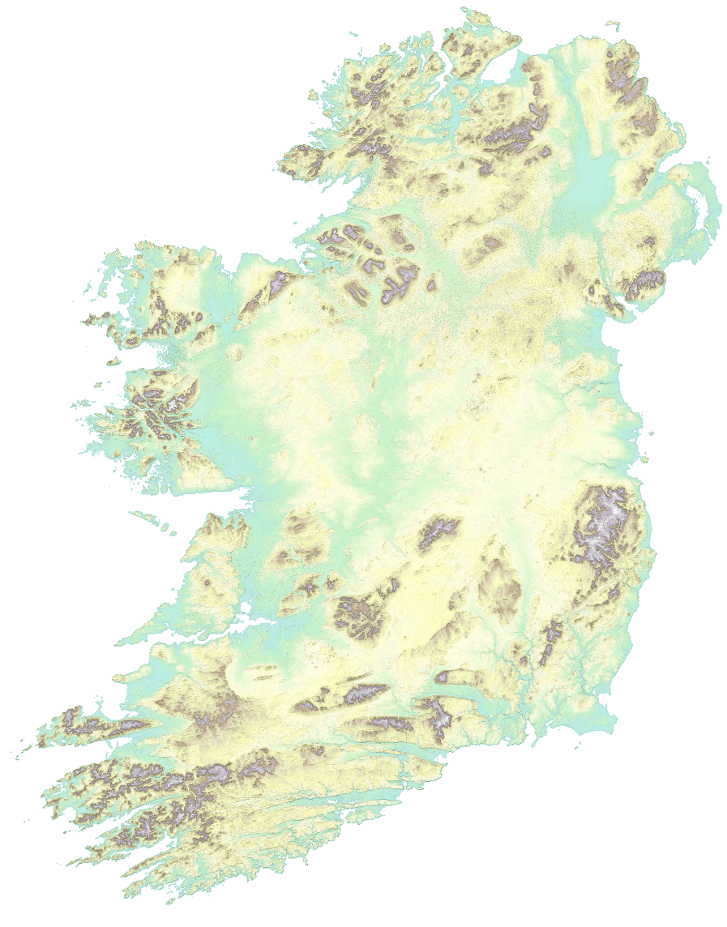
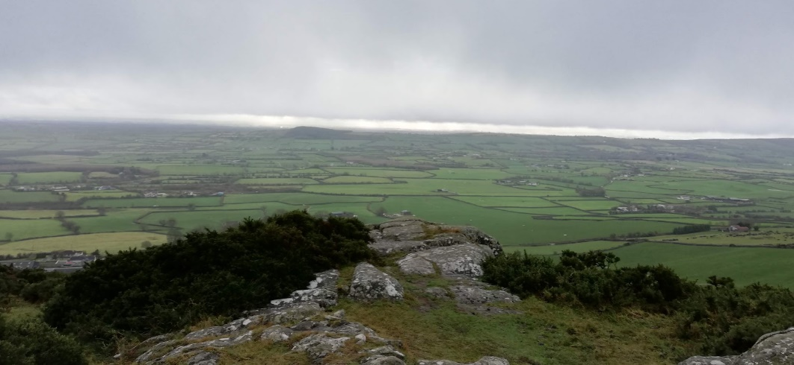

Region Overview
Limerick Syncline
Namurian Clastics
Dromkeen Fm
Visean Basinal
Knockseefin Volc.
Visean Shelf
Historic mining district (Zn, Pb, Cu, Ag)
  Oola + Gortdrum
  Over 50 Mt @ Pallas Green + Stonepark
  Several small prospects
Zn/Pb mineralisation hosted in Waulsortian
Cu mineralisation hosted in LLS/Ballysteen
Herbertstown Fm.
Waulsortian Mudmounds
Knockroe Volc.
Ballysteen Limestone
Lough Gur
Lower Limestone Shales
Historic Mine
Devonian ORS
Mineral Resource
Lower Palaeozoic Basement
¹Kilbricken
2.7 Mt @ 8.8 %
Zn + Pb *
Prospect
Silvermines
17.7 Mt @ 8.96 %
Zn +Pb
³Pallas Green
45.4 Mt @ 8 %
Zn + Pb
Courtbrown
²Stonepark
5.1 Mt @ 11.3 %
Zn + Pb
Rathkeale
Gortdrom 3.81 Mt
@ 1.19% Cu
Knockfierna Inlier, looking north
Carrickittle
Ballywire
Shannon Estuary
Kilmallock
Aherlow
(Cu/Ag)
Lower Carboniferous Basin
ORS + Volcanic rocks
¹ Colthurst & Reed (2019) Kilbricken NI 43-101.
²Gordon et al. (2018), Stonepark NI 43-101
³Glencore Resources & Reserves report 2018
Kerr, 2013
Geology modified from GSI 100K series
Notes:
Metal endowed region
Challengin exploration under cover (ORS inliers vs open planes of lower Carboniferous)

Slide 3
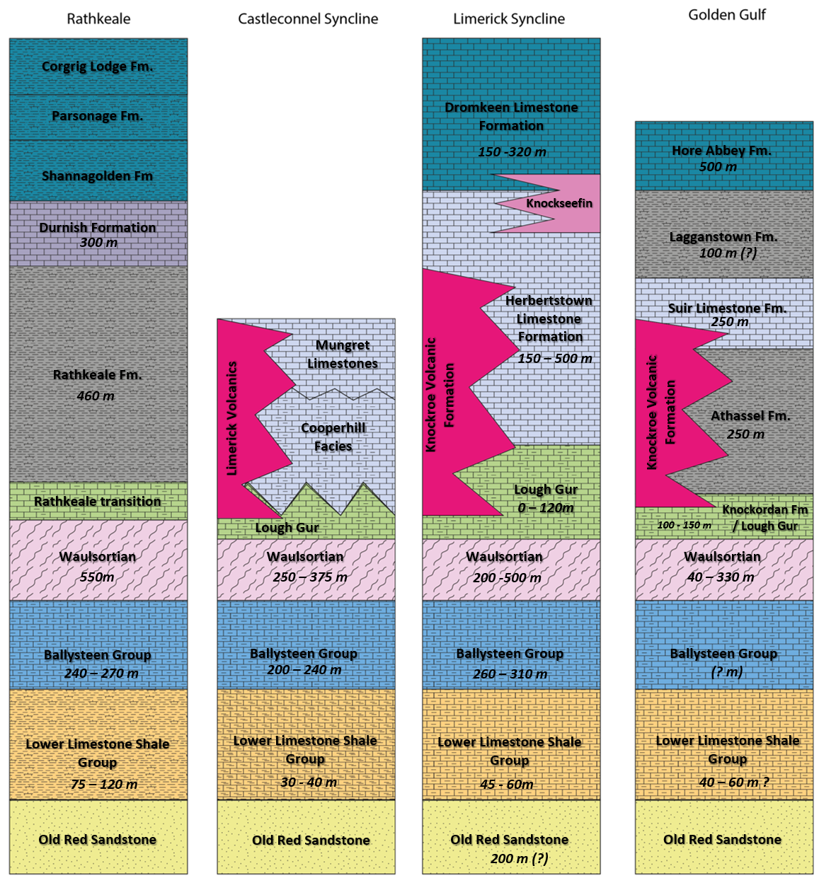
Lithostratigraphy
W
Rathkeale
Castleconnel
Syncline
Limerick Syncline
Golden
Gulf
E
Lithofacies variations mapped in 54 boreholes in Limerick Region
4 stratigraphic domains defined across the Limerick region
  Differentiation apparent from Waulsortian onward
Intra-formational lithology variations mapped in each formation
Castleconnel Syncline
Limerick Syncline
Rathkeale
Gortdrum
Golden
Gulf

Slide 4
Blue Book
Summary Sections

Slide 5
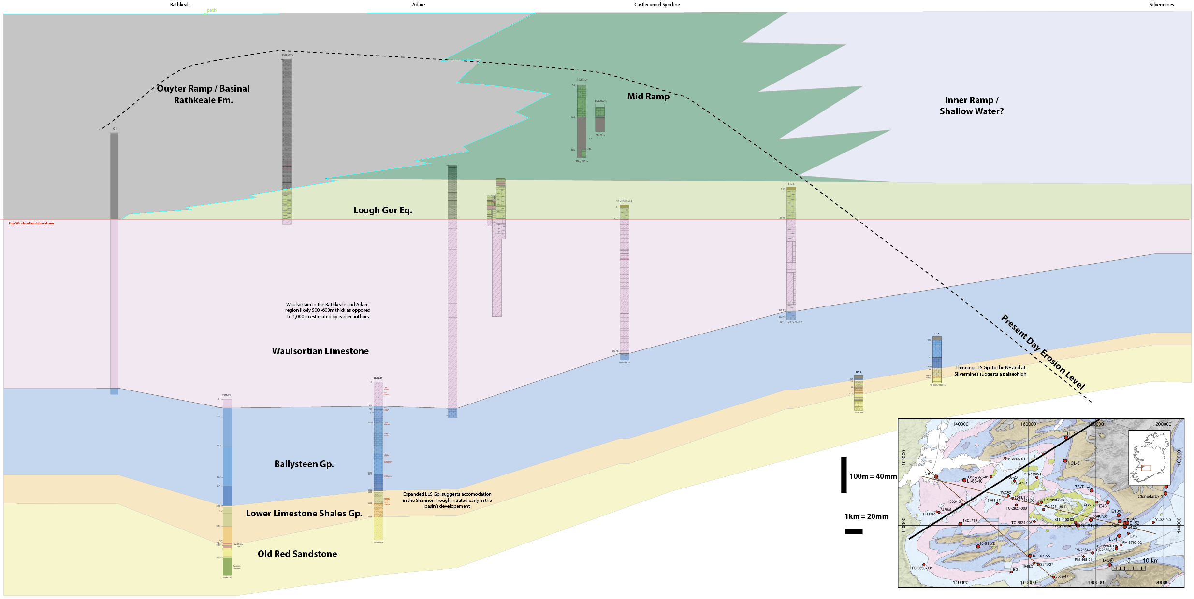
Rathkeale to Silvermines
SW
NE
Flattened to Waulsortian
258 m
Formations thin onto Silvermines High
Expanded Waulsortian section in Rathkeale/Adare
530 m
27 m
107 m
Notes:
One important take away here is that earlier works by Somerville & Strogen suggested the Wauslortian was in excess of 1000 m moving westward.
This was before we had the drill control that we have now.
The estimation was based on extrapolation of a trend and not actual data. Available boreholes suggest a thickness up to 650m in the Kilmallock area (see slide 8)

Slide 6
Blue Book
Summary Sections

Slide 7
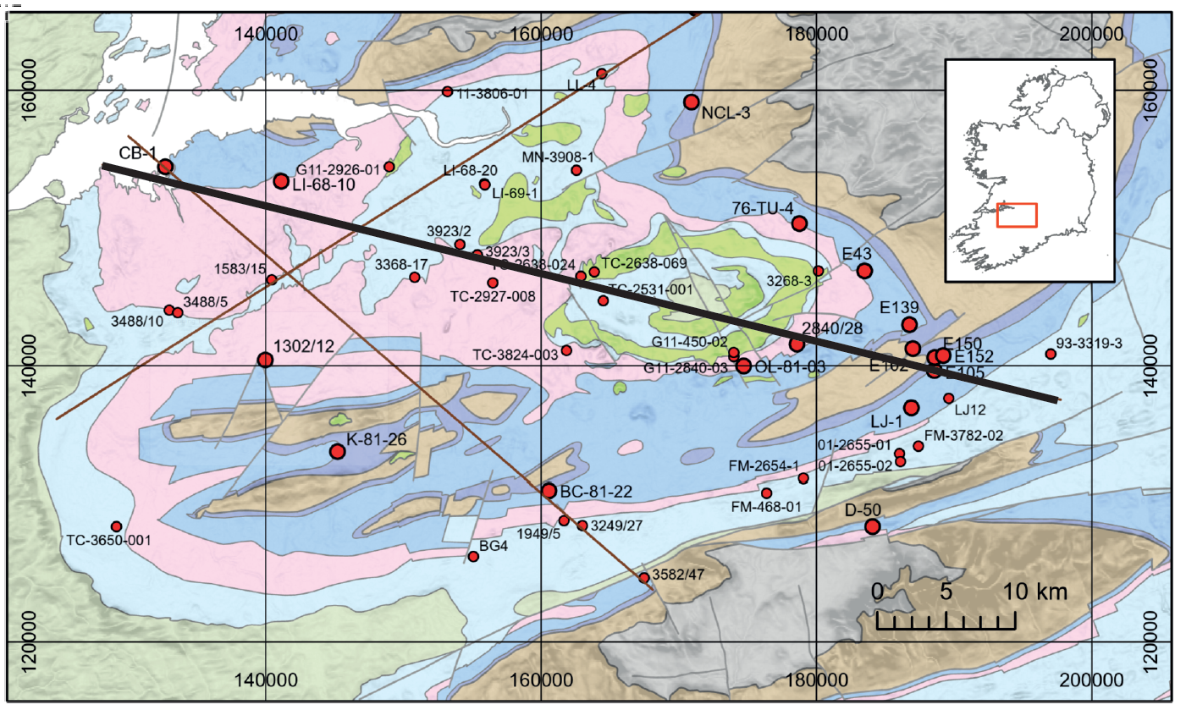
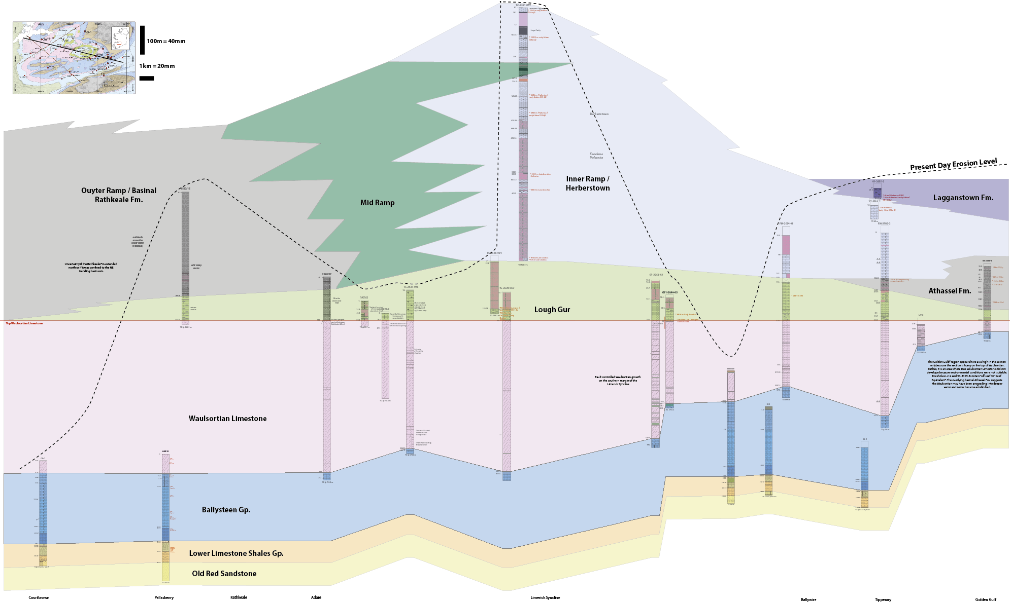
Courtbrown to
the Golden Gulf
NW
SE
Flattened to Waulsortian
240 m
510 m
Growth into the Limerick Syncline
278 m
530 m
Ballywire
Carrickittle
Rathkeale
/ Killeen
Stonepark &
Pallas Green
Courtbrown
Oola
Gortdrum
Golden Gulf
Courtbrown
Rathkeale / Adare
Limerick Syncline

Slide 8
BB Summary Sections
Blue Book
Summary Sections

Slide 9
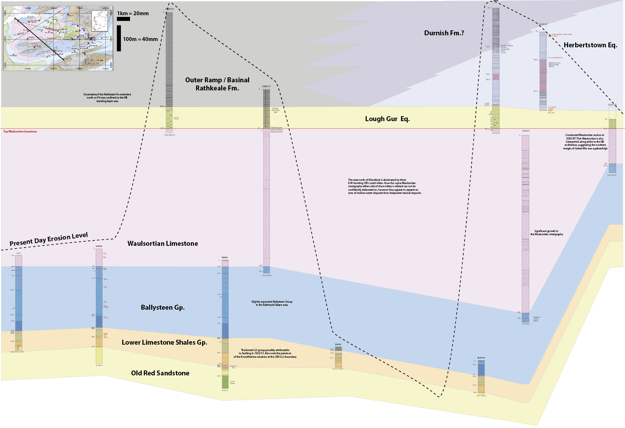
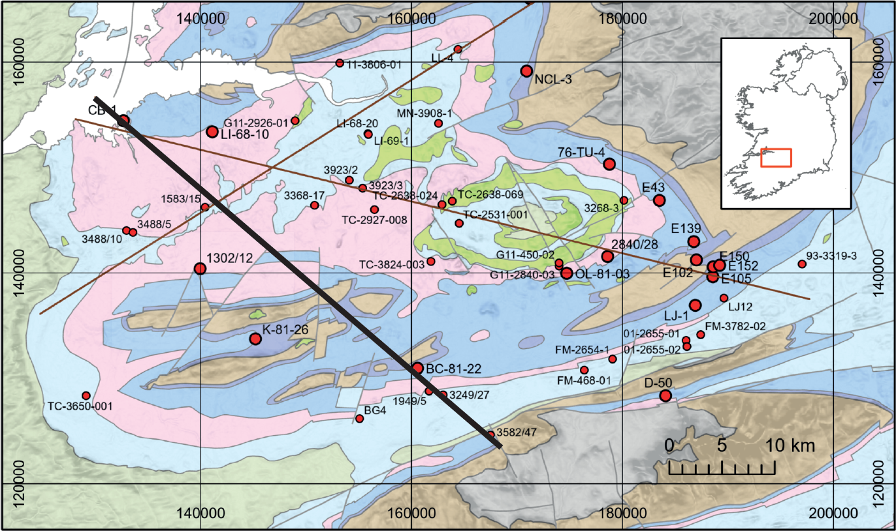
BB Summary Sections
Courtbrown to
Galtee Mountains
SE
NW
Flattened to Waulsortian
135 m
500m growth in Waulsortian
ORS inliers –
No data
530 m
+650 m
Courtbrown
Kilmallock /
Bulgaden

Slide 10
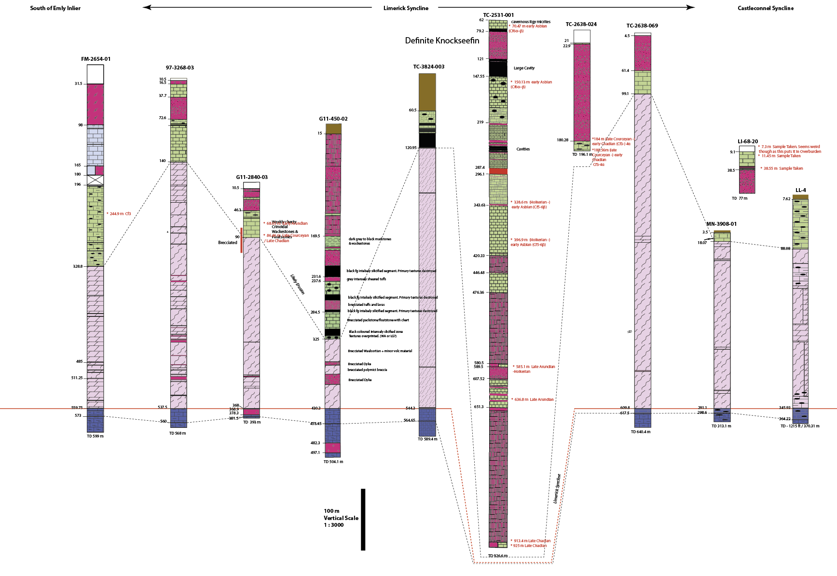
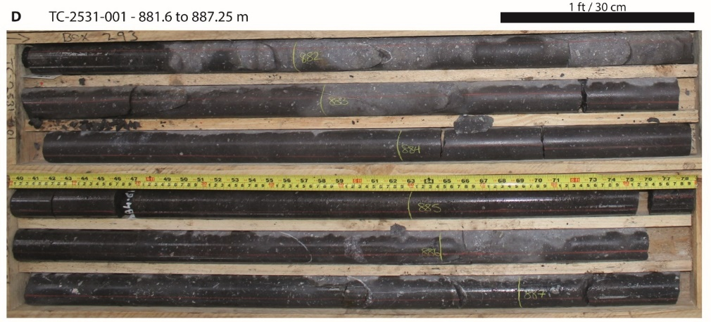
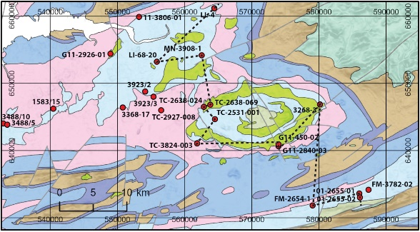
Irish Lower Carboniferous Lithostratigraphy - The Blue Book Project
Main Outcomes
Several regional intraformational lithofacies variations established
Improved biostratigraphic constraints
Thickness distributions helping to define main depocentres and key structures

Slide 11
Reef grows into Syncline
accommodation
Reef dies out
into Golden Gulf
Reef thins onto high @ Ballywire (+ diatreme)
+ 500m Waulsortian growth
Notes:
Ballywire, Aherlow and 3582/47 high possibly the same high?

Slide 12
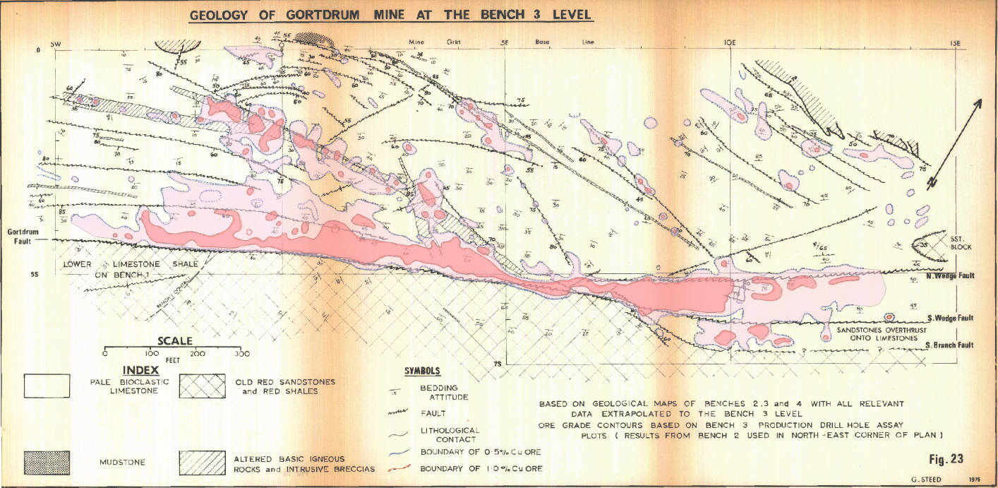
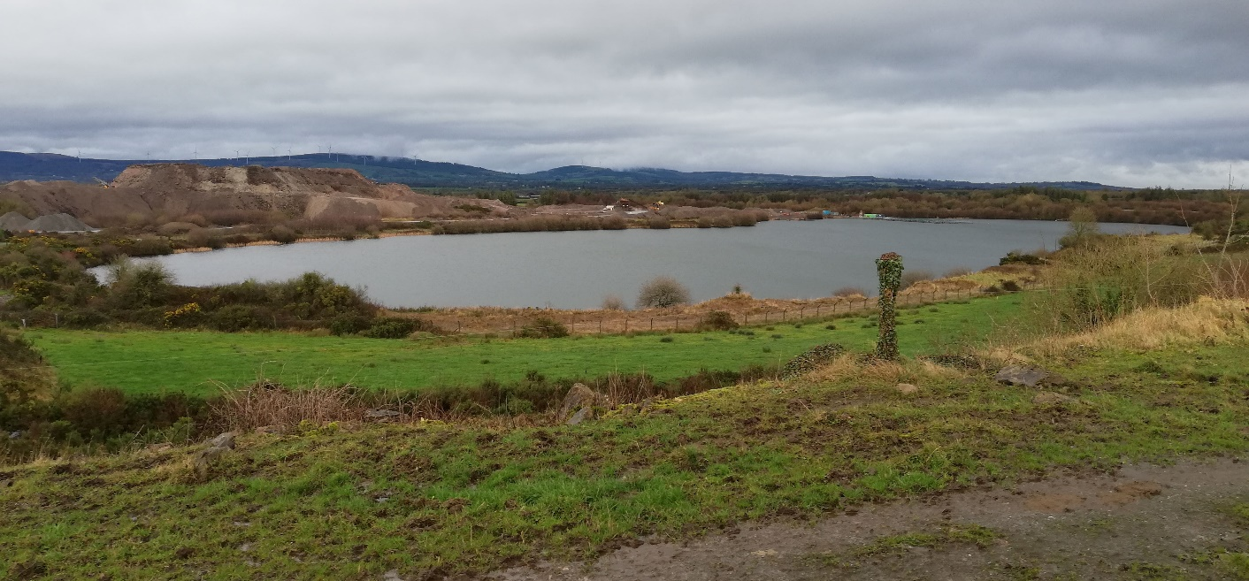
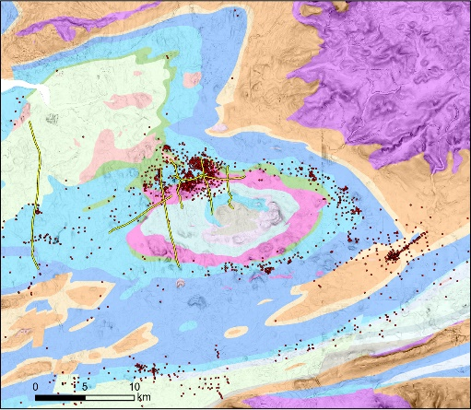
Gortdrum Mine
Steed (1975)
Discovered in 1963 by soils + IP
Operated 1967 - 1975
Copper – Silver Deposit
Ore Reserves of 3.81 Mt @ 1.19% Cu + 25.1 g/t Ag (Steed, 1986)
Hosted in Lower Limestone Shales & Ballymartin Limestone
Ore sits within ~ 100 m of the Gortdrum Fault
Spatial association with intrusions
  Analogies to Stonepark / Pallas Green
1 % Cu
0.5 % Cu
Gortdrum Open Pit
Notes:
The open pit has a fish farm + the tailings pile is earmarked for a 43MW Solar PV developement

Slide 13
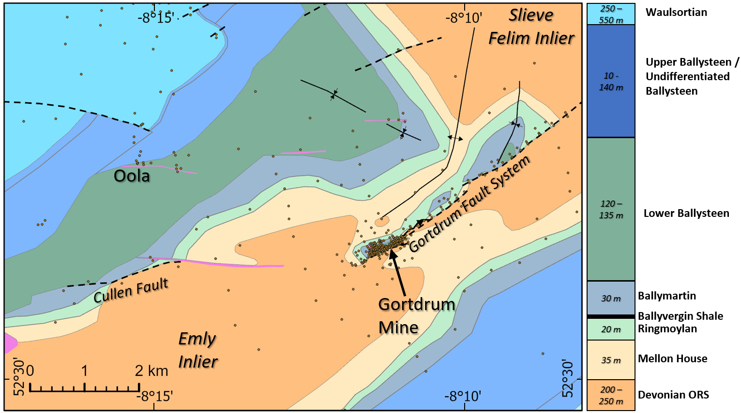


Gortdrum Mine
Approximately 430 drillholes (mine + regional exploration)
Drillholes reinterpreted to conform with modern nomenclature
Structure and Stratigraphy evaluated and interpreted in 3D modelling packages
Notes:
One of the issues with the Limerick region is the poor constraint on faulting (particularly around the Limerick Syncline @ Stonepark & Pallas Green)
The original aim of this study was to better constrain fault system behaviour in a data dense area, to apply lessons learned to data poor areas
Displacement on Gortdrum Fault dies out into the Emly Inlier.
Next structure of similar scale along strike is the Cullen Fault

Slide 14
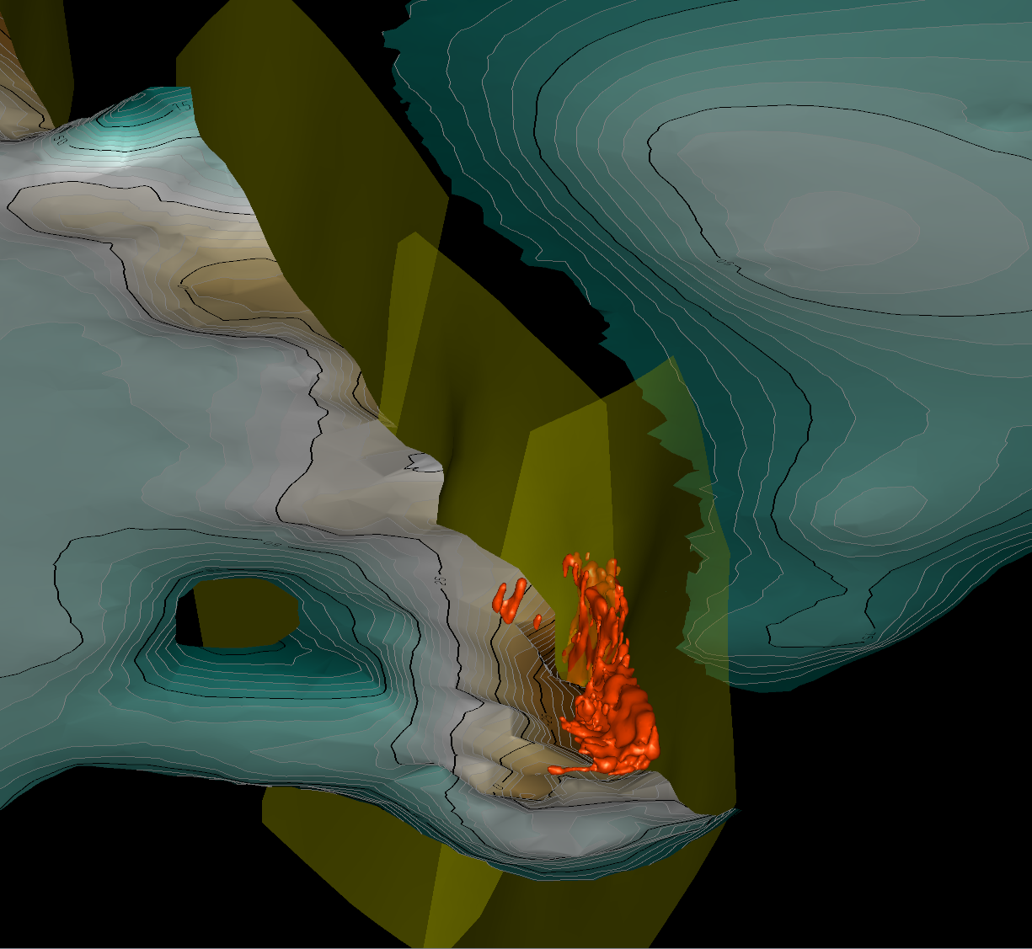
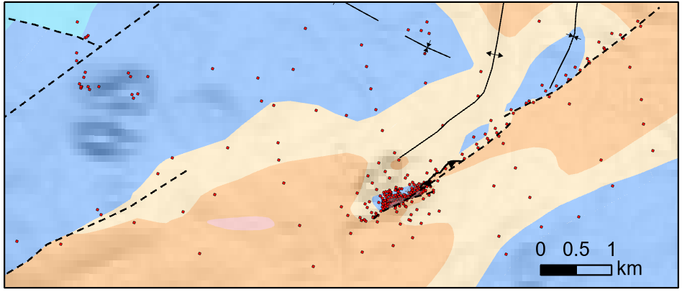
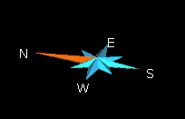

Gortdrum Mine
Reinterpretation of mine + exploration drilling
  Structure + Stratigraphy
Gortdrum Fault system is a segmented system
  Segments 750 – 1 km long with 100 m throw
  Previously mapped as through going structure
Mineralisation sits at the maximum fault throw
Fault Segments
Next Slide
3D View
3D Model of Gortdrum Fault System
Orebody (0.5% Cu)
Elevation at Top ORS
Notes:
Orebody was digitised from open file cross sections (represents 0.5% Cu)

Slide 15
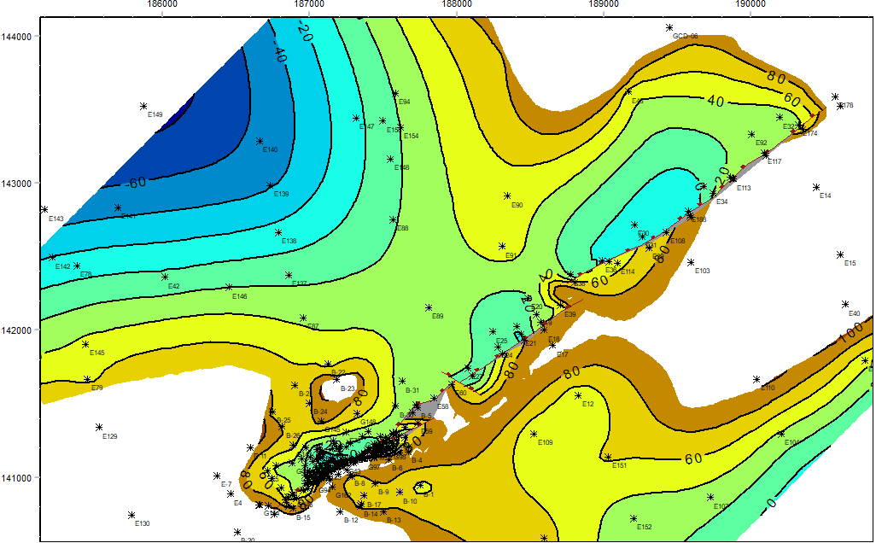
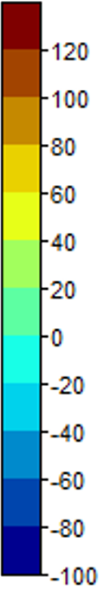
Gortdrum Mine
Base Mixed Beds / Top ORS
Displacement analysis along the Gortdrum Fault system
Offset in top ORS measured on cross sections with drill control
Datapoints every 100 – 200m in mine area
Lower data density in Gortdrum 3 & 4 faults
Fault throws @ Top ORS
Gortdrum 4
Elevation of Top ORS
(m)
Relay Ramp
Gortdrum 3
Possible NW fault between
Gortdrum 2 & 3
Gortdrum Mine
Gortdrum 1 & 2
1km
Notes:
Top ORS isn’t present in FW but was projected (still good control)

Slide 16
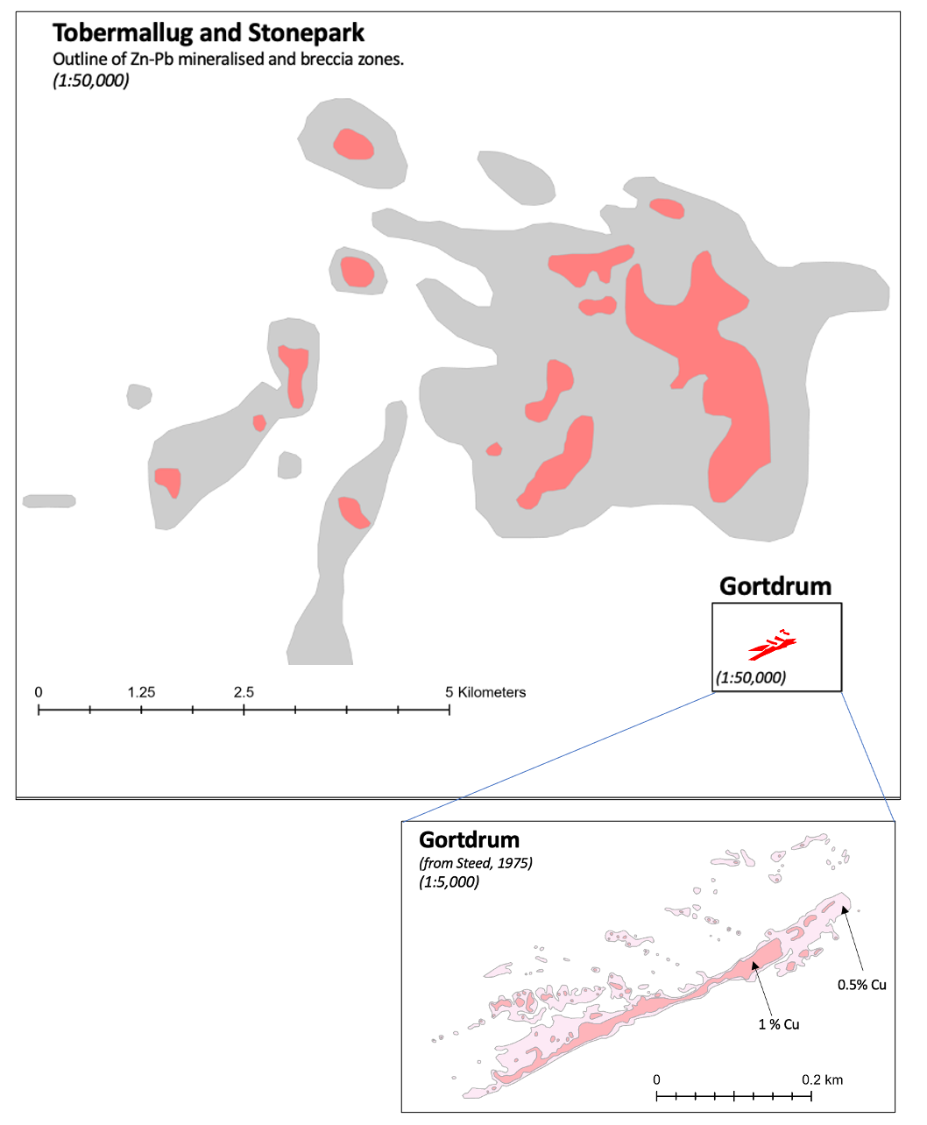
Copper in the Limerick Syncline?
Stacked Cu & Zn/Pb deposit
The question we all want answered (you know who you are)
  Is there another Gortdrum under Stonepark & Tobermallug?
* Radically alters the economics of both deposits *
Two main challenges (and possible solutions)
Fluid Chemistry
  Could the Zn+Pb be the exhaust of a Cu system? Or different system more likely?
Scale & Structure
  Gortdrum is extremely localised against a fault but Stonepark/Tobemallug (currently) has poorly defined structure
    Difficult Targeting
Notes:
I’m not the first person proposing this idea and I won’t be the last!
The difference here is an evaluation of how we can move toward de-risking such a target…

Slide 17
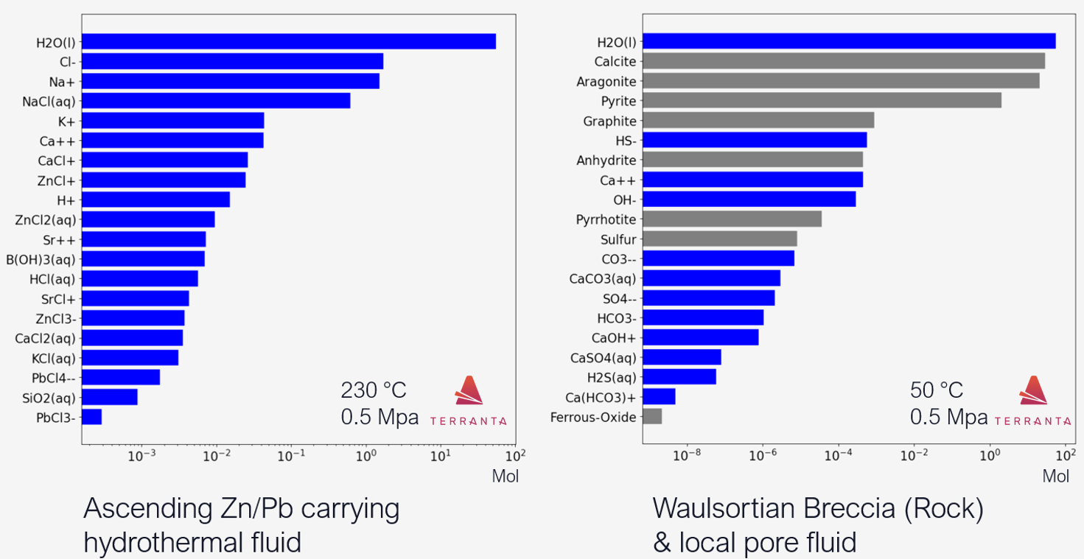
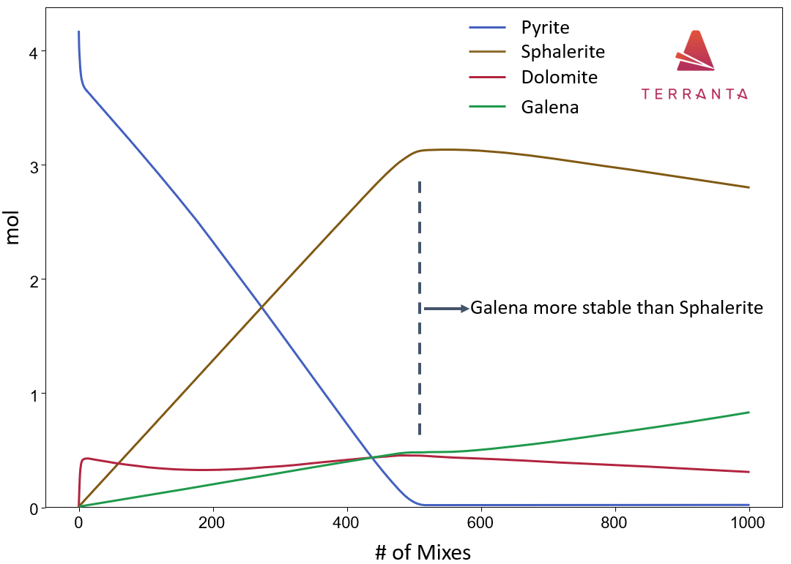
Copper in the Limerick Syncline?
De-Risking Exploration
Fluid Chemistry + Reactive Flow Modelling
    Could the same fluids be responsible for a stacked mineral system? Geochemical modelling could help answer this
    Can sulphur rich fluids penetrate deep enough to provide adequate sulphur for an economic deposit?
    What would happen to a deep Cu deposit if a later Zn + Pb rich fluid passed through later? Redissolve Cu?
Examples of fluid characterisation & mixing from Silvermines
Courtesy of Terranta
Notes:
Better understand the system

Slide 18
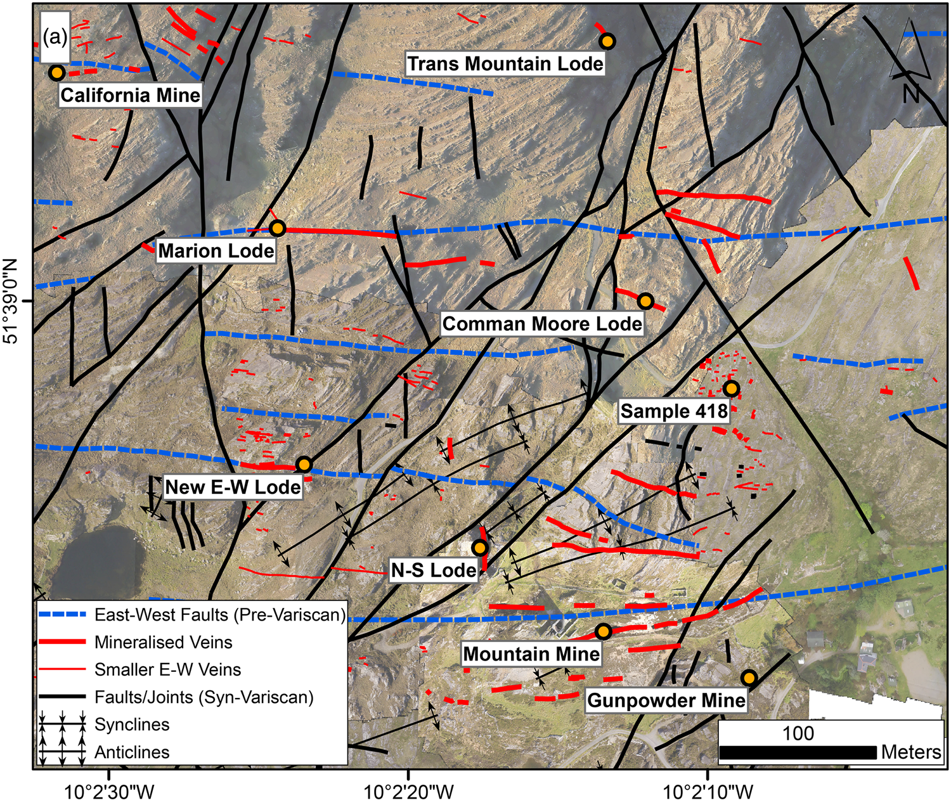
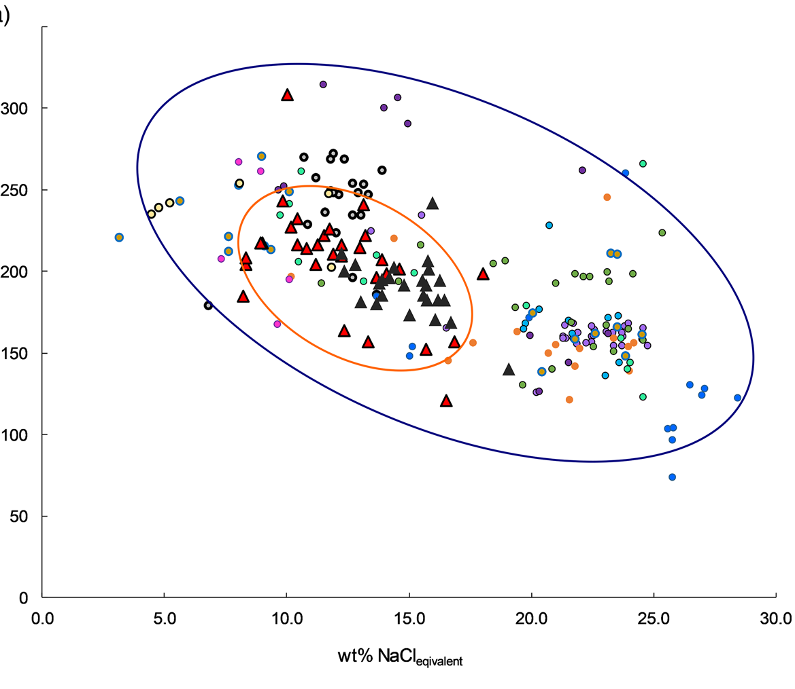
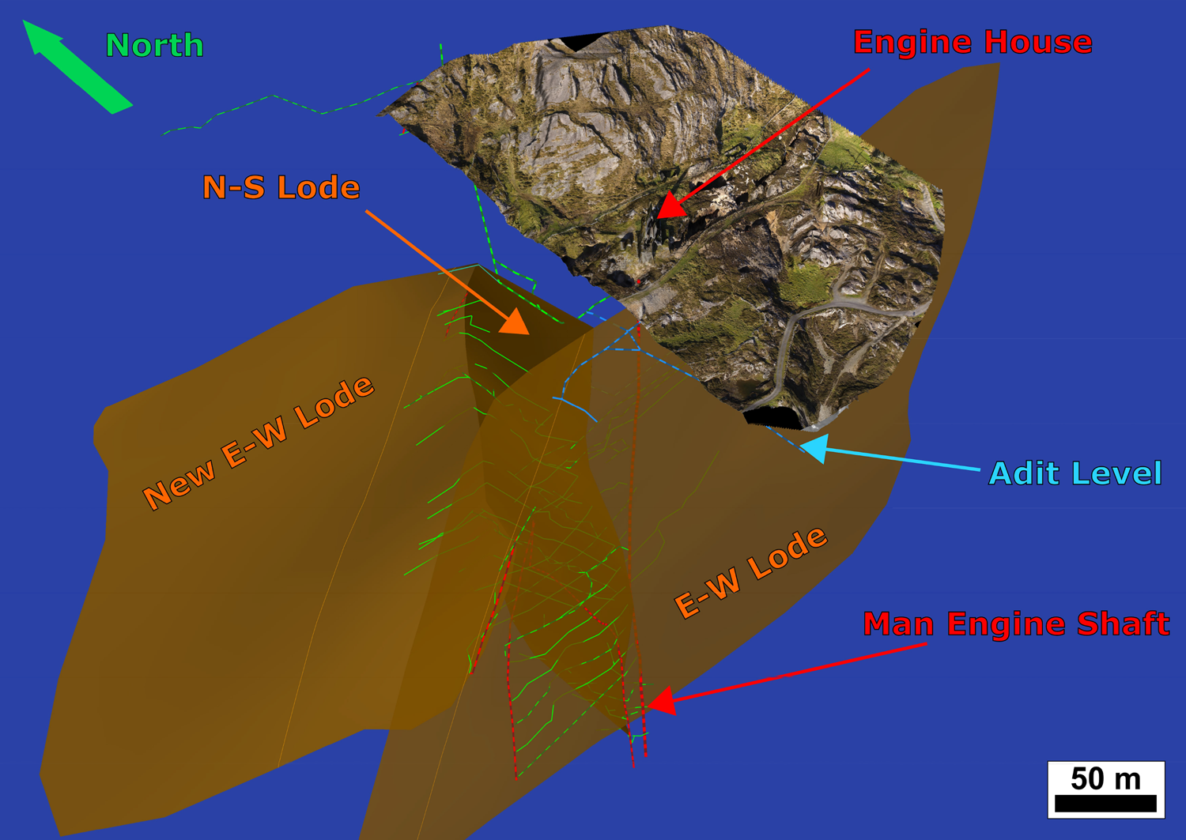
Evidence pre-Variscan copper in normal faults
Allihies area of the Beara Peninsula
Major lodes of the Mountain Mine.
Ore-bearing, east–west-striking quartz veins directly related to early extensional, basinal normal faults.
Molybdenite Re–Os dating of main-stage Cu lode: 367.3 ± 5.5 to 366.4 ± 1.9 Ma.
T_{h} (deg C)
wt% NaCl_{eq}
Lang et al. (2020) J. Geological Society 177(4)
Notes:
Uncertainty including all sources of analytical uncertainty plus decay constant.

Slide 19
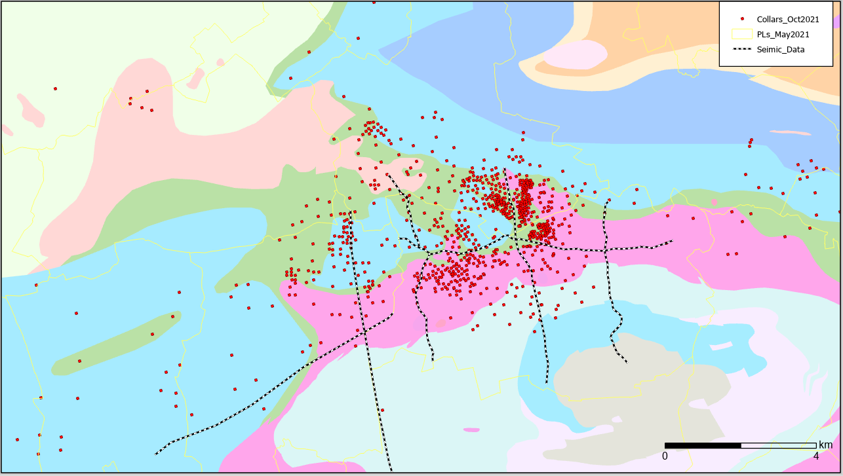
Copper in the Limerick Syncline?
Indicators of underlying structure
Stonepark & Pallas Green have a poorly defined structural model
How do we generate structural targets where structure is poorly defined?
Basic Base of reef model inputs
Base of Reef DH intersections
Base of reef sub-crop boundary
No faults included in model
PL Boundaries
Notes:
Idea was to see any patterns that the BOR contours might suggest
All work done on both sytems has struggled to highlight any significant structures that are typical in Irish Deposits.

Slide 20
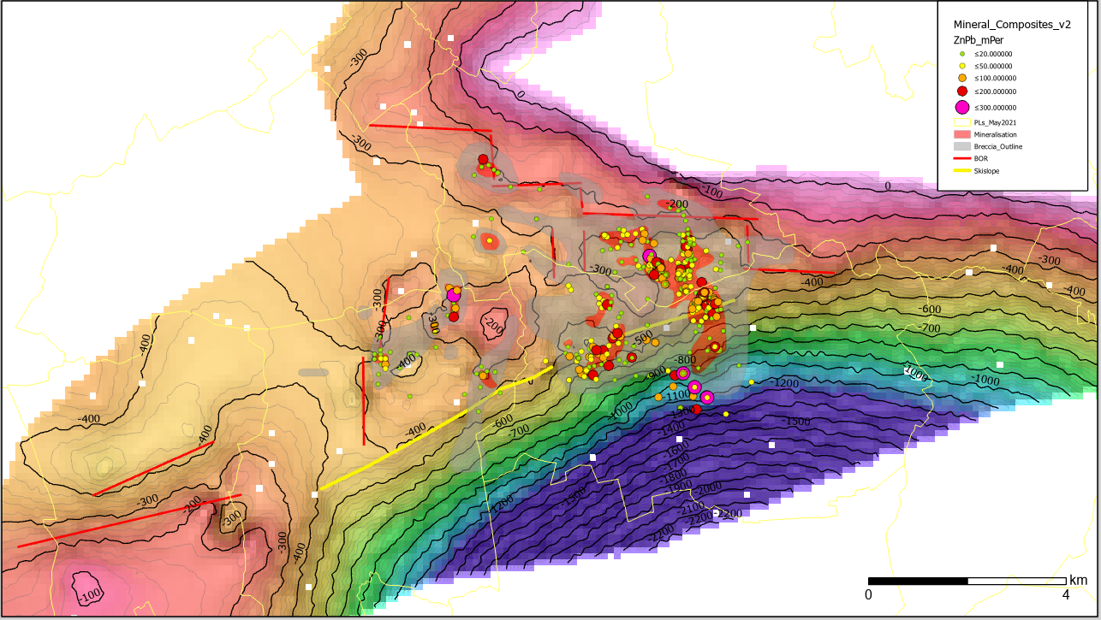
Copper in the Limerick Syncline?
Indicators of underlying structure
Stonepark & Pallas Green have a poorly defined structural model
How do we generate structural targets where structure is poorly defined?
Basic Base of reef model inputs
Base of Reef DH intersections
Base of reef sub-crop boundary
No faults included in model
Main Observations
Subtle right - stepping in base of reef
Large orebody sitting at intersection of ski slope and right stepping lineament
PL Boundaries
Tobermallug
Stonepark
“Ski Slope”
Base of Reef Elevation
Notes:
Dave Blaney will likely show a lot of NW oriented structures but will also probably say that larger structures haven’t been identified.
The main message to convey here is that there is likely some underlying larger structures that could be Cu targets in close proximity to faulting
General Observations
Base of reef has 2 main structural domain –
the gently dipping/flattish area around Stonepark / Tobermalug
The domain dipping steeply to the south (boundary between the 2 domains is the NW trending “ski-slope”)
On the northern margin of the map, are a series of apparent right stepping closely spaced contours, remeniscient of a right stepping normal fault system
Highest mineralisation sits close to where these two lineaments intersect.
There is undoubtedly also a NW – SE pattern to the mineralisation at Tobermallug too.
I suggest the best mineralisation is where it is because of the intersection of these NW lineament with an underlying NE-SW structural grain creating fluid permeability pathways

Slide 21
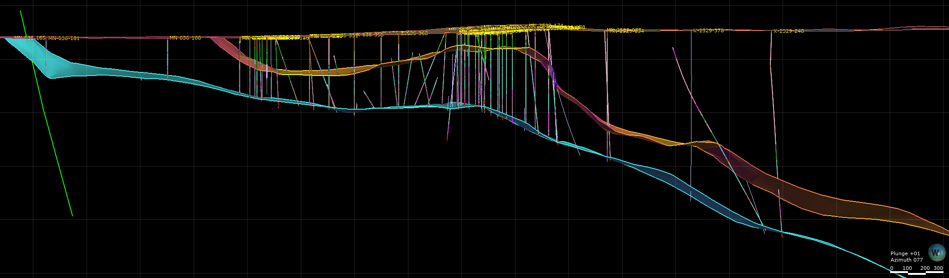
Copper in the Limerick Syncline
What could a target look like?
Blue book synthesis suggests ±350 m from Base of Reef to top ORS
Copper Targets starting from ~650 m drillhole length
  Glencore are already drilling +1400 m DHs
N
Topography
S
0m
Reef thinned by explosive volcanism (Pyroclastic Infill)
-300 m
Cu
650 – 700 m Target
-600 m
Cu
900 - 1000m
Target
Top of Reef
-900 m
300m
Faults expressed as subtle rollovers in Base of Waulsortian
Projected Top ORS
Base of reef
-1200 m
300m
Notes:
These structures are very hypothetical, but I wanted to get them thinking about how a target could look…
Do the diatremes help pick out structural lineaments? Could they help us site a drillhole targeting a fault bounded Cu deposit?
I think the hinge point of the ski slope would be an ideal target… Even if the fault is antithetic to a larger fault downdip, it has big potential for fracture enhanced permeability.
They’re already drilling deeper than 1400 m down the ski slope so why not invest and test the bigger money prize?

Slide 22
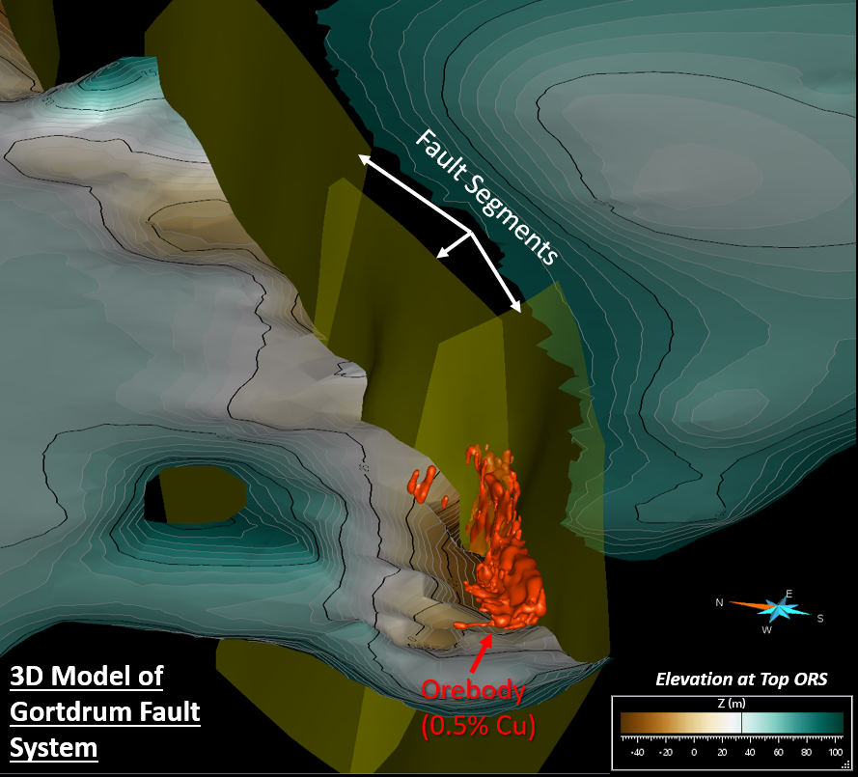
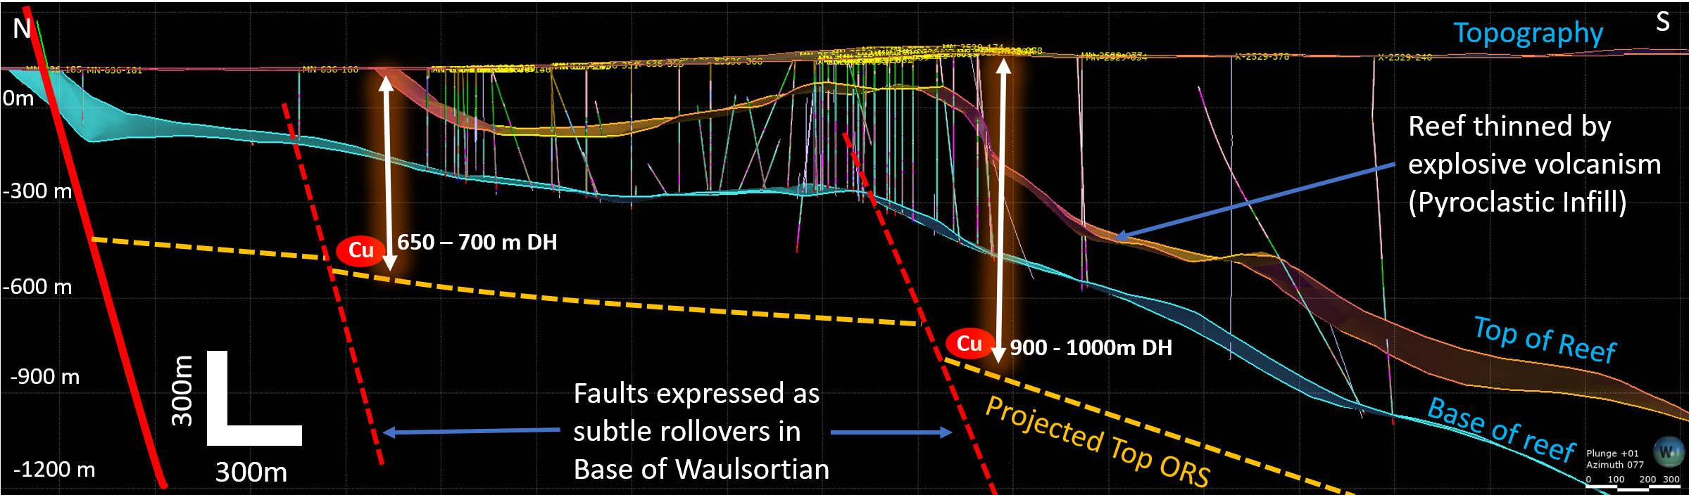
Conclusions
Blue book synthesis highlights main growth centres and lithological variation in the lower Carboniferous stratigraphy
Gortdrum was likely a segmented normal fault system
Copper Targets starting from
~650 m below surface in the
Limerick Syncline

Slide 23








Acknowledgments
With support from:
This presentation has emanated from research supported in part by a research grant from Science Foundation Ireland (SFI) under Grant Number 16/RP/3849 & 13/RC/2092_P2.
The authors would like to thank the Geological Survey Ireland (GSI), Geoscience Regulation Office (GSRO) of the Department of the Environment, Climate and Communications (DECC), Ireland, for providing access to released well, seismic and potential field datasets.
All rights reserved on the content, images and data within this presentation.
Academic Software licences

