Slide 1
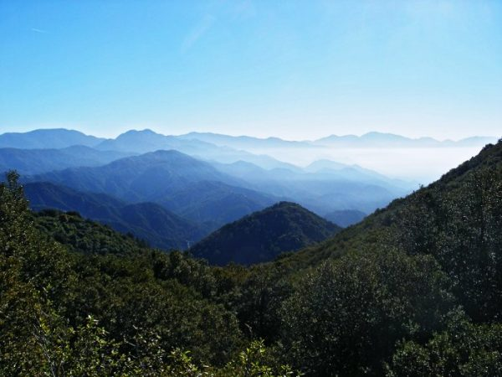
Dolomite hosted Zinc-Lead deposits of Zawar, Aravalli Supergroup, Udaipur district, Rajasthan, India
SHUBHABRATA MUKHOPADHYAY

Slide 2
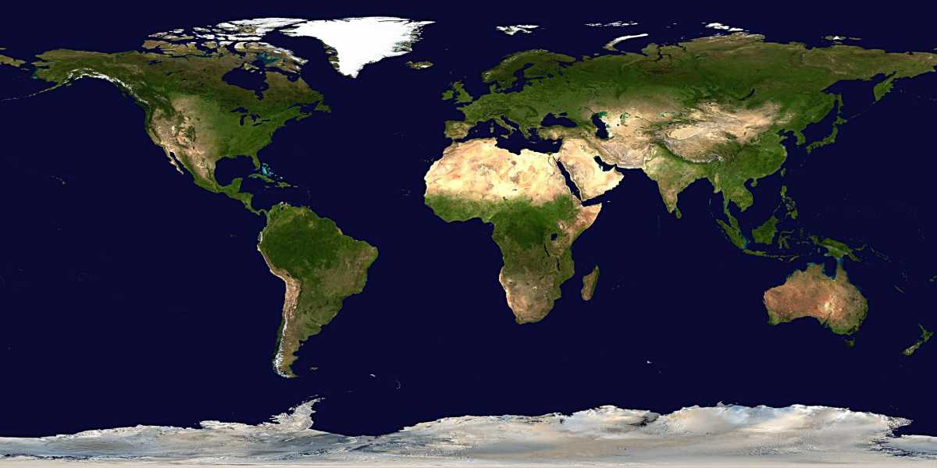
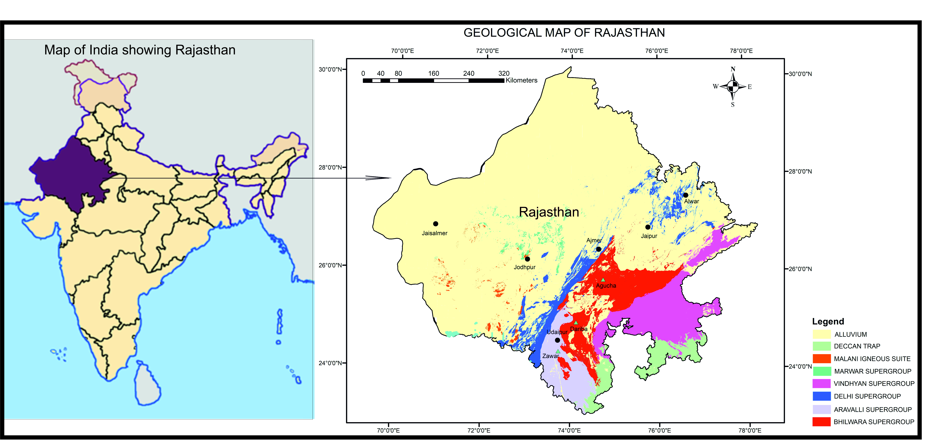
LOCATION
Rajasthan is the largest state of India
Republic of Ireland is 0.21 times as big as Rajasthan
ZAWAR
The Zawar Zinc-Lead Belt (ZZB), within the Aravalli Supergroup of rocks, is located about 35 km south of Udaipur, Rajasthan

Slide 3
SALIENT FEATURES OF ZAWAR ZINC LEAD BELT (ZZB)
LOCATED IN THE ARAVALLI MONTAIN RANGE
ZAWAR ZINC LEAD BELT IS AROUND 20 KM LONG
ONE OF THE GEOLOGICALLY OLDEST SEDIMENT HOSTED ZINC LEAD DEPOSITS OF THE WORLD
PRESERVE REMNANTS OF MINING BASED CIVILISATION OF 2500 YEARS OLD
OLDEST SMELTING CITES OF THE WORLD FOR ZINC
FOUR WORKING MINES IN ZZB: RESOURCES OF ABOUT 141 MT OF ORE WITH GRADES RANGING FROM 1.71 % TO 4.51 % FOR ZINC AND 2.14 % TO 5.63% FOR LEAD

Slide 4
GENERALISED GEOLOGICAL MAP OF PARTS OF RAJASTHAN
The Aravalli Delhi Fold Belt is a major mobile belt in the north-western part of India.
It is comprised of a gneissic Archean basement, the Banded Gneissic Complex (BGC), with meta-volcano-sedimentary rocks and intrusive granites of Proterozoic age.
The Palaeo to Mesoproterozoic Aravalli Supergroup metasedimentary rocks unconformably overly the BGC.
The Aravalli Supergroup is overlain by sedimentary rocks of the Meso to Neoproterozoic Delhi Supergroup

Slide 5
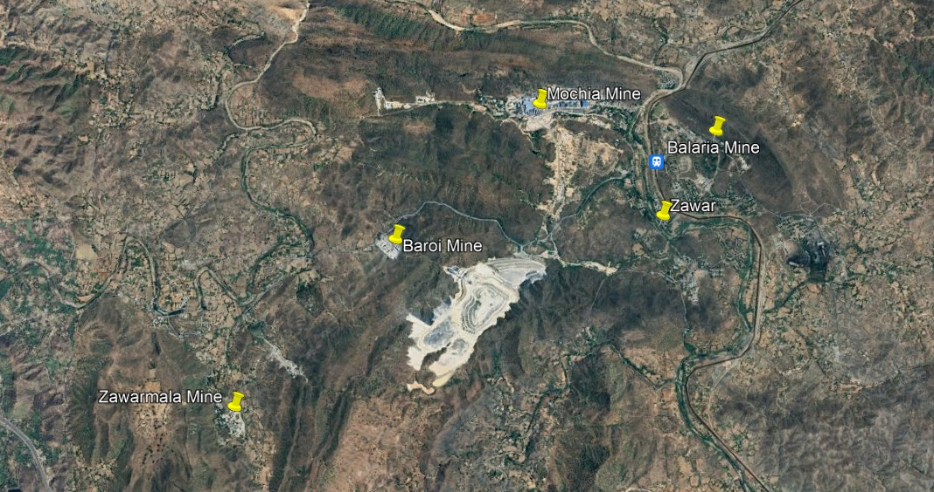
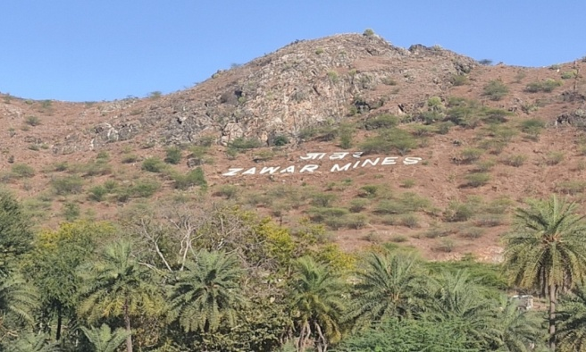
LOCATION OF FOUR MINES OF ZZB, RAJASTHAN
N
3 km

Slide 6
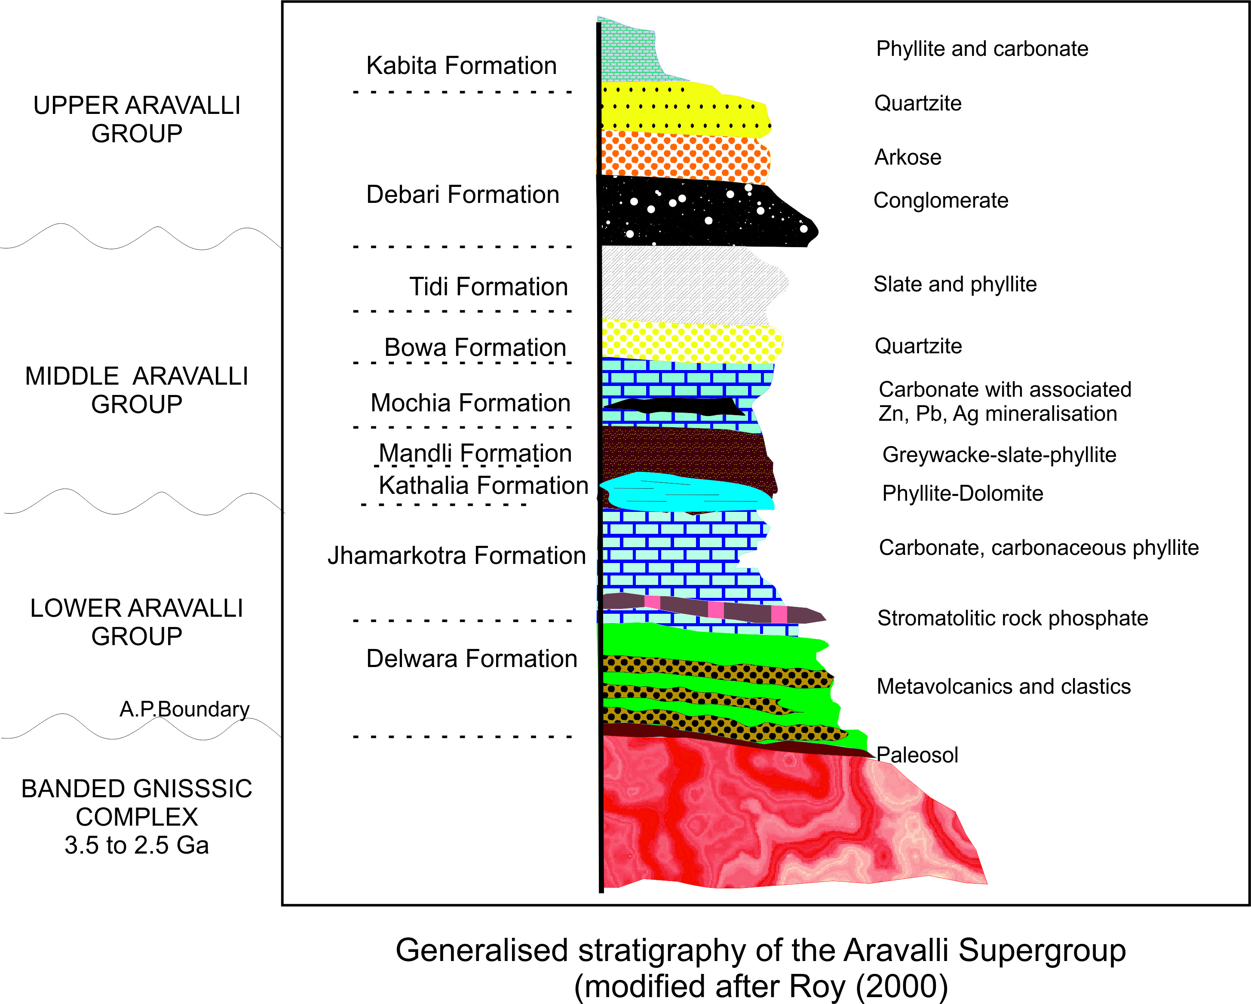
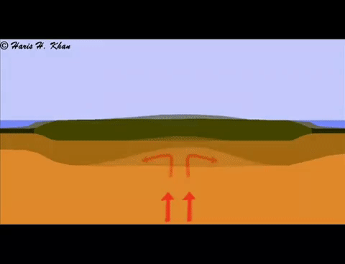
RIFTING AROUND 2300 MA: SEDIMENTARY BASIN FORMATION
Aravalli Rift Stage ~2300 Ma
NW
SE
Development of intra continental rift basin and deposition of huge thickness of sediments.
Three-fold classification (Lower, Middle and Upper Groups) has been proposed for the Aravalli Supergroup.
Meta-sedimentary rocks of the 2.5 km thick Middle Aravalli Group host the Zawar Zn–Pb deposits.
(2326±321Ma)

Slide 7
FOUR SEDIMENTARY FACIES ASSEMBLAGES IN ZZB
Facies assemblage-I : Represented by a siliciclastic–carbonate facies association
(Kathalia Form.)
Facies assemblage-II: Carbonate-free siliciclastic facies, mudstone–greywacke–conglomerate association (Mandli Form.)
Facies assemblage-III: Siliciclastic–carbonate facies association, host Zn-Pb ores
(Mochia Form.)
Facies assemblage-IV: Thick siliciclastic, quartz-pebble conglomerate–sandstone association
(Bowa Form.)
The sedimentary succession records development of multiple tectonism-induced sedimentary cycles
Such frequent change is expected in basins that remain tectonically hyperactive during sedimentation and frequent changes in depositional environment

Slide 8
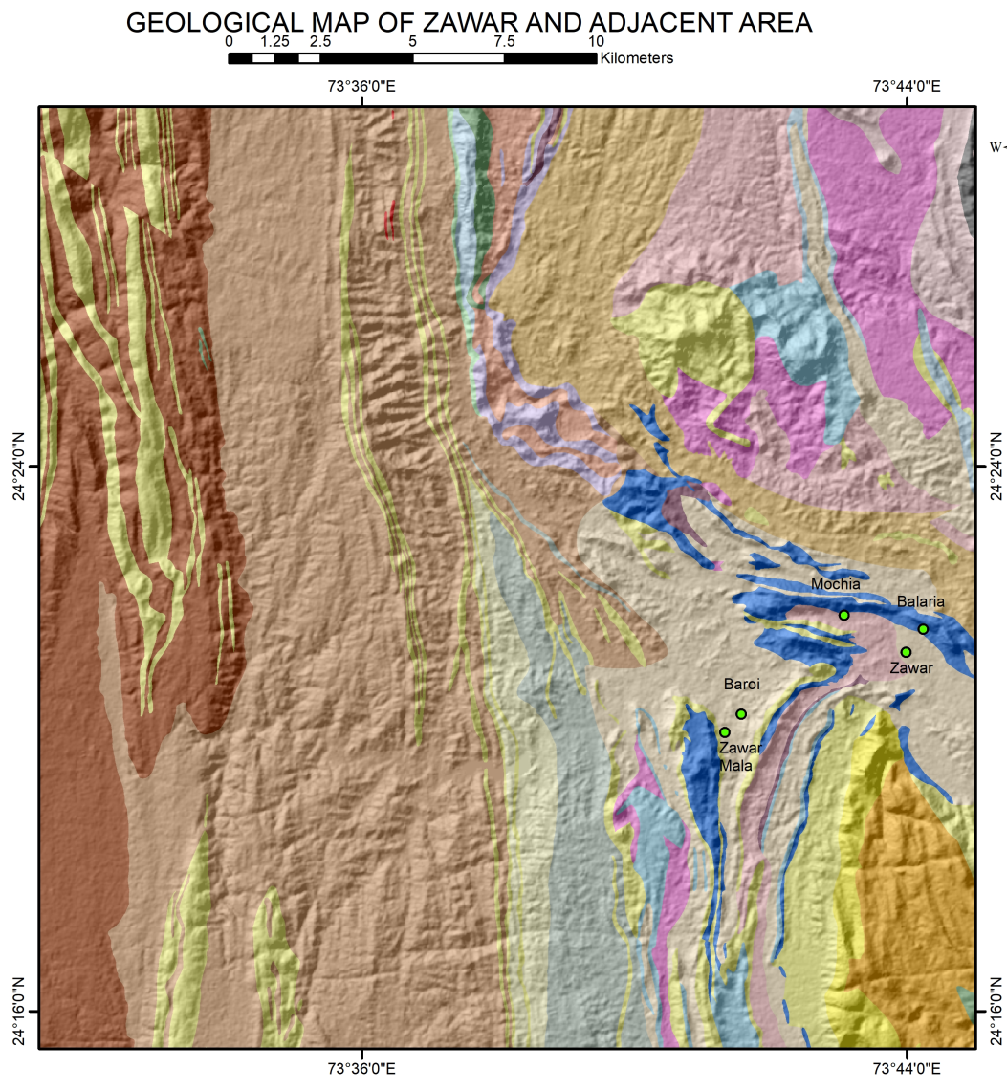
REGIONAL GEOLOGICAL MAP AROUND ZZB
Dominant lithologies: phyllite, schist, greywacke and dolomite

Slide 9
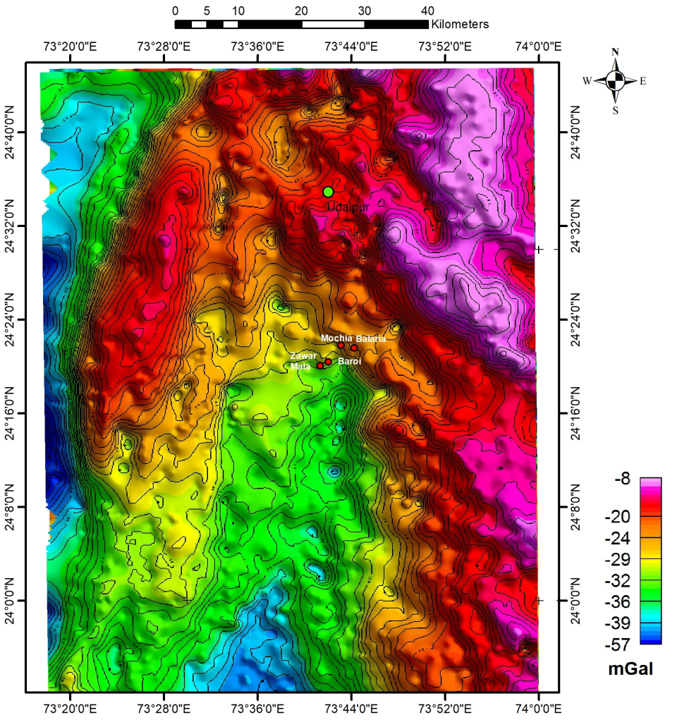
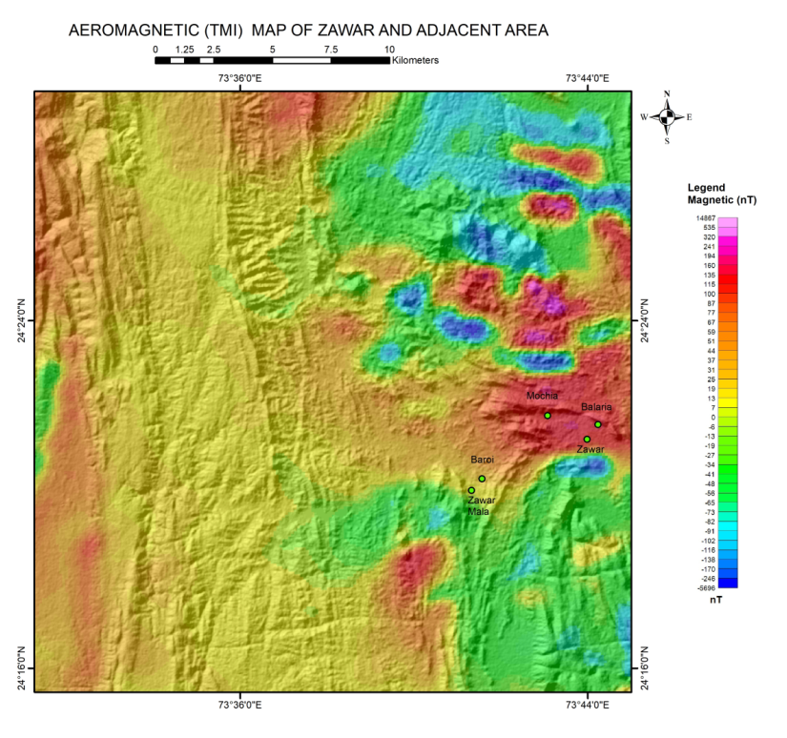
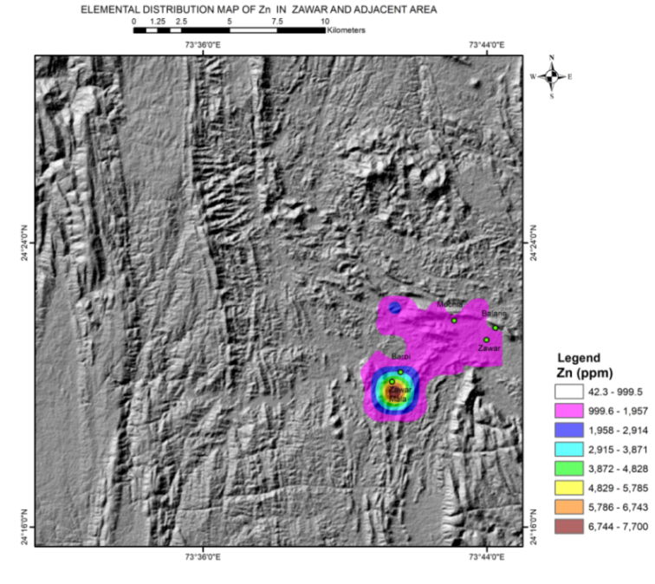
REGIONAL GEOPHYSICAL AND GEOCHEMICAL CHARACTERS
Medium to moderately high aeromagnetic zone
GRAVITY
ZZB is located at moderate gravity
Geochemical
signature
of Zn
around ZZB
NW-SE trending gravity gradient zones in the vicinity of Zawar mines
Zawarmala mine reveal several residual gravity highs probably due to presence of high-density Pb-Zn ore

Slide 10
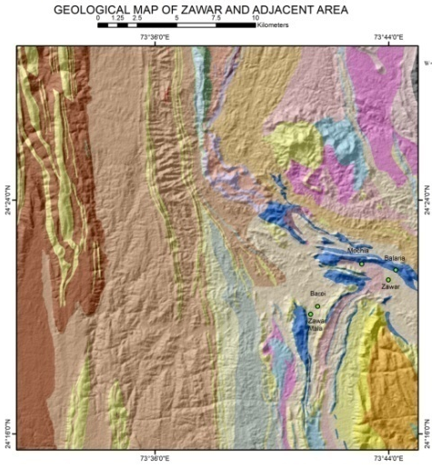
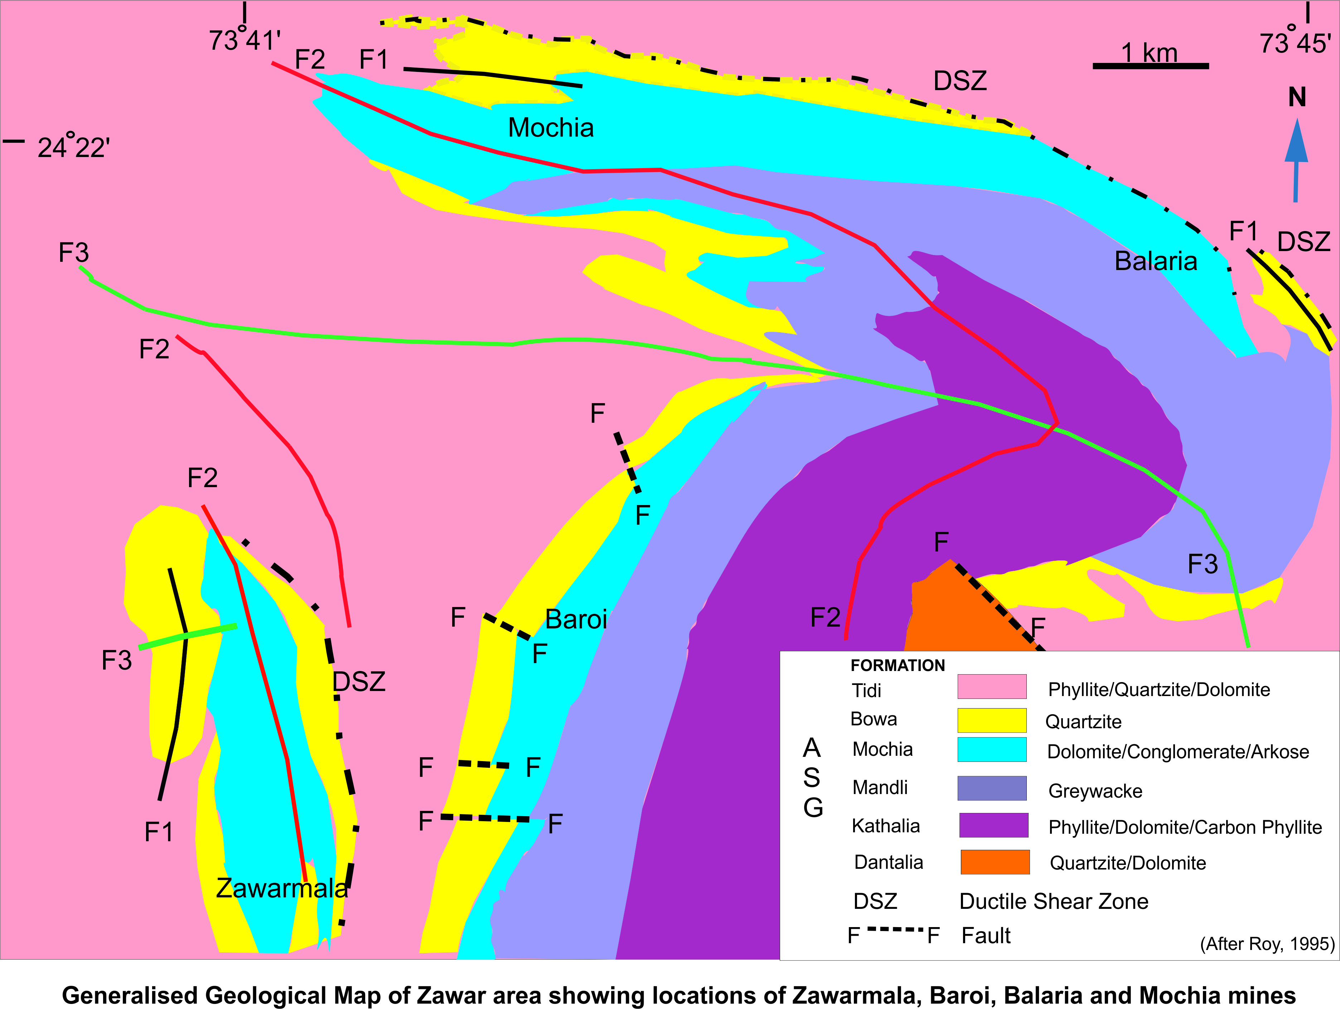
GENERALISED GEOLOGICAL MAP OF ZZB
65
50
50
Main Zawar Fold
(Superimposition of F3 on F2)
52
Zawarmala antiform

Slide 11
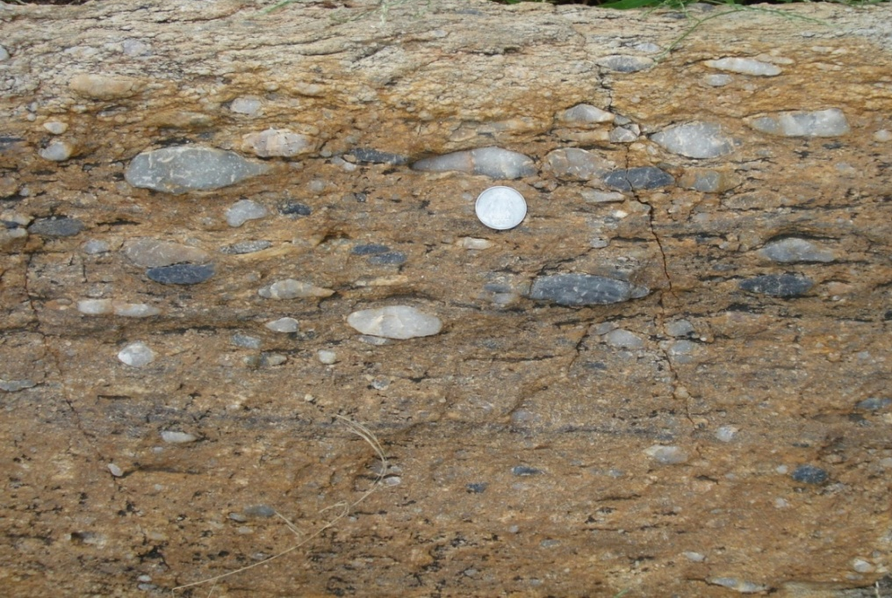
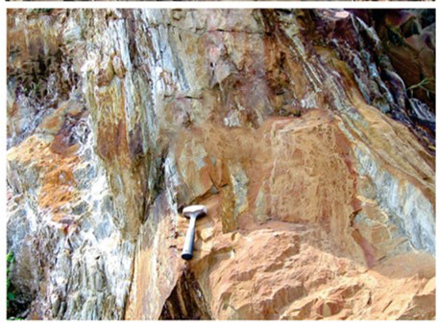
MOCHIA FORMATION
Host Zn-Pb mineralisation
Clast supported conglomerate at the base of
the Mochia Formation
Metamorphosed carbonaceous mudstone and layered sulphides of Fe, Zn and Pb, constitute 60cm to 7m thick units
Sulphide interbeds are <1mm to 2 cm thick
Thicker pyrite layers and comparatively thinner sphalerite layers with galena at places
This variety of thinly bedded stratified ore best exposed in Balaria mine section, resembles SEDEX-type
Massive siliceous dolomite

Slide 12
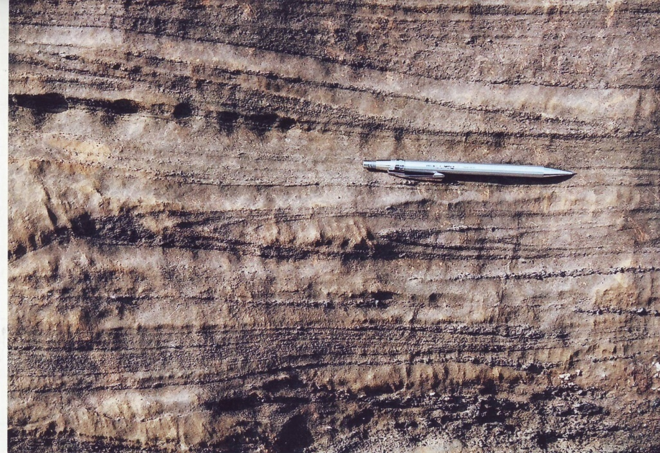
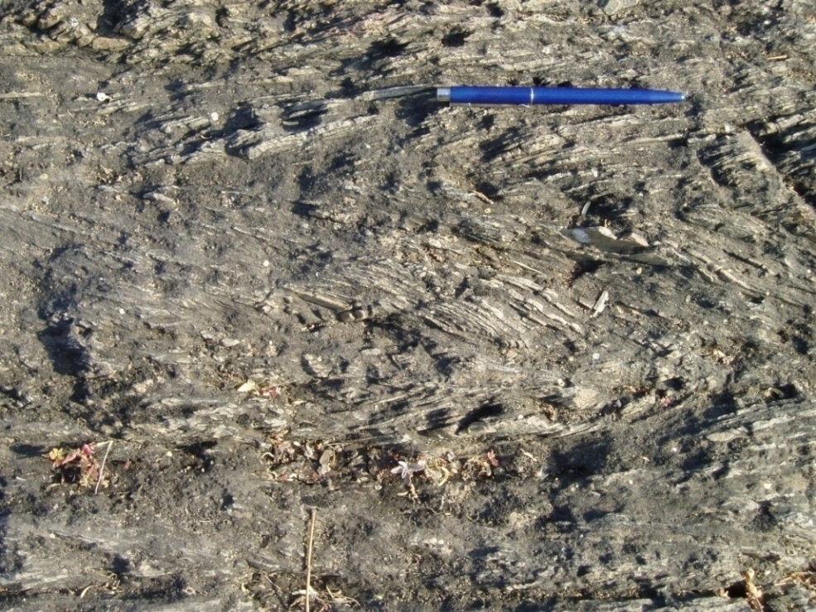
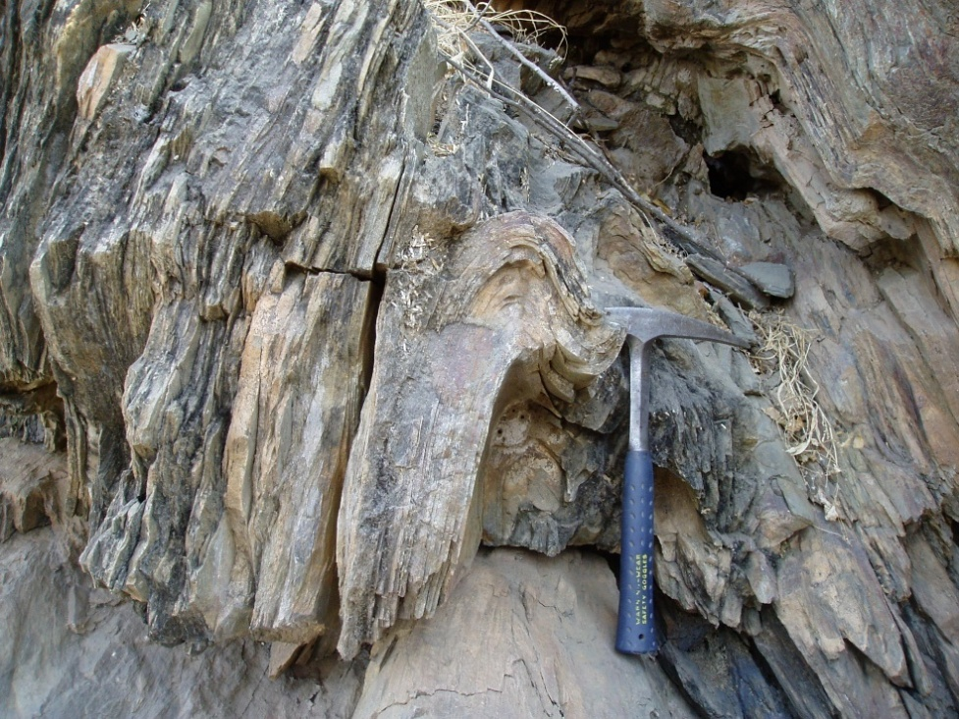
STRUCTURE
FOUR PHASES OF DEFORMATION
First and second deformations
Isoclinal to tight F1 fold
F2 folds in Mochia
Second Deformation (F2)
Mesoscopic to megascopic folds
Tight to close, upright folds with steep axial plane
Moderately plunging folds with variable plunge amount
Most dominant and control the disposition of outcrop pattern

Slide 13
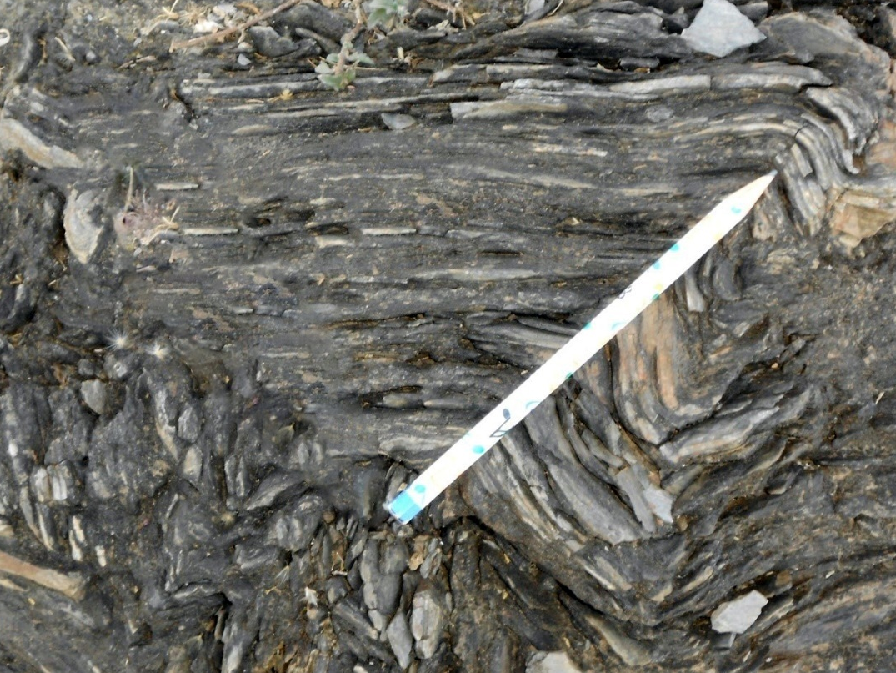
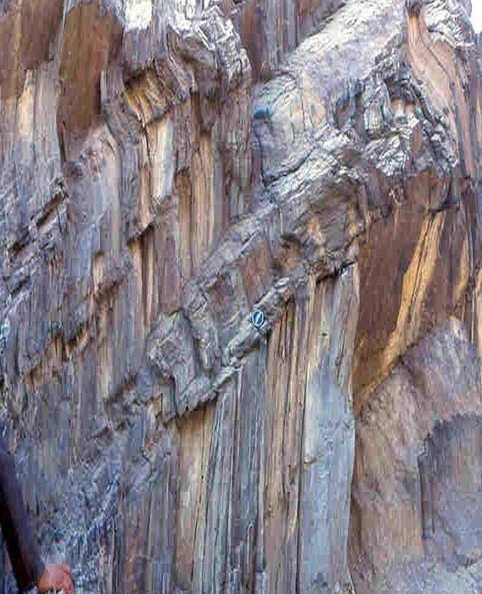
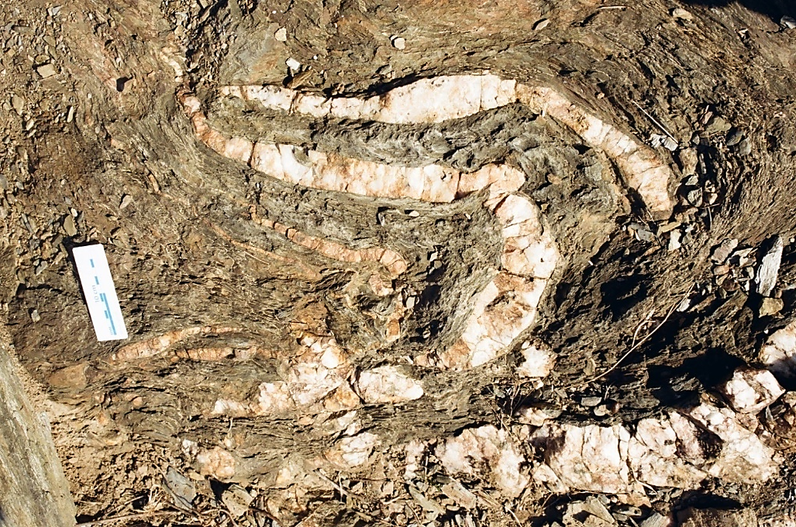
Third and fourth deformations
Third deformation (F3)
Fourth deformation (F4)
Folds with sub horizontal axial plane
Open broad warps, chevron folds, kink and box folds
Axial plane of these folds have high angle with F2 folds
Type III interference
E-W trending faults are prominent at places which are parallel to the axial plane of F3 folds

Slide 14
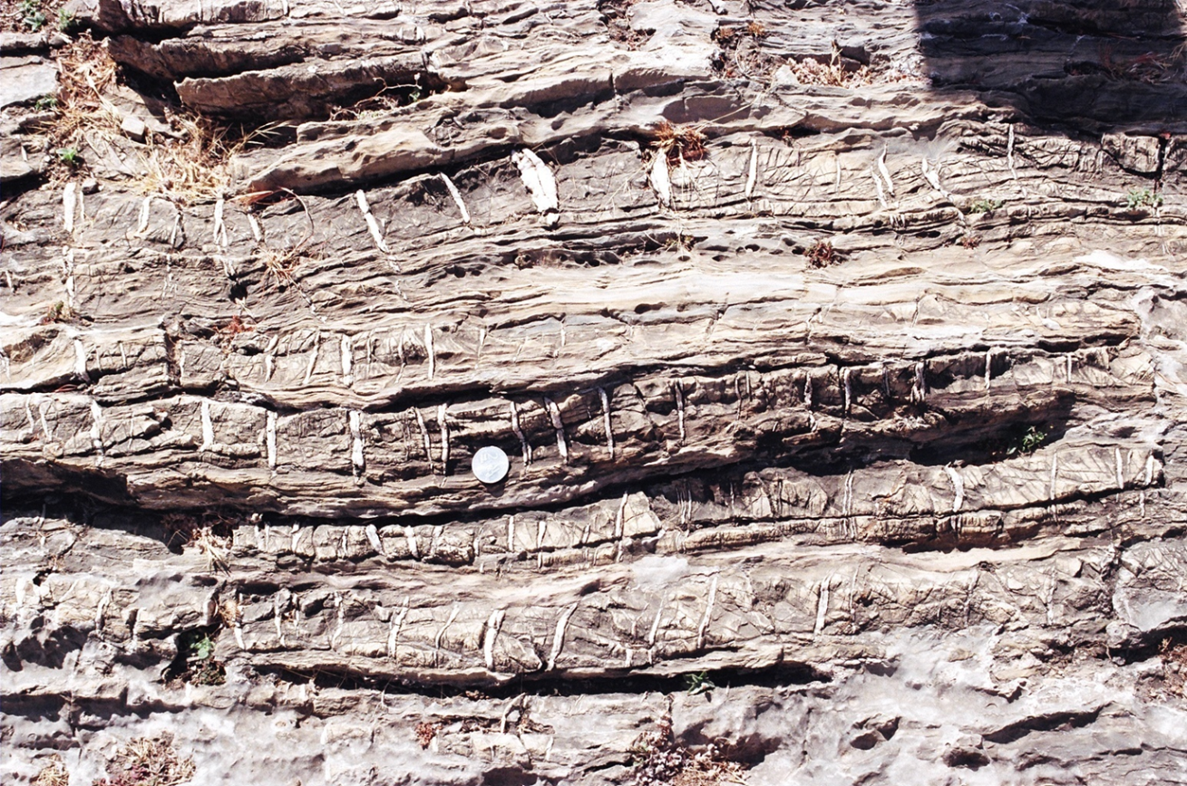
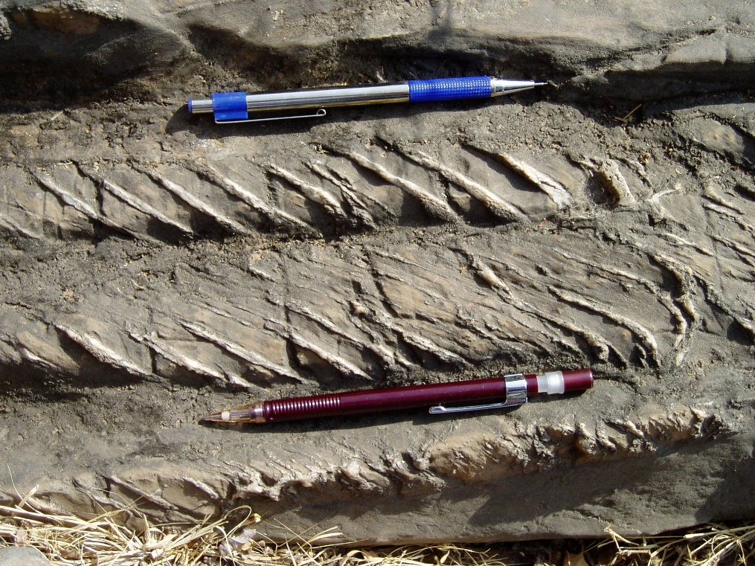
Ductile Shear Zones (DSZ)
Ductile Shear Zones (DSZ) are developed, mostly along the basin marginal faults, during D1 & D2. Movement along these DSZs is more prominent during second deformation with strong strike slip component.
An arcuate DSZ is marked on the northern boundary of Mochia-Balaria hill.
Flattening and stretching of quartz grains, development of strong anatomizing foliations in quartzite,
S-C fabric, rotation of quartz veins developed along extensional cracks are evidences of DSZ.
Quartz veins forming ladder structure
Tension gashes

Slide 15
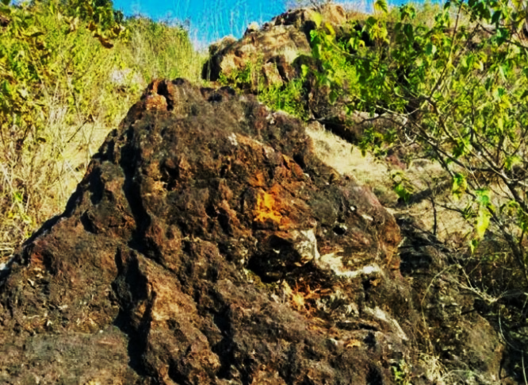
ZINC - LEAD MINERALIZATION
ORE MINERALS : Sphalerite and galena, pyrrhotite and pyrite with minor arsenopyrite, native silver, and chalcopyrite.
HOST ROCK: Dolomite and the ore lenses usually terminate at the contact with the phyllite.
Brownish white to grey dolomites, medium to coarse grained, massive, at places gritty often form long strike ridges at Mochia, Zawarmala and Baroi.
There are also interbands of dolomitic phyllite and phyllitic dolomite.
Dolomite often locally grades in to quartzose or feldspathic dolomite, but all dolomite bands are not mineralized
All Zawar ore is indicated to be “clean” and easy to liberate with minimal level of metal impurities or other contaminants
Partly gossanised oxidation zone Zawarmala Hill
CORE FROM BALARIA MINE

Slide 16
THREE TYPES OF MINERALISATION
S1 parallel banded pyrite and sphalerite and discordant massive galena-sphalerite ore in siliceous dolomite
Vein-type/patchy sphalerite-pyrite ore in siliceous dolomite
Bhuyan & Hazarika, 2022
Composition of sulphide phases from different mines
 | SPHALERITE |  |  |  | GALENA
Element % | 1 | 2 | 3 | 4 | 1 | 2 | 3 | 4 | 5
S | 32.723 | 31.833 | 32.374 | 32.217 | 13.306 | 12.059 | 13.54 | 13.708 | 13.484
Zn | 57.157 | 58.625 | 58.617 | 60.399 | 2.434 | 0 | 0 | 0 | 0
Pb | 0.044 | 0.191 | 0.092 | 0.215 | 84.001 | 88.642 | 84.998 | 86.52 | 85.889
Fe | 7.12 | 6.866 | 7.316 | 5.33 | 0.18 | 0 | 0.329 | 0.014 | 0
Cd | 0.187 | 0.16 | 0.241 | 0.283 | - | - | - | - | -
Ag | - | - | - | - | 0.012 | 0 | 0 | 0.055 | 0
Co | - | - | - | - | 0.014 | 0 | 0.053 | 0.022 | 0.079
Total | 97.231 | 97.675 | 98.64 | 98.444 | 99.947 | 100.701 | 98.92 | 100.319 | 99.452
Cadmium is reported to occur with sphalerite
Silver occurs predominantly with galena
Bhuyan & Hazarika, 2022

Slide 17
TYPE-I
(Photomicrograph)
Banded Py-I and Sph-I occurring along S1 schistosity are associated with euhedral K-feldspar
Syngenetic to diagenetic | Pyrite -I | Fine grained, subhedral to anhedral, occur within banded layers of Sphalerite-I, parallel to S1 schistosity | Mo is highest, Zn, Cu, Ga, Ag, Pb, Sb, Tl contents are lowest | Sphalerite-I | Fine grained, occur as banded layers, parallel to S1 schistosity | Cd, Co highest, Zn, Cu, Ga, Ag, Pb, Sb, Tl, Hg , In contents are low
Bhuyan & Hazarika, 2022

Slide 18
TYPE-II
(Photomicrograph)
Coarse grained Py-II and Sph-II represents discordant vein type sphalerite-pyrite ore
Py-II preserves 120 interfacial angles in a Sph-II matrix
Metamorphic recrystalization, syn D2, Temp. 395 to 290°C, pressure ~ 1,450 bars, pH 5.5 | Pyrite –II, occur in vein type | Coarse grained, subhedral to euhedral, occur as polycyrstalline aggregates | Cu, Tl, Mn, Ga, As are highest | Sphalerite-II | Coarse grained, anhedral to subhedral, occur as polycyrstalline aggregates | Mn, Hg, As, Ga contents are highest | Low-salinity (4.3–14.7 wt % NaCl equiv) H₂O-NaCl fluids
Bhuyan & Hazarika, 2022

Slide 19
TYPE-III
(Photomicrograph)
Coarse grained sphalerite-III contains fine grained Py-III and represents massive galena sphalerite ore
Late stage of D2, Temp. 250 to 150° C, pressure 2,000 to 750 bars, pH 4.25 to 4.3 | Pyrite –III, occur in massive type | Fine to medium grained, anhedral to subhedral | Zn, Pb, Ag, Sb, Co and Ni contents are highest | Sphalerite-III | Coarse grained, anhedral to subhedral, occurs in massive galena-sphalerite ores | Pb, Ag, Sb, In and Ni contents are highest | Lower salinity (about 3–4 wt % NaCl equiv). H₂O-CO₂- NaCl fluids
Bhuyan & Hazarika, 2022

Slide 20
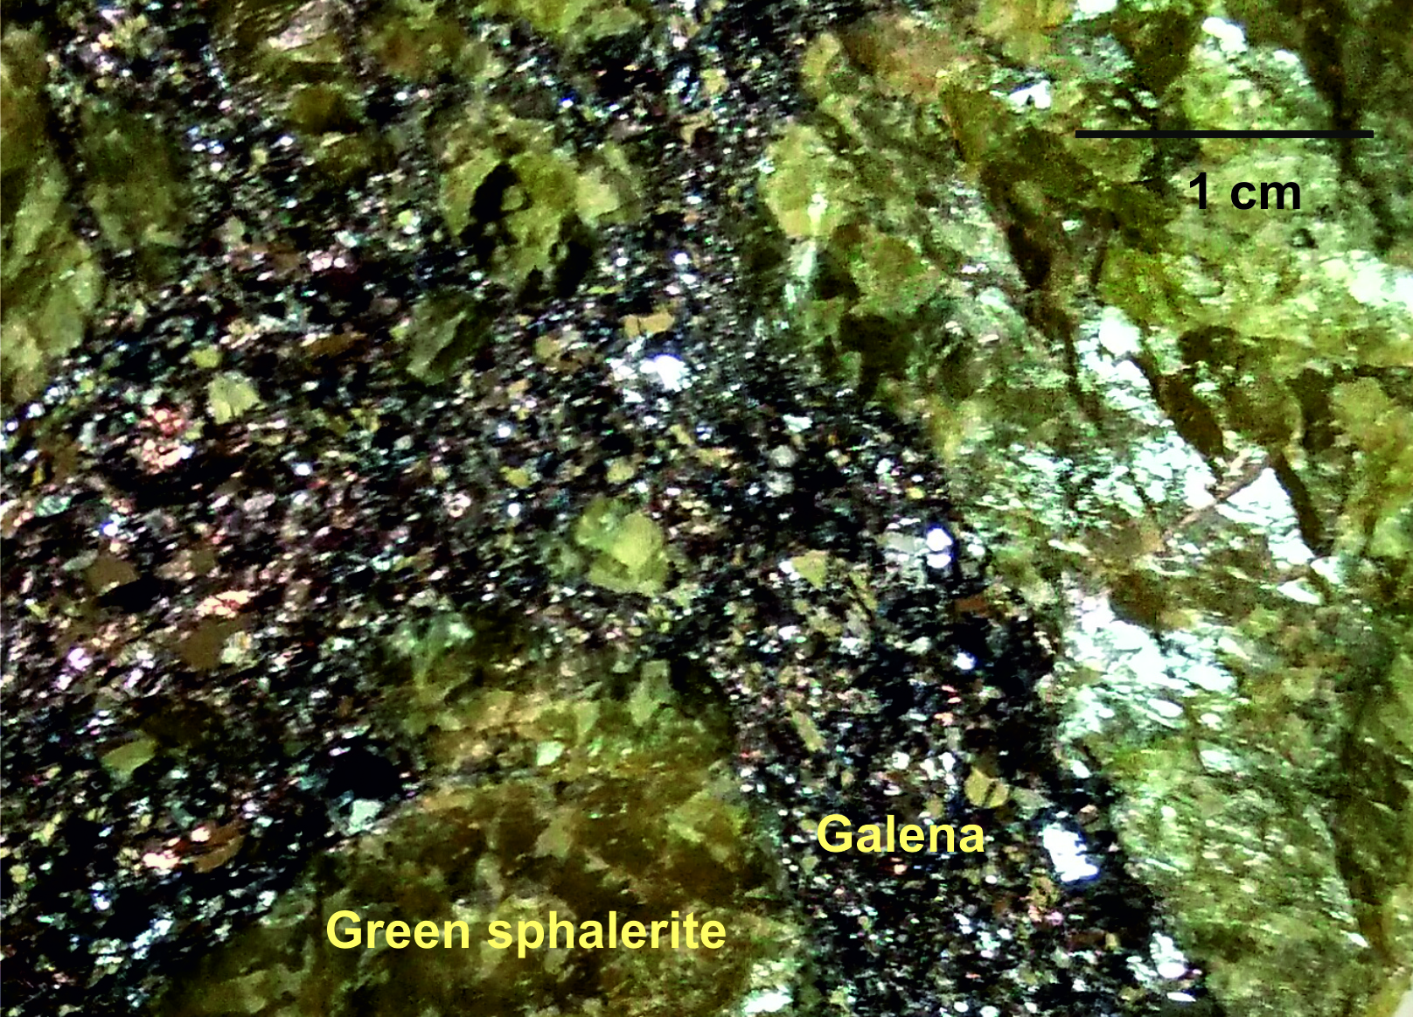
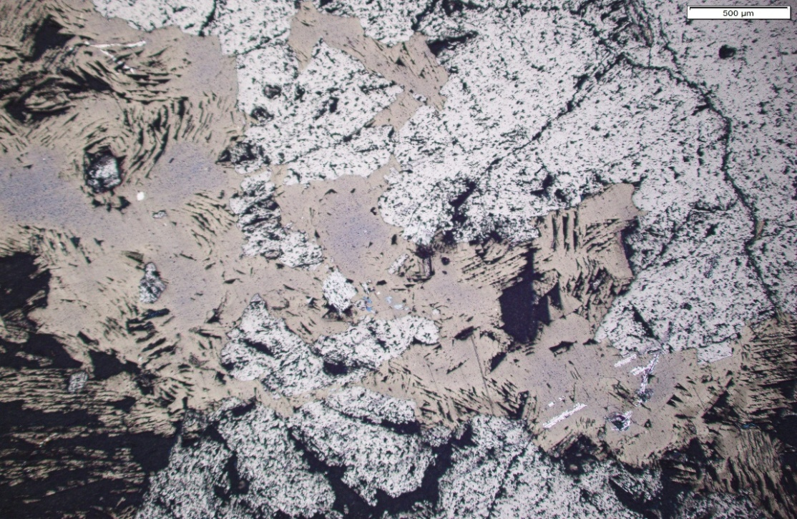
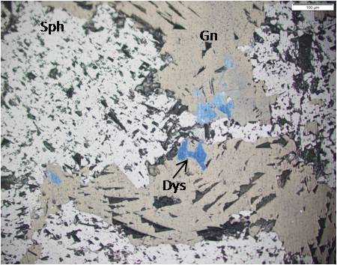
GREEN SPHALERITE
Sph
Gn
Hand specimen of green sphalerite and galena from Zawarmala mine.
The green colour of sphalerite is due to presence of trace amount of Co and Fe .
Photomicrograph of green sphalerite and galena (Reflected light)
Photomicrograph showing sphalerite, galena and dyscrasite (Ag₃Sb)
Mukhopadhyay et al. 2019

Slide 21
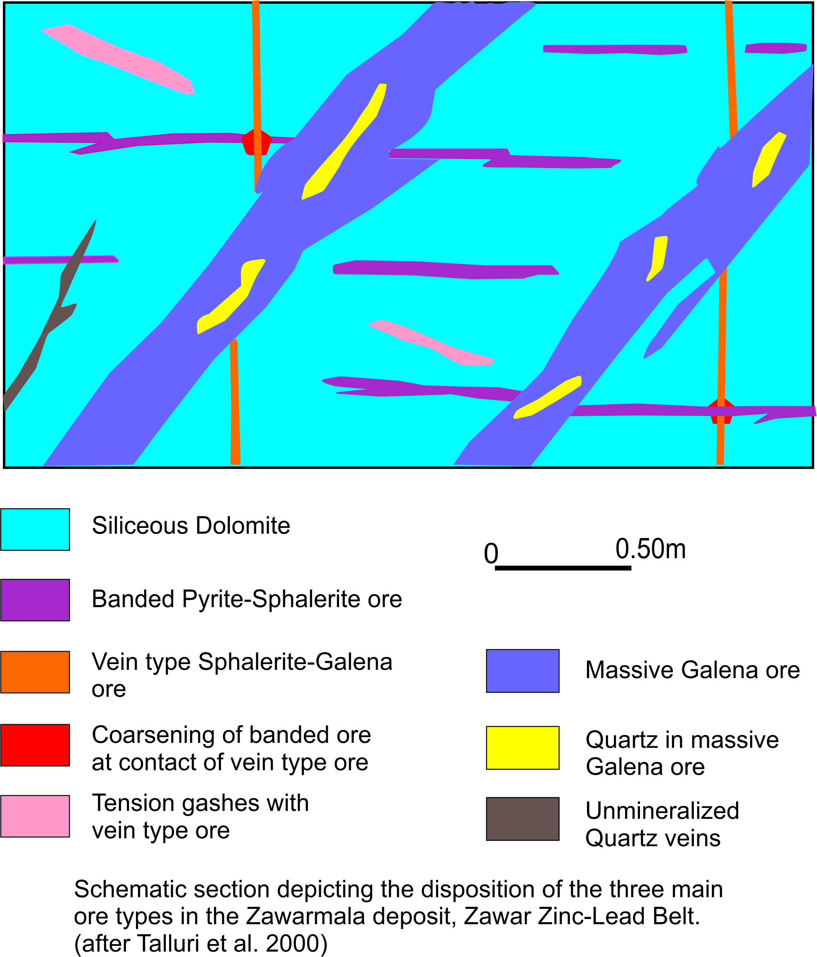
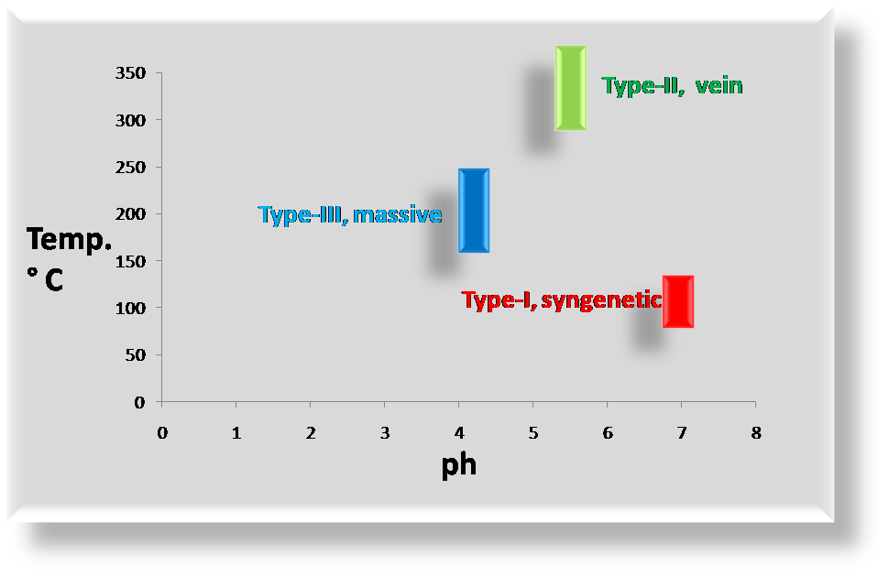
DISPOSITION OF THE THREE MAIN ORE TYPES

Slide 22
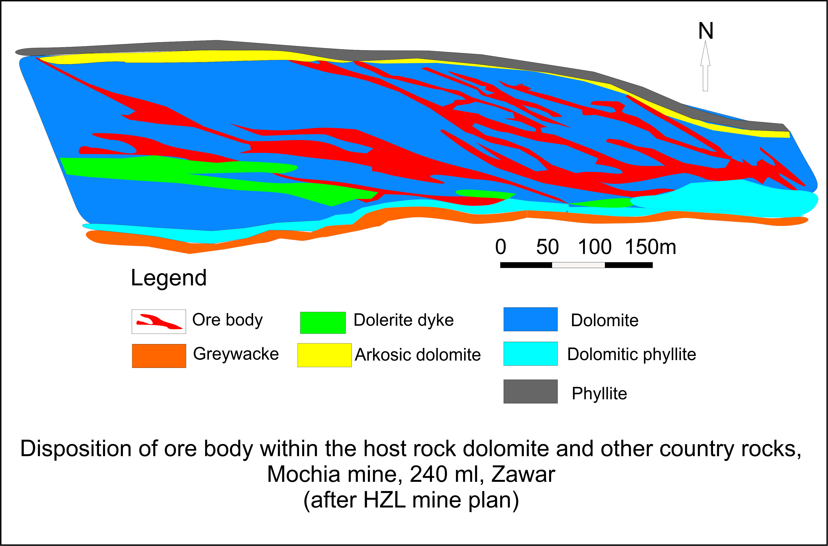
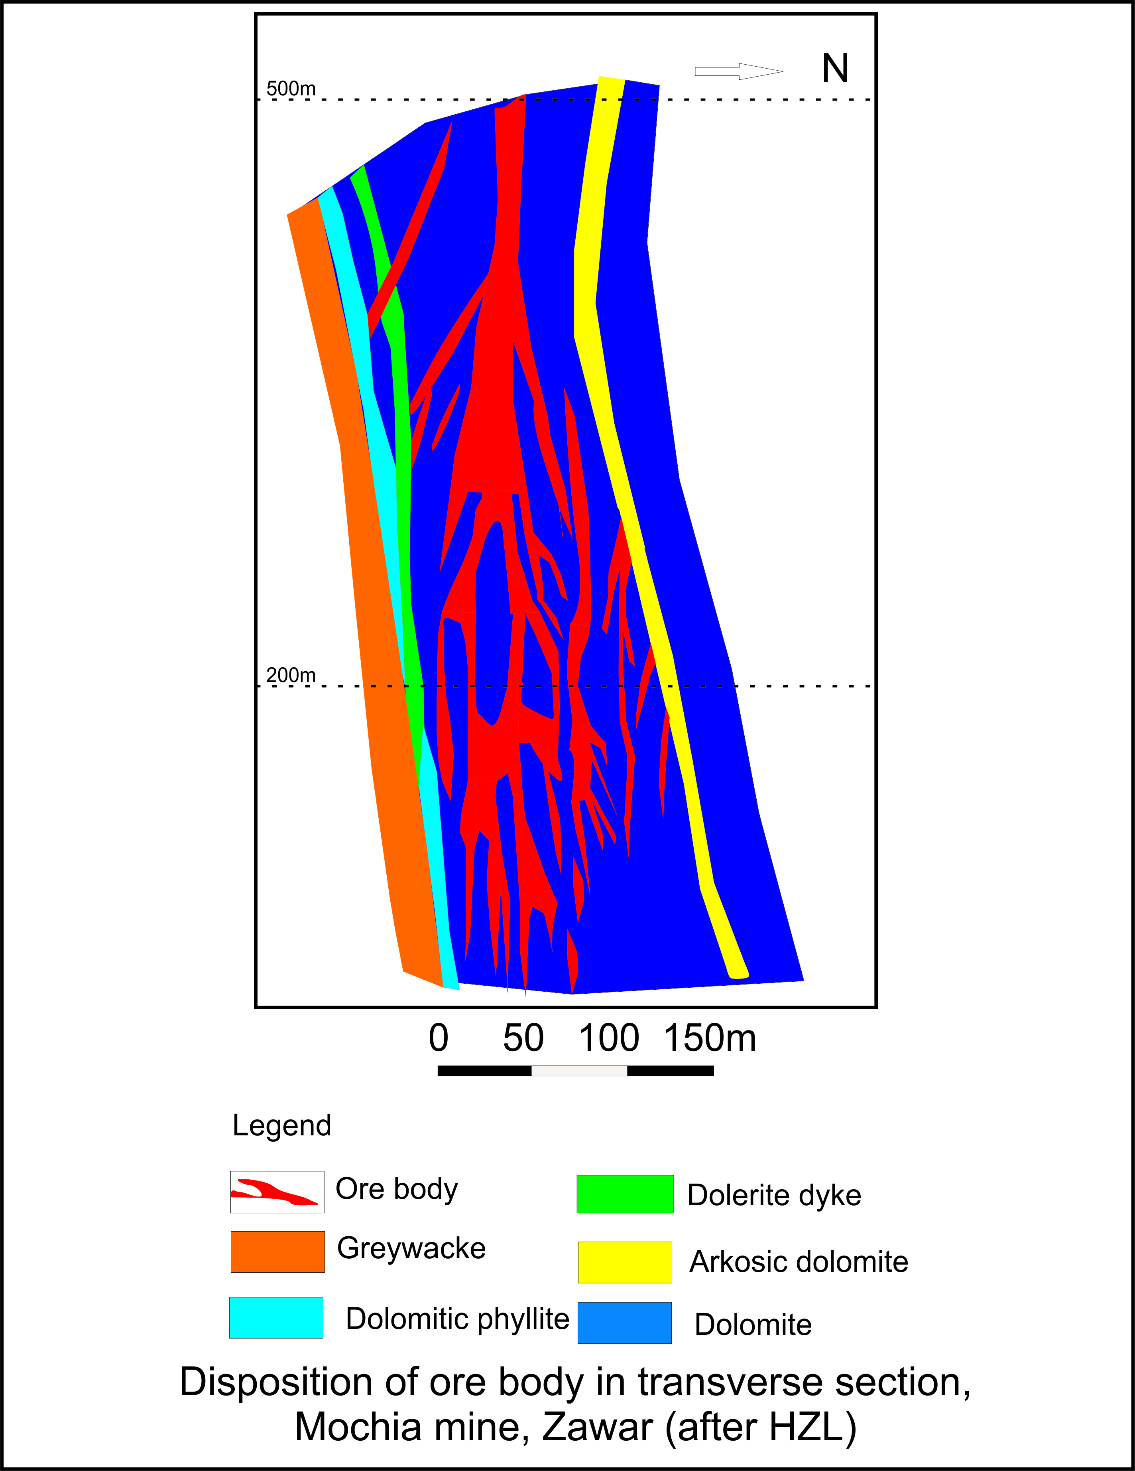
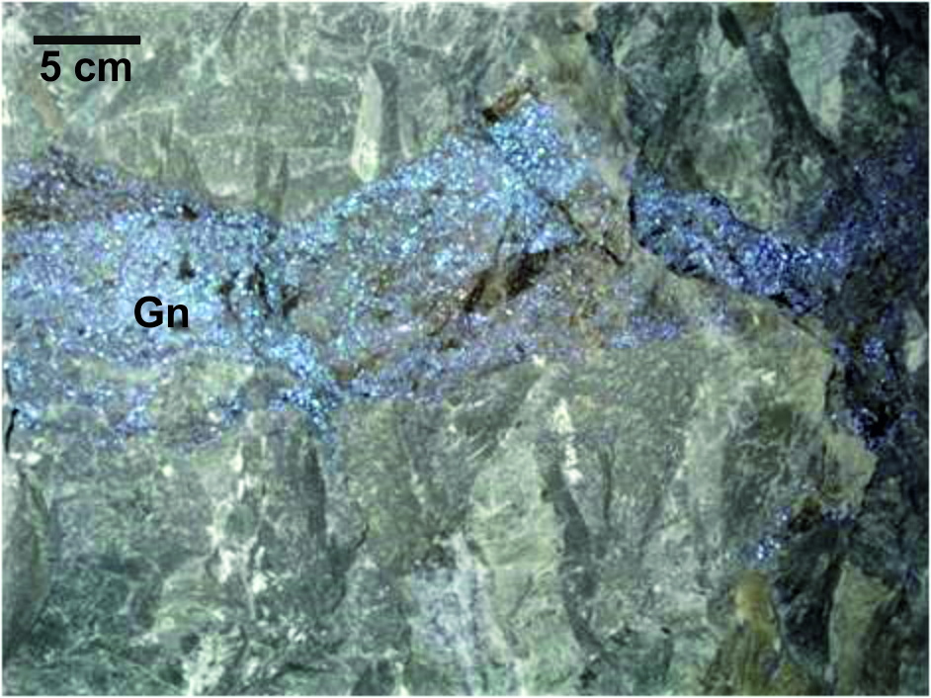
During development of major F3 fold, different sets of fractures developed due to shear, parallel to S₂
Hydrothermal activities along these fractures caused deposition of veins of ores (type –II) and massive ore (type III) in different time
The initial pH of the ore solution is below the pH value at which dolomite dissolution takes place at around 250°C. Contact of low ph solution with dolomite leads to increase the pH of the ore solution and decrease in solubility of sulfides, resulting in sulfide precipitation
Cooling reduces the solubility of galena and sphalerite and thereby causes deposition

Slide 23
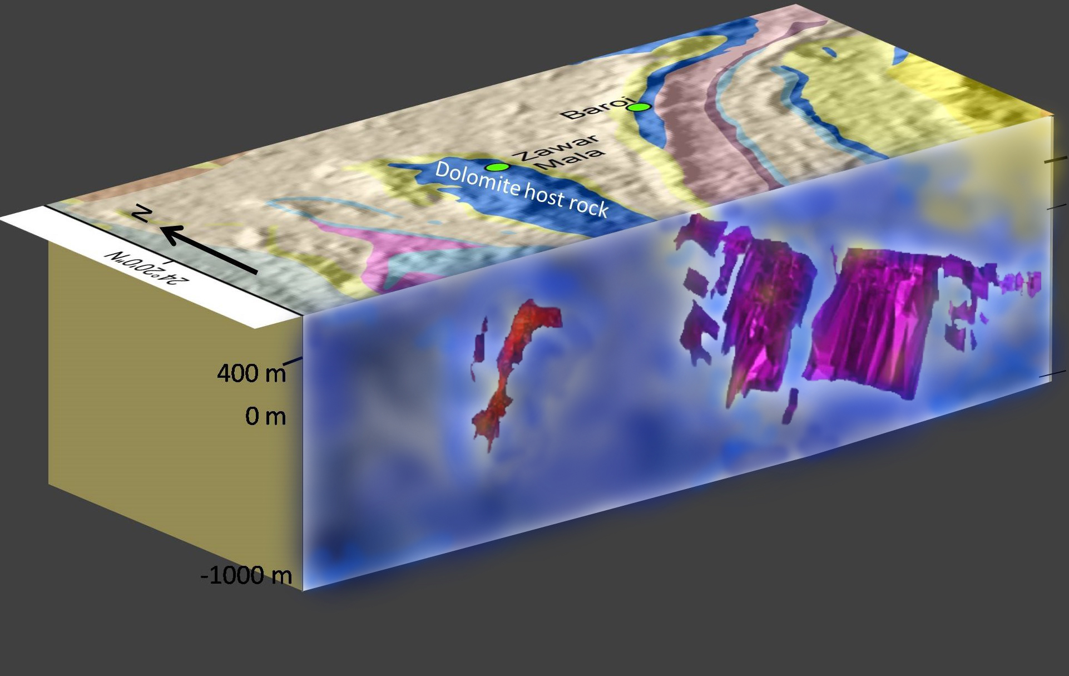
SCHEMATIC DIAGRAM SHOWING ORE BODIES OF ZAWARMALA AND BAROI MINES
35.7
MT
8.96
MT
2.47% Pb, 2.10% Zn
Zn/Zn+Pb 0.46
2.14 % Pb, 4.51 % Zn
Zn/Zn+Pb-0.68
Ore body
Ore body
Baroi: Strike length of ~1,200 m NW-SE and dipping at 70° W.
The dominant plunge is 50 ° to 60 ° NW.
Ore lenses 60 to 250m, width 2 to 20m
Zawarmala: Strike length of ~550 m NW-SE and dipping at 70° SW. Ore at the core of the fold. The dominant plunge is 30° to 60° NW. Ore lenses 60 to 200m, width 2 to 40m
Modified after HZL

Slide 24
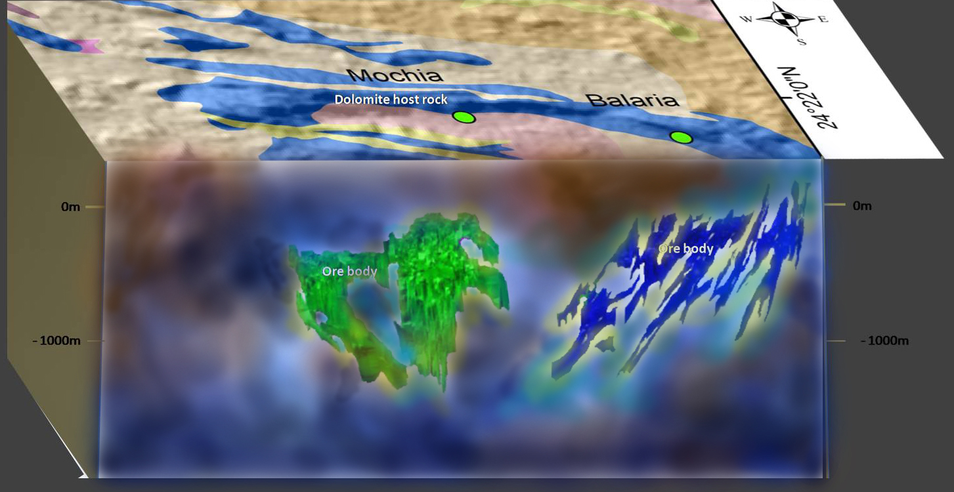
SCHEMATIC DIAGRAM SHOWING ORE BODIES OF MOCHIA AND BALARIA MINES
54.46
MT
41.95
MT
2.3 % Pb, 3.56% Zn,
5.63% Pb, 1.71 % Zn,
Zn/Zn+Pb-0.6
Zn/Zn+Pb- 0.23
Balaria: Strike length of ~1,800 m, WNW to ESE and dipping at 70 ° NW. The dominant plunge is 50 ° to 60 ° SW. Ore lenses 60 to 200m,width 2 to 40m
Mochia: Strike length of ~1,800 m,E-W and dipping at 80° to 85° south.
The dominant plunge is 50° to 60° SW.
Ore lenses 60 to 200m, width 2 to 45m
Modified after HZL

Slide 25
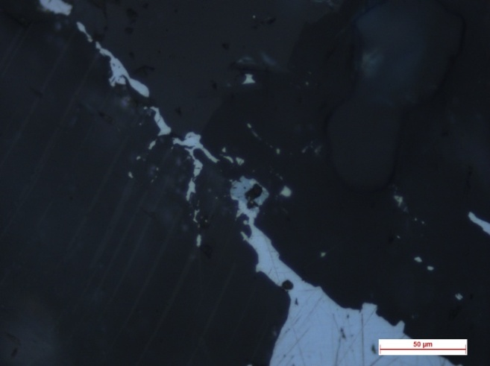
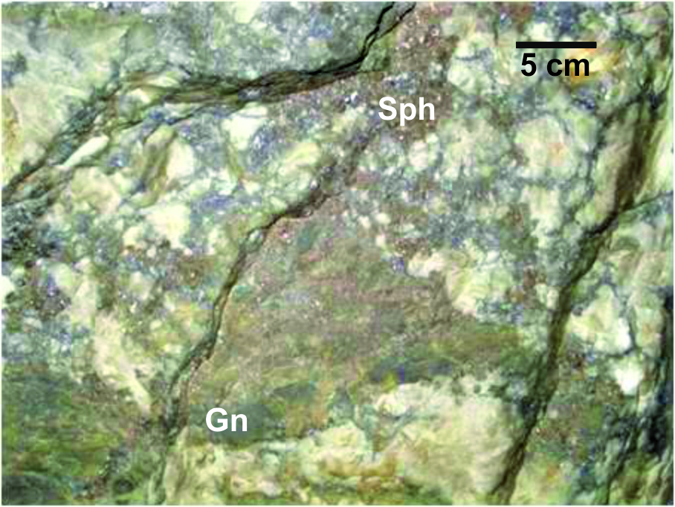
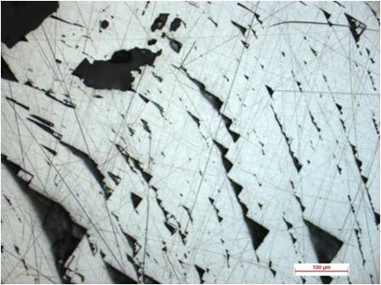
EVIDENCES IN FAVOUR OF SYNGENETIC ORIGIN
The early stage type-I seems to be the product of rift system developed in extensional regime related to distal vent
Dominantly strata-bound nature of mineralization over the 20km long belt, presence of sedimentary structures in the bedded ores, lack of wall rock alteration
Lesser significant carbonaceous phyllite hosted primary stratified ores (type–I) resemble SEDEX-type in macro- and micro-scales, and the textural features associated with it, indicate syn-sedimentary /diagenetic origin
EVIDENCES OF REMOBILIZATION AND RECRYSTALLIZATION
Coarsening of grains of stratified ore at contacts with vein quartz, abundance of coarsely crystalline galena and sphalerite in the later formed shoots relative to the stratified ore, deformed sulphides
Galena
Galena

Slide 26
GEOCHEMICAL AND GEOBOTANICAL SIGNATURES
Wt %
ROCK | SiO₂ | Al₂O₃ | Fe₂O₃ | Na₂O | K₂O | MgO | CaO | CO₂
Dolomite | 7.12 | 1.08 | 1.01 | 0.15 | 0.51 | 18.12 | 27.91 | 41.65
Quartzite | 91.30 | 5.70 | 0.84 | 0.46 | 1.16 | 0.16 | 0.20 | -
Phyllite | 71.47 | 16.45 | 5.63 | 0.72 | 3.60 | 1.15 | 0.23 | -
Low REE in carbonate indicates that the deposit was formed under syngenetic and sedimentary marine condition
The average Th/U ratio in Zawar phyllite is 8.5 and Zawar quartzite is 4.7
Overall synthesis of geochemical data suggests low to extreme degree of chemical weathering in their source area
Geobotanical studies reveal a variety of plant Impatiens Balsamina, is the characteristics species which accumulate appreciable amount of zinc as high as 12141 ppm and is considered to be the local indicator of zinc deposit

Slide 27
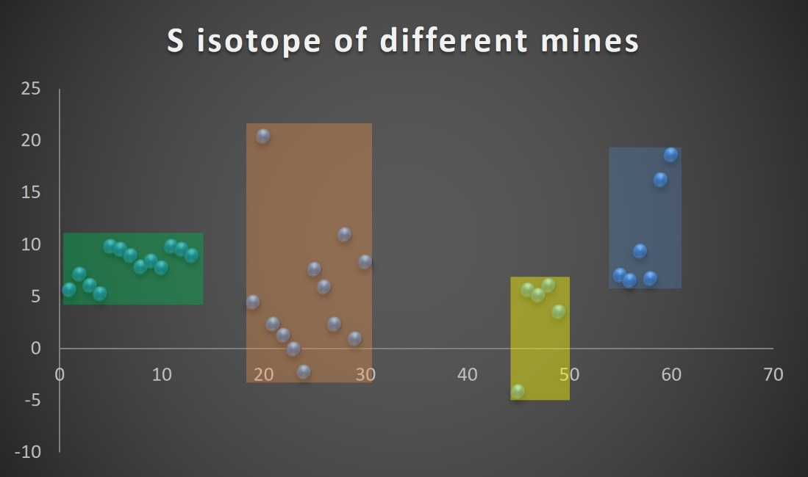
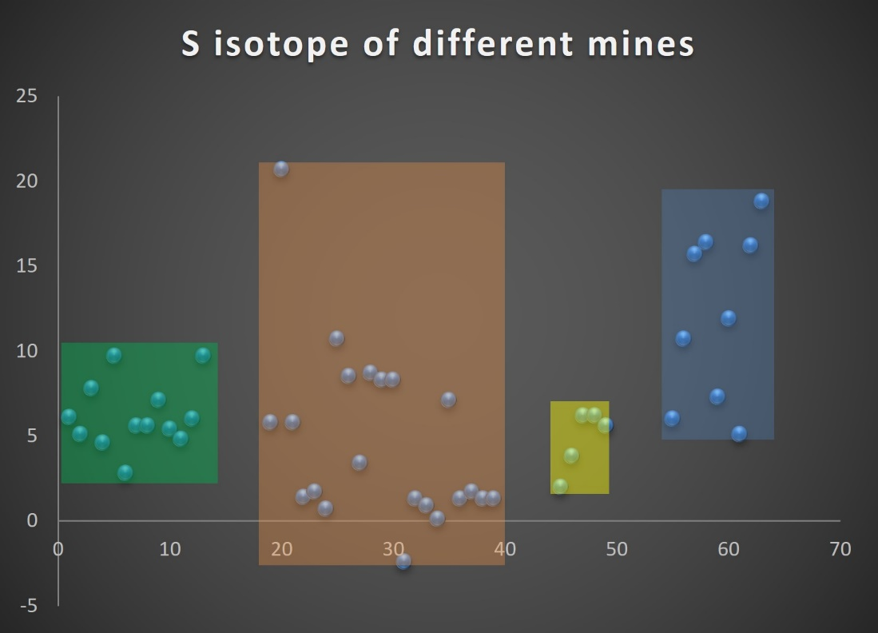
ISOTOPE CHARACTERS
δ³⁴S
(1) 5.2 to 9.8 ‰ for galena and 2.8 to 9.7 ‰ for sphalerite from Mochia
(2) -2.3 to 20.4 ‰ for galena and -2.4 to 20.7 ‰ for sphalerite from Balaria
(3) 6.5 to 18.6 ‰ for galena and 5.1 to 18.8 ‰ for sphalerite from Zawarmala
(4) -4.2 to 6 ‰ for galena and 2.0 to 6.2 ‰ for sphalerite from Baroi have been reported
The large spread of sulphur isotopic values may be due to partial biogenic fractionation of the sulphur isotopes.
S-isotope distribution appears bimodal with pyrite-pyrrhotite veinlets having a distinctly different or enhanced δ³⁴S values in relation to the galena-sphalerite veinlets reflecting different processes of formation and time events.
Balaria
Zawarmala
δ³⁴S
Galena
Mochia
Baroi
δ³⁴S
Zawarmala
Balaria
Sphalerite
Mochia
Baroi

Slide 28
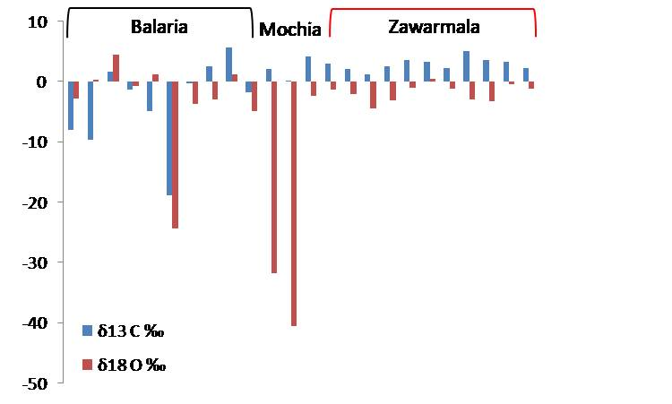
CARBON AND OXYGEN ISOTOPE DATA FROM THE ORE ZONE CARBONATES OF
MOCHIA, BALARIA AND ZAWARMALA MINES
Majority of the carbonates exhibit normal marine signatures
Carbonates in the vicinity of Pb-Zn mineralization have depleted O-isotopic values due to influence of hydrothermal solutions on normal marine carbonates
Depleted O-isotopic signature is due to post-depositional equilibration with isotopically light meteoric water

Slide 29
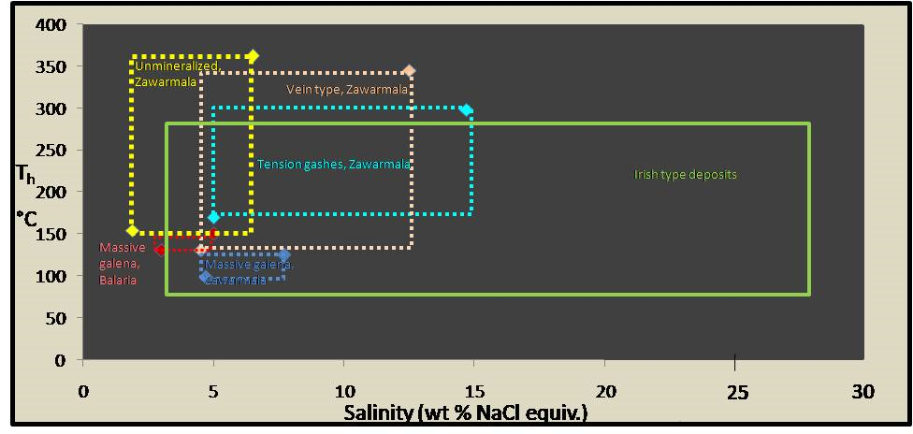
FLUID INCLUSION
Temperature of homogenization (Th ) vs. salinity plot of fluid inclusions in quartz associated with a. vein type ore, b. massive galena ore, c. tension-gash, d. un-mineralized quartz vein from Zawarmala, massive galena ore from Balaria. Compared with Irish & MVT type deposit.
MVT
Vein-type ore : Low-salinity (4.3–14.7 wt % NaCl equiv.) H₂O-NaCl fluids. Trapping temperature of ore fluid : 395° to 290°C
Massive galena ore: H₂O-CO₂-NaCl fluids of lower salinity (about 3–4 wt % NaCl equiv). Trapping temperature of fluid : 250° and 150°C at pressures of 2,000 to 750 bars . Fluids are made up of variable H₂O, CO₂ CH₄ and N₂
Fluid inclusion salinity ranges from ~ 5 to ~7 wt % NaCl equiv. and temperature ranges from ~ 100 to ~ 340 °C,
in overlapping domain.
Irish type data from Wilkinson 2015
Zawarmala data from Talluri, Balaria from Illyas

Slide 30
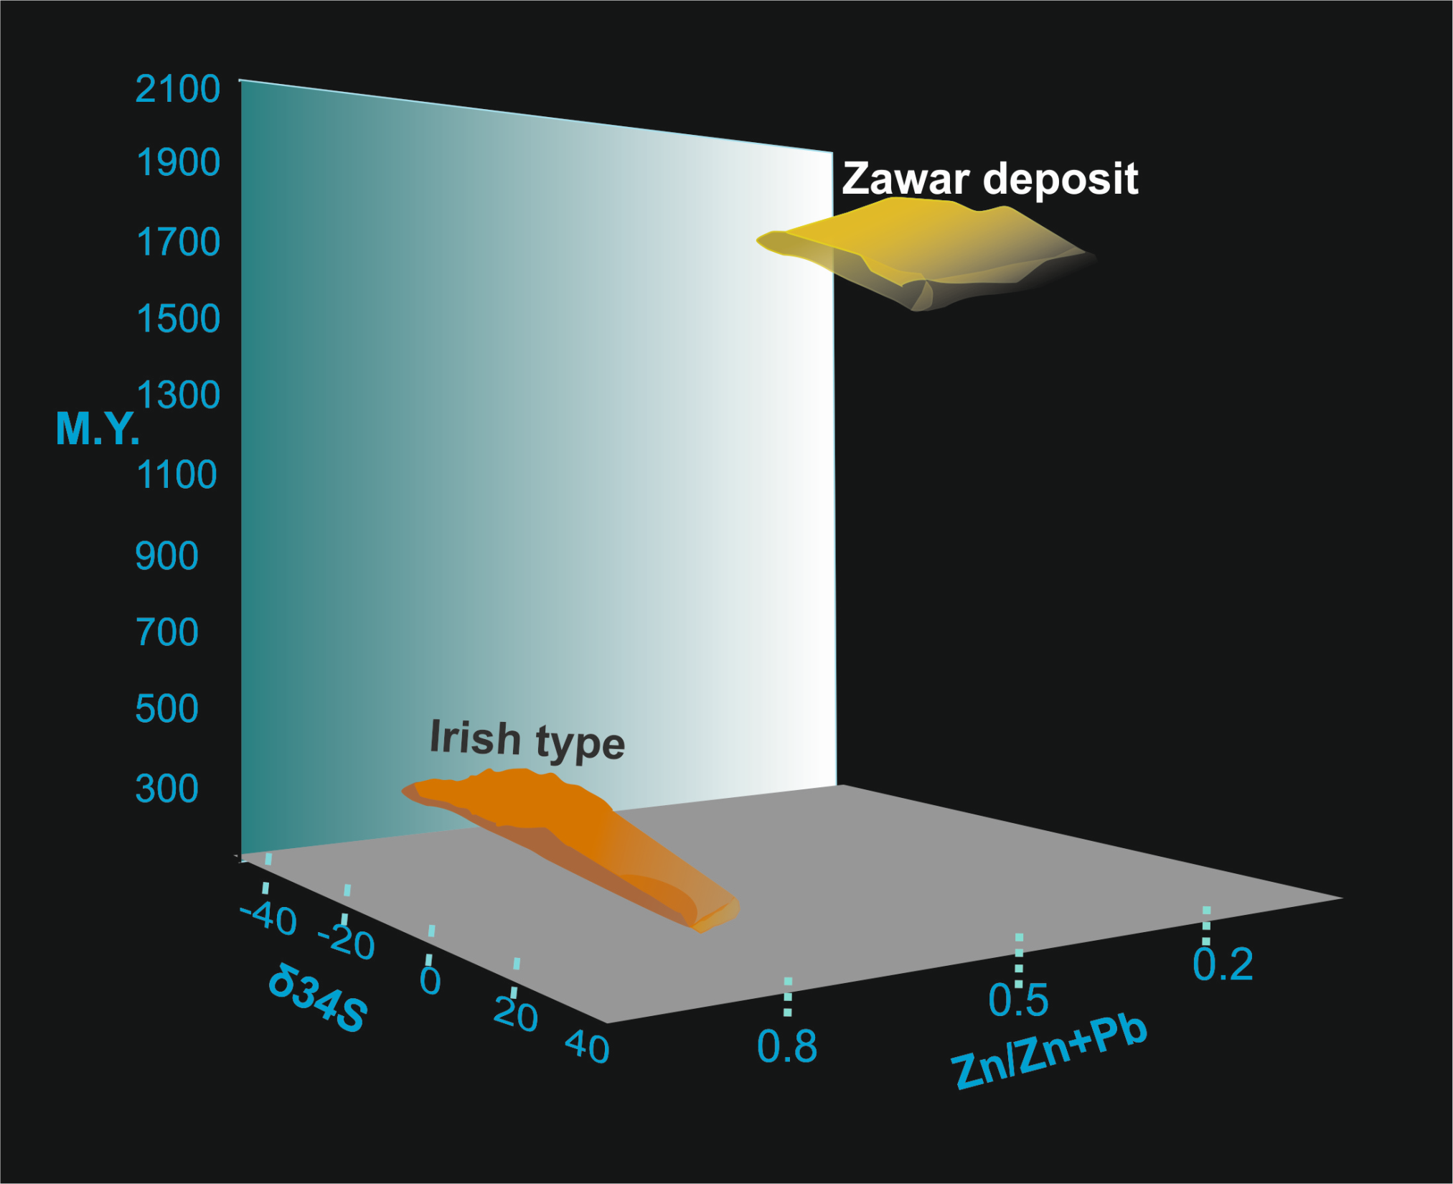
COMPARISON OF ZAWAR DEPOSITS AND IRISH TYPE DEPOSITS

Slide 31
GEOLOGICAL NATURE ANALYSIS, (GNA) OF IRISH TYPE AND ZZB
 | IRISH TYPE | ZAWAR ZINC – LEAD MINERAL BELT (ZZB)
Regional setting | Block faulting associated with crustal extension | Continental rift basin (followed by orogeny)
Host rock | Host rocks are limestones, marls and shales. | Main host rock is dolomite.
Stratigraphy | Two stratigraphic units of Lower Carboniferous. Waulsortian Limestone Formation and the Navan Group. | Mochia Formation of middle Aravalli Group of Proterozoic age.
Structure | The Waulsortian-hosted deposits occur largely in the complexly faulted hanging walls of large normal faults Ores at Lisheen and Navan are cut by faults. | Zawar ore bodies are stratabound and occur within a megascopic fold. Ore bodies are largely controlled by folding and ductile shear zone
Nature of fluid | Two types of fluids: 1. 130° to 240°C but locally up to 280°C, 8-19 wt% NaCl equiv., reduced and sulphur-poor, metal-bearing fluid 2. 50-130°C, high salinity (>20 wt% NaCl equiv.) | Fluids associated with epigenetic type ores are of two types. 1. Vein-type ore 4.3–14.7 wt % NaCl equiv., H₂O-NaCl fluids, temperature 395° to 290°C , pressure 1,450 bars. 2. Massive galena ore are H₂O-CO₂-NaCl fluids , 3–4 wt % NaCl equiv. Temperature between 250° and 150°C, pressures 2,000 to 750 bars.
Proximity to Igneous activity | The intimate relationship between mineralization and volcanic activity in the Limerick province supports a model involving magmatic heat as a key driver for fluid circulation. | Relation between mineralisation and volcanic activity is not well established.
Control | The carbonate-hosted zinc-lead deposits of the Irish Orefield are stratigraphically and structurally controlled. | The carbonate-hosted zinc-lead deposits of the Zawar are stratigraphically and structurally controlled

Slide 32
GNA OF IRISH TYPE AND ZZB
 | IRISH TYPE | ZAWAR ZINC – LEAD MINERAL BELT (ZZB)
Isotope nature | Sulphides in the Irish ore deposits exhibit a wide range of δ³⁴S values from -45 ‰ to +15 ‰. | Sulphides in ZZB show a δ³⁴S values range from -2.3 to 20.4‰.
Age of mineralisation | Mineralisation appears to have occurred around ~359-346 Ma. Ore formation occurred episodically over an extended period of time (10-15 My) | Three types of ore formation occurred over an extended period. Host rock of mineralisation is of middle Aravalli i.e around 2000 Ma, but date of mineralisation is ~ 1700 Ma.
Grade | 22.4 MT of ore@ 11.63% zinc, 1.96% lead and 26 ppm silver, Lisheen Mine. 10.2% zinc and 1.9% lead for the Tobermalug zone. Navan deposit, 105 Mt @8.1% Zn and 2%Pb | 141.07 MT of ore with grades ranging from 1.71 % to 4.51 % for zinc and 2.14 % to 5.63% for lead, 24 ppm to 45 ppm silver
Base metal ratio Zn/ (Zn + Pb) | Varies from 0.8 to 0.85. | Varies from 0.23 to 0.68.
Ore minerals | Galena, sphalerite, pyrite, chalcopyrite. | Galena, sphalerite, pyrite, pyrrhotite and arsenopyrite, chalcopyrite at places.

Slide 33
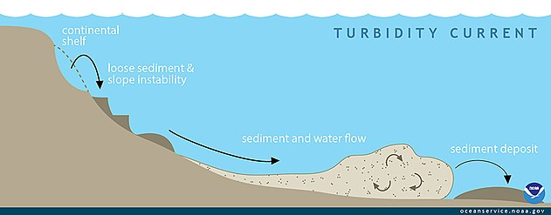
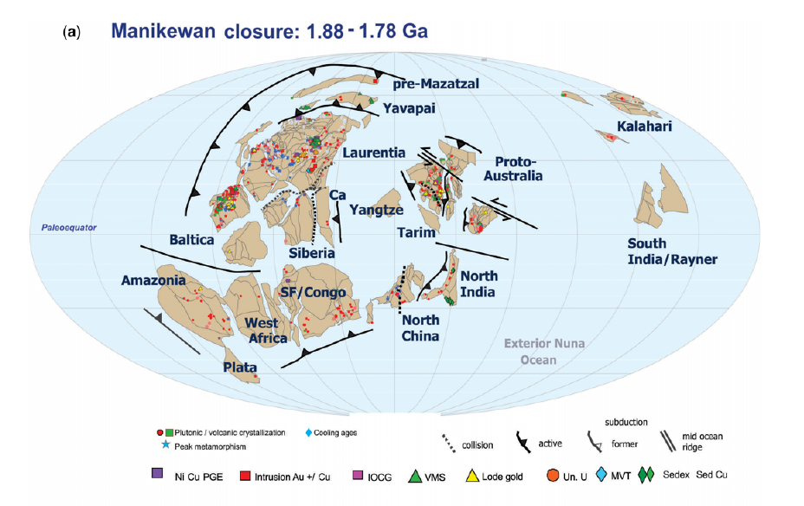
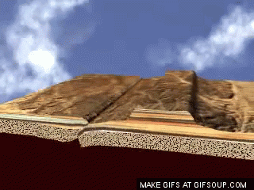
SUMMARY
ARAVALLI RIFT STAGE
~2300 Ma
NW
SE
Type –I ore
ARAVALLI OROGENY
1700 to 1800 Ma
Sediments with zinc and lead
NW
SE
ZAWAR
Marwar Craton
Bundelkhand Craton
Vein type ore 290 -395°C, 1.4 kb
Massive type ore 150-250°C, 0.7 to 2 kb

Slide 34
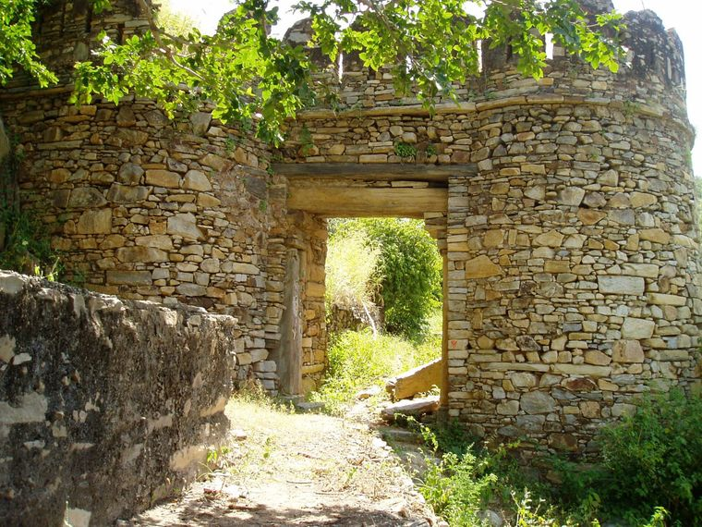
Minerals-mining-smelting-metals
GEOHERITAGE
Zawar: It is the story of a lost city, a once-bustling centre of trade and pilgrimage
Prosperous mining region known for its magnificent silver jewellery
2,500-year-old smelting technique which was lost to the world
Rediscovered in 18th Century.

Slide 35
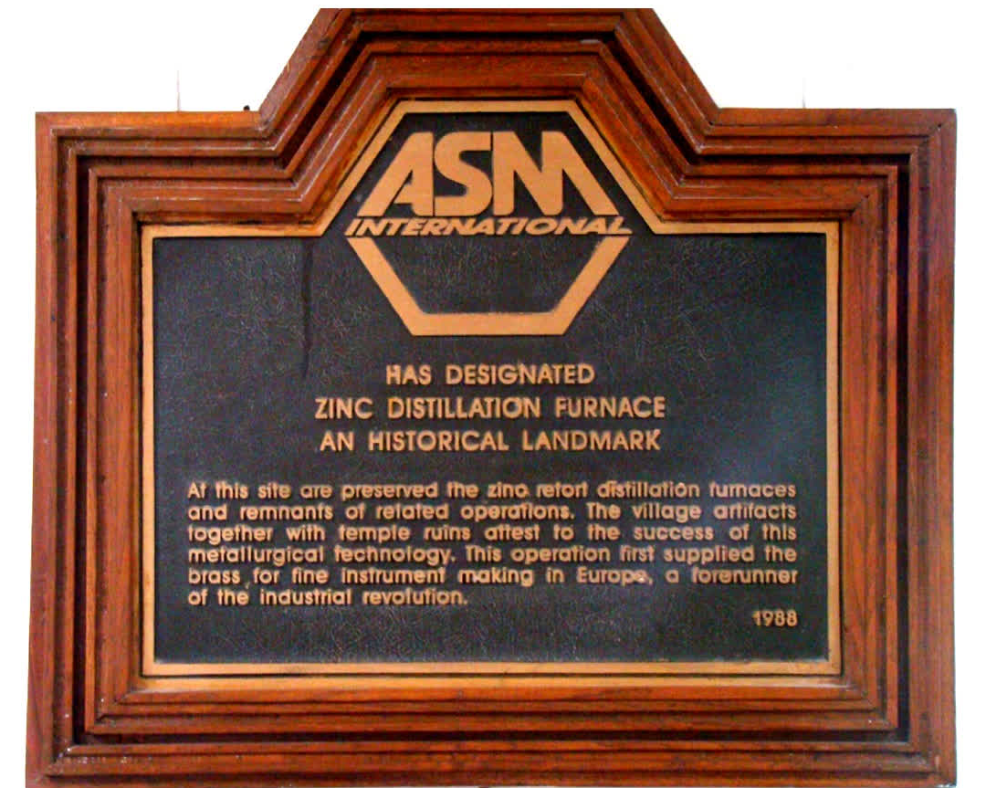
In 1988, the American Society of Metals (ASM International) recognised Zawar Mine as an ‘International Historical Landmark’.
The Geological Society of India recognised Zawar as a National Geological Monument/ Geo-heritage site in 2016.

Slide 37
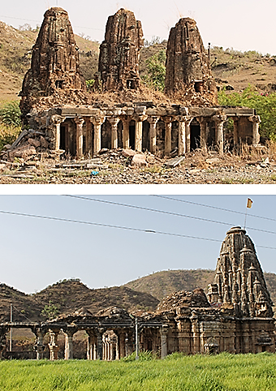
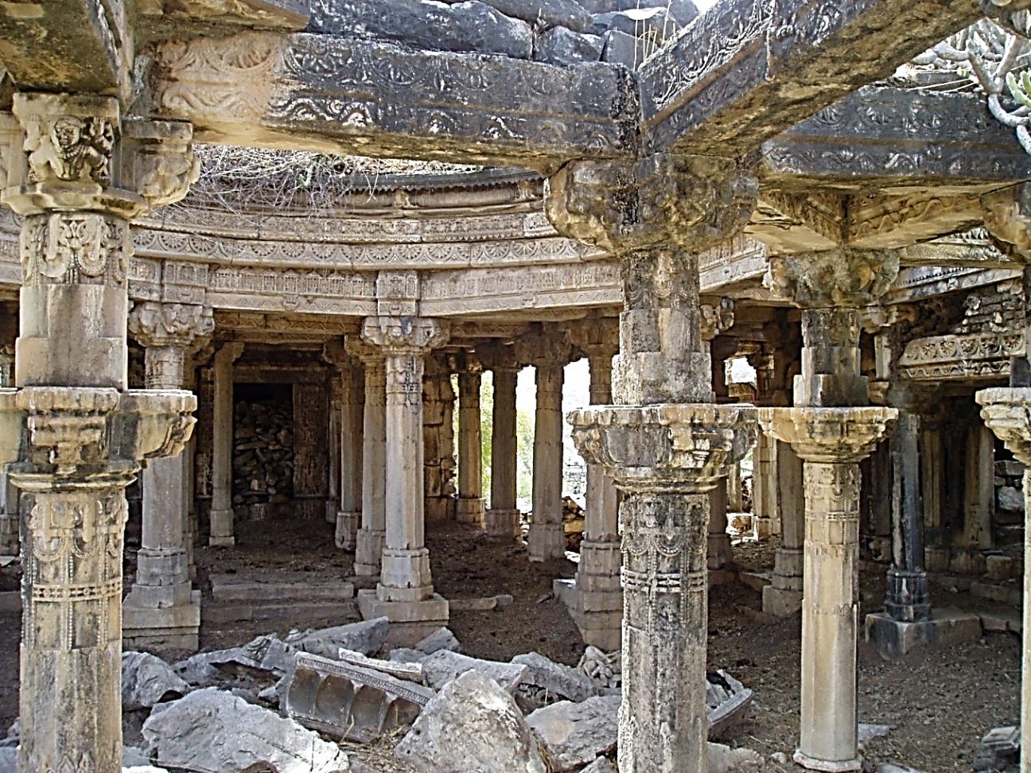
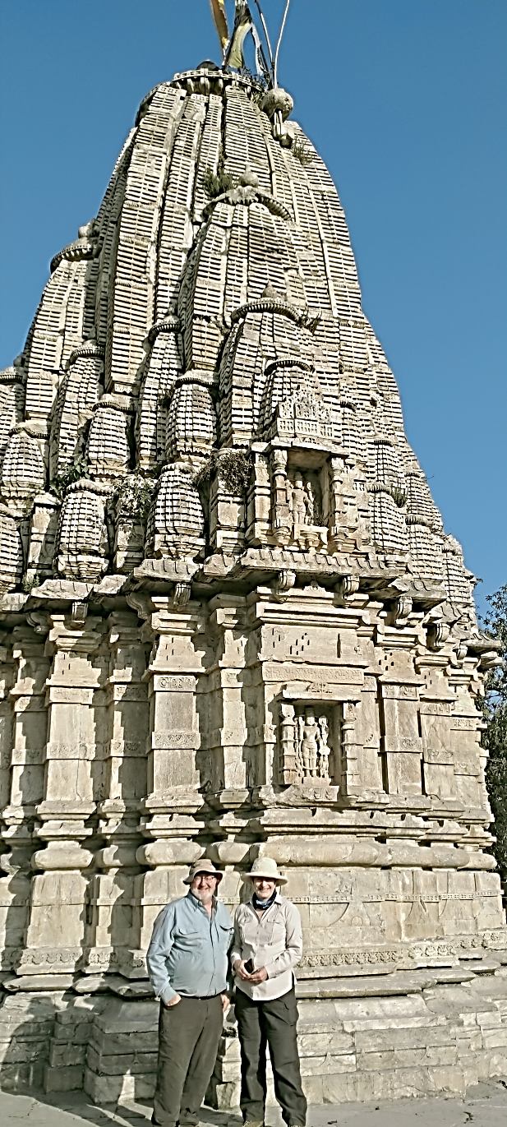
Walls made by used retorts
Slag and retorts
Old workings

Slide 38
THANK YOU

