Slide 1

Applying the concepts from complex system science to the deposit model for Irish Type base metal mineralisation
David Plunkett P.Geo
50 Years of Irish Base Metal Deposits
IAEG, GaLWAY 2023

Slide 2
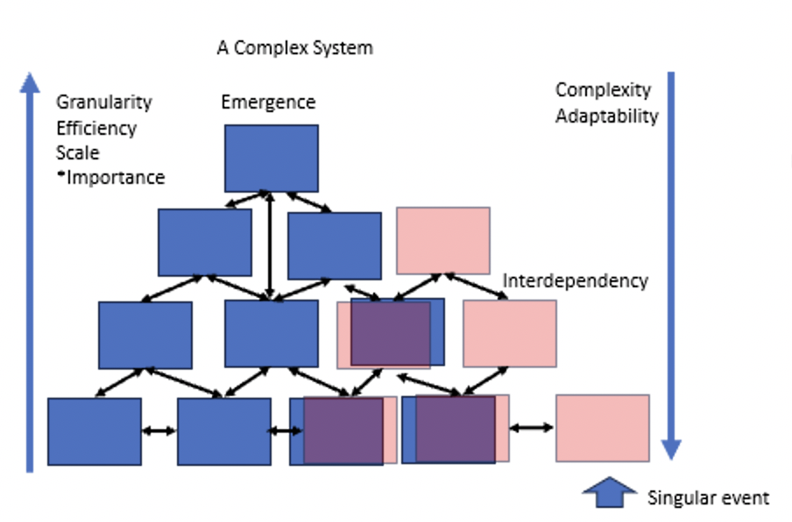
What is complex system science
Complexity is The length of the description of a system’s behaviour
Complex systems get less complex with scale.
Emergent phenomenon or behaviours become apparent at higher scales that would not be evident at the smaller scale
The more complex or the more interdependencies a system is the more susceptible to singular events.
The more complex a system is the more adaptable it is. The less complex, more efficient.
Siegenfeld, and Yaneer 2020

Slide 3

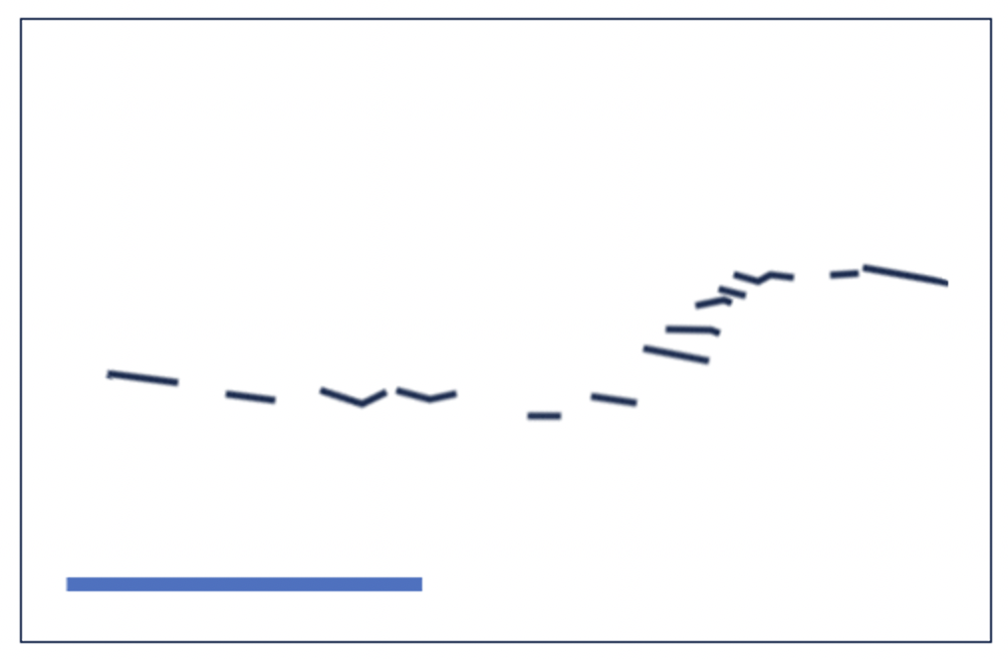
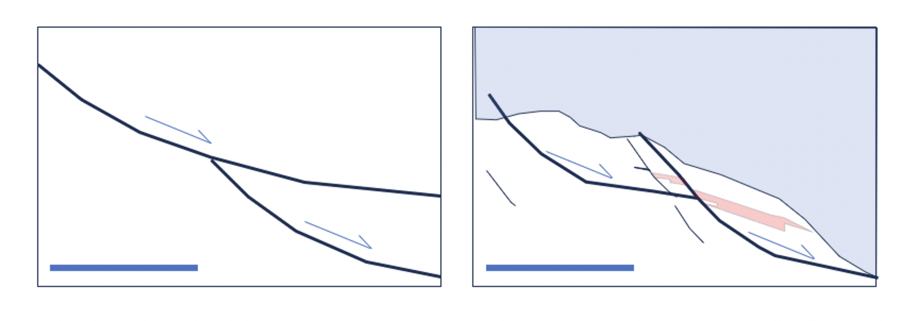
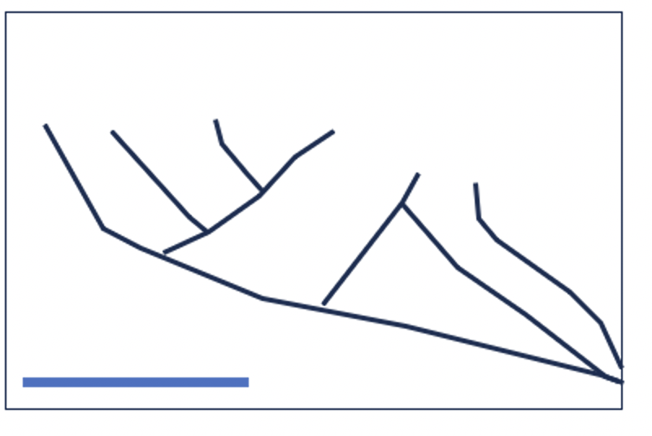
Properties of complex systems from the Irish midlands ore-field – Scale Invariance
Y=mX
Log X
100m
1km
4km
Log Y
Fault system length = overlap ^{M}
100m
200m
4km
Scale invariance: - common patterns where you can remove the scale bar!
Notes:
Self organisation: Emergent un-planned patterns that would not be evident or predicted from examining the system at a smaller scale, or one of the components of the system in isolation

Slide 4
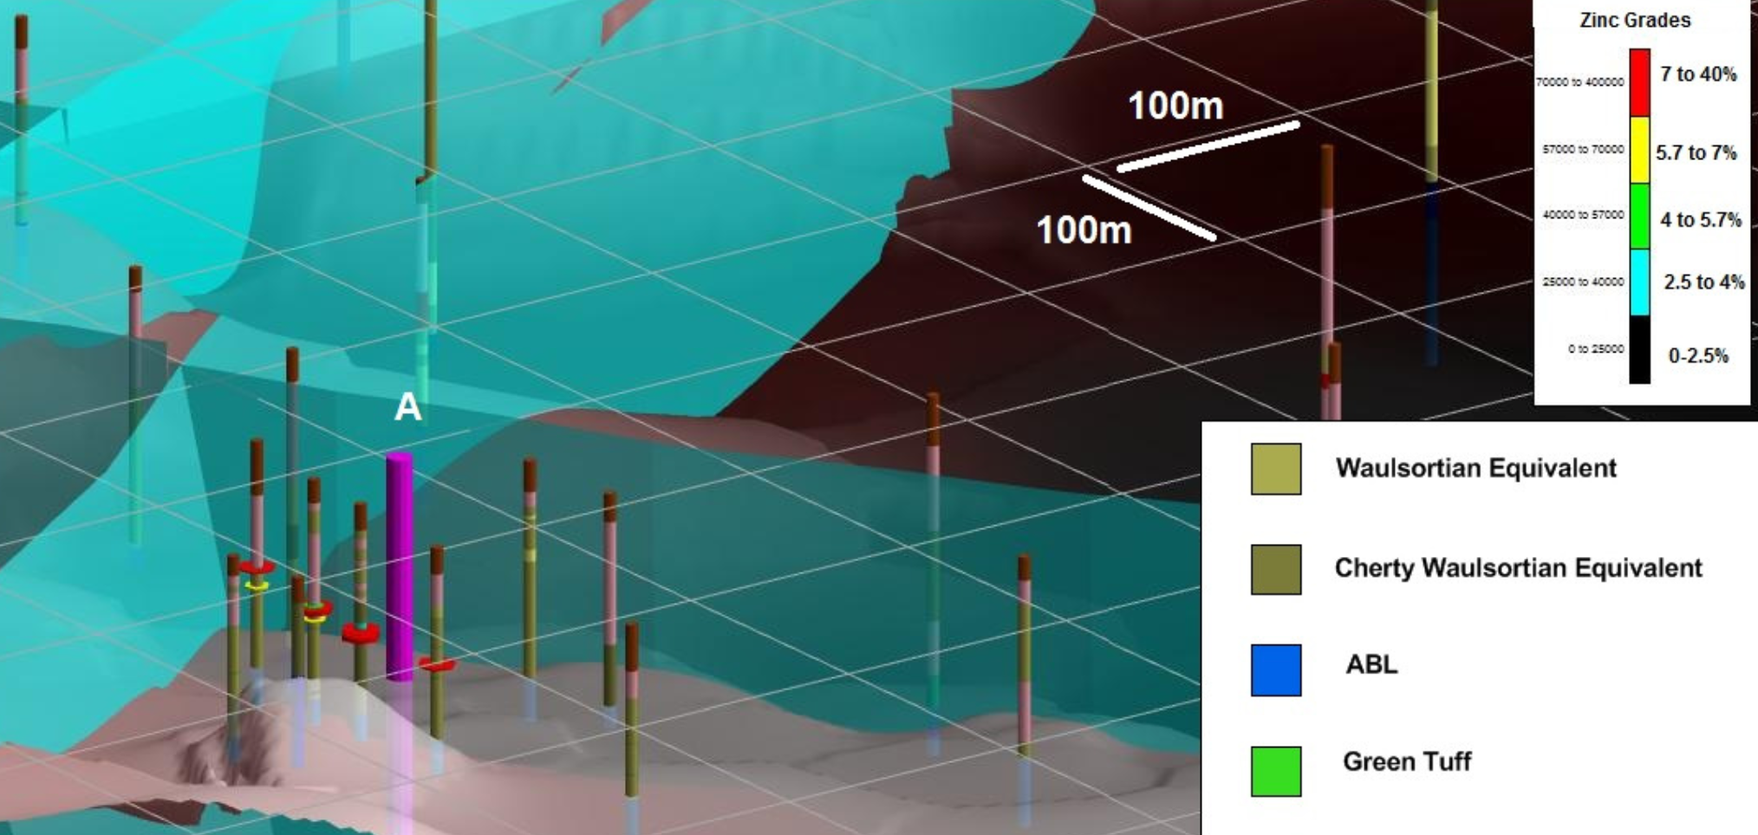
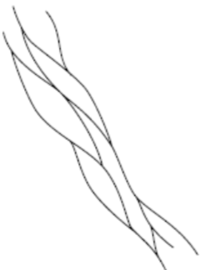
Complexity in the Low granularity sedimentary system of the irish midlands- Self Organised Patterns
Notes:
Add log log –plot
Definition
Self organisation: Emergent un-planned patterns that would not be evident or predicted from examining the system at a smaller scale, or one of the components of the system in isolation
Meaning more than one process interacting
Next Slide – animation –first fault to open

Slide 5
Complexity in the Low granularity sedimentary system of the Irish midlands
Fault systems show scale invariance in profile and map view
Similar deposits along the Rathdowney trend show regularity
Grades / tonnages of deposits decrease to the NE in a non-linear pattern
Theory:
Irish Type Deposits are emergent, self organised behaviours of the carbonate basin, caused by interdependent processes
Notes:
Two systems – at play; catbonate and sedimentary
Sedimentary system relatively simple; controlled by weathering and erosion of subarial rocks and depositional processes.
Carbonate system more complex – controlled by sunlight, pH, Alkalinity, biological activity, salinity etc (look up reference)
Makes a better host?
Carbonate system – spread and stick: emergent phenomenom show how relate to sequence stratigraphy

Slide 6
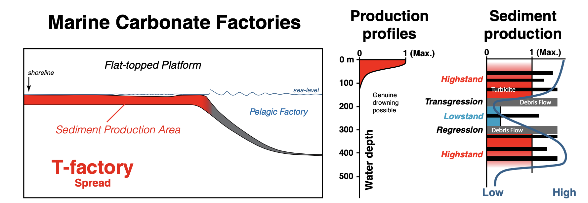
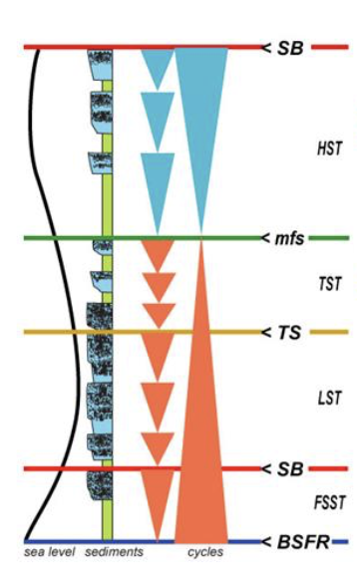
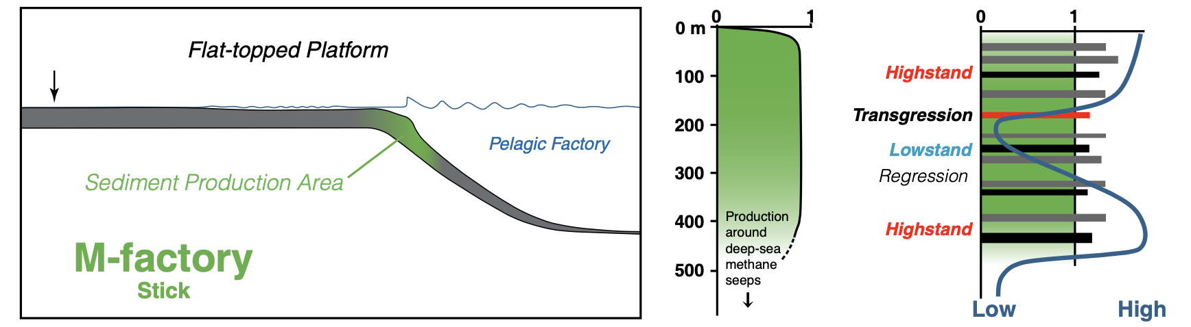
Sea-floor
Depth
Sunlight Penetration
Nutrients
Substrate
Salinity
Flow
pO2
pH
MicrobeRedox
Total Alkalinity
pCO2
Temp
Weathering
Erosion
Topography
Reigmer 2022
Notes:
Points – Carbonate system is more complex
More adaptable
Emergent behaviour Spread and stick
Silicate system still active

Slide 7
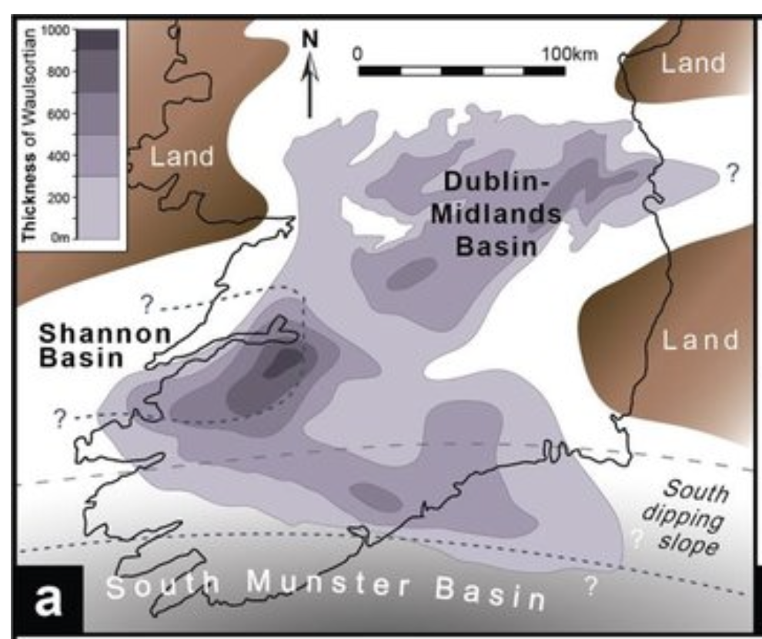
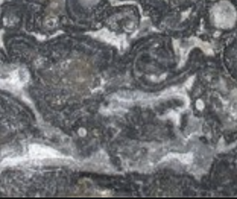
Levels of Granularity in the Waulsortian Mudmound
High Granularity
Medium Granularity
Low Granularity

Slide 8
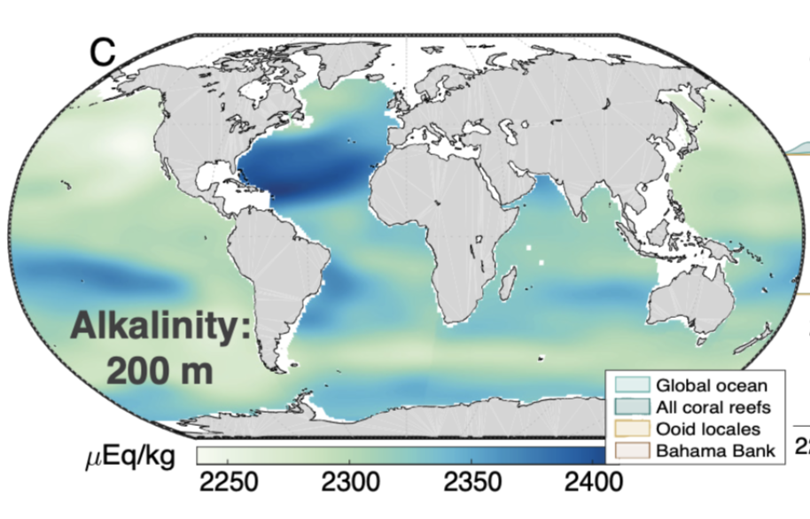
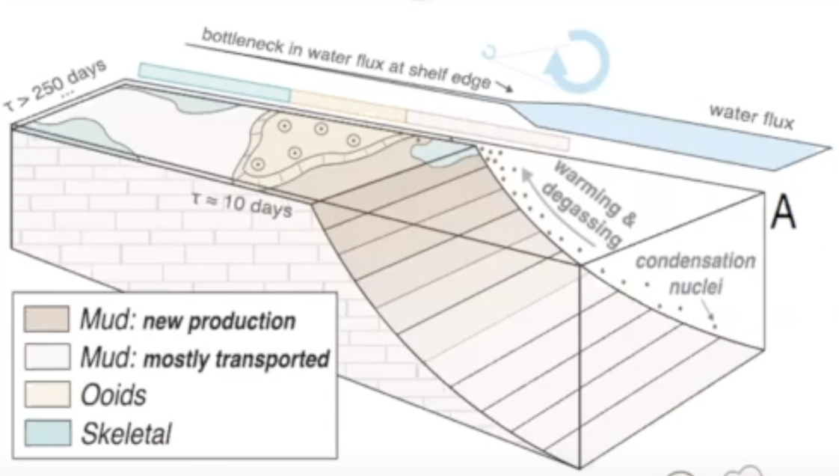
High Granularity controls on Waulsortian Mudmound
Alkaline Water Current
Geyman et al. 2022

Slide 9
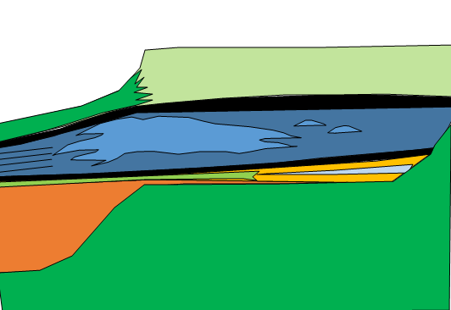
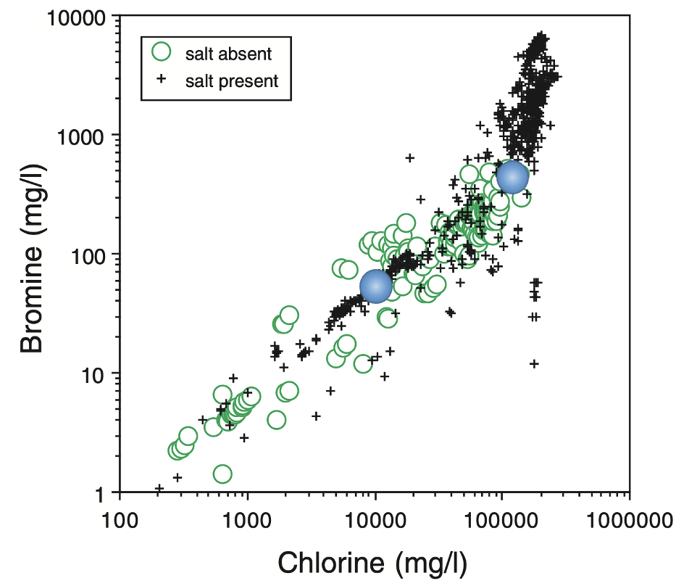
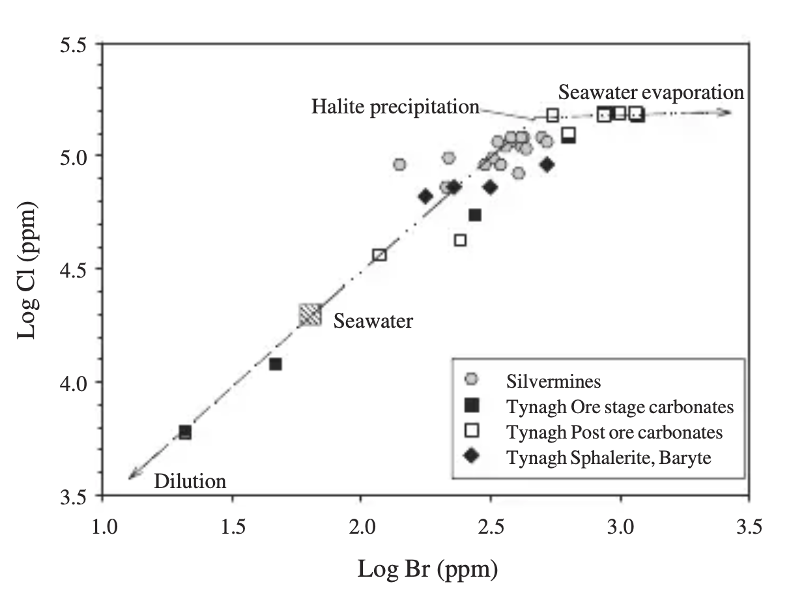
What would evolution look like without faulting
CARBONATE PLATFORM
ABL
REEF
DEVONIAN
RIFT
BASEMENT
?
Banks 2002, Worden 1996
Notes:
Add faulting and

Slide 10
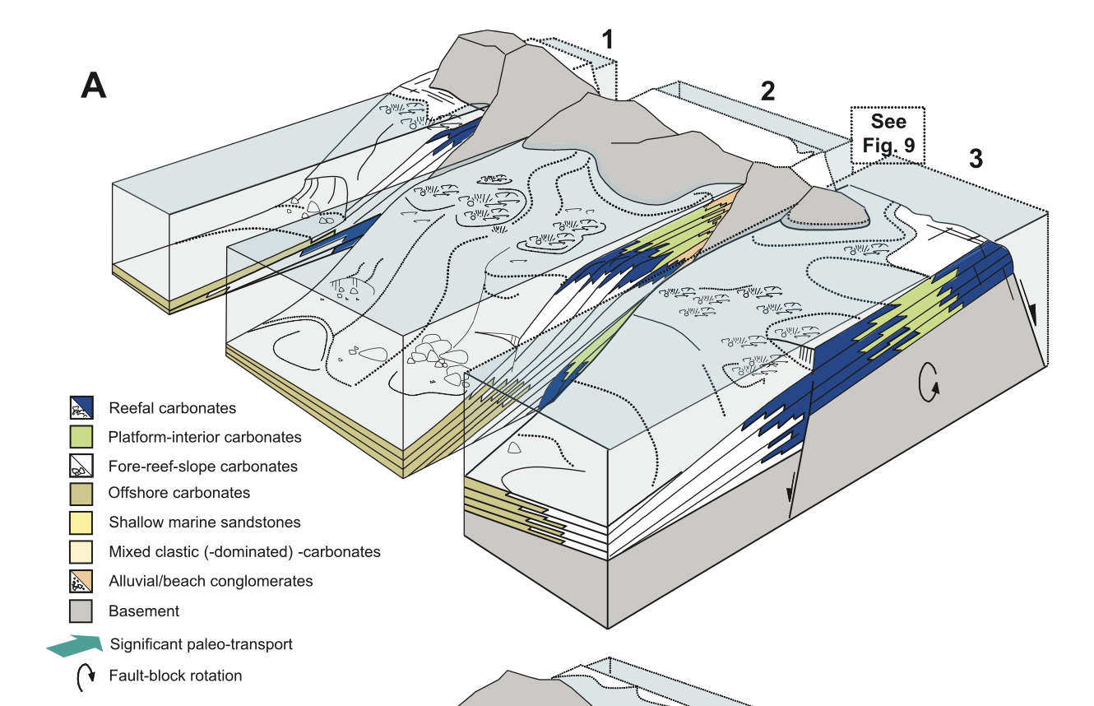
INTERDEPENDENCE OF THE CARBONATE, Fluid AND FAULT SYSTEM
Lees, 1996, Cross and Bosenance 2008
Notes:
Faulting

Slide 11
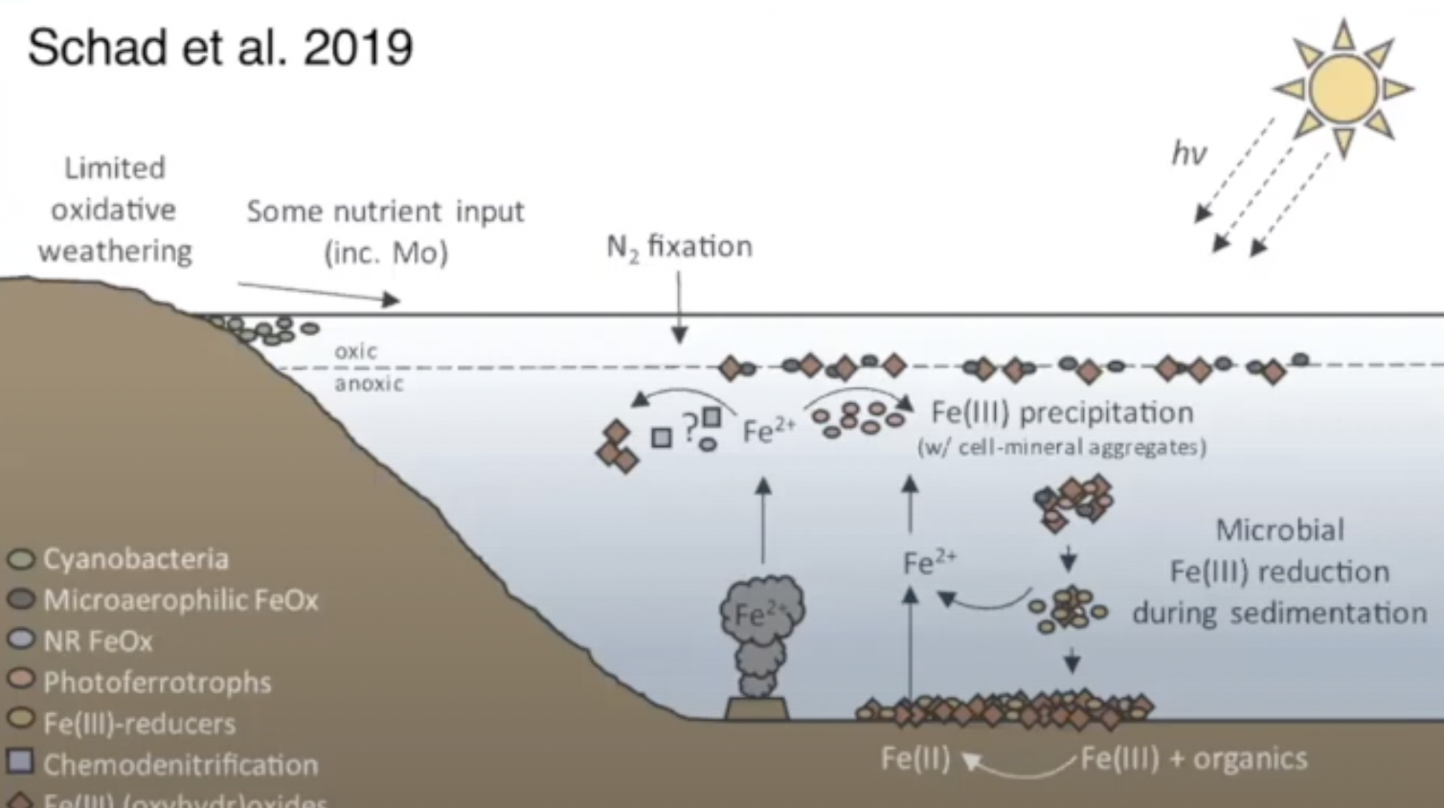
MICROBIAL IRON CYCLE IN AN ANOXIC BASIN
Notes:
Faulting

Slide 12
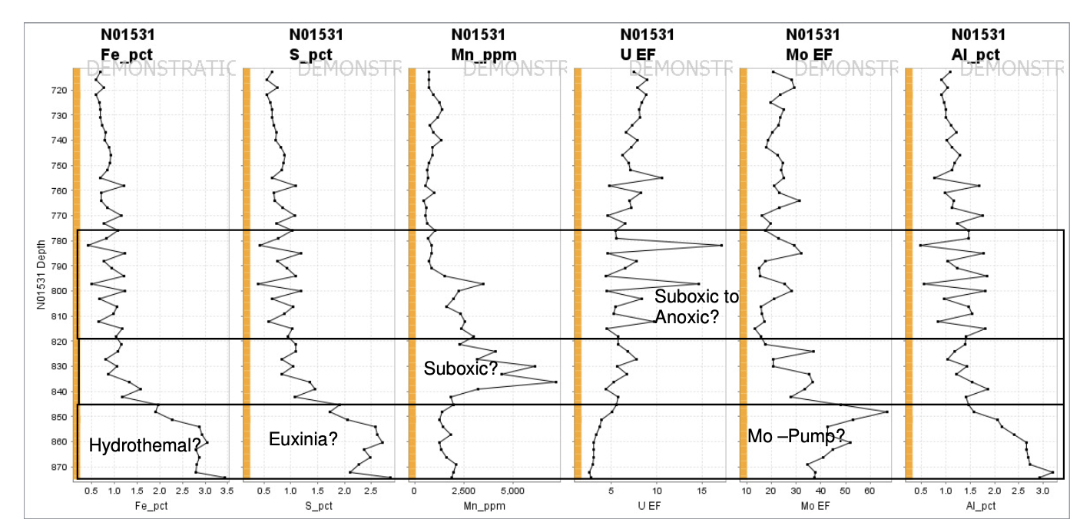
TRACING THE FLUID SYSTEM
According to Tribovillard 2009

Slide 13
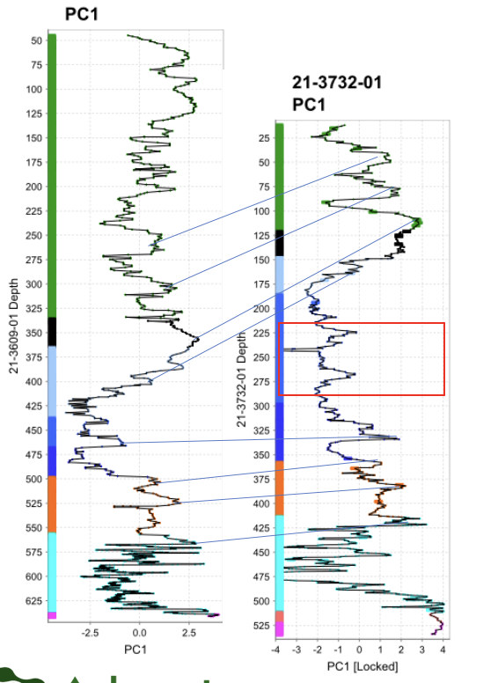
TRACING THE SILICATE SYSTEM
Immobile element (detrital) proxy
Shows combined variation in the elements Cr, Ti, Si, Zr, Ni – should represent detrital processes and sedimentology
Allows for comparison between 21-3609-01 and 21-3732-01
Shows that c.60m of the lower ABL is missing or faulted out from 21-3732-01
Other faults in 21-3732-01 (horizontal symbols on profile trace) do not seem to have a large throw.
Notes:
Faulting

Slide 14
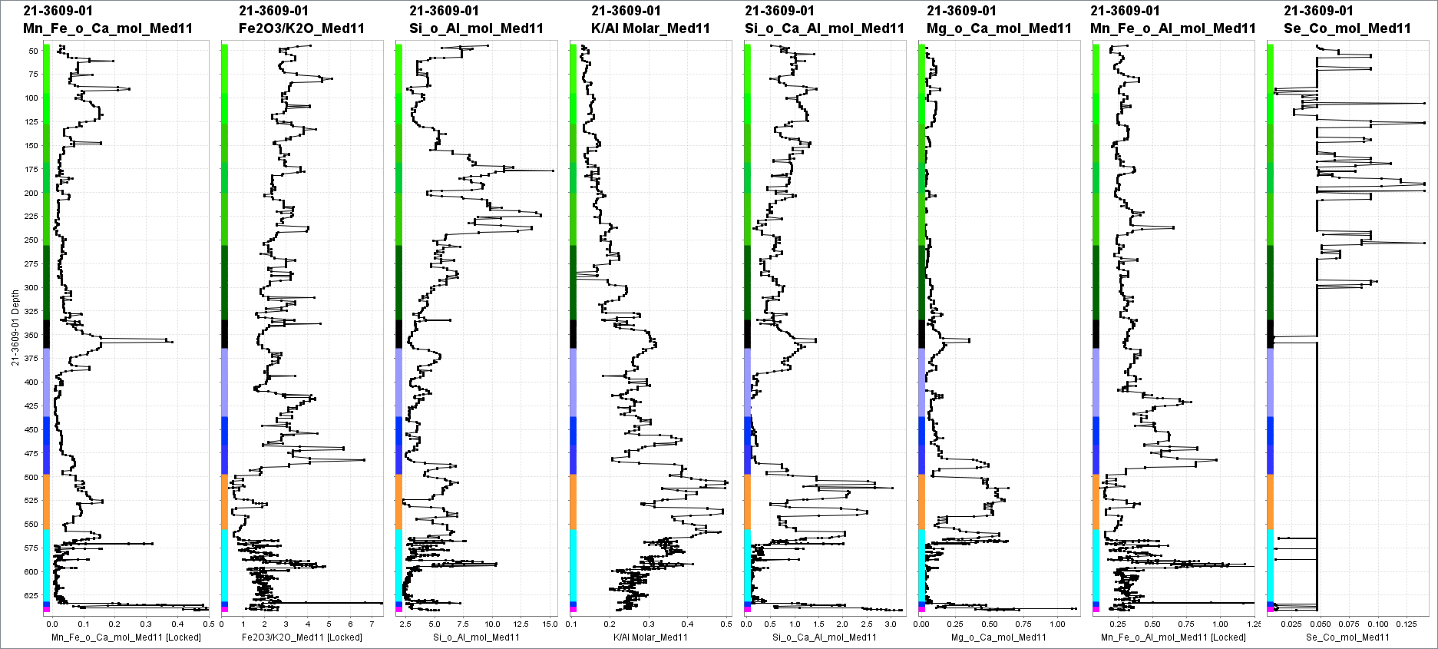
TRACING THE SILICATE SYSTEM
Mn+Fe/Ca
Fe₂O₃/K₂O
Si/Al
K/Al
Si/Ca+Al
Mg/Ca
Mn+Fe/Al
Se/Co
Calp
Mature sed.
Sandier
Slumped
Unit
Tober
Colleen Fm.
Upper ABL.
Lower ABL
+ Shaley pales.
Dolomite.
Upper Sandstone
Unit.
Sand
Micrite Unit
Basement
Notes:
Faulting

Slide 15
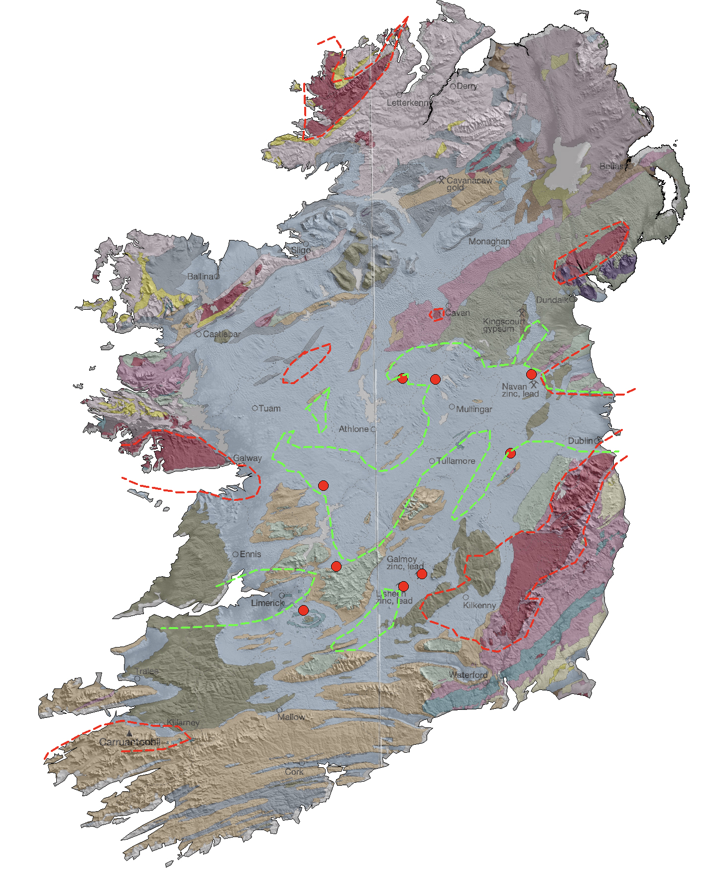
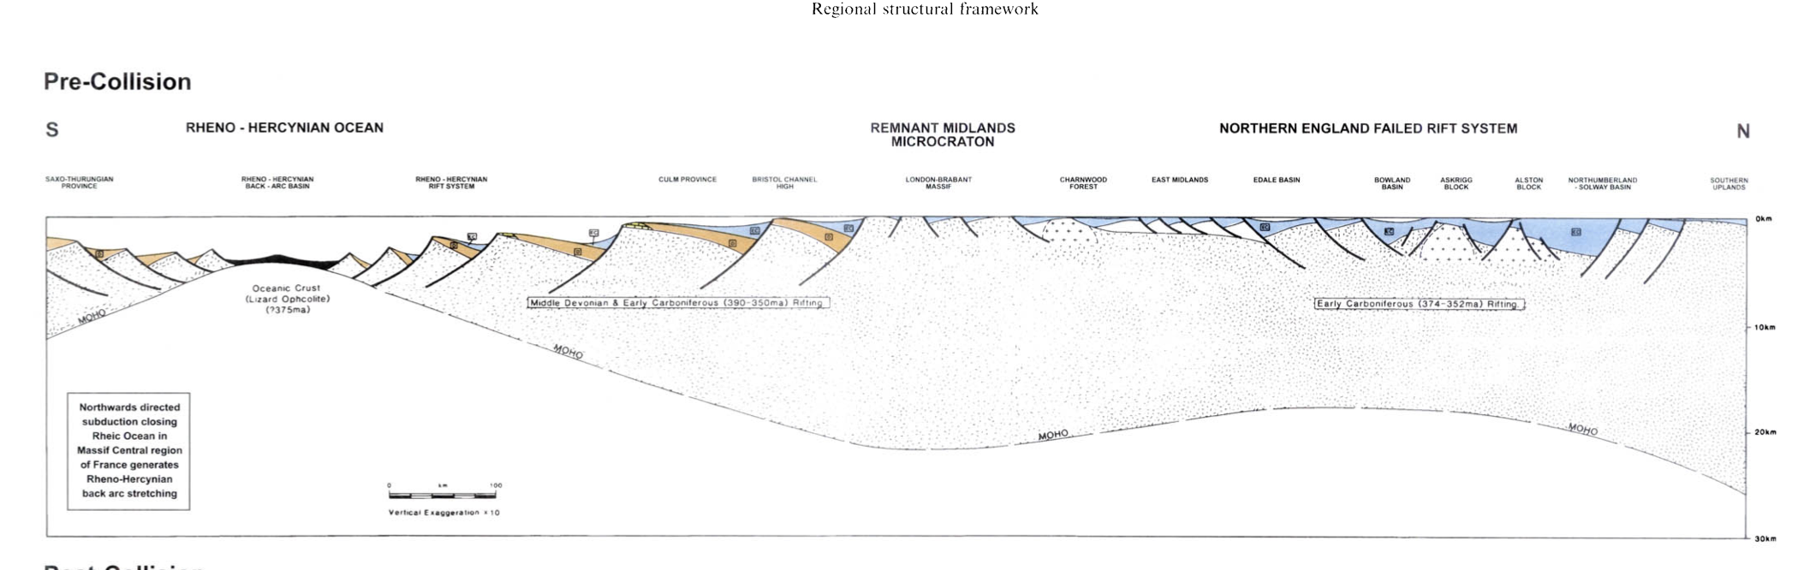
ADDING The Tectonic System
Did the deposits form due to:
The initial stages of extension (Tipping point)
Switches in the prevailing far-field stress (External or rare transient geodynamic trigger)
The high granularity ‘normal’ basin evolution:
Marine transgression → Rifting → Progradation (Thermal subsidence) → Compression
FRAISER AND GAWTHORPE 2003

Slide 16
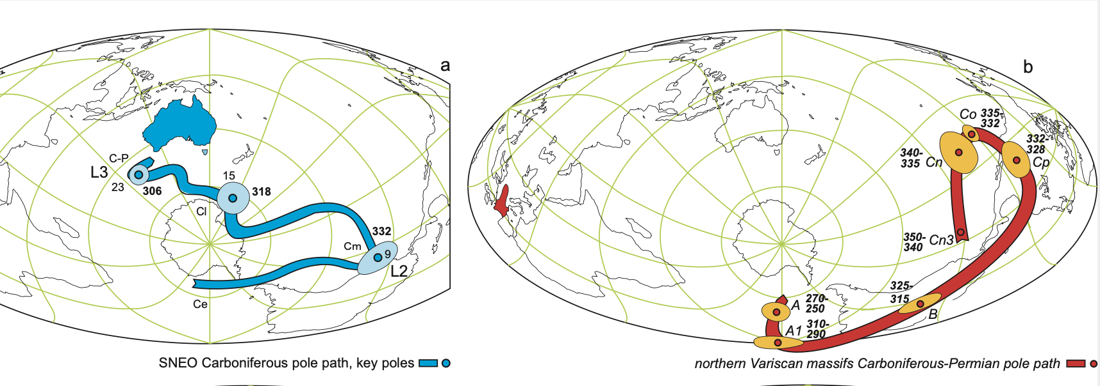
EXTERNAL TRANSIENT GEODYNAMIC TRIGGER
Klootwijk · 2023
Notes:
Waulsortian Reef Map profile
Point – very successful and adaptable and the formation of a reef knoll is an emergent behavior

