Slide 1
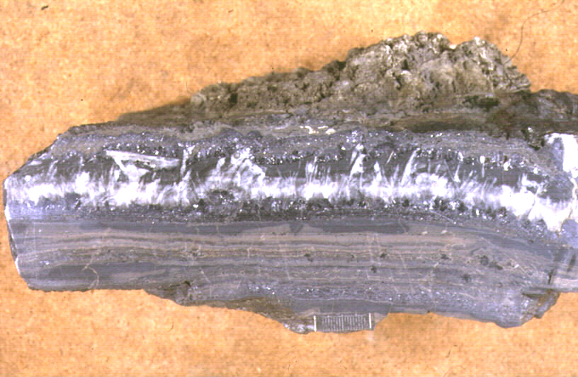
On Irish Bacteriometallogenesis and its
Wider Connotations
IAEG50
Michael Russell
NIS Università degli Studi di Torino
michaeljrussell80@gmail.com
Credit: David Banks
Notes:
8th September 2023

Slide 2

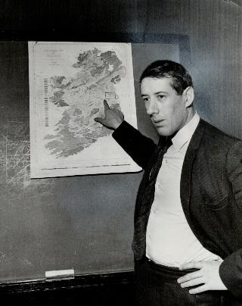

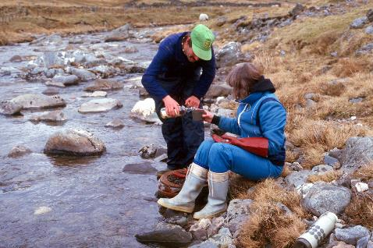


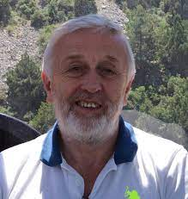


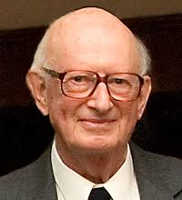

KERR ANDERSON
DEREK ROMER
GARTH EARLS
A
D
R
I
A
N
ROB
BLAKEMAN
COLIN
ANDREW
B
O
Y
C
E
JOHN ASHTON
DAVID BANKS
IAIN SAMSON
ALLAN HALL
TONY FALLICK
MIKE SOLOMON
DUTCH
VAN TASSELL
DICK STANTON
EARL DODSON

Slide 3
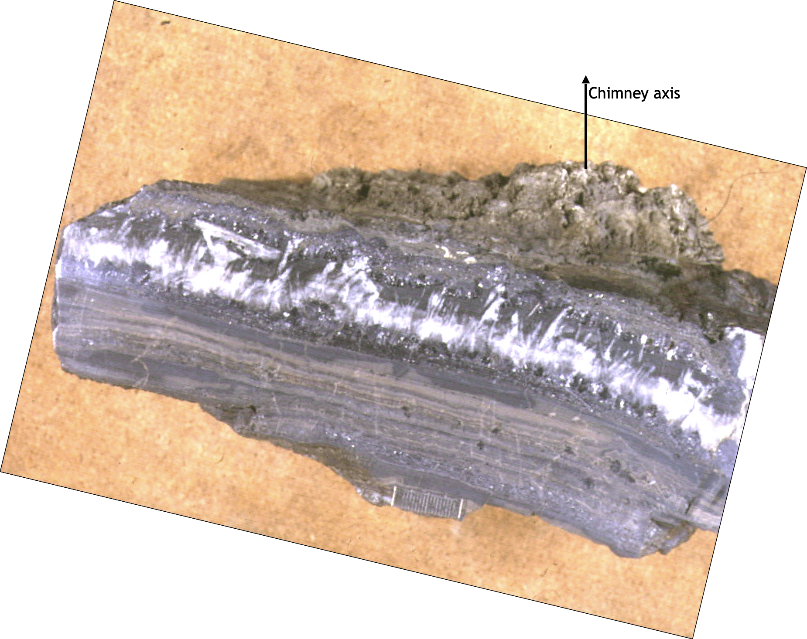
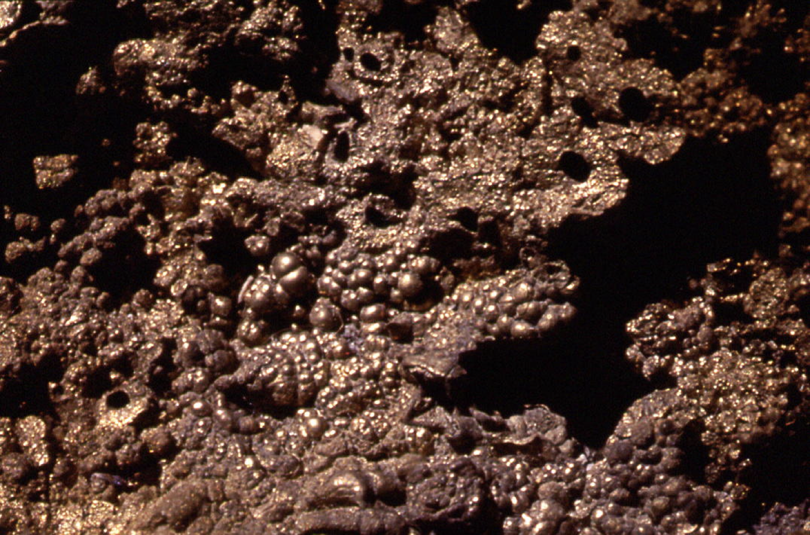
Chimney axis
Credit:
David Banks
1985
Nature 313, 128
TYNAGH Pb-Zn
Hunterian
Museum
Glasgow
2 cm
Banks, D. A. (1985). A fossil hydrothermal worm assemblage from the Tynagh lead–zinc deposit in Ireland. Nature, 313(5998), 128-131.

Slide 4
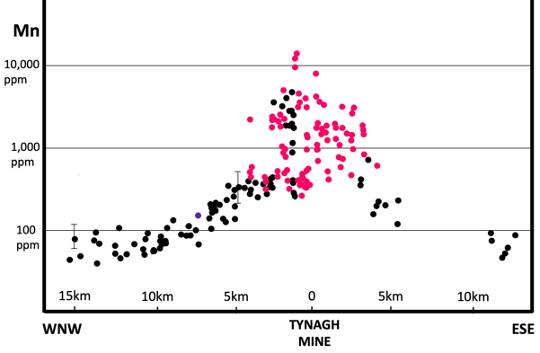
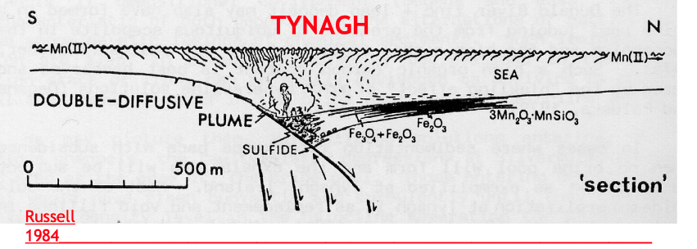
Russell, 1974 Manganese halo surrounding the Tynagh ore
Trans Institution Mining Metallurgy, Applied Earth Science 83, B65-66.

Slide 5
Disrupted hematitic barite and pyrite soft sediments,
+ diagenetic galena overgrowths –Ballynoe, Silvermines
and see Andrew, The tectono-stratigraphic controls to mineralization in the Silvermines area,
In Geology and Genesis of Mineral Deposits in Ireland, Andrew et al.; IAEG: Dublin, 1986, 377-417

Slide 6
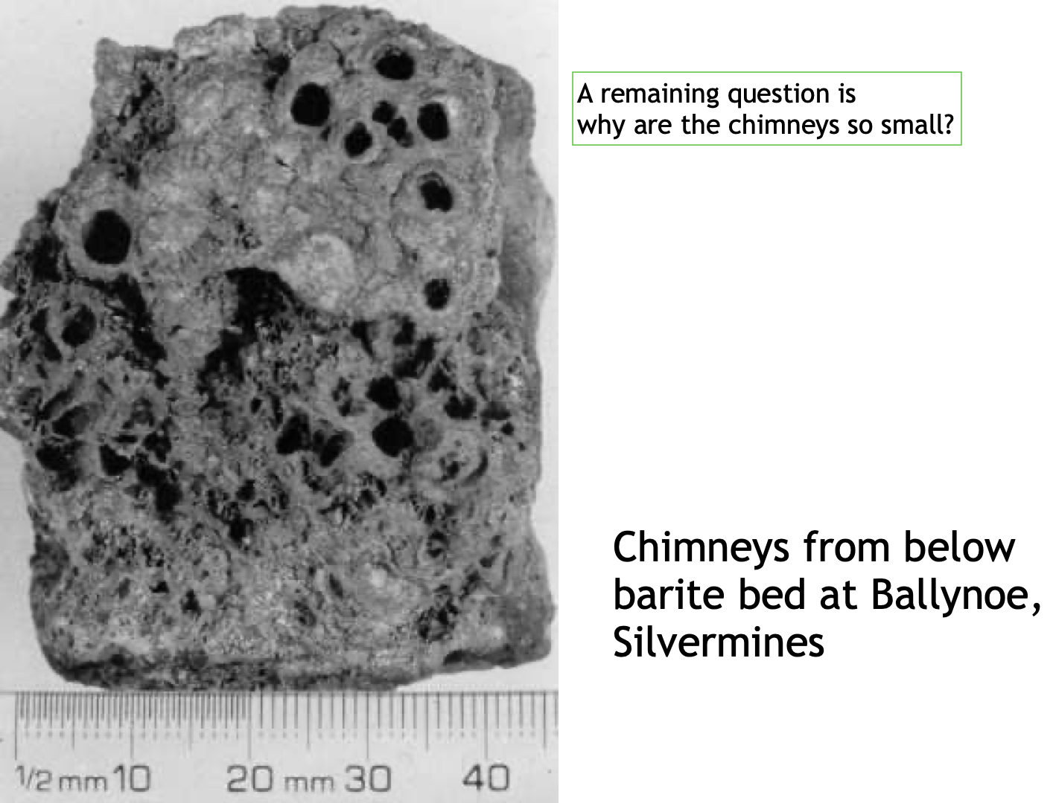
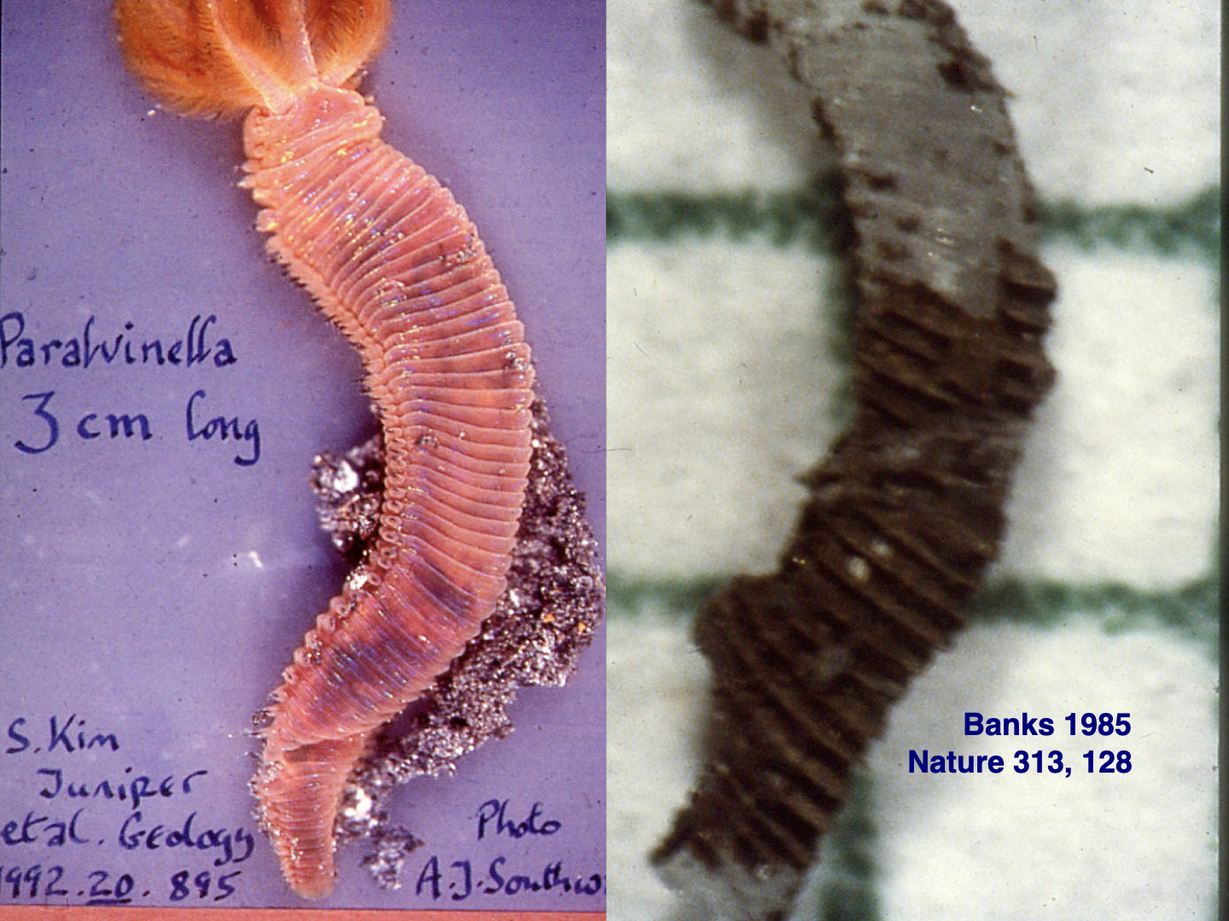
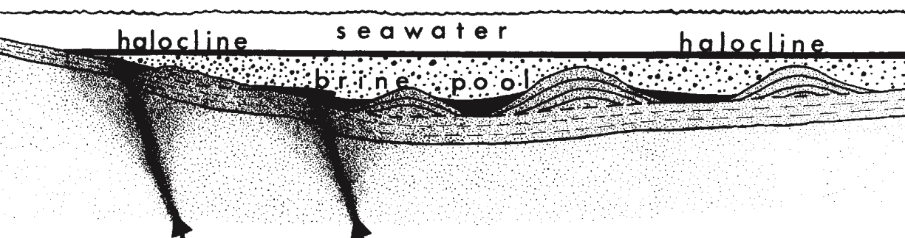
TYNAGH
e.g., Boyce et al. 1983 Nature 306, 545-550
Boyce et
al. 1983
Taylor and Andrew, 1978, Silvermines

Slide 7
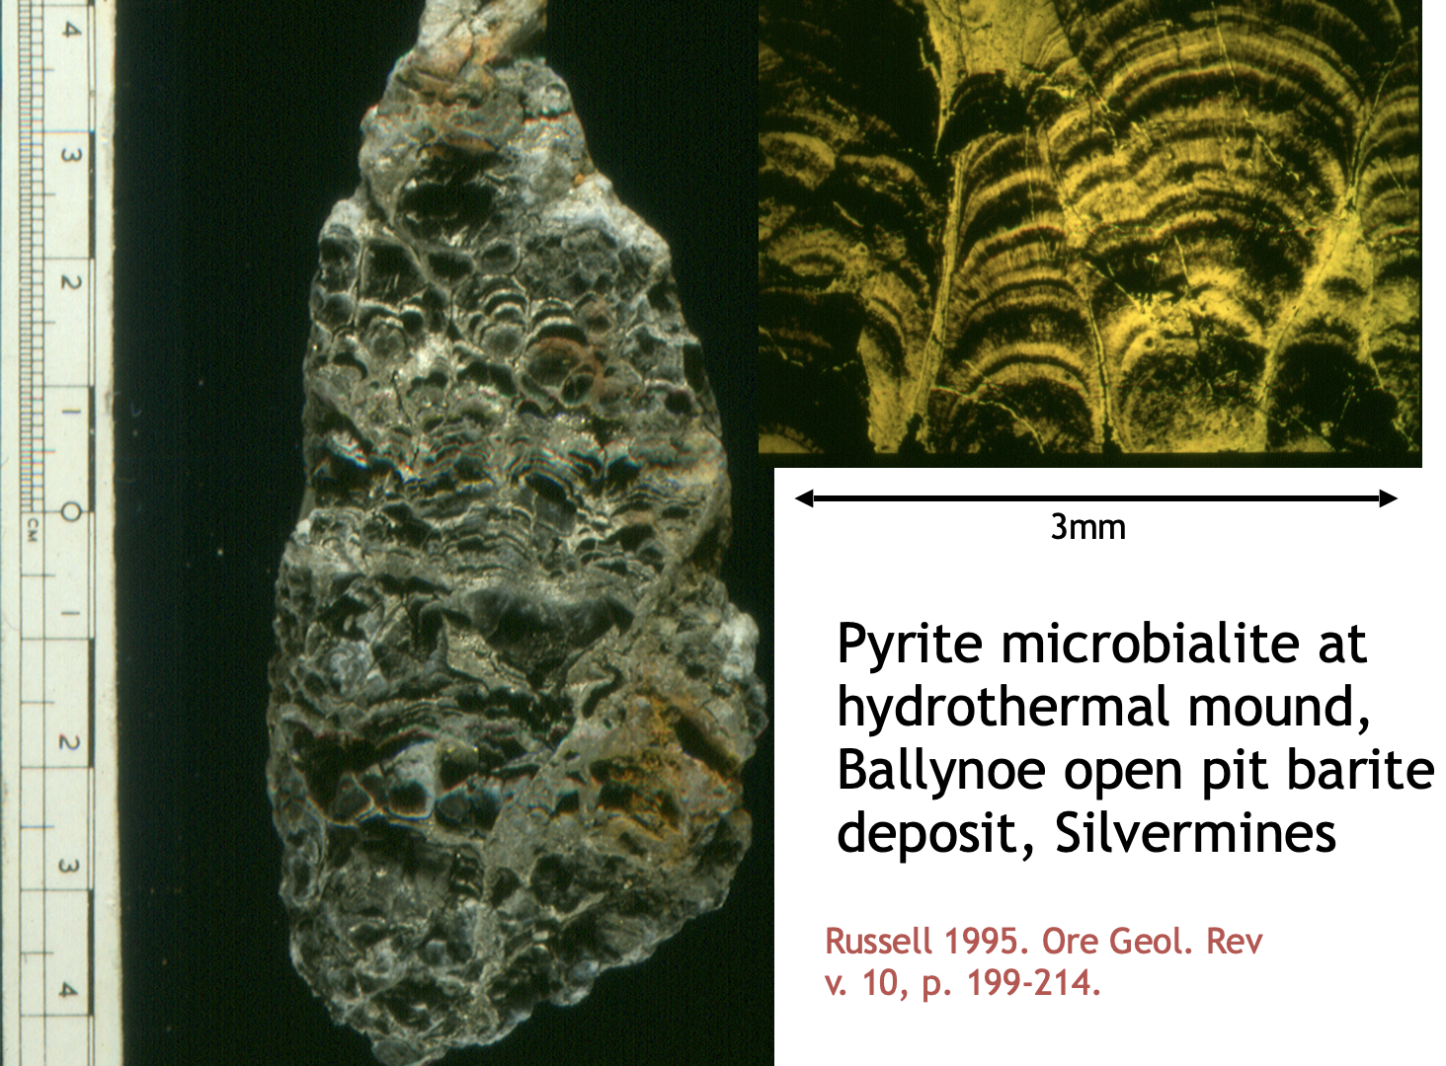

Slide 8
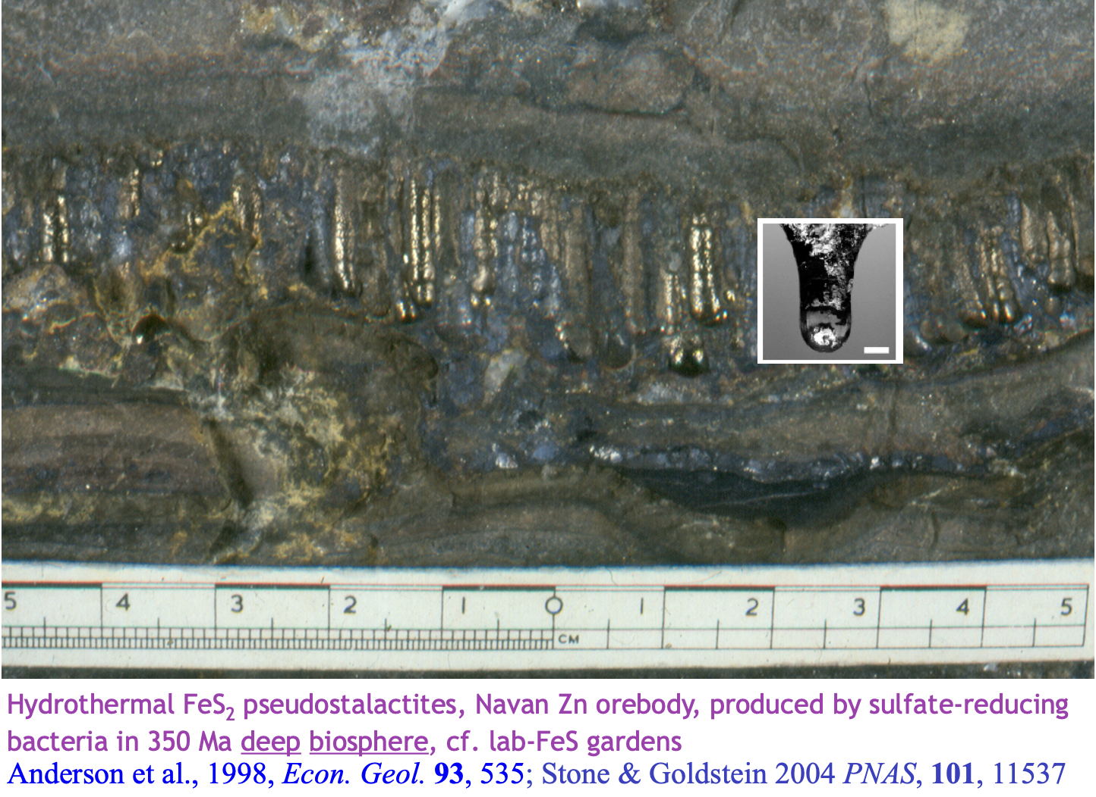
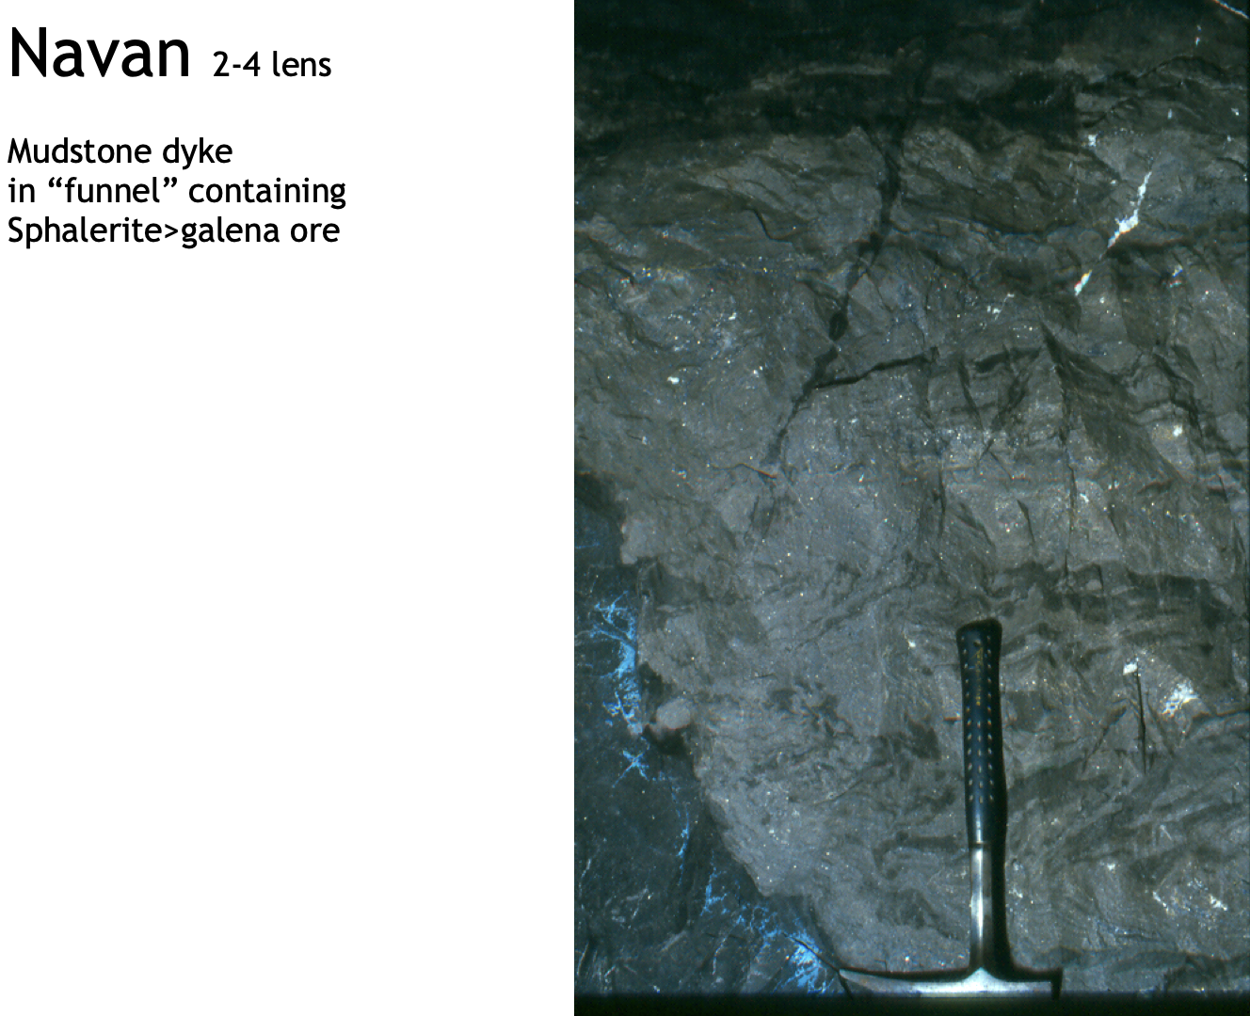
Pyrite stalactites dripping into jacked joint,
Navan
Anderson et al. 1998 Econ Geol 93, 535
Neptunian dyke
Navan
Lab homolog
Stone, Goldstein
PNAS 101 11537

Slide 9
Russell 1969,
Trans Inst Min
Metal B78, 127
plus Navan,
Galmoy, Lisheen,
Tara Deep and
N. Channel Dyke
Russell 1972
Scott J Geol 8, 75
Murphy’s line

Slide 10
N
N
Russell 1969,
Trans Inst Min
Metal B78, 127
NC
NC
CF1
CF2
Navan
Tara D
Vaughan 1974
PhD Strathclyde
Gf2
CF3
Gf1
Gf3
N
CF1
CF2
Galmoy
Lisheen
Stonepark
PG

Slide 11
N
N
NC
NC
CF1
CF2
Navan
Tara D
Gf2
CF3
Gf1
Gf3
N
CF1
CF2
Galmoy
Lisheen
Stonepark
PG

Slide 12


0/0.2
Davidheiser-Kroll et al. 2014 Mineralium Deposita 4, 547
“Mantle heat drives
hydrothermal fluids”
0/0.1/0.2 ³He/⁴He
0/0.1
Near surface dissipation of pore pressure
2∅
Gf1
CF3
Gf2
CF2
Gf3
CF1
High pressure volatiles
Russell, 1973 Implications
Continental Drift to Earth Sciences
Academic Press, 581-597
Rivas-Dorado et al., 2023
EPSL. 594, 117692.
BRITTLE CRUST
PARTIAL MELT
…
.
.
Stähler
2022
Domain of disequilibria
$$μ$$
Domain of disequilibria
∅
Failure envelope
Stable domain
𝜎_{h}
Russell, Burgess 1969
Nature 222, 1056
𝜎
𝜎
𝜎_{h - x}
𝜎_{h - x}
𝜎_{v-}$μ$
𝜎_{v}
𝜎_{h - x}
𝜎_{h}
shear
failure
𝜎_{v}
Extensional
failure
Pore pressures
anomalously high
0 50 km
…
..
Notes:
𝜎_{v}
𝜎_{v}
𝜎_{v}
𝜎_{v}

Slide 13
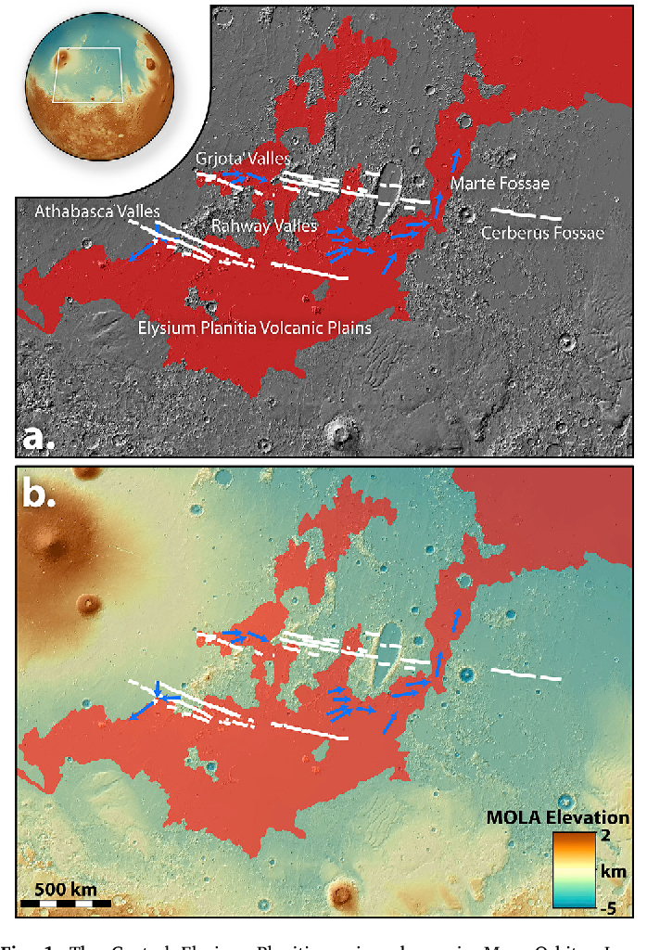
Cassanelli, Head 2018 Formation of Athabasca Valles. Planet Space Sci 158, 96
Cerberus Fossae
500km

Slide 14
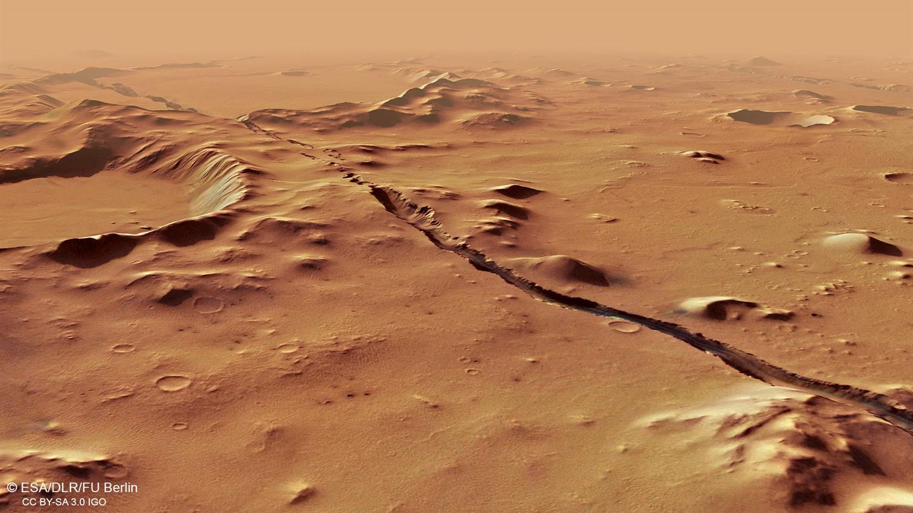
Perspective view of Cerberus Fossae, ESA

Slide 15
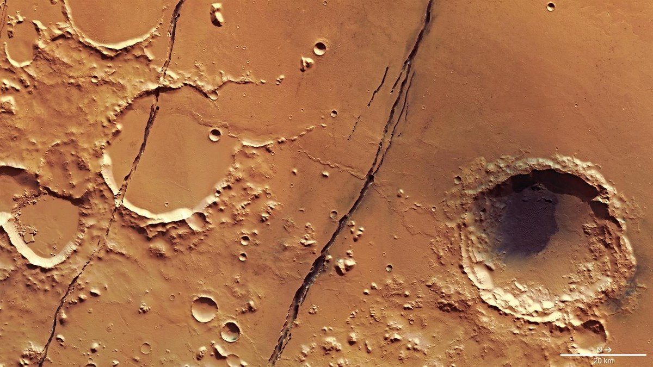
Cerberus Fossae
ESA
20km

Slide 16
N
N
Same
scale
Cerberus Fossae
Stahler et al 2022
Nature Astron 6, 1376
NC
NC
CF1
CF2
N
Navan
Tara D
CF1
Gf2
CF3
Gf1
Gf3
CF2
Galmoy
Lisheen
Cerberus Fossae
Stonepark
PG

Slide 17
Magma rose along these fractures reaching a high level in the crust (Russell 1968, 1972)
Stähler
2022
Rivas-Dorado 2023 Dike induced
graben nucleation Mars
EPSL 594, 117692.

Slide 18
Stähler et al. 2022
Tectonics of Cerberus Fossae
unveiled by marsquakes.
Nature Astronomy 6, 1376
High pressure volatiles

Slide 19
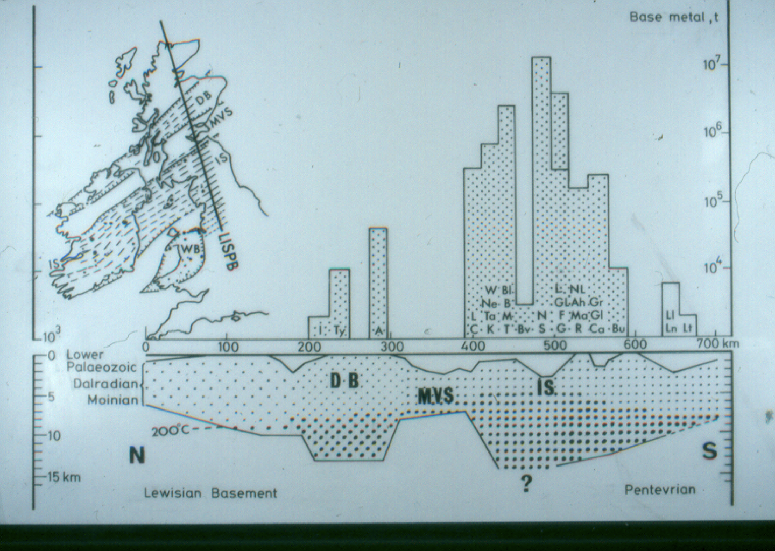
Russell,1978 Downward-excavating hydrothermal cells Trans Instn Min Metall 89, B168-171.

Slide 20
High pressure volatiles
³He
DOWNWARD EXCAVATING CRACKING ENGINE (Russell, Skauli, 1991)

Slide 21
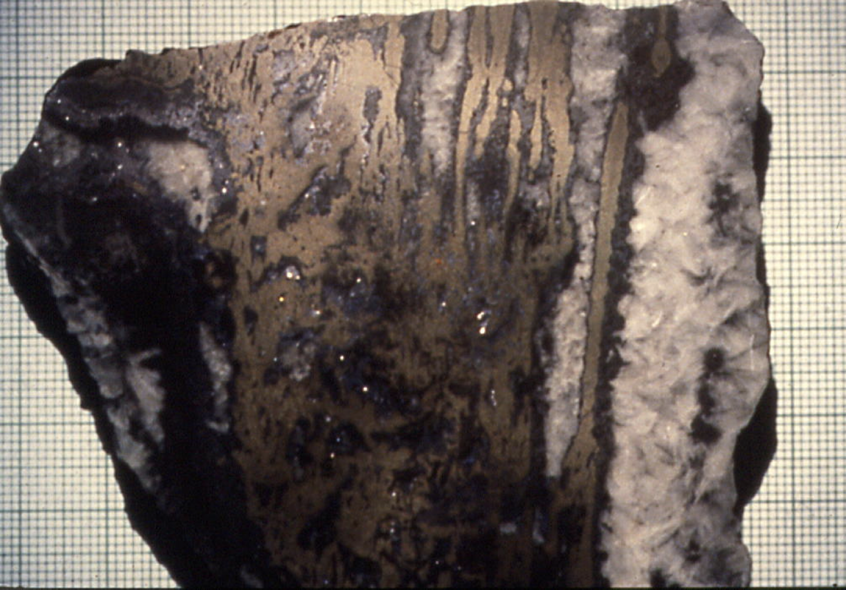
Natural pyrite garden, Tynagh
John Hutchings

Slide 22
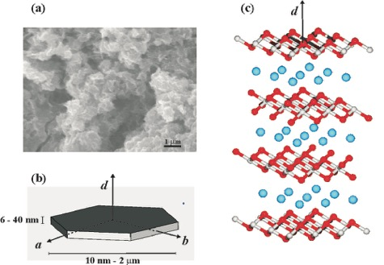
2D Fougerite, complex green rust mineral
~Fe₂(OH)₅.H₂O
anions
OH
Green rust wall
~10 - 40 µm thick comprising ~50 – 200 nanocrysts orthogonal with wall, so likely resonating, and self organizing
Barge et al. 2020, 3D-analysis of simulated prebiotic hydrothermal chimney. ACS Earth Space Chem. 4.9, 1663

Slide 23
Submarine power-plant
Barge et al. 2015 Generation of Electrical Potential and Current Across Self‐Assembling Iron Mineral Membranes
Angew Chem Int Ed 54:8184.
…
Yamamoto et al. 2013 Generation of Electricity and Illumination by an Environmental Fuel Cell in Deep‐Sea Hydrothermal Vents. 52: 10758

Slide 24
N₂+CO₂→NO
CO₂ > NO₃–, NO₂–
Fe^{III}
Carbonic ocean
CO₂ P₄O₁₀
↑WASTE
v. hot
acidic
spring
Fe²⁺ Ni²⁺ Co²⁺ Zn²⁺ H₂PO₄–
H₃O⁺
EoL
H₂ CH₄
alkaline
vent
~130℃
2D fougerite
BIF
magmatic
vapors
410℃
Russell, M. 2023 A Self-sustaining Serpentinization Mega-engine Feeds the Fougerite Nanoengines Implicated in the Emergence of Guided Metabolism. Front. Microbiol. 14, 1083.

Slide 25
Supernovae
YOUNG SUN
Russell, M. J. (2023).
A self-sustaining serpentinization mega-engine feeds the fougerite nanoengines implicated in the emergence of guided metabolism. Frontiers Microbiol 14, 1145915.
Rain-out from
Hadean atmosphere
N₂+2CO₂→2NO+2CO
Fe^{III} Mn^{IV}
CARBONIC
OCEAN
DISEQUILIBRIA
ē
CO₂ > NO₃–
ē
ē
CO₂ >>P₄O₁₀ >N₂O
H₃O⁺
↑WASTE
𝝙pH ~ 5
2D Fougerite engines
2D Greenalite & Mackinawite
410℃ springs
Fe²⁺ Ni²⁺ Zn²⁺ Co²⁺…
H₂
OH–
CH₄
EoL
90-40℃
HS–
Mo^{IV}
Fougerite precursor ------------------> to Fe₃O₄ in BIF
↑
Alkaline vent
~130ºC
Magmatic
devolatilization
SERPENTINIZING ENGINE

Slide 26
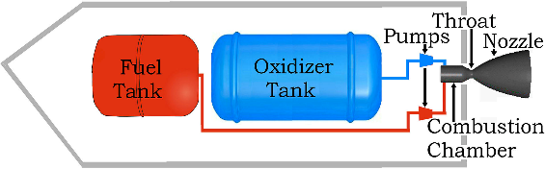
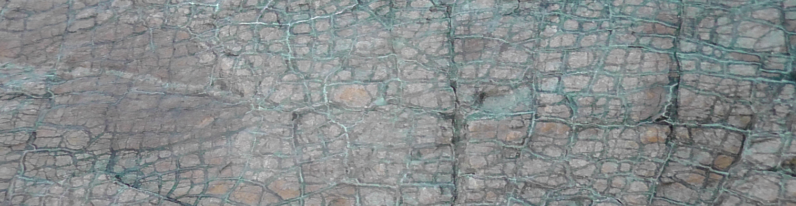
Figuring out how life first took off is (much like) rocket science!
Russell 2019 Planetary and Space Science, 175:13-20
Exhalation
H₂O etc.
NO
mound & rocket
are both
ENGINES!
guidance comes later !
PREBIOTIC
CHEMISTRY
IS
VITALISTIC!
Carbonic
ocean
pH ~5.5
BIOSYNTHESIS
Carbureted oxidation
CO
•CH₃
~100°C
pH ~11
NH₃ ←
H⁺ + NO₃⁻
CO₂
H₂O + NO + CO
H₂
H₂
H₂ + CH₄
Serpentinizing
mother engine
CH₄

Slide 27

Binding
pocket
fougerite BARRIER
?
CO₂
H⁺ →
OH⁻
← ē ē
OH⁻
ē
ē
2H⁺
ē
H⁺
2H⁺
ē
2H⁺
ē
H⁺
N₂H₄
H₂
2H⁺ + NO₃⁻
NO₂⁻
NO
HNO
H₂NOH
NH₂⁻
NH₃
OH⁻
OCEAN
ē
ē
ē
ē
← ē ē
ē
~130℃
Electrostatic/Conformational Gate
controls escapement mechanism →
0.3–0.4nm
gallery
H₂
NO₃⁻
CH₄
ē
H⁺ →
ALKALINE SOLUTION
ē
Figure 2 in Russell, M. J., 2023 A self-sustaining serpentinization mega-engine feeds the fougerite nanoengines implicated in the emergence of guided metabolism. Frontiers in Microbiology 9, 1357

Slide 28

ACIDULOUS OCEAN
GREEN RUST ENGINE
ALKALINE
HYDROTHERMAL
FLUX
ē
ē
ē
ē
← ē ē
2H⁺
H⁺
2H⁺
2H⁺ + NO₃⁻
NO₂⁻
2H⁺
H⁺
H⁺/OH⁻
NO
HNO
H₂NOH
NH₂
NH₃
H⁺/OH⁻
H⁺/OH⁻
ē
ē
ē
ē
← ē ē
H⁺/OH⁻
H⁺/OH⁻
CH₄ + NO + 2e⁻ + 2H⁺ → CH₃OH + NH₂
H⁺/OH⁻
←
H⁺/OH⁻
H⁺/OH⁻
CO₂
H⁺ →
H⁺ → NH₃ → NH₄⁺ + C₃H₄O₃⁻ → C₃H₆O₂NH₂ → [C₃H₅O₂NH₂]_{n}
CO₂
H⁺/OH⁻
← ē ē
OH⁻
OH⁻
H⁺ →
polyalanine
_{OH}⁻
H₂
_{OH}⁻
H₂
OH⁻
OH⁻
OCEAN
CH₄
NO₃
NO₃
OH⁻
OH⁻
OH⁻
https://doi.org/10.3390/life8030035

Slide 29
KERR ANDERSON
DEREK ROMER
GARTH EARLS
A
D
R
I
A
N
ROB
BLAKEMAN
COLIN
ANDREW
B
O
Y
C
E
JOHN ASHTON
DAVID BANKS
IAIN SAMSON
ALLAN HALL
TONY FALLICK
MIKE SOLOMON
DUTCH
VAN TASSELL
DICK STANTON
EARL DODSON

Slide 32
Jacob et al. 2022 Seismic sources of InSight marsquakes … of Elysium Planitia, Mars
Tectonophysics 837, 229434.

Slide 33
Cerberus Fossae
Perrin et al. 2022
JGR Planets 127,
p.e2021JE007118.

Slide 34
Cerberus Fossae
Stahler et al 2022
Nature Astron 6, 1376

Slide 35
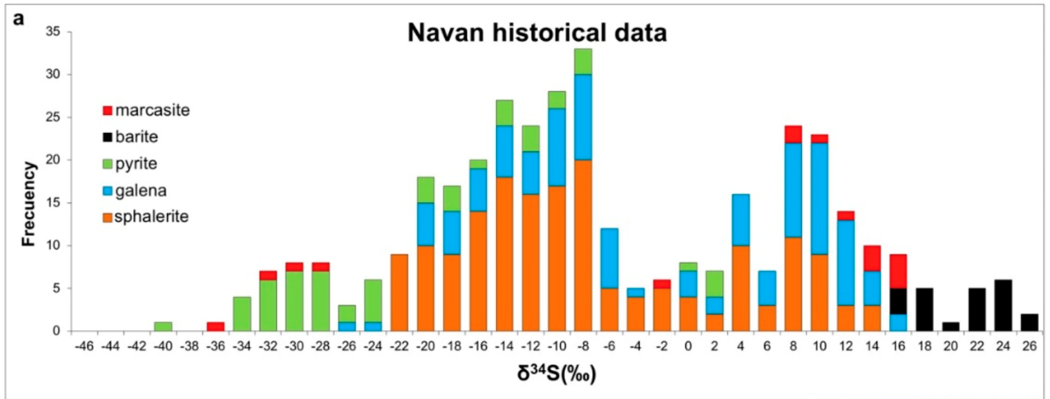
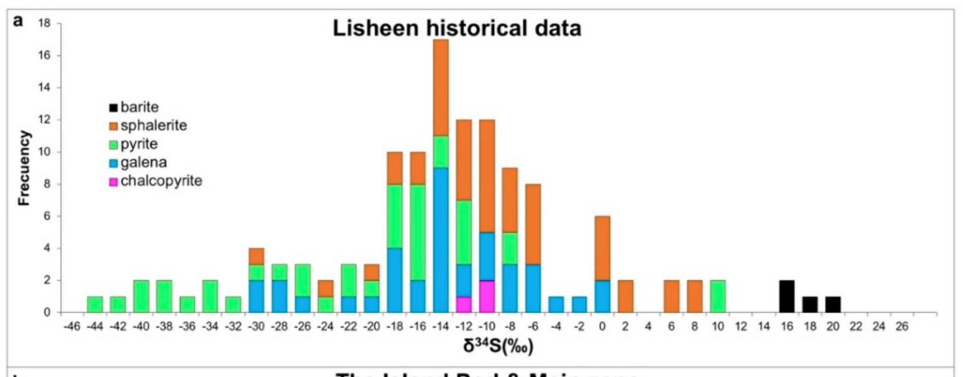
Yesares et al. 2019
Coupling Mineralogy, …
Stable and Radiogenic
Isotopes in …
Ore-Forming Processes
Minerals 2019, 9, 335.
and see
Fallick et al. 2000 Econ. Geol.
2001, 96, 885–890.
and
Wilkinson et al. Econ. Geol.
2005, 100, 63–86

