Slide 1
Carbonate-hosted Pb-Zn deposits in China: a review of the geological characteristics and genesis
Dr. Lingli Zhou, VU Amsterdam/ iCRAG, UCD
Yi Zheng, Yucai, Jiaxi Zhou, Xiaoxia Duan, Yumiao Meng, Peng-peng Yu, Zhanke Li, Suofei Xiong, Fan Xiao, Yongbin Wang

Slide 2
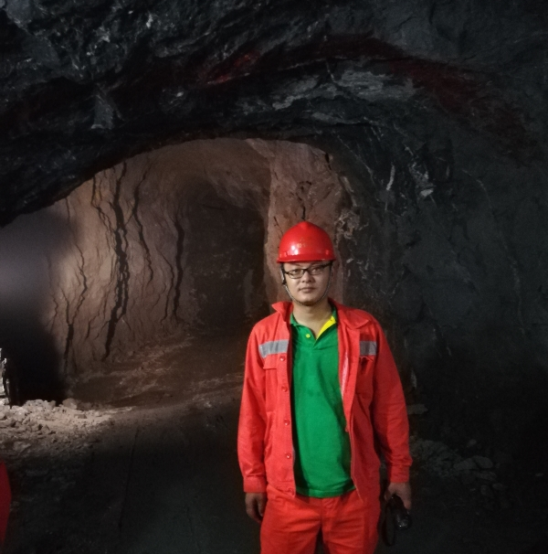
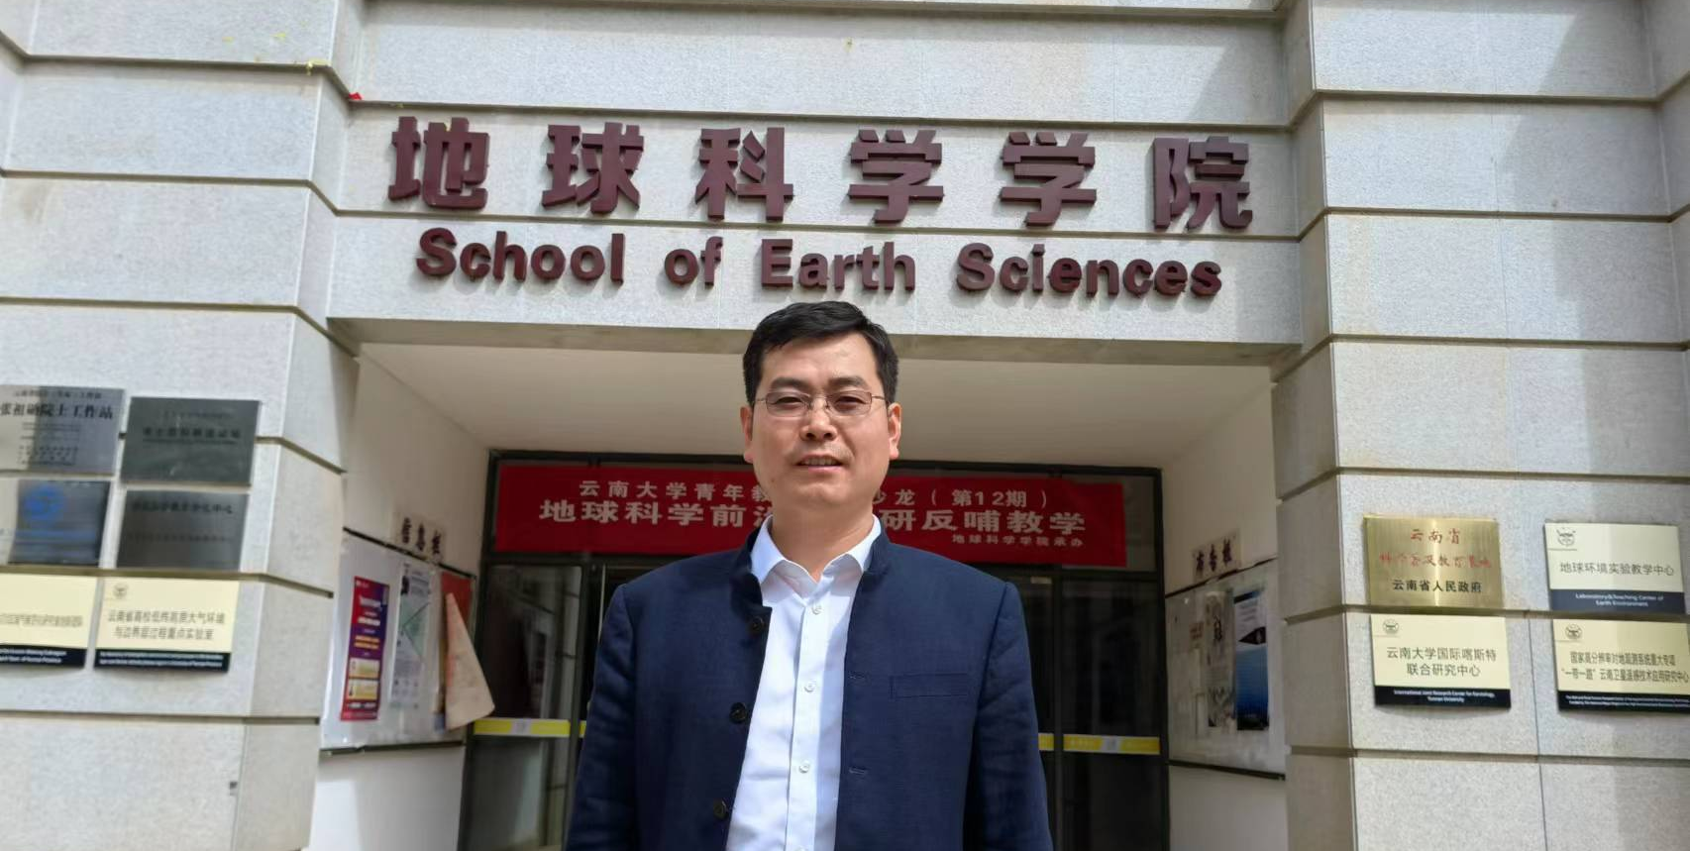
Acknowledgement
Prof. Yi Zheng, Sun Yat-Sen University
Dr. Yucai Song, Chinese Academy of Geological Sciences
Prof. Jiaxi Zhou, Yunnan University
Zhaobin Hu, Yihan Wu and Lijie Long, Sun Yat-Sen University

Slide 3
Outline
1- Tectonic evolution history of China
2- Distribution of marine carbonate-hosted Pb-Zn deposits
3- Geological characteristics and genesis of selected Pb-Zn deposits
4- Wrap up thoughts: Essentials for making a big marine carbonate hosted Pb-Zn deposit

Slide 4
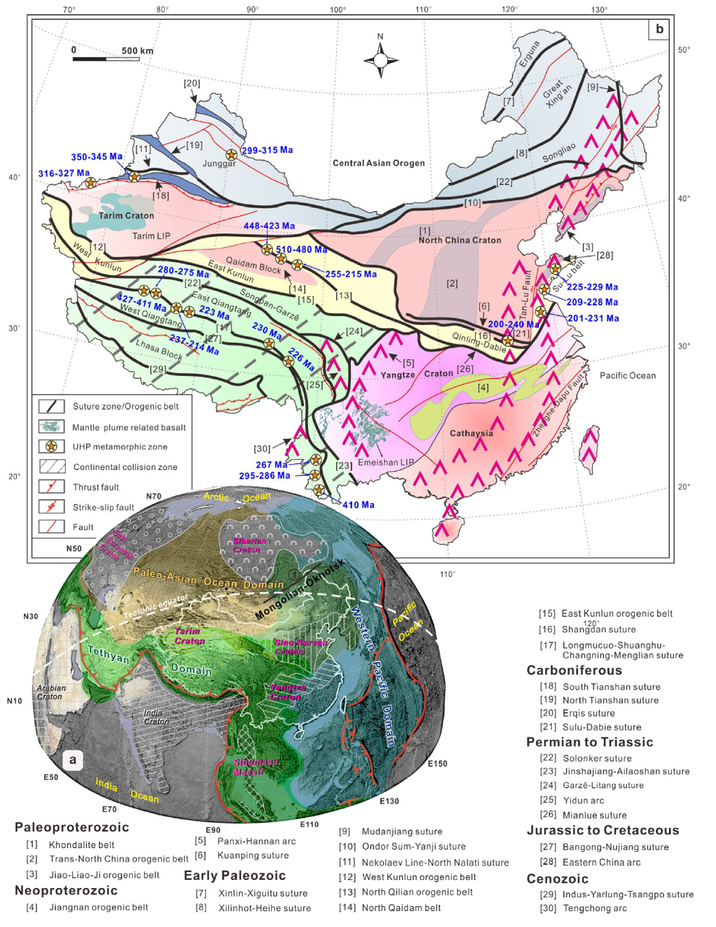
1. Tectonic evolution history of China
China in Presinian times一the formation of continental nuclei, protoplatforms and platforms
China from the Sinian (Neoproterozoic) to the Triassic the formation of supercontinent
China in post-Indosinian times一intracontinental development
(Deng et al., 2017)
Notes:
during which the Paleo-Asian Ocean, Tethyan and Western Pacific domains conjured and formed a continental crust composed of cratonic blocks and orogenic belts
the tectonic evolution of China is characterized by the formation of continental crust nuclei and increasing size and stabilization of the continental crust. Continental crust nuclei were scattered mainly in north China in the Archean and were assembled during the cratonization of the North China through the amalgamation of micro-blocks
From the late Neoproterozoic to the Triassic China experienced complicated development of continental margins through rifting, splitting and reaccretion of marginal massifs, eventually forming the Eurasian Supercontinent

Slide 5
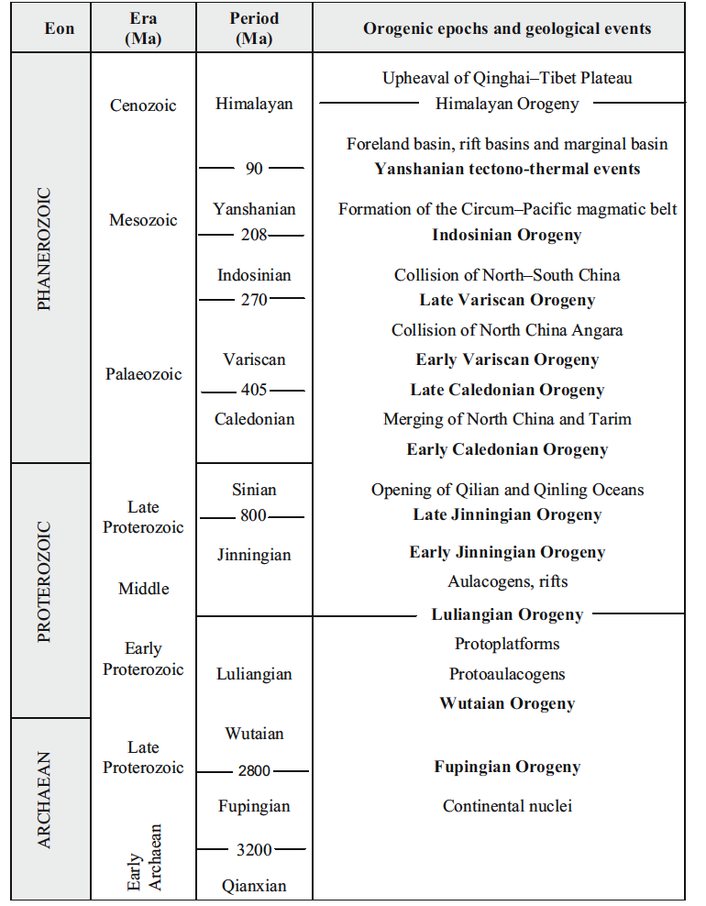
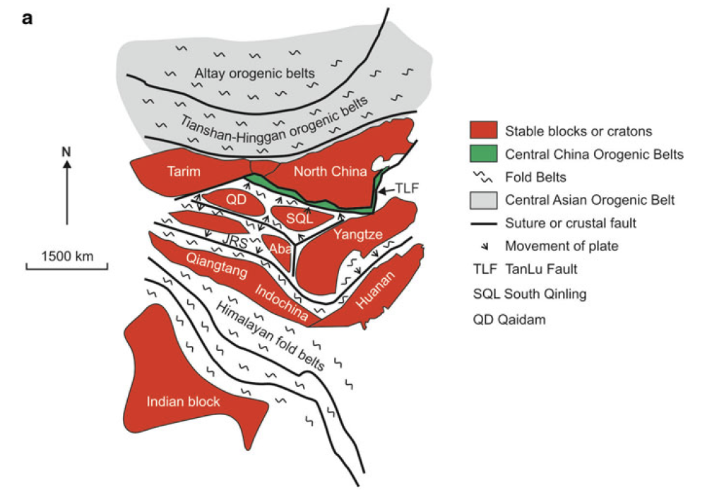
1. Tectonic evolution history of China
Main tectonic events in China (Pirajno, 2002)
Notes:
The end of the Indosinian Stage is marked with profound changes in the tectonic regime of China. The Palaeozoic tectonic framework was replaced by a Tethyan system in west China and a Pacific system in east China. The closure of Palaeo-Tethys in the Late Triassic resulted in several convergent and accretional crustal consumption zones as evidenced by the occurrence of ophiolite and ophiolitic mélange zones of Indosinian age in the Himalayan-Tibetan area. Almost every zone is accompanied with a magmatic belt, consisting of subduction- and collision-type volcanic and granitic rocks of Late Permian to Late Triassic age. The Indosinian convergence in the east Palaeo-Tethys region also formed foreland type sediments in the western border parts of the Ordos and Sichuan basins in Late Triassic. The post-Indosinian of China was mainly intracontinental. Continental collision, subduction and indentation of the massifs prevailed as the three surrounding plates, India, Siberia and Pacific, interacted. East and west China, however, were marked with different tectonic evolution history during the post-Indosinian time
Fig. 2.2 a Sketch showing the stable and/or cratonic blocks of China and intervening accreted
terranes, now forming fold or orogenic belts; b shows major southeast Asian fragments accreted
during the Late Palaeozoic, Mesozoic and Cenozoic. Sutures between the Qangtanga and Songpan-
Ganze represent the closure of the Palaeotethys in the Mesozoic; sutures bordering the India block
(Indus-Tsango) to the north represent the closure of the Neo-Tethys (India-Asia collision); sutures to
the north of the Tarim-North China cratonic block represent Palaeozoic oceanic closures associated
with the geodynamic evolution of the Central Asian Orogenic Belt. Details in text for both a and b

Slide 6
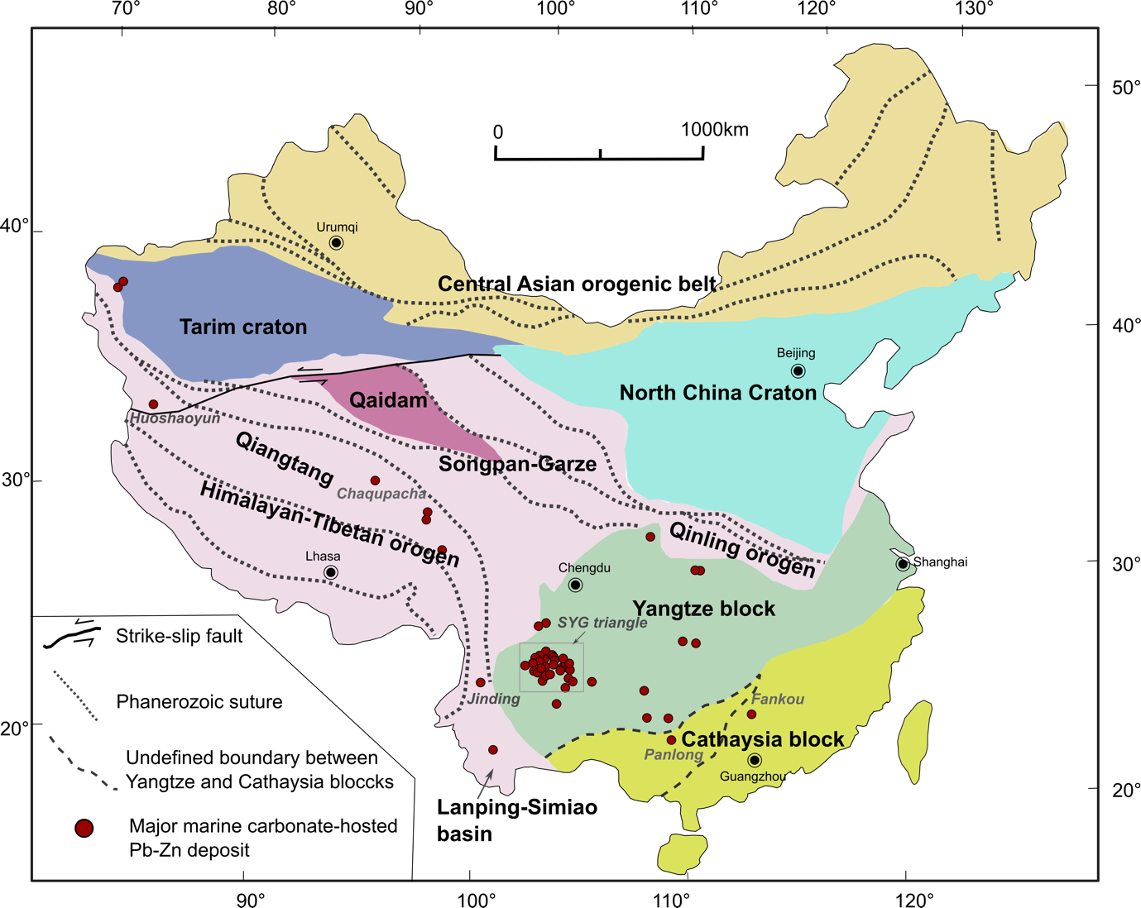
2. Distribution of major marine carbonate-hosted Pb-Zn deposits in China
(modified from Leach et al., 2019)
Carbonate-hosted Pb-Zn deposits in the SYG triangle of the Yangtze block
Huize Pb-Zn-(Ag-Ge) deposit
Carbonate-hosted Pb-Zn deposits in the Cathaysia block
Fankou Pb-Zn-(Ag-Ga-Ge-Cd) deposit
Carbonate-hosted Pb-Zn deposits in the Himalayan-Tibetan orogen
Jinding Pb-Zn deposit

Slide 7
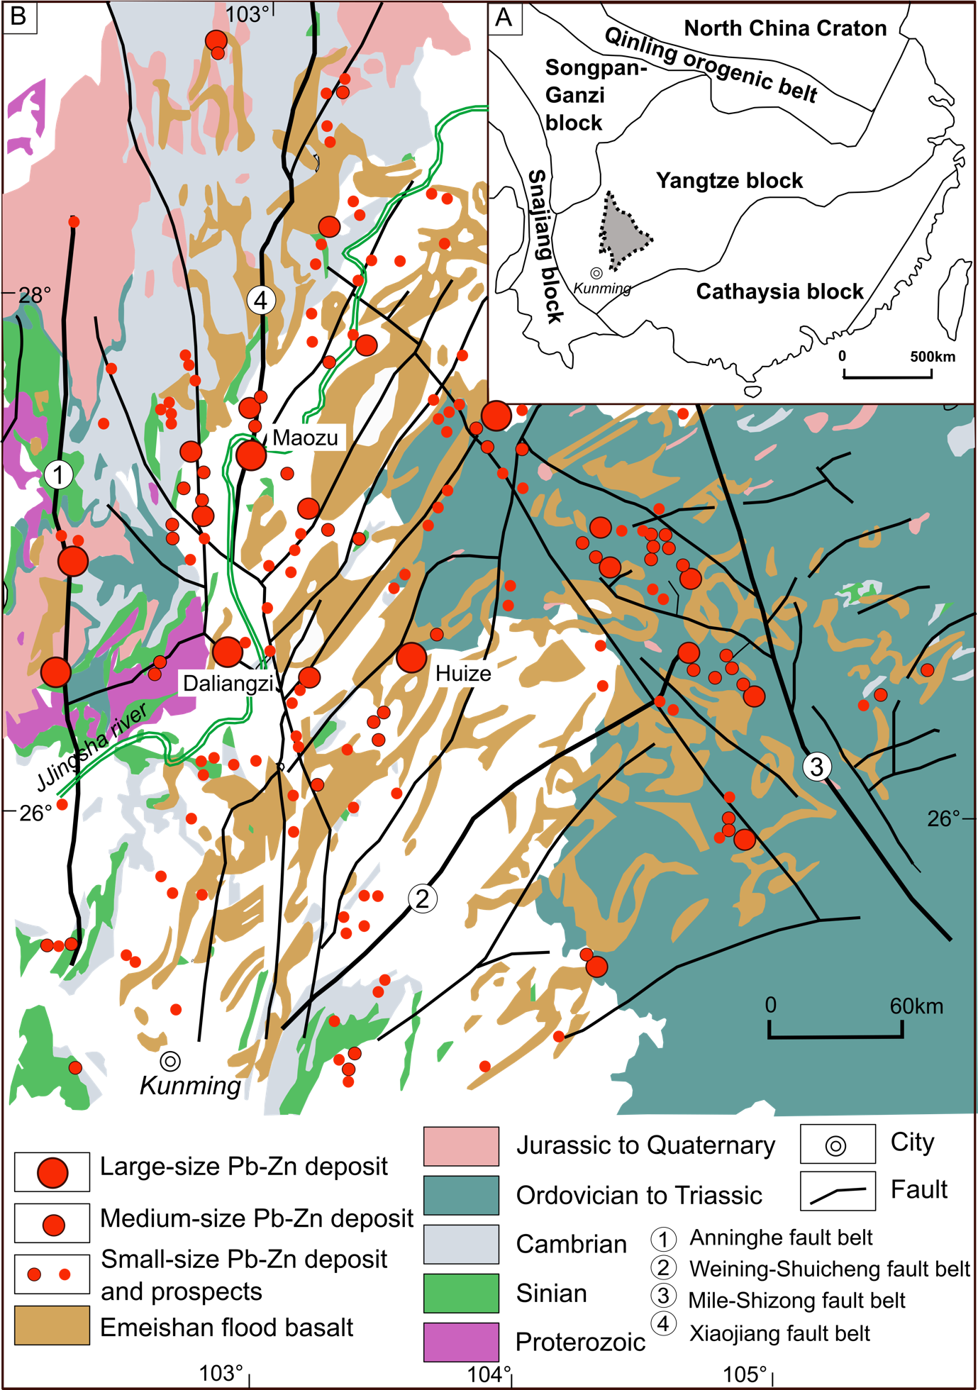
Sichuan-Yunnan-Guizhou (SYG)
Pb-Zn triangle
~170,000 km² and consists of northeastern Yunnan Province, northwestern Guizhou Province, and southwestern Sichuan Province
>450 carbonate-hosted Zn-Pb deposits, high grade, rich in Ge-Ag-Ga-Hg-Cd. The Huize deposit contains ~7 Mt metal reserves with an average grade > 25% Pb+Zn. Several other large Zn-Pb deposits have grades in the range of 10-30% Pb+Zn and contain between 0.65 and 4.2 Mt metal resources (Zhang et al., 2015)
Four regional fault belts, numerous secondary NE-SW- and NW-SE trending faults and thrust-fold belts. The Zn-Pb deposits are usually located near deep-seated regional faults and spatially associated with fault intersections and thrust-fold systems.
Extensive Permian Emeishan basalt are spatially associated with the Pb-Zn mineralization; >50 outcrops of diabase and gabbro sills and dykes are distributed along the Xiaojiang fault belt
﻿Simplified geological map (A) of the Sichuan-Yunnan-Guizhou triangle in grey and simplified tectonic map of South China (B), after Xu et al. (2019)
Notes:
Home to 292,301 people covering over 6,500 square kilometres
There are up to 52 igneous outcrops of intermediate to basic-ultrabasicity rocks along the NS-trending Xiaojiang fault zone of the SYGT (Yuan et al., 1985b; Song et al., 2001). There is, however, only one location where pyritised ultramafic rocks supported Pb and Zn mineralisation. These diabase and gabbro-diabase sills and dikes (K–Ar ages: 246–283 Ma) lie on the eastern side of the Xiaojiang fault (Liu and Lin, 1999). Certain diabase contact zones experienced intense hydrothermal alteration (e.g., silicification and epidotisation) and Pb, Zn, and Cu mineralisation.

Slide 8
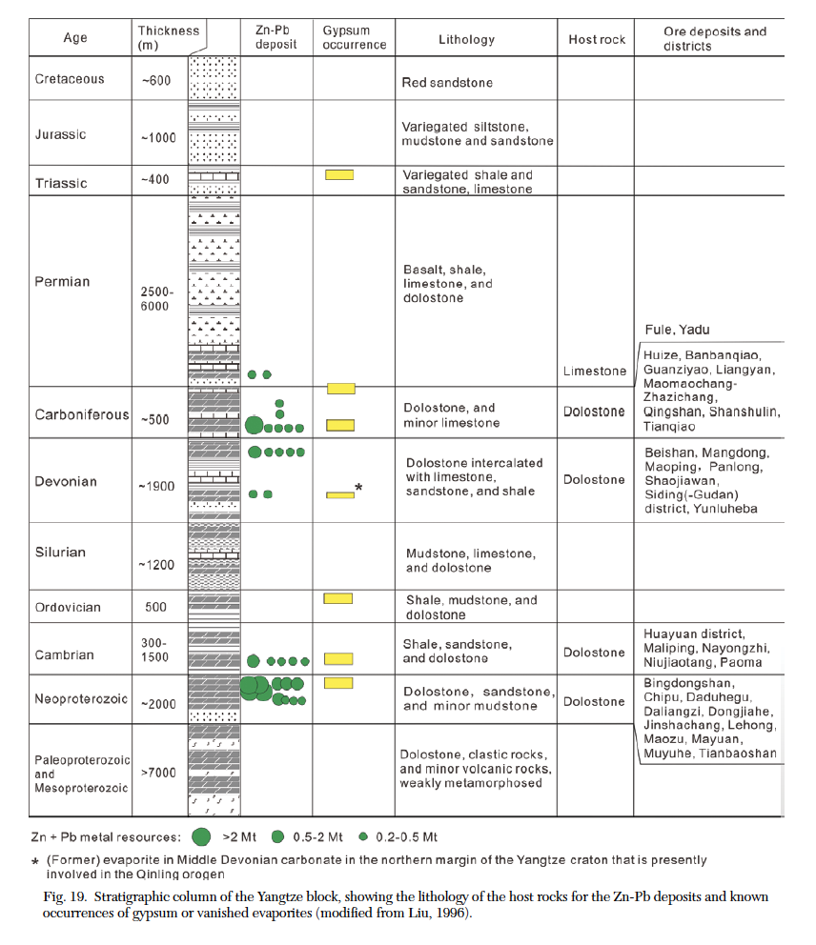
Stratigraphic column of the Yangtze block
Sichuan-Yunnan-Guizhou (SYG)
Pb-Zn triangle
The stratigraphy consists of a pre-Sinian basement, Sinian (Neoproterozoic) to lower Mesozoic submarine sedimentary sequences, and Jurassic to Cenozoic terrigenous sediments
Mineralization are mainly hosted by the rocks ranged from Sinian to Permian. Dolostone of the Sinian and Early Carboniferous ages are the major ore-bearing rocks, accounting for ~70% of the Pb+Zn reserves (Wu et al., 2013)
Sulfide orebodies are generally present as stratabound lenses in bedding-parallel fractures or as pipe-like orebodies with high-angle thrust, both of which are related to regional compressive deformation
Leach and Song, 2020
Notes:
Stratigraphic column of the Yangtze block, showing the lithology of the host rocks for the Zn-Pb deposits and known occurences of gympsum or vanished avaporites (modified from Liu, 1996)
There are up to 52 igneous outcrops of intermediate to basic-ultrabasicity rocks along the NS-trending Xiaojiang fault zone of the SYGT (Yuan et al., 1985b; Song et al., 2001). There is, however, only one location where pyritised ultramafic rocks supported Pb and Zn mineralisation. These diabase and gabbro-diabase sills and dikes (K–Ar ages: 246–283 Ma) lie on the eastern side of the Xiaojiang fault (Liu and Lin, 1999). Certain diabase contact zones experienced intense hydrothermal alteration (e.g., silicification and epidotisation) and Pb, Zn, and Cu mineralisation.

Slide 9
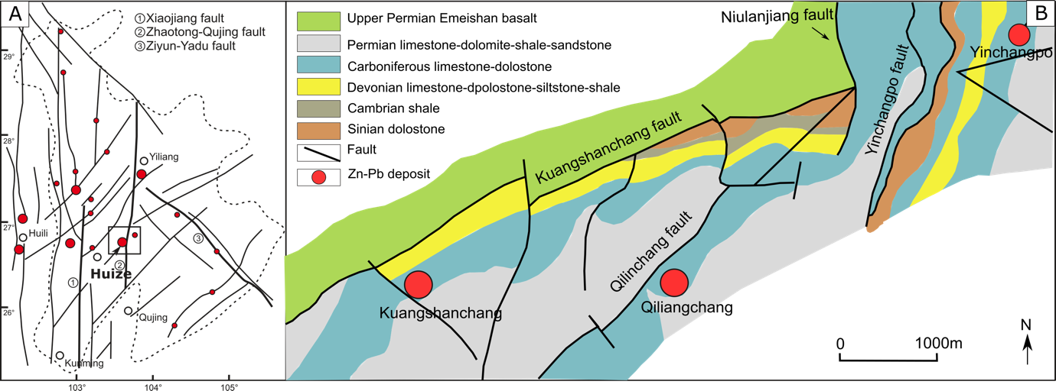
Huize Pb-Zn-(Ag-Ge) deposit
The largest Zn-Pb deposits (15.56 Mt at 24.15% Zn+Pb) in the Yangtze block, with important mining by-products of Ge, and Ag (ore grade: 62.1 ppm Ge, and 54.7 ppm Ag, Han et al., 2012).
The deposit consists of the main Qilinchang and Kuangshanchang ore blocks, and the minor Yinchangpo ore block.
The strata in the deposit area are composed of carbonate and clastic rocks of late Neoproterozoic to Early Cambrian and Middle Devonian to Early Permian ages that strike northeast and dip to the southeast.
Sketch map of the regional structure (A) and deposit geology (B) of the Huize Zn-Pb-(Ag-Ge) deposit (modified from Han et al., 2015)
Notes:
Structure controlled. Tectonic zones are characterised by large-scale overthrust structures, folds, and
compressional-shear faults.
Magmatic activity in the district is marked by the Late Permian Emeishan basalt (K–Ar ages: 218.6–
253.3 Ma)

Slide 10
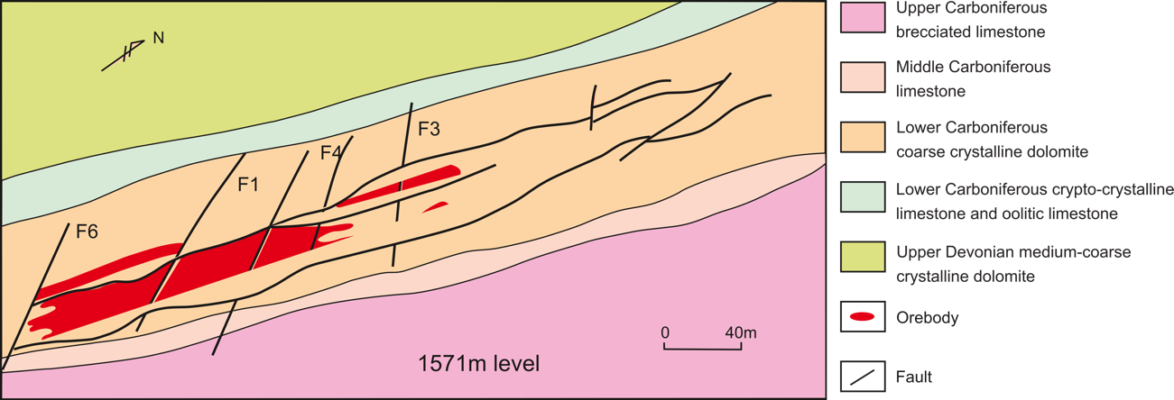
Huize Pb-Zn-(Ag-Ge) deposit
Huize Pb-Zn-(Cd-Ag-Ge) deposit
Plan map of No. 6 orebody at the 1631 level in the Qilinchang Zn-Pb-(Ag) deposit.
The Huize orebodies are strata-bound and typically lenticular in shape with variable thickness
The main ore types are oxide ores in the upper parts, mixed ores containing both oxides and sulfides in middle levels, and sulphide ores in the deeper parts.
The mineralization is hosted in the Carbonniferous Baizuo Formation

Slide 11
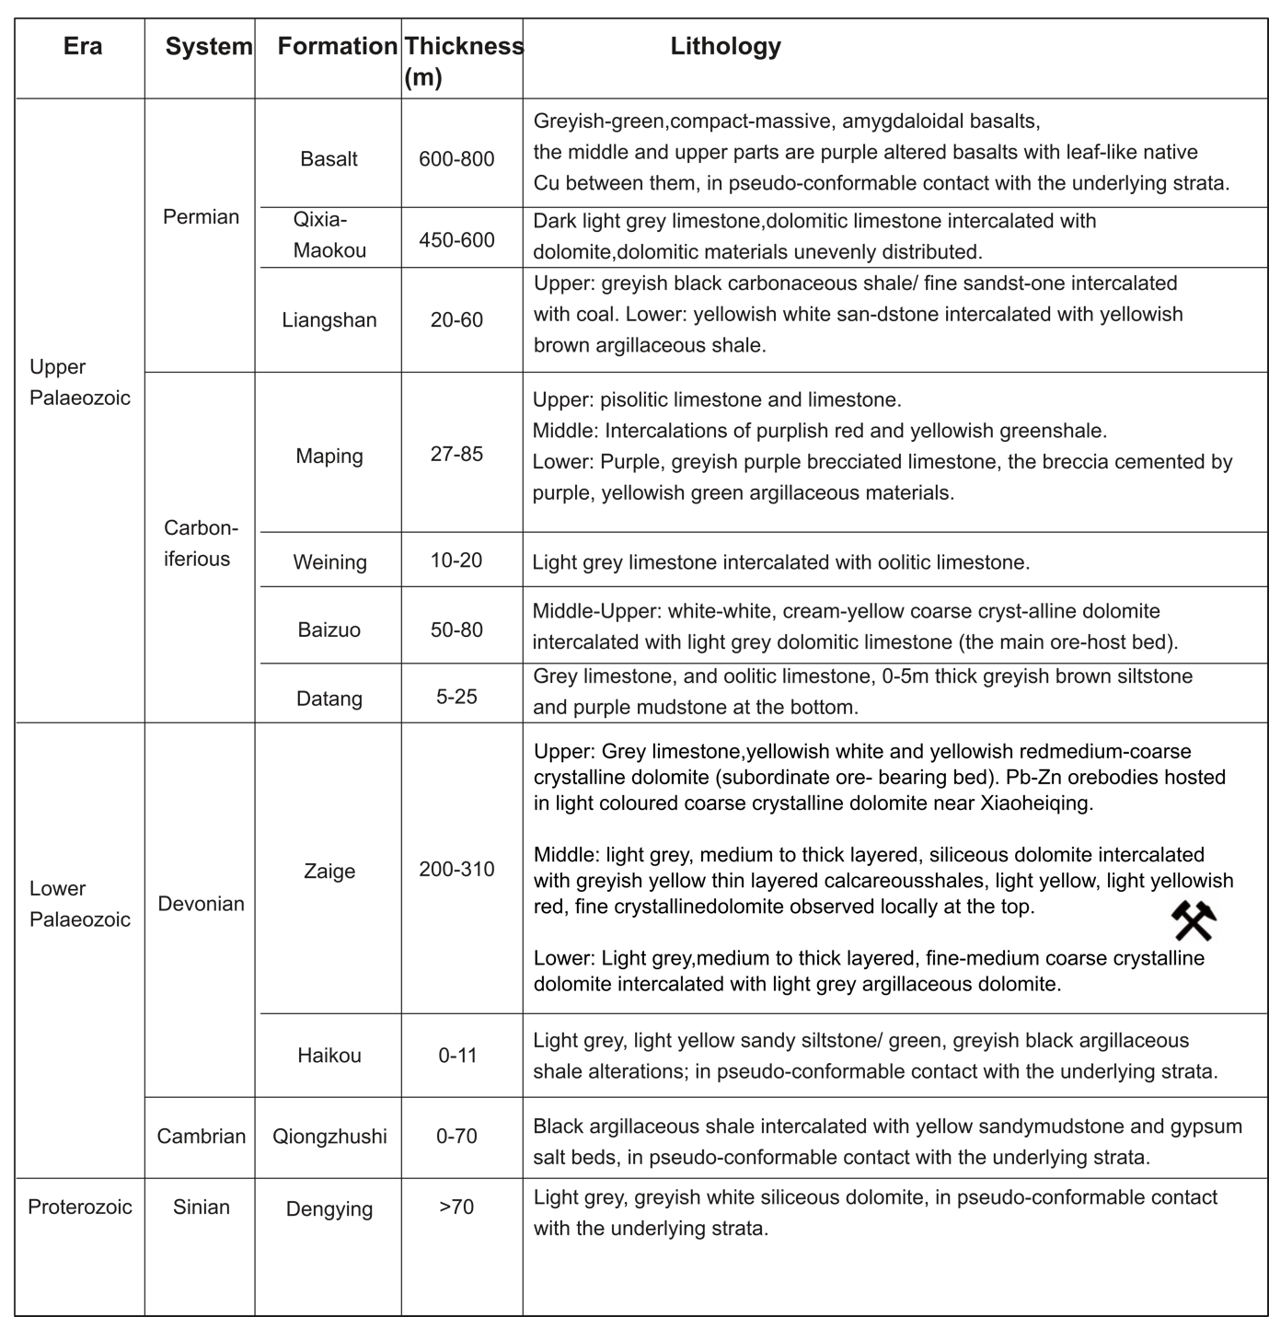
Huize Pb-Zn-(Cd-Ag-Ge) deposit
The main host rock is a grayish-white to cream-colored sparry dolostone and dolomitic fine-grain limestone of the Early Carboniferous Baizuo Formation that is 50 to 80 m thick.
The Baizuo Formation is a product of sediment and evaporite deposition in a restricted basin and part of an important gypsum-bearing sequence in the western and central Yangtze block.
The coarse sparry ore-bearing dolostone has significant secondary porosity with abundant bitumen.
Stratigraphic column of the Huize Pb-Zn-(Ag-Ge) deposit, Yunnan Province, China (after Han et al., 2007)
Leach and Song, 2020
Notes:
A. Huize deposit ore showing zinc and lead sulfides in a porous dolostone and replacing the host rock.
B. Porous and vuggy dolostone with bitumen in pores in the Huize deposit, China; a potential reduced sulfur and hydrocarbon gas reservoir.
The Early
Carboniferous Baizuo Formation (C1b) is the principal ore
host sequence (Fig. 4) and is predominantly composed of
greyish-white, yellowish-red, and cream-coloured, coarsecrystalline
dolomite, compact light-grey limestone, and
siliceous dolomitic limestone interbedded with barite.
Gypsum beds have been found in the mine at Huize (Fig. 27A), in strata in the central and western Yangtze block (Li et al., 1963; Jin et al., 2006). Barite-bearing gypsum units are also found in the Baizuo Formation carbonates (Han et al., 2007, 2015).

Slide 12
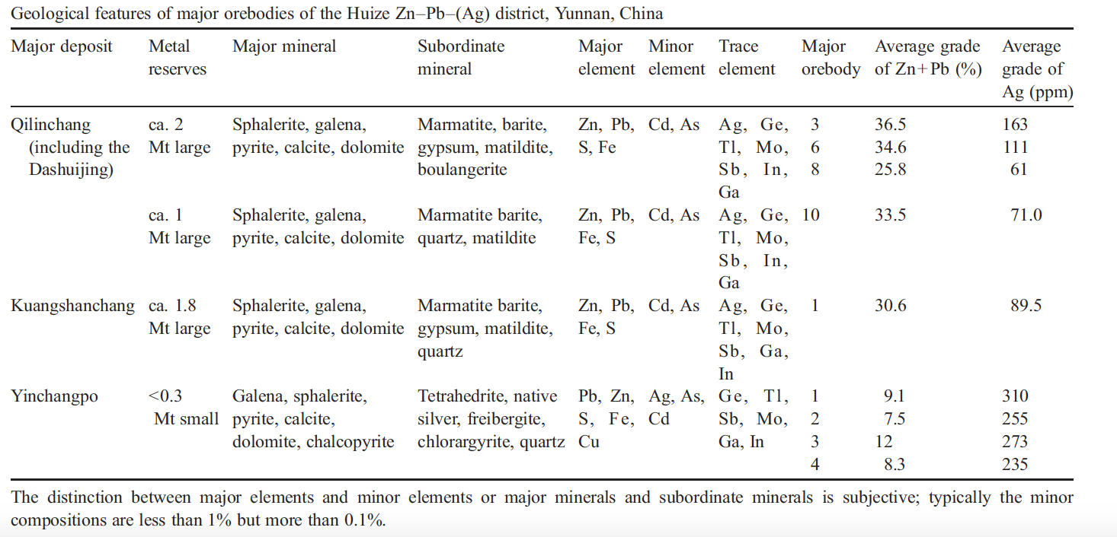
Huize Pb-Zn-(Cd-Ag-Ge) deposit
Fifty orebodies of various sizes are present within the 20 km2 area that is the Huize Zn–Pb–(Ag) district.
Han et al., 2007
Notes:
AgBiS2 (matildite)

Slide 13
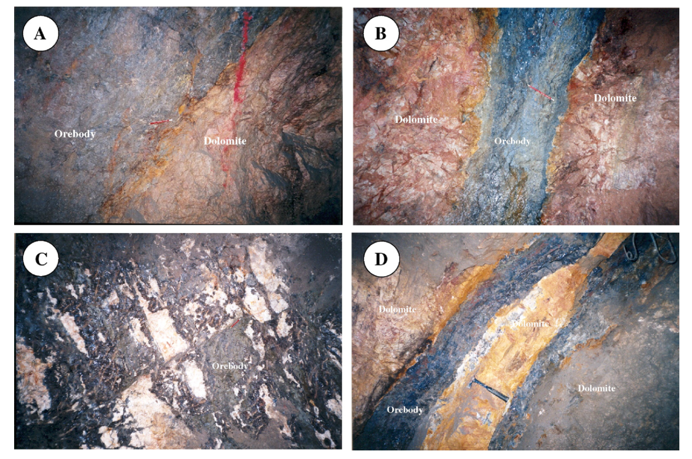
Huize Pb-Zn-(Cd-Ag-Ge) deposit
The ores occur as replacement of the carbonate rocks and vary from massive bodies to disseminated sulfides in extensive open-space fill in secondary porosity
The dominant controls on the shape and distribution of the orebodies are dramatic changes in lithology, and therefore permeability and host-rock reactivity, which include transitions from coarse sparry dolostone to fine-grained dolomitic limestone, interbedded evaporites, and brittle silicified dolostone.
Leach and Song, 2020
Han et al, 2007

Slide 14
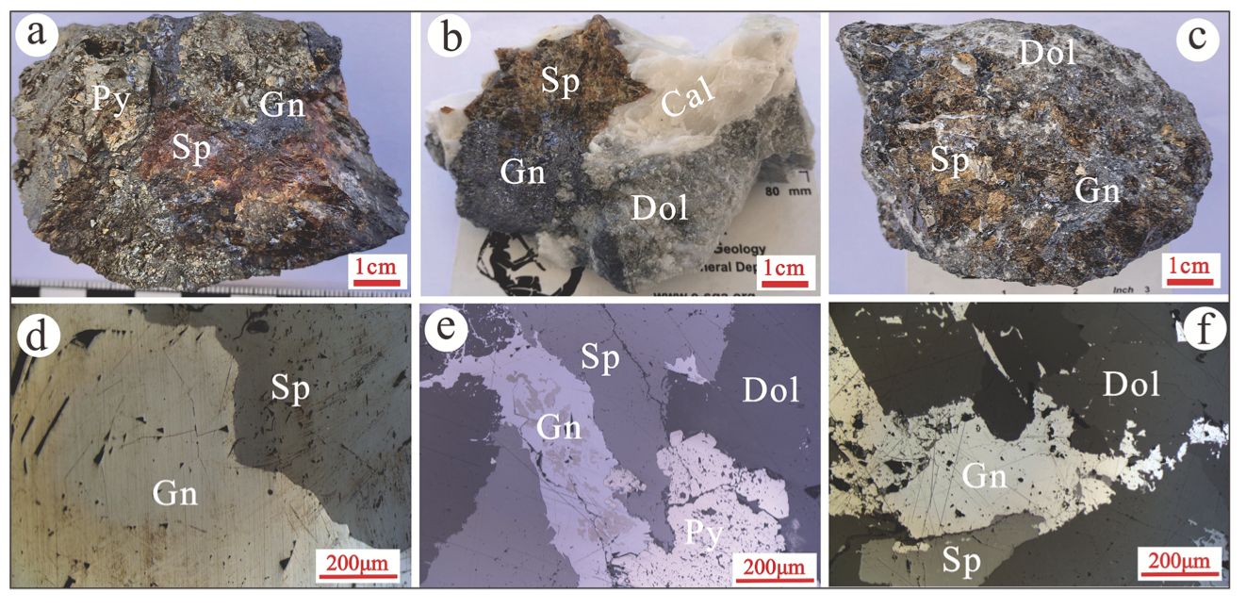
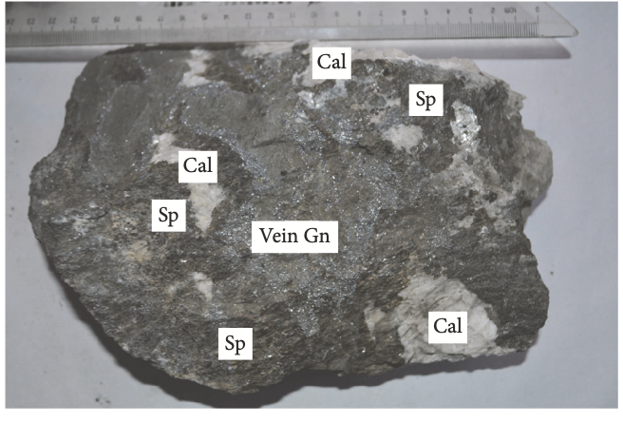
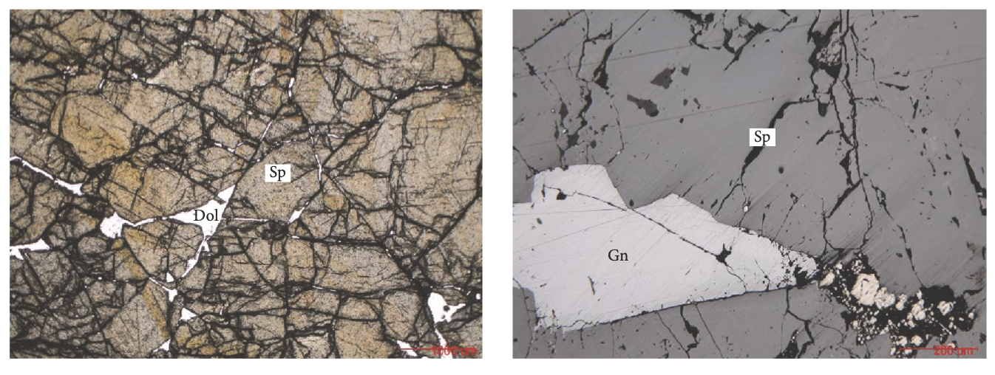
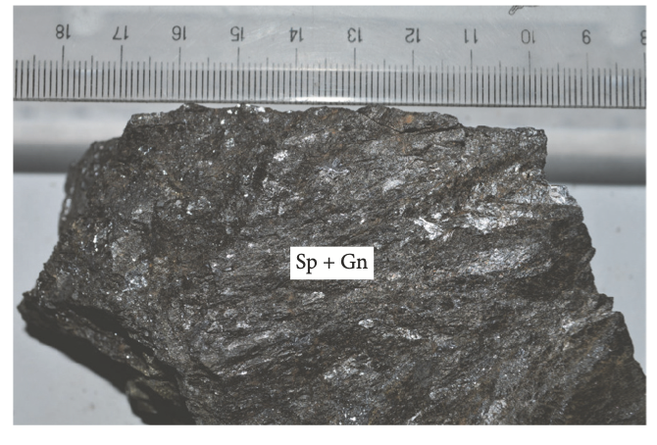
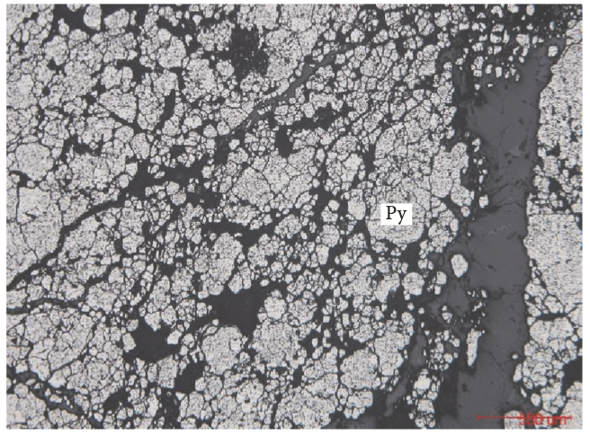
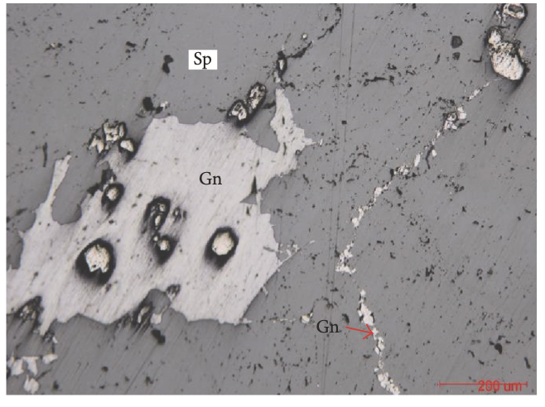
Huize Pb-Zn-(Cd-Ag-Ge) deposit
Euhedral–subhedral granular textures and microcrystalline granular textures
Massive mineralization, and subordinate veined, disseminated, and brecciated.
Tan et al, 2023
Zhang et al, 2017

Slide 15
Genesis
A lot of data and geological observation but without a consistent interpretation….
What seems to be certain is that..
Fluid circulated deep, so was able to scavenge lots of metals along its way
Permeability of host rock is important for precipitation of metals
Sulphur is sourced from TSR of seawater sulphate
Strike-slip movement drove the fluids
Mineralization happened at around 220 Ma, ~40 Ma later than the Emeishan basalt
Notes:
Strontium isotope data indicate more radiogenic component source(s) relative to the host rocks. Lead isotope measurements show a crustal metal source that most likely reflects derivation from basement igneous rocks (Zhou et al., 2001). Again, homogeneous Pb isotope suggest the metals are sourced from the Kunyang Group in a relatively short ore-forming process may be the major reason for the nearly constant Pb isotope signatures of the Huize Zn-Pb deposit and insignificant contribution of the host rocks.
C-H-O isotopes and fluid inclusion study of calcite suggested the existence of two fluids and their mixing (Zhang et al., 2017, but suspicious…)
Following the Hercynian event, the Pacific Plate subducted from SE to NW, leading to sinistral strike slip movement of the Xiaojiang fault zone and Zhaotong– Qujing fault zones. NE-trending fold and compressional shear zones associated with the NW-trending tension or tensional faults strike–slip movement also drove the fluids.
The age of the Huize ores is controversial. Calcite Sm-Nd isochron age of 222±14 Ma (Li et al., 2004); Two samples of sphalerite from the ore yielded Rb-Sr isochron ages of 223.5 ± 3.9 and 226 ± 6.4 Ma (Yin et al., 2009).

Slide 16
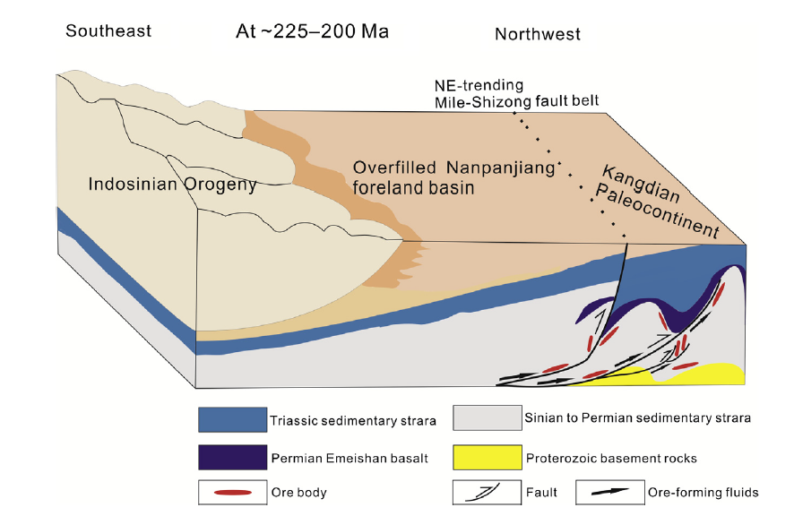
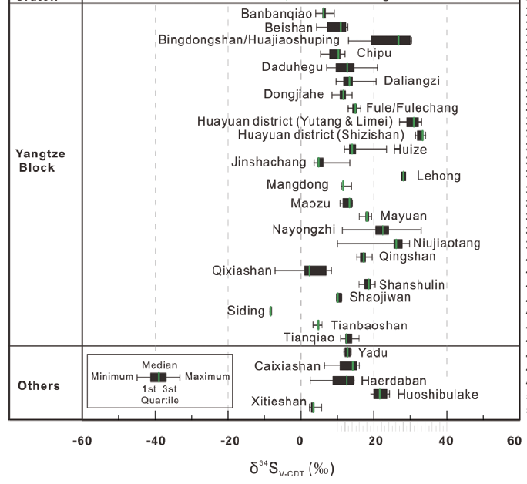
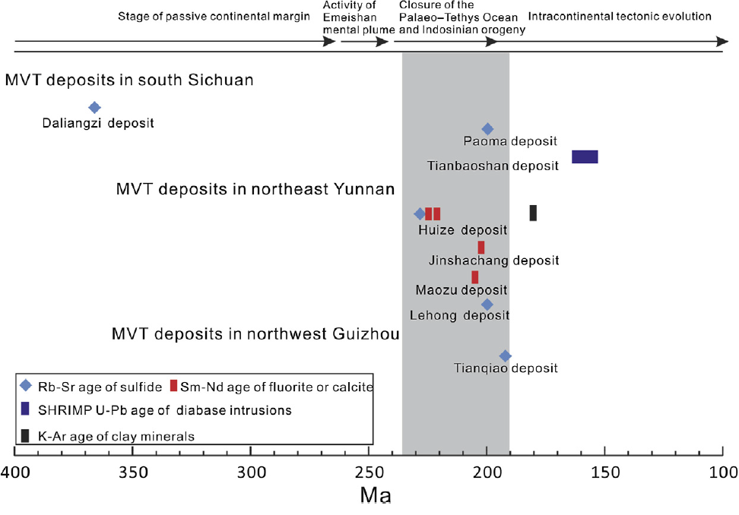
Genesis
Mineralization may have occurred between the late Indosinian and the early Yanshanian, a time period was contemporaneous with the late Indosinian Orogeny in response to the closure of the Paleo-Tethys Ocean
Basinal brines migrated at basin scale and circulated deep along the deep-seated regional faults
Secondary faults and thrust-fold system are important to channel ore fluids upwards
The precipitation of sulfides could be driven by the TSR of seawater sulfate and/or mixing with reduced sulfur-bearing fluids
Leach and Song, 2020
Zhang et al., 2015
Zhang et al., 2017
Notes:
Suturing between the Indochina and South China blocks along
the southwestern margin of the Yangtze Block started at the late
Permian (or slightly later) and was completed by the Middle Triassic
(Cai and Zhang, 2009). This was contemporaneous with the
onset of the Indosinian Orogeny in this area as a response to the
closure of the Paleo-Tethys Ocean (Shu et al., 2008; Cai and
Zhang, 2009). The Indosinian Orogeny caused the Nanpanjiang
Basin, located near the southeastern boundary of the S–Y–G
Zn–Pb triangle, to evolve into a foreland basin during the Middle
Triassic (Yang et al., 2012). Basinal brines migrated through
this foreland basin as a result of gravity- and/or tectonic
compression-driven flow, with fluids migrating into the Kangdian
Paleocontinent (i.e., the S–Y–G Zn–Pb triangle area), most probably
from southeast to northwest (Zhou et al., 2013e) along deep-seated
regional faults such as the NW–SW-trending Weining–Shuicheng
fault belt, the NE–SW-trending Mile–Shizong fault belt, and
various N–S-trending fault belts. Then, these basinal fluids could
migrate in different directions throughout the S–Y–G triangle
through numerous secondary faults that were linked with the
major regional faults at depth. The long-distance migration
enabled the hot basinal fluids to continuously extract trace metals
and sometimes sulfur from rocks of different ages (e.g., Proterozoic
basement rocks, Sinian to Permian sedimentary rocks, and Permian
Emeishan basalts), gradually evolving to ore-bearing brines. Continuous
compression, a far-field effect of the Indosinian orogeny
may have lasted up to the late Triassic, caused intensive intracontinental
deformation which was characterized by the development
of numerous thrust–fold systems in the study area (Shu et al.,
2008; Cai and Zhang, 2009). The ore-forming fluids flowed through
and precipitated Zn–Pb sulfides in interlayered fracture zones
within these thrust–fold systems, forming a series of stratabound
orebodies (e.g., the Huize, Maozu, Maoping, Jinshachang, and
Chipu deposits; Table 1) and/or flowed through and deposited
sulfides along thrust faults to form pipe-like orebodies (e.g., the
Tianbaoshan, Lehong, and Qingshan deposits; Table 1). The precipitation
of sulfides could be driven by the in situ TSR of seawater
sulfate (Table 1) and/or mixing with reduced sulfur-bearing fluids
(e.g., the H2S-rich gas reservoirs associated with the formation of
the Chipu deposit; Wu et al., 2013).

Slide 17
2. Distribution of major marine carbonate-hosted Pb-Zn deposits in China
(modified from Leach et al., 2019)
Carbonate-hosted Pb-Zn deposits in the SYG triangle of the Yangtze block
Huize Pb-Zn-(Ag-Ge) deposit
Carbonate-hosted Pb-Zn deposits in the Cathaysia block
Fankou Pb-Zn-(Ag-Ga-Ge-Cd) deposit
Carbonate-hosted Pb-Zn deposits in the Himalayan-Tibetan orogen
Jinding Pb-Zn deposit
Notes:
Sediment-hosted PbeZn deposits in the Tethyan domain of China occur in the North Qiangtang and LanpingeSimao blocks (Fig. 3), in
the Cenozoic fold-and-thrust belts, the interior of the HimalayaneTibetan orogen (He et al., 2009; Liu et al., 2015a; Song
et al., 2015).

Slide 18
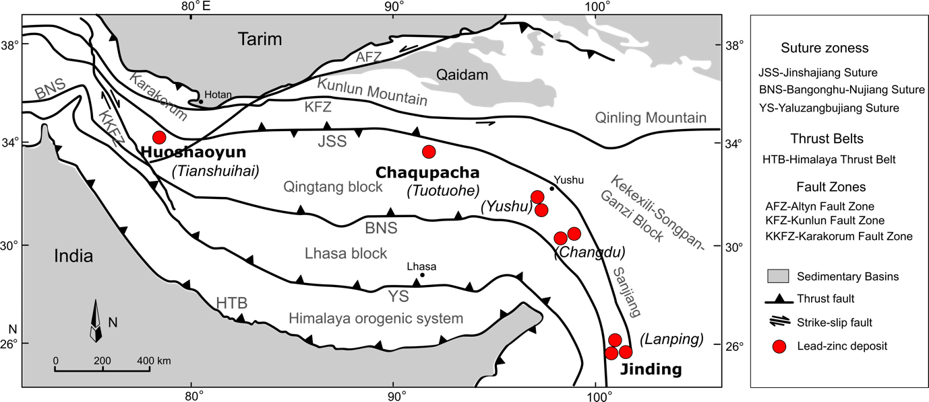
Carbonate-hosted Pb-Zn deposits in the Himalayan-Tibetan orogenic belt
Regional geology map of the major Pb-Zn deposits in distributed in the Himalayan-Tibetan orogenic belt, which are mainly concentrated in the Lanping, Changdu, Tuotuohe and Tianshuihai ore districts (after Li et al., 2019)
Notes:
The MVT deposits are distributed in the fold-and-thrust belts,
but the mineralization mainly took place in the postcompressional
tectonic settings (Song et al., 2017a)

Slide 19
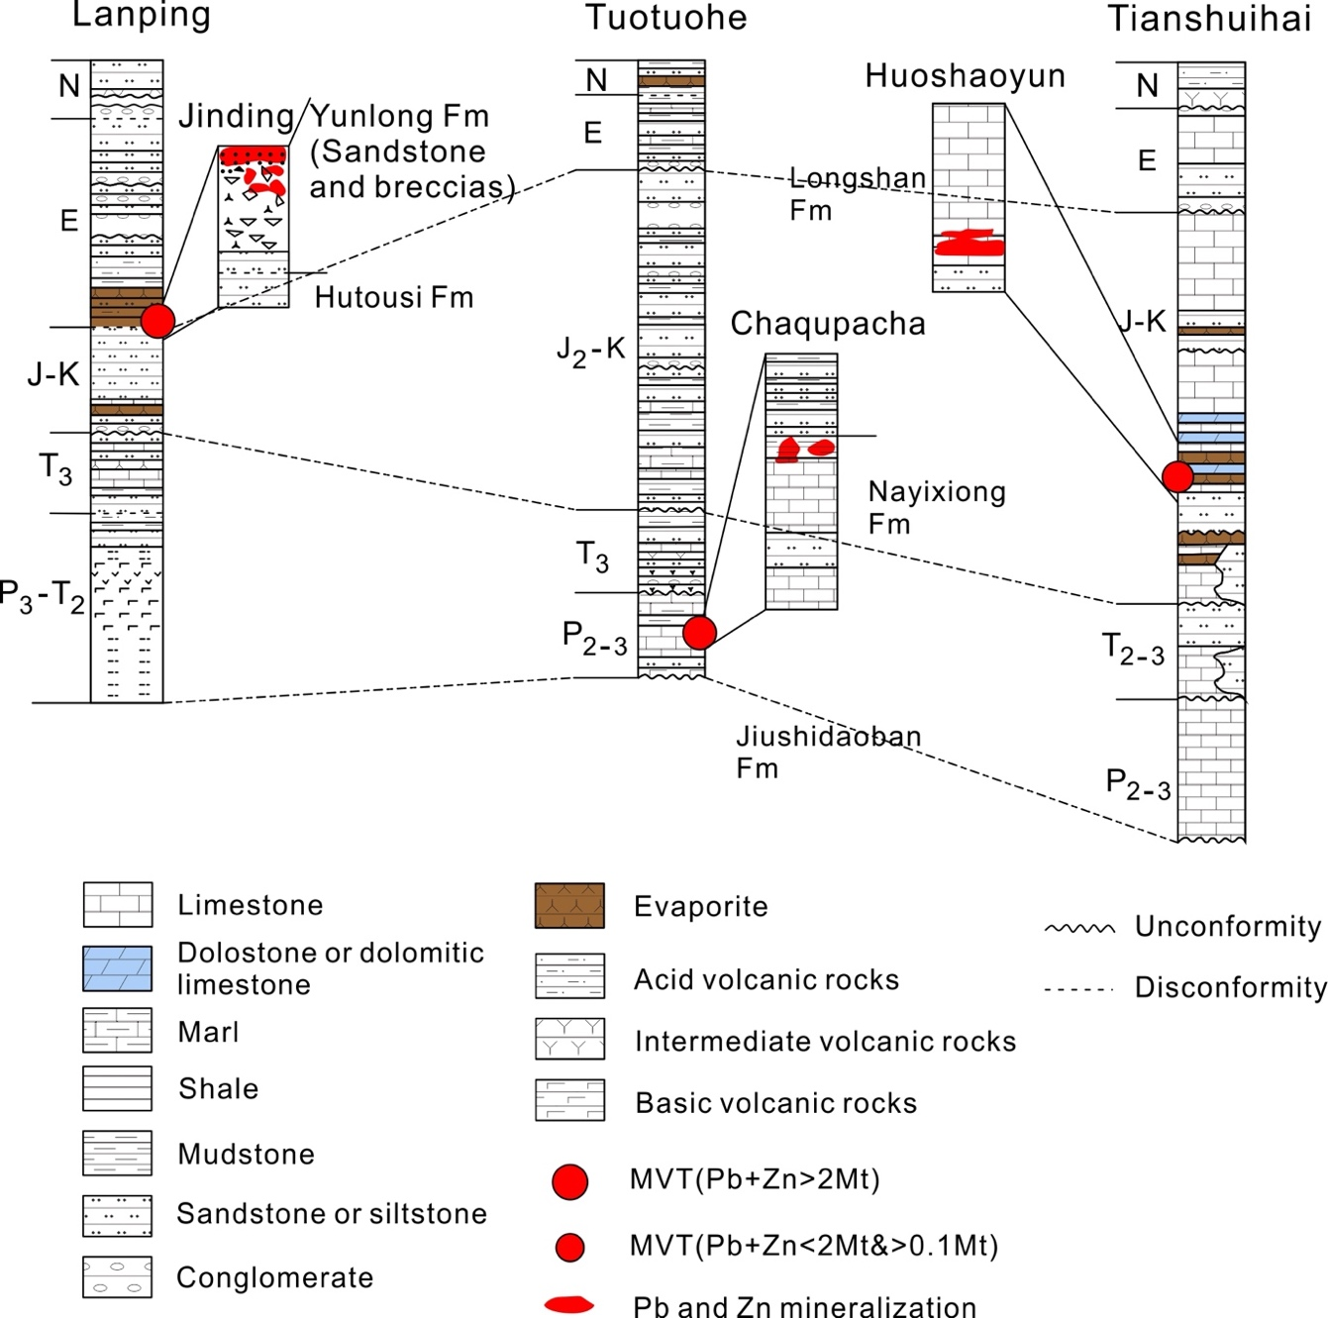
Pb-Zn deposits in the Himalayan-Tibetan orogenic belt
Carboniferous to Neogene volcanic and sedimentary rocks are widespread in the North Qiangtang and Lanping-Simao blocks where the Late Triassic to Neogene strata contain evaporites.
Most of the sediment-hosted Pb-Zn deposits in this belt are hosted by Carboniferous-Cretaceous carbonates (mainly limestone).
An exception is the Jinding deposit, which is hosted by a sequence thought to be genetically related to evaporite diapirism and temporally equivalent to the Paleocene Yunlong Formation
(after Song et al., 2019)
Notes:
Fig. 10 Stratigraphic columns of the major Pb-Zn ore districts in the Himalayan-Tibetan orogenic belt, China
Carboniferous to Neogene volcanic and sedimentary rocks are widespread in the North Qiangtang and Lanping-Simao blocks where the Late Triassic to Neogene strata contain evaporites
The North Qiangtang and Lanping-Simao blocks contain Carboniferous carbonate and clastic rocks that were deposited in passive continental margin settings, and Permian to Triassic carbonate, clastic, and volcanic rocks that were deposited in active continental margin settings. Foreland (or sag) basins were formed during Jurassic to Cretaceous and were filled with red marine and terrestrial clastic rocks and marine carbonates.

Slide 20
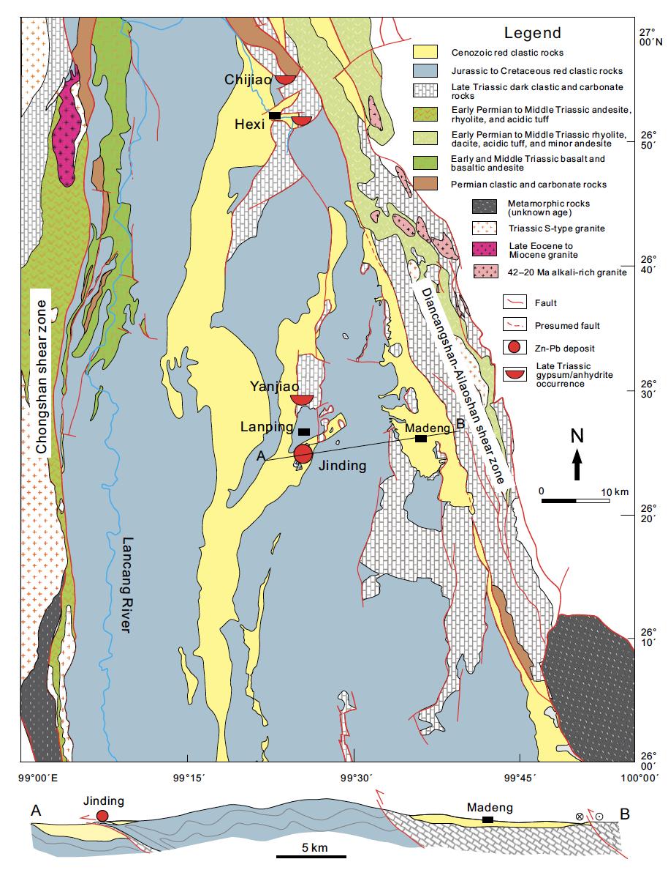
Jingding Pb-Zn deposit
The deposit has resource of 200 Mt of ore that averages 6.1% Zn and 1.3% Pb (Xue et al., 2007).
The deposit is located in the western margin of a fold and thrust belt in contact with the Cenozoic basin
The Cenozoic continental collision resulted in large-scale folding and thrusting, strike-slip faulting, and related basins. The Indian continent subsequently collided with the accretionary margin of the Eurasia continent to produce the high elevation terrane in the Cenozoic.
Notes:
Simplified geologic map and cross section A-B through the Lanping Basin showing the location of the Jinding deposit
in the western margin of a fold and thrust belt in contact with the Cenozoic basin (modified from Third Geological Team of
Yunnan, 1975; Fourth Geological Team, 1986; Liang, 2016). The map also shows the location of Late Triassic gypsum and/or
anhydrite occurrences in the basin.

Slide 21
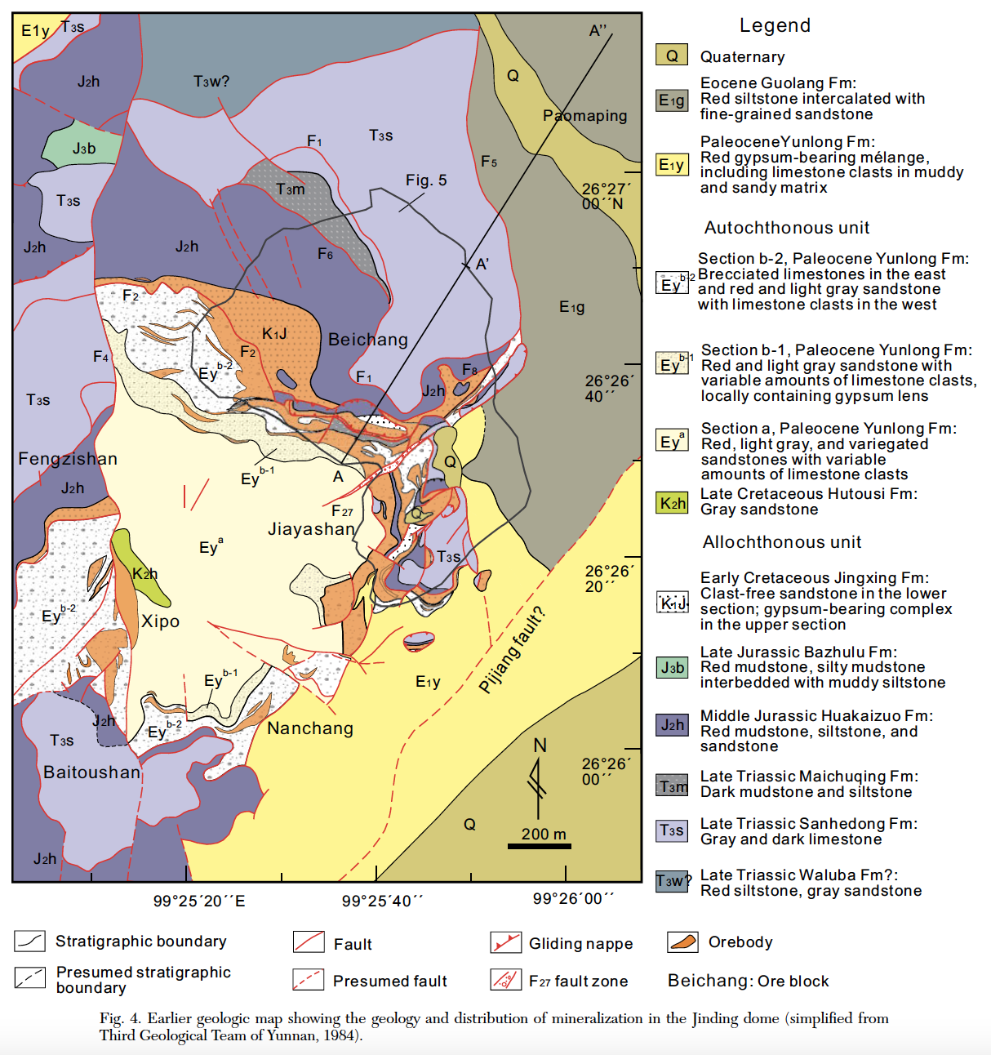
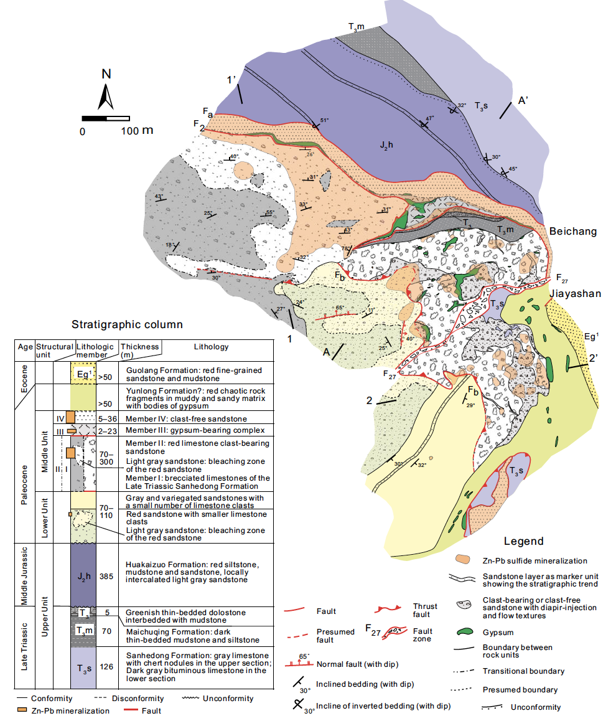
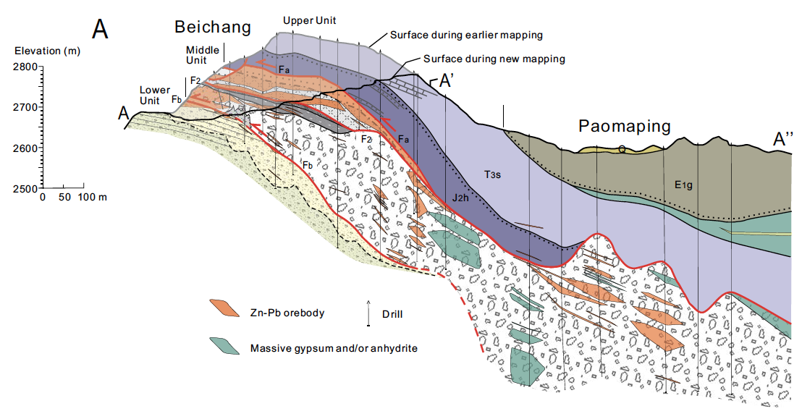
Jingding Pb-Zn deposit
A dome structure was identified. Evaporites in the sedimentary sequence ascended along the thrust fault are thought to create the Jinding dome.
Mineralization is closely associated with brecciated limestone and sandstone, which contain abundant abundant gypsum and/or anhydrite. Abundant in bitumen
Overturned Mesozoic strata overlie evaporite-bearing brecciated limestones and sandstones. The lower part of the Mesozoic units comprises impermeable red mudstone and siltstone.
(TGTY, 1984)
Song et al., 2020
Notes:
Evaporite diapiric structure. However, our recent study suggested that the host rocks are the products of
evaporite diapir (Leach et al., 2017).
These evaporite diapir-related rocks created a dome structure
that formed a trap for hydrocarbon and metalliferous fluids. Nearly
all of the PbeZn sulfides precipitated in the evaporate-diapirrelated
rocks within the dome.
Most Zn-Pb mineralization in the Jinding deposit is hosted
by the Middle unit. Previous research suggested that the majority of the ore host rocks represent subaqueous sedimentary rocks, although more recent research suggests that these rocks were in fact formed by evaporite halokinesis (Leach et al., 2017). Our new geologic mapping provides further support for this new model for the genesis of the ore hosts.

Slide 22
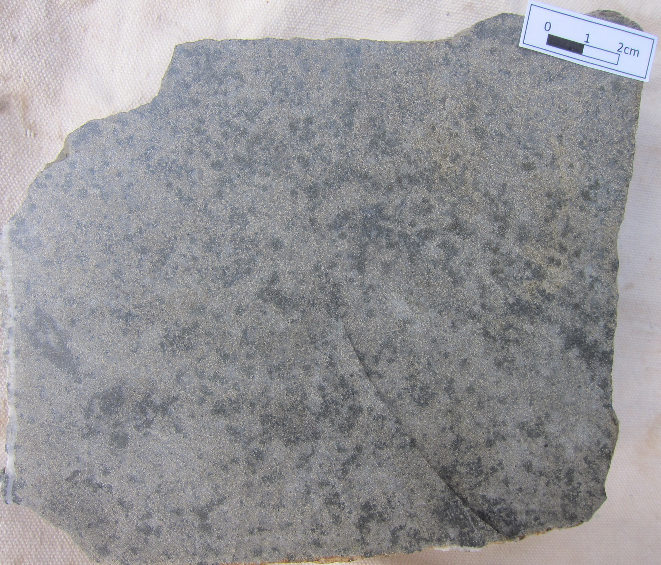
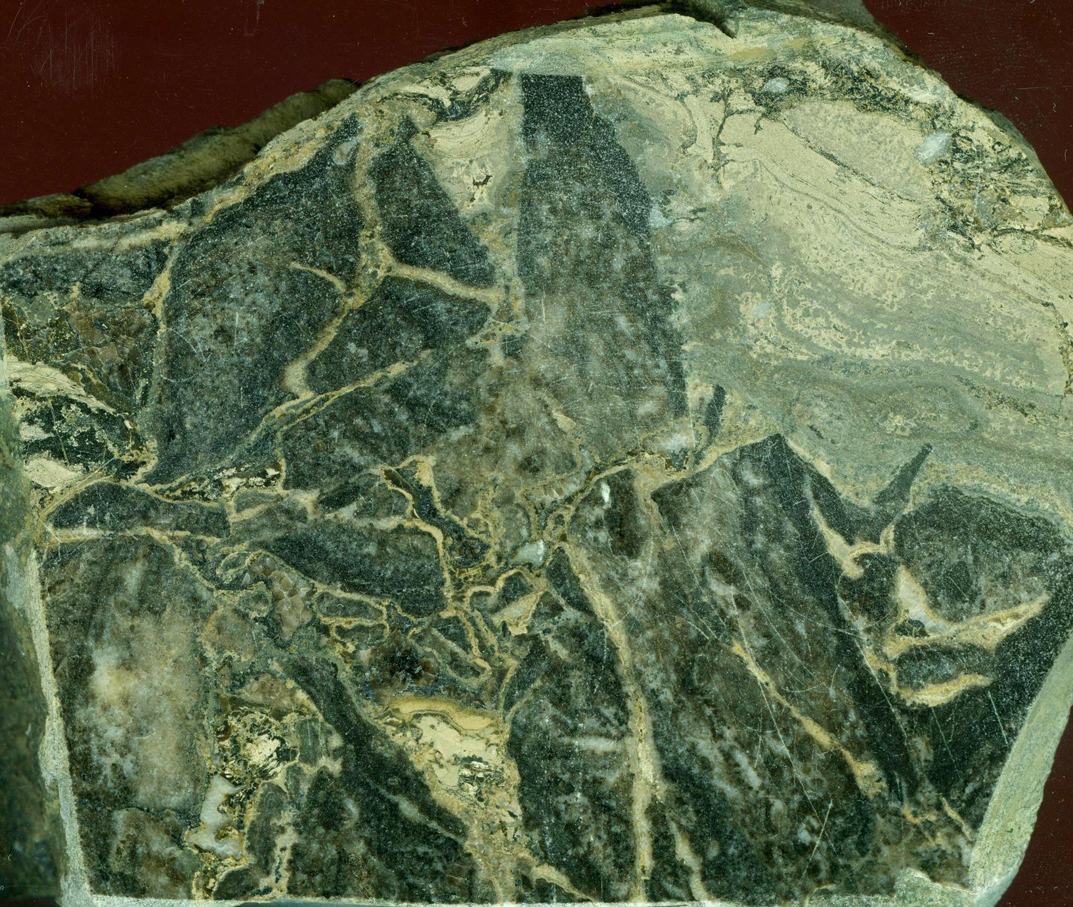
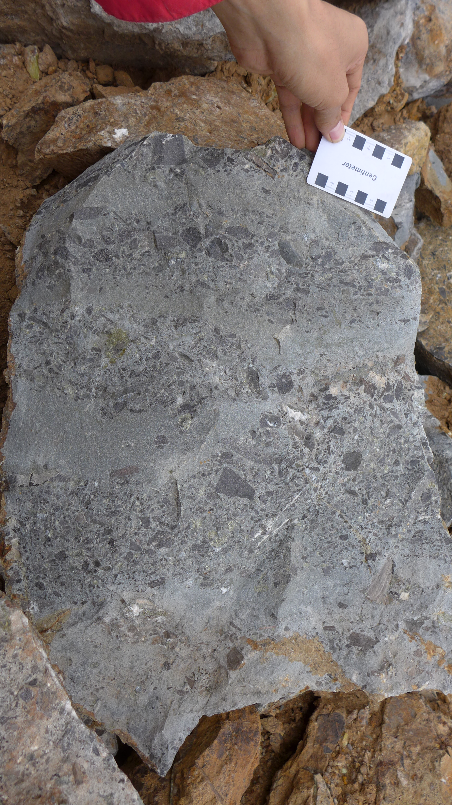
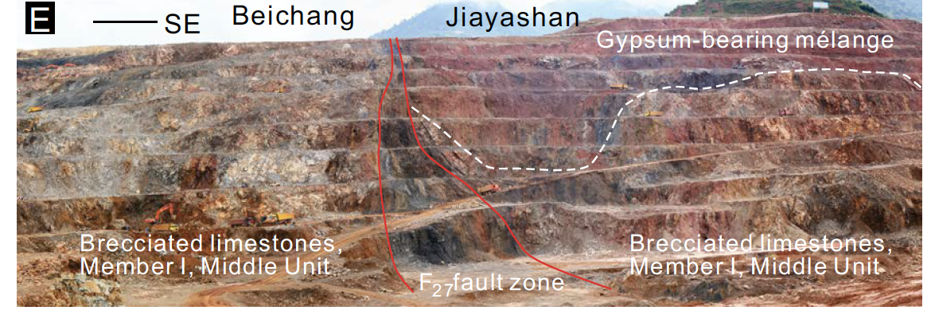
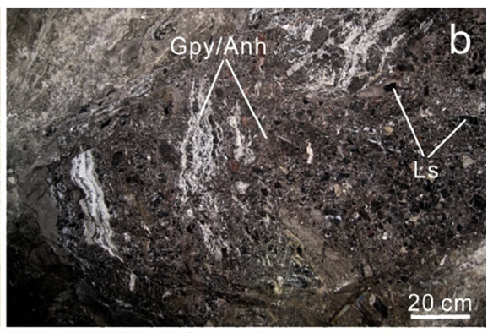
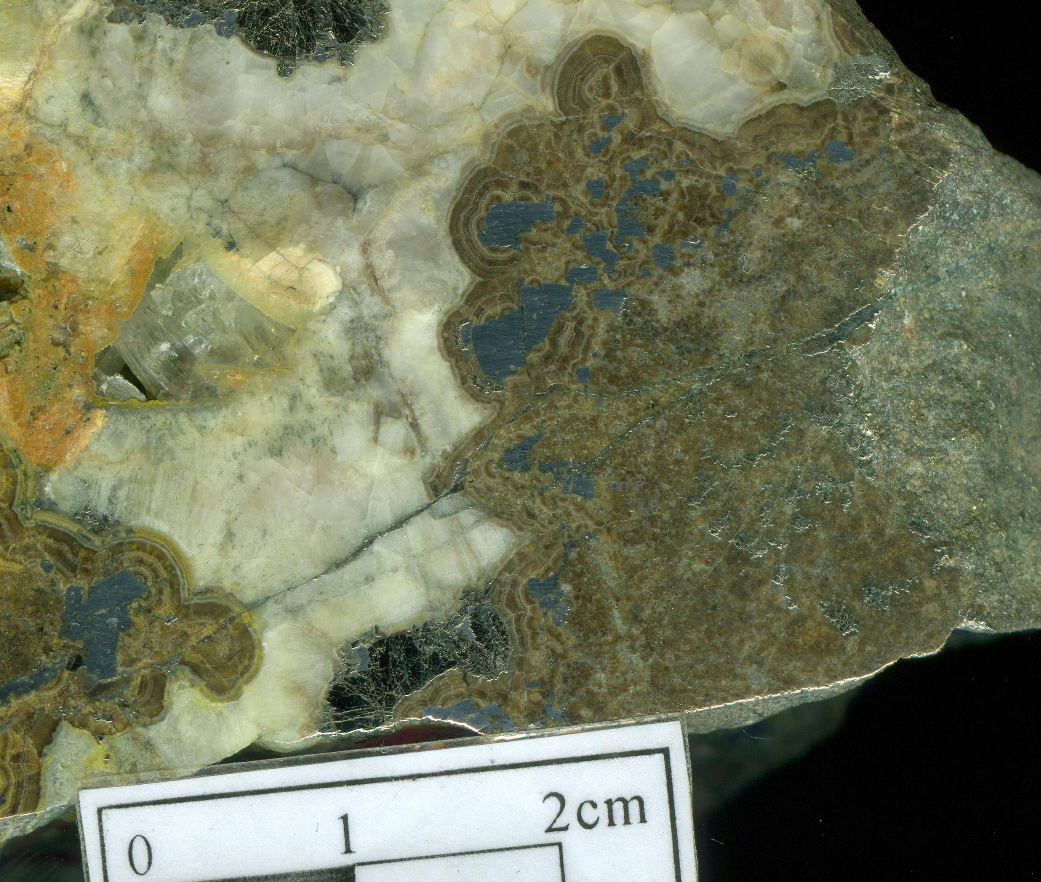
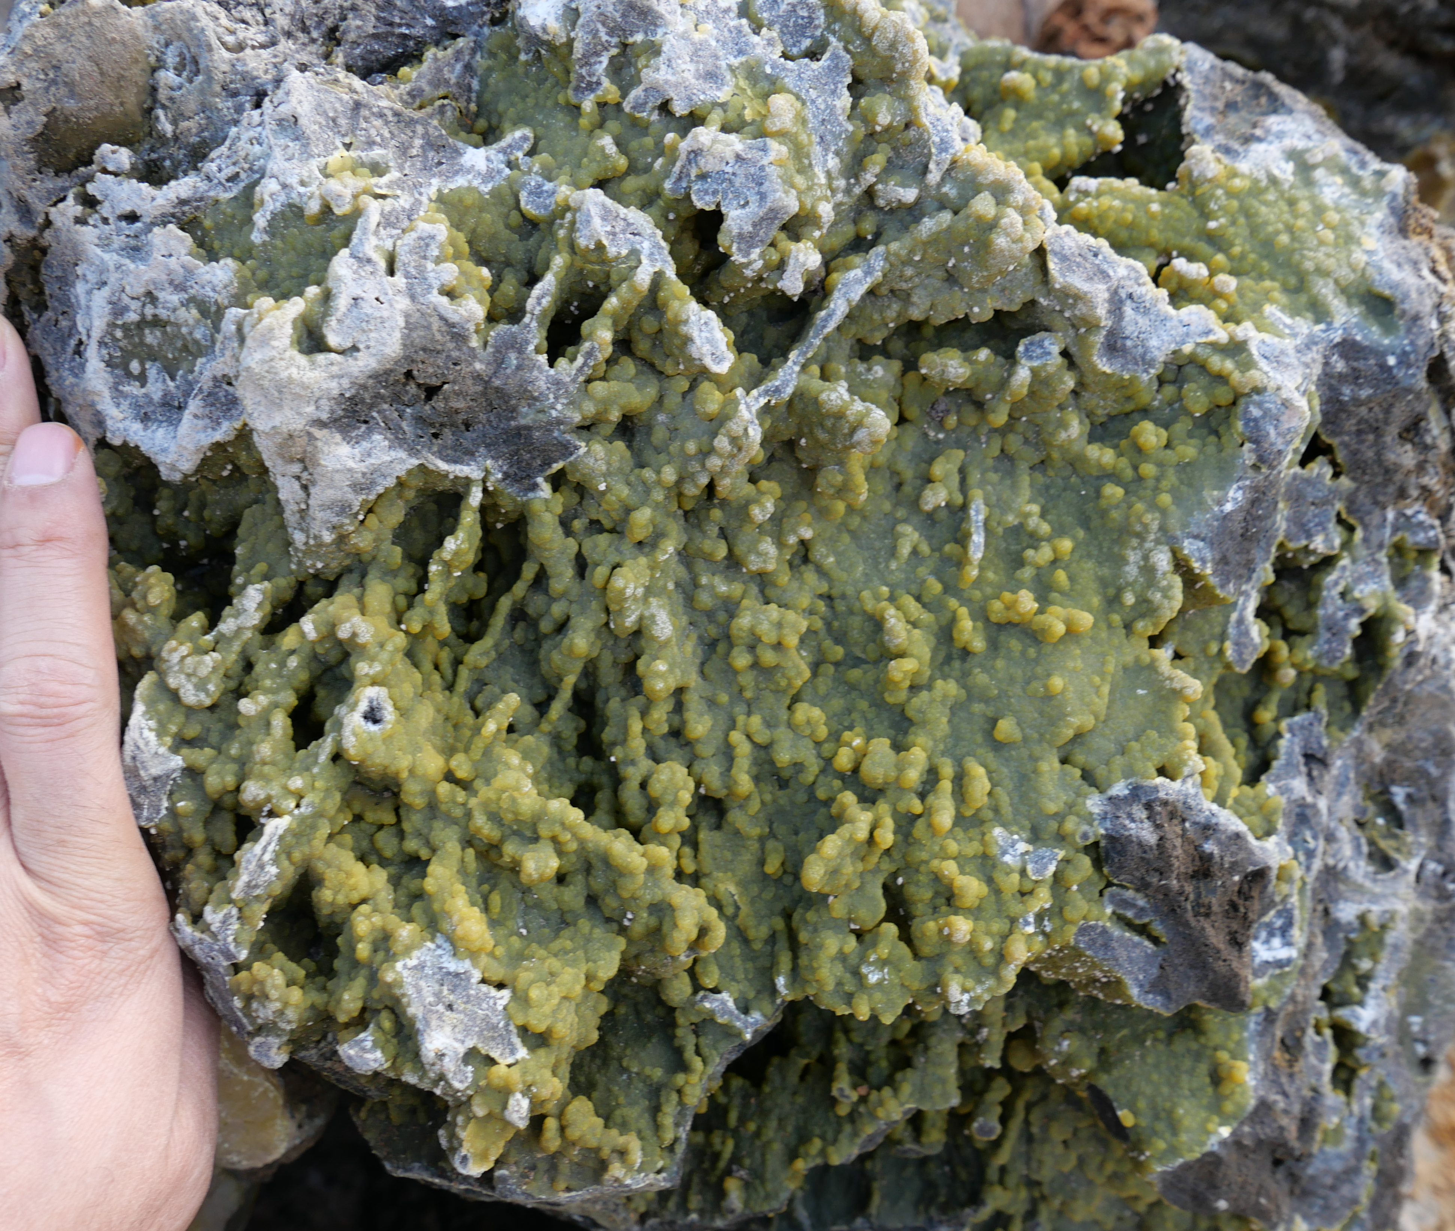
Jingding Pb-Zn deposit
Massive, brecciated and veined mineralization
In the sandstone with or without limestone breccias, the calcite is replaced by sphalerite, galena and pyrite; in the brecciated limestone, the breccia matrix is replaced by sulfides
Smithsonite is the primary ore mineral, subordinately cerussite.
(a)
(c)
(d)
(b)
(e)
Song et al., 2019, 2020, per. com.

Slide 23
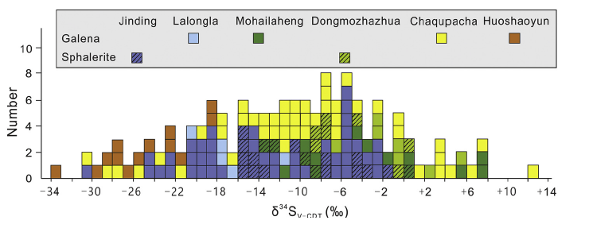
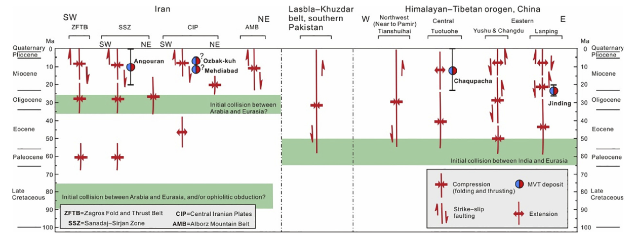
Genesis
Most of the deposits are still in the stage of understanding the geology
Here are the few things we seem to know:
Fold-thrust belt is great.
A dome structure formed from evaporite diapir is key to trap the metallic fluids
Sulfur isotopes suggest that reduced sulfur derived from interaction between hydrocarbon fluids and sulfate evaporite via BSR process
Mineralization is speculated to be at around 23 Ma (Yalikun et al., 2018 Li et al., 2000, paleomagnetic and apatite fission track ages)
Song et al., 2019 and references therein
Notes:
Using paleomagnetic techniques, Yalikun et al. (2018) determined a mean mineralization age of 23 ± 3Ma in the Jinding deposit,
which is roughly consistent with apatite fission track ages of 28e25 Ma, which probably reflect the cooling time of the mineralizing fluid (>100 C) and thus approximate the age of mineralization (Li et al., 2000). Therefore, the Jinding deposit formed during a regional transpressional deformation event subsequent to the
main phase of regional compression during the IndiaeEurasia continental collision (Fig. 7).

Slide 24
2. Distribution of major marine carbonate-hosted Pb-Zn deposits in China
(modified from Leach et al., 2019)
Carbonate-hosted Pb-Zn deposits in the SYG triangle of the Yangtze block
Huize Pb-Zn-(Ag-Ge) deposit
Carbonate-hosted Pb-Zn deposits in the Cathaysia block
Fankou Pb-Zn-(Ag-Ga-Ge-Cd) deposit
Carbonate-hosted Pb-Zn deposits in the Himalayan-Tibetan orogen
Jinding Pb-Zn deposit
Notes:
Sediment-hosted PbeZn deposits in the Tethyan domain of China occur in the North Qiangtang and LanpingeSimao blocks (Fig. 3), in
the Cenozoic fold-and-thrust belts, the interior of the HimalayaneTibetan orogen (He et al., 2009; Liu et al., 2015a; Song
et al., 2015).

Slide 25
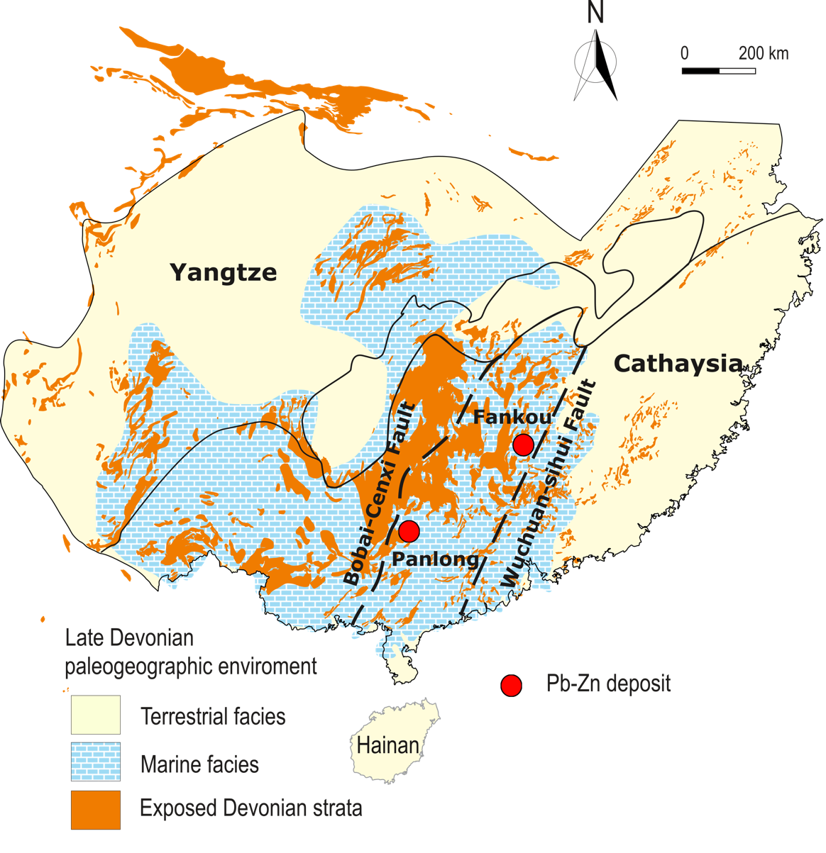
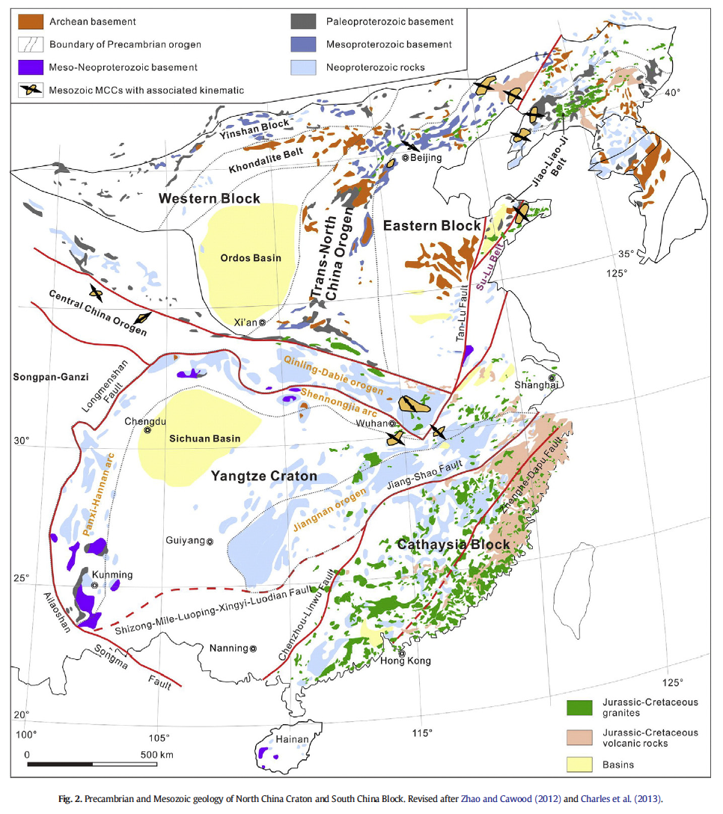
Carbonate-hosted Pb-Zn-(Ag-Ga-Ge-Cd) deposits in the Cathaysia block
Widespread Paleozoic siliclastic and carbonate successions overlie the basement with an unconformity. The Devonian to Carboniferous marine sedimentary strata is extensively developed in the region, dominated by clastic, carbonates and carbonaceous shales in lithological composition.
Deep regional faults, including the Wuchuan-Sihui and Bohai-Cenxi faults exist
Due to the Caledonian orogeny during the Early Paleozoic, the Cathaysia was in a continent-continent collision setting where Late Ordovician to Middle Devonian strata are absent. Instead, granitic intrusion of ages ranging from 480 to 400 Ma are widespread in the region
After Hu et al., 2023
(Deng et al., 2017)

Slide 26
Fankou Pb-Zn-(Ag-Ga-Ge-Cd) deposit
10 Mt metal reserves at an average grade of 15% Zn+Pb
Located in the Quren basin, which is filled with folded late Paleozoic intercalated marine carbonate and clastic sequences and abundant in Devonian fossils (Li et al., 1997)
The basin and the deposit is very much fault constrained
Three mineralization zones
Magmatism is generally absent, only a minor occurrence of diabase dyke
Hu et al., 2023
Notes:
The deposit is located in the northern margin of the Quren Basin, which is filled with folded Late Paleozoic intercalated marine carbonate and clastic sequences.
Surrounding the basin are the outcrops
of low grade metamorphic rocks of the pre-Devonian system which comprises the basement
of the basin.
The Quren Basin is bounded by a group of regional faults, i.e., the EW-striking Zhuguangshan fault to the north, the Dadongshan-Guidong fault which is now filled with granitic intrusions to the south, the NE-striking Taozhou-Huaiji fault to the west and the Renhua-Shaoguan fault to the east. Inside the basin, two groups of faults have been identified, including NE-striking faults that parrel to the regional Wuchuan-Sihui fault, and NW-striking faults which is smaller in size and cut by the NE-striking faults
Mineralization is hosted in the Late Devonian to Early Carboniferous carbonate strata, which overlies the basement with an angular unconformity and conformably underlie the Late Carboniferous to Permian marine carbonate rock

Slide 27
Fankou Pb-Zn-(Ag-Ga-Ge-Cd) deposit
Mineralization is predominantly hosted in the Middle-Upper Devonian carbonate and partially in the Lower Carboniferous argillaceous carbonate.
The Middle-Upper Devonian carbonate formation is characterized by the overall presence of terrigenous clastic quartz in the rocks, the presence of interbeds of pyrite shale (slate) or pyritiferous silty shale, the abundant fossils and the high contents of carbon and of clay minerals.
The orebodies are stratiform, lentiform and irregular in shape.
after Hu et al., 2023
Notes:
The Cambrian Bacun Group comprises the basement of the Quren Basin, and has a lithological composition of sandy shale, siltstone and sandstone subjected to low-greenschist facies metamorphism (Fig. 19B). The Lower Devonian Guitou Group unconformably overlies the Bacun basement and contains a sequence of red sandstone interlayered with silty shale and conglomerate, indicative of an oxidizing depositional environment. The overlying Devonian Donggangling and Carboniferous Tianziling formations are the major host rocks for the Pb-Zn mineralization. The Donggangling Formation comprises dolomitic limestone, dolomite, argillaceous shale and siltstone. The Tianziling Formation contains oolitic limestone, micritic limestone, silty shale, siltstone and argillaceous shale. Both the Donggangling and Tianziling formations are characterized by the overall presence of terrigenous clastic quartz, the presence of interlayers of pyrite shale (slate) or pyritiferous silty shale, the abundance of fossils and organic matters, suggesting a relatively reduced depositional environment. The Devonian Maozifeng Formation lies above the Tianziling Formation and consists of fine-grained sandstone and shale with low permeability. On top of the Maozifeng Formation overlies the well-developed Carboniferous Datang Formation, which forms an unconformably cover of the Devonian strata and consists of dolomite, limestone and sandstone. The Permian Qixia and Maokou formations, which compose of limestone and shale, occur locally in the southeast of the mining area.
The stratiform orebodies distribute conformably within the sedimentary host rocks, while the lentiform and irregular ones are spatially associated with the fault systems.

Slide 28
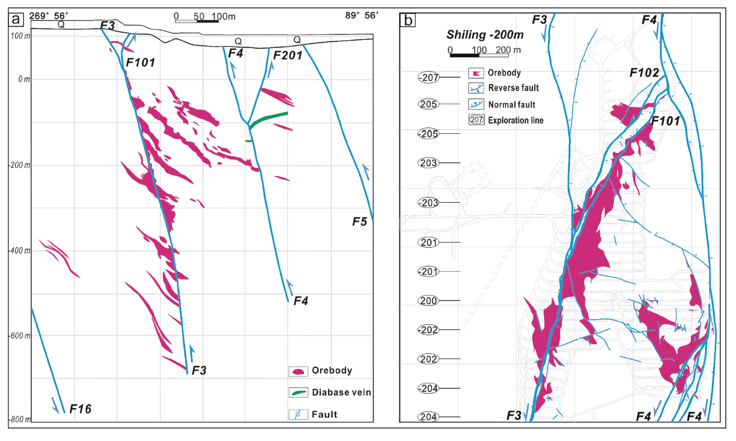
Fankou Pb-Zn-(Ag-Ga-Ge-Cd) deposit
Structure and stratigraphic control on the morphology of orebodies
Hu et al., 2023

Slide 29
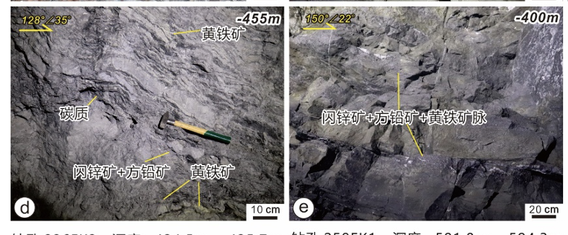
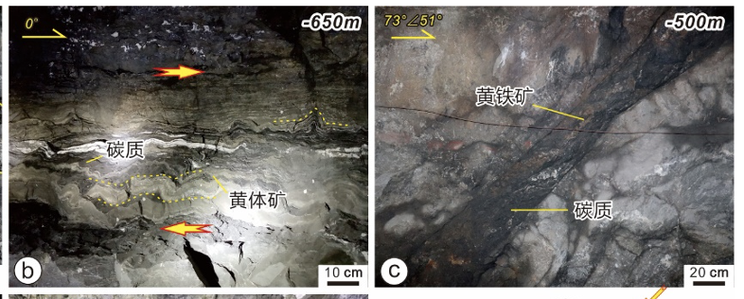
Fankou Pb-Zn-(Ag-Ga-Ge-Cd) deposit
(a)
(b)
mineralization includes massive pyrite, massive lead-zinc ores, and mixed pyrite and lead-zinc ores
Mineralization styles include massive, banded, disseminated, veined and brecciated ores. The mineralization styles vary depending on the type of host rocks.
The Pb-Zn ores are hosted in pyritiferous silty limestone, dolomitized micrite containing limeclasts or sparite limestone containing quartz clasts
(Hu Z.B. 2023, Ph.D dissertation)
Notes:
The same types of porphyrins and hydrocarbons were recognized in the rocks and ores and hydrocarbon-
bearing inclusions are widespread in quartz and calcite, particularly in Dabaoshan.
It
is thought that the organic matter must have played a critical role in diagenesis and metallization
in these deposits and that the hydrothermal solution was most likely to be the type of water-
oil hot brine.

Slide 30
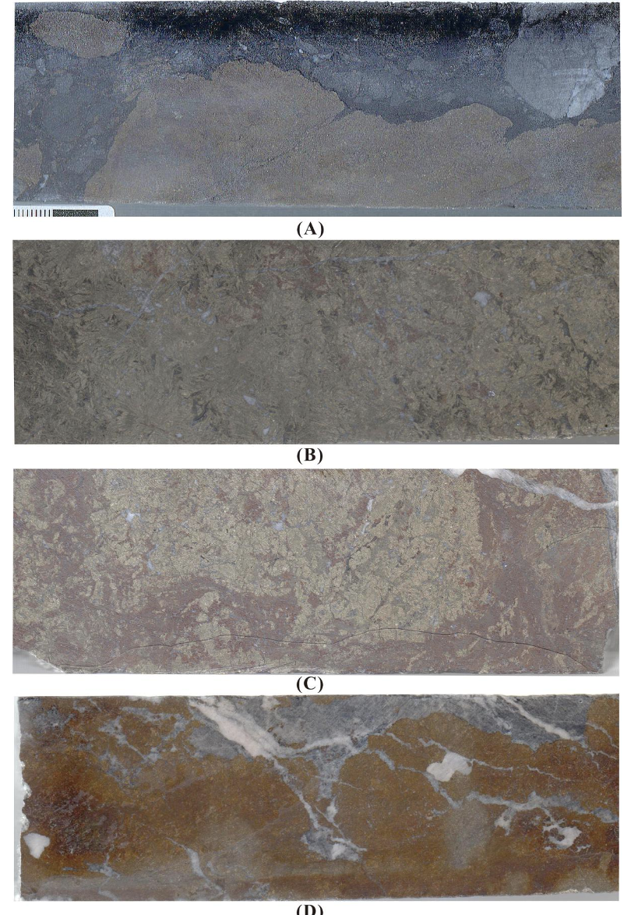
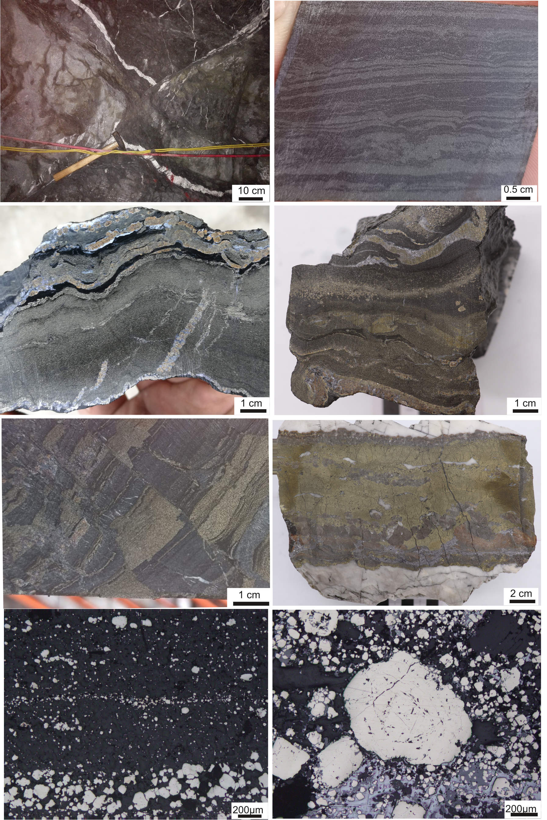
Fankou Pb-Zn-(Ag-Ga-Ge-Cd) deposit
(Hu Z.B. 2023, Ph.D dissertation)

Slide 31
Fankou Pb-Zn-(Ag-Ga-Ge-Cd) deposit
(a)
(b)
Coarse- to medium-grained sphalerite and galena are the most economic ore minerals in Fankou. Pyrite displays variable morphology changing from finely anhedral to coarsely euhedral grains.
In addition, variable amounts of chalcopyrite, siderite, tetrahedrite, silver-rich tetrahedrite, pyrargyrite, argentite and arsenopyrite are concentrated in local areas near the faults. The main gangue minerals are pyrite, quartz, calcite, dolomite, siderite, barite and illite.
The sphalerites are rich in Cd, Ga, Ge and Ag, butpoor in Se and Te; the Fankou galenas are rich in Ag, Hg, Sb and As, but poor in Se, Te, T1 and Bi. The Ga, Ge, and Ag contents are within the ranges 70-540ppm, 30-170 ppm, and 110-360 ppm respectively. The Cd contents range from 1,400 to 2,700 ppm. The Fe contents are in the range 3.10-7.51%. (Xue, 1984).
(Hu Z.B. 2023, Ph.D dissertation)
Notes:
Alteration in this deposit is very weak. The weak and
irregular dolomitization can be seen only near the massive
pyrite and the Pb-Zn orebodies.
Pyrargyrite (Ag3SbS3), argentite (AgS)

Slide 32
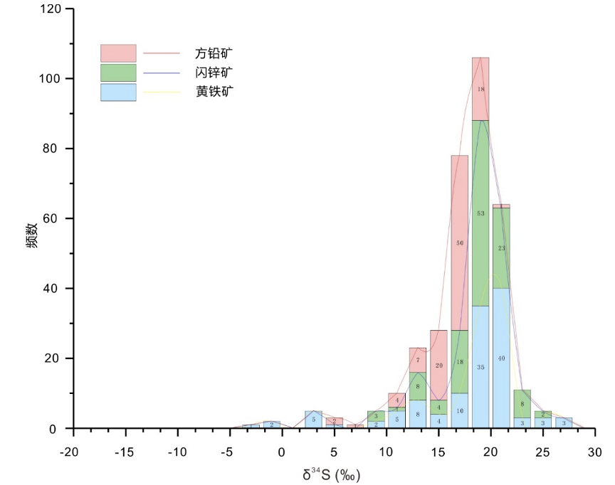
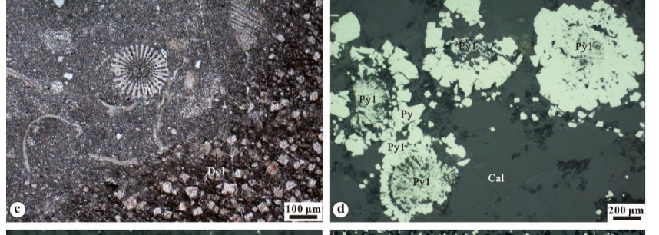
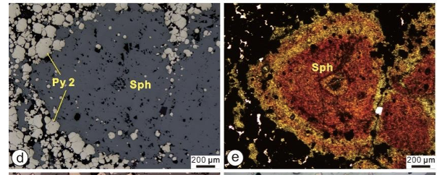
Fankou Pb-Zn-(Ag-Ga-Ge-Cd) deposit
Syngenetic and epigenetic mineralization
Sphalerite contains high Ga and Ge
δ34S mostly between 10-25 ‰
Ga average of 145 ppm at Shiling and average of 331 ppm at Shiling south
Ge average of 285 ppm at Shiling and average of252 ppm at Shiling south。
3Zn2+ ↔Ge4+ +2(Ag+, Cu+) and 2Zn2+↔Ga3++(Ag, Cu)+
(Hu Z.B. 2023, Ph.D dissertation)

Slide 33
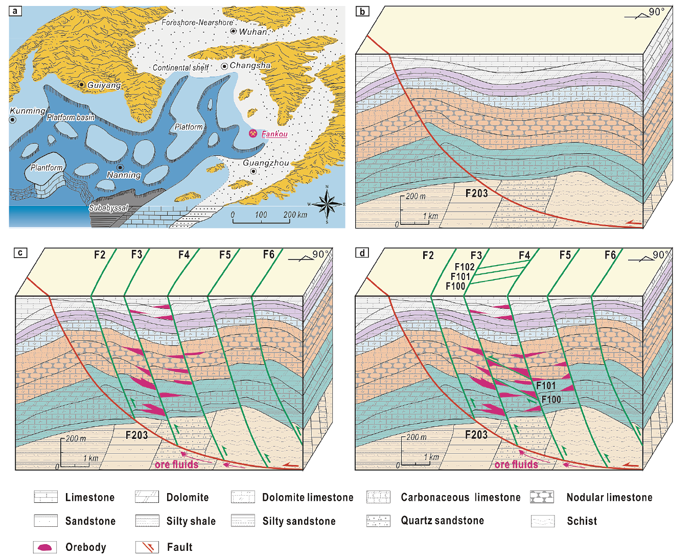
Genesis
(Hu et al. 2023, OGR)

Slide 34
4. Wrap up
Marine carbonate-hosted Pb-Zn deposits in China are rather geographically concentrated in the south (and to the west)
They share quite strong regional affinities.
We looked at the geology of three large deposits, the Fankou (10 Mt metal reserves at an average grade of 15% Zn+Pb), the Jingding (200 Mt ores that average 6.1% Zn and 1.3% Pb), the Huize (15.56 Mt at 24.15% Zn+Pb)
What makes them special? The organic matters, a deep regional structure, evaporites… a sealing layer…and some other tricks!

Slide 35
Thank you!

Slide 36
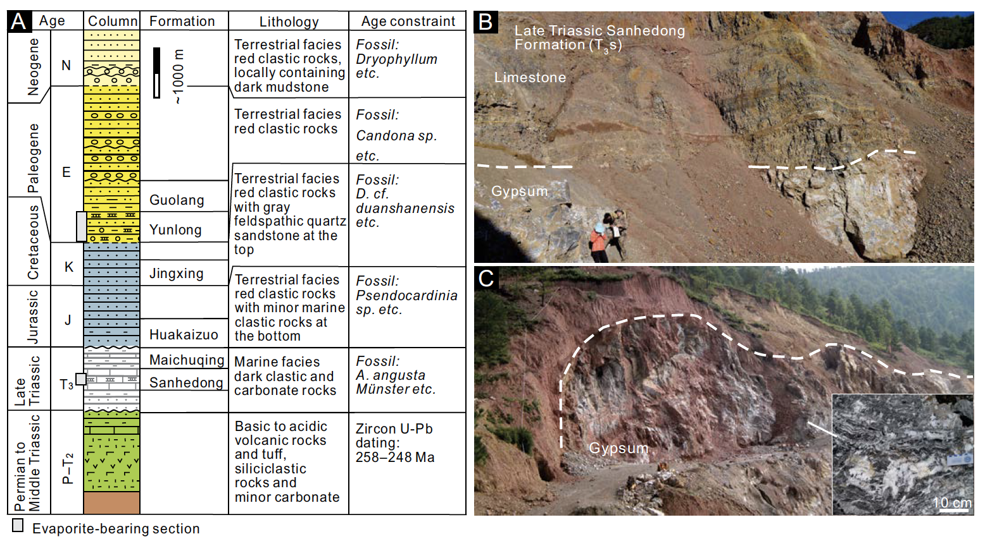
Notes:
Fig. 3. (A) Simplified stratigraphic column for the Lanping Basin showing the location of evaporite-bearing sedimentary
sections (Yunnan Geological Bureau, 1974a, 1986; Mu et al., 1999; Liang, 2016). (B) Sedimentary gypsum bed within Late
Triassic Sanhedong Formation (T3s) carbonate in the Chijiao area, Lanping. (C) Diapiric gypsum body containing aligned T3s
limestone clasts near Hexi, Lanping.

Slide 37
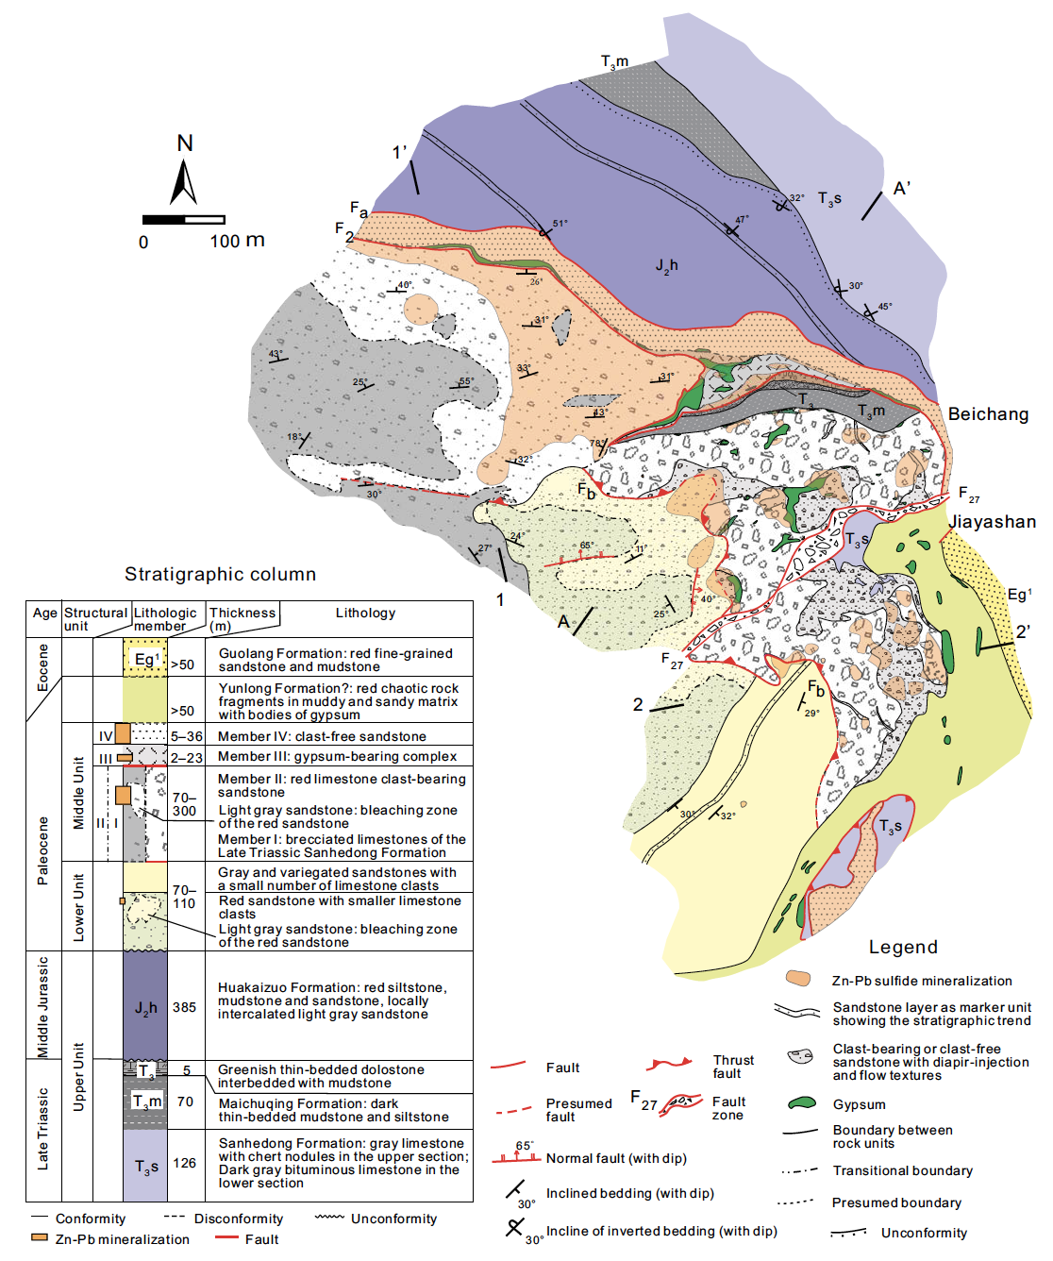

Slide 40
Lead isotope studies suggest the majority of metals are sourced from a mixture of basement and sedimentary rocks (Zhou et al., 2013c, d)
Sulphur isotope studies syggest the majority of sulphur are probably derived from the thermochemical sulfate reduction (TSR) of seawater sulfate (Han et al., 2023)

